Slide 1


Federal legislative
&
Regulatory
Update
Thursday, October 24, 2024

Slide 2
AGENDA
The 2023-2024 Regulatory Countdown
&
2024 Presidential and Congressional Elections
Regulatory Update
2024 Elections
CSPEN Conference
Q&A

Slide 3



REGULATORY
UPDATE

Slide 4


Slide 5
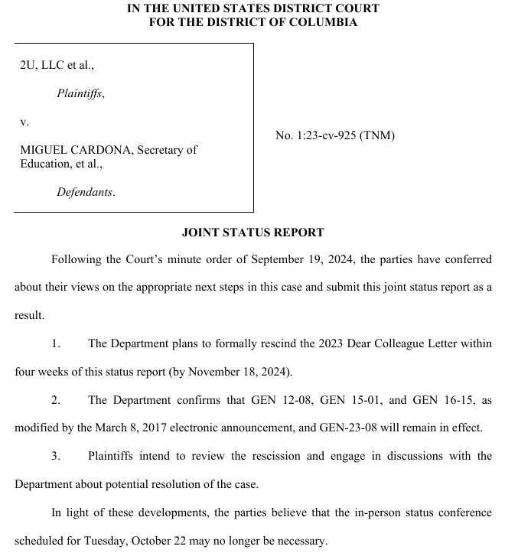
DEPARTMENT OF EDUCATION
ANNOUNCES
RECISION OF
THIRD-PARTY GUIDANCE
EFFECTIVE BY NOVEMBER 18th
https://www.ed.gov/about/news/press-release/biden-harris-administration-create-new-national-recognition-program

Slide 6
PRIOR THIRD-PARTY REGULATIOIN TO REMAIN IN EFFECT
KEY REGULATORY GUIDANCE
“The Department confirms that GEN 12-08, GEN 15-01, and GEN 16-15, as modified by the March 8, 2017 electronic announcement, and GEN-23-08 will remain in effect.”
GEN-12-08
  Regarding the Conditions Under Which an Institution Submits a Copy of its Contract with a Third-Party Servicer
  (April 26, 2012)
  Corrections to Dear Colleague Letter GEN-12-08: Regarding the Conditions Under Which an Institution Submits a Copy of its Contract with a Third-Party Servicer (May 18, 2021)
GEN-15-10 – Third-Party Servicer Institutional Requirements and Responsibilities (Jan. 9, 2015)
GEN-16-15 – Third-Party Servicer Questions and Answers (August 18. 2016 – Updated March 8, 2017 – Rescinding May 16,2023 mods)
GEN-23-08 – Update to Third-Party Servicer Guidance in GEN-23-03 (May 16, 2023)
GEN-23-03 – Requirements and Responsibilities for Third-Party Servicers and Institutions (Feb. 15, 2023)

Slide 7

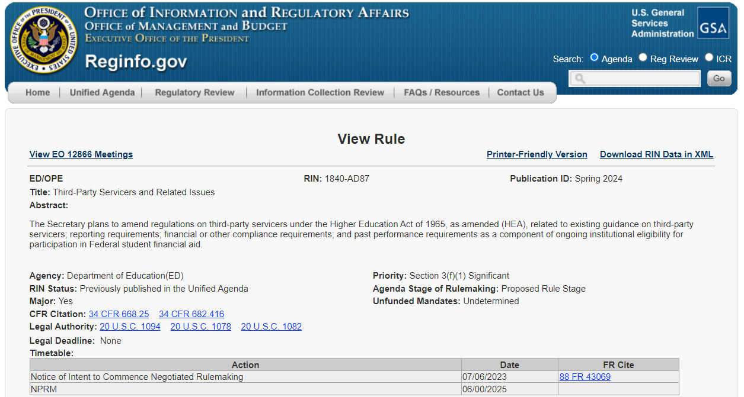

Slide 8
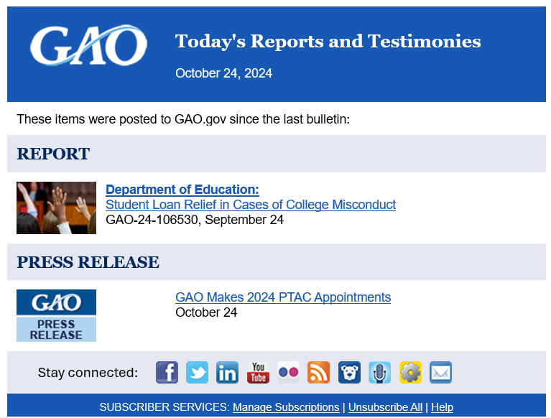
STUDENT LOAN DEBT RELIEF
in CASES OF
COLLEGE MISCONDUCT
https://www.gao.gov/products/gao-24-106530?utm_campaign=usgao_email&utm_content=daybook&utm_medium=email&utm_source=govdelivery

Slide 9
STUDENT LOAN RELIEF IN CASES OF COLLEGE MISCONDUCT
FAST FACTS
When the Department of Education finds a college engaged in certain kinds of misconduct, such as misrepresenting graduates' job prospects, students may qualify for loan relief.
Students can apply through a process known as "borrower defense." If Education finds misconduct, it can forgive outstanding loan balances and refund payments already made. If colleges engaged in misconduct over time and across locations, Education can approve relief for a group of borrowers, including those who did not apply.
As of April 30, 2024, Education forgave a cumulative total of $17.2 billion in federal student loans for 974,820 borrowers under borrower defense.

Slide 10
STUDENT LOAN RELIEF IN CASES OF COLLEGE MISCONDUCT
WHAT THE GAO FOUND
The Department of Education can approve relief for student loan borrowers through a process called borrower defense to repayment (borrower defense) if colleges engaged in certain types of misconduct. As of April 30, 2024, Education had discharged (i.e., forgiven) a cumulative total of $17.2 billion in federal student loans for 974,820 borrowers under borrower defense, according to agency data. Under the 1995 and 2016 borrower defense regulations, the agency determines if a borrower qualifies for loan relief using two pathways. Under the first pathway, Education evaluates individual borrower defense applications by following a multistep process to determine if a borrower's claim of a college's misconduct is credible. Under the second pathway, Education provides relief for a group of borrowers. Education uses this “group discharge” process when it determines that a college engaged in widespread and pervasive misconduct. In such cases, Education may provide relief to all borrowers who attended a specific college, campus, or program during a specific time, even if they did not submit applications. The $17.2 billion represents discharges through both the individual and group application pathways. The 974,820 borrowers include those who filed applications as well as those who did not.

Slide 11
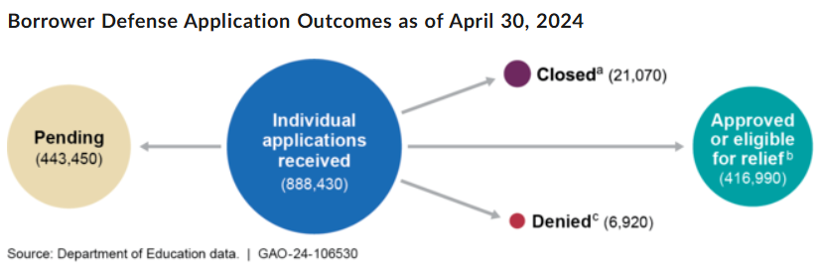
STUDENT LOAN RELIEF IN CASES OF COLLEGE MISCONDUCT
WHAT THE GAO FOUND
Education had received a cumulative total of 888,430 borrower defense applications filed by individual borrowers as of April 30, 2024, according to agency data (see figure). All borrowers with approved applications received full relief (i.e., the discharge of outstanding loan(s) to attend the college and a refund of payments made to Education), according to agency data and officials.

Slide 12
STUDENT LOAN RELIEF IN CASES OF COLLEGE MISCONDUCT
WHAT THE GAO FOUND
As of April 30, 2024, Education approved group discharges for seven colleges. According to agency officials, all borrowers in the seven groups received full relief. According to GAO's analysis of agency documents and information from officials, the most common type of misconduct Education found (for six of the seven colleges) was the college misrepresenting its graduates' employment prospects, including job placement rates or expected earnings. Education determined that six of the seven colleges engaged in more than one type of misrepresentation. To assess the allegations, Education used information from various sources, including state attorneys general.

Slide 13


Slide 14
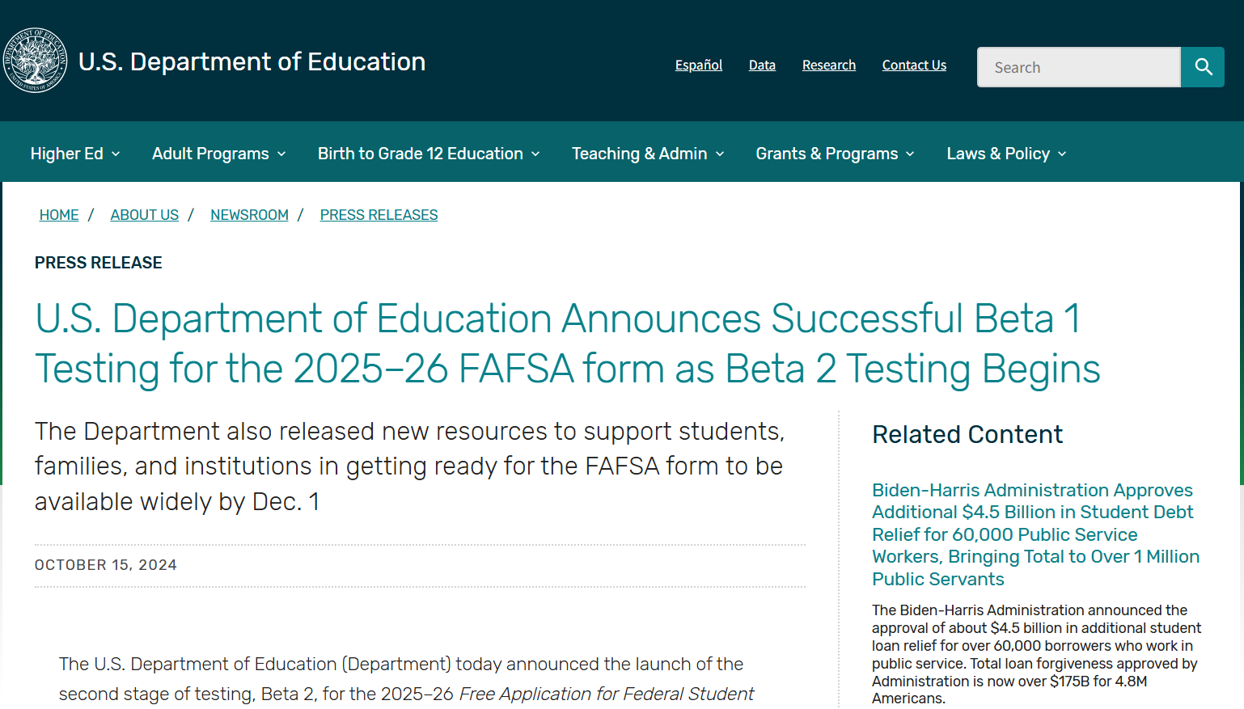
https://www.ed.gov/about/news/press-release/us-department-of-education-announces-successful-beta-1-testing-2025-26

Slide 15


Slide 16
The MASTER CALENDAR RULE
20 U.S. CODE § 1089 – Master Calendar
(a)Secretary Required to Comply with Schedule
(b) Timing for Reallocations
(c) Delay of Effective Date of Late Publication
(1)Except as provided in paragraph (2), any regulatory changes initiated by the Secretary affecting the programs under this subchapter that have not been published in final form by November 1 prior to the start of the award year shall not become effective until the beginning of the second award year after such November 1 date.
(2)
(A)The Secretary may designate any regulatory provision that affects the programs under this subchapter and is published in final form after November 1 as one that an entity subject to the provision may, in the entity’s discretion, choose to implement prior to the effective date described in paragraph (1). The Secretary may specify in the designation when, and under what conditions, an entity may implement the provision prior to that effective date. The Secretary shall publish any designation under this subparagraph in the Federal Register.

Slide 17
The MASTER CALENDAR RULE
20 U.S. CODE § 1089 – Master Calendar
(c) Delay of Effective Date of Late Publication
(1)Except as provided in paragraph (2), any regulatory changes initiated by the Secretary affecting the programs under this subchapter that have not been published in final form by November 1 prior to the start of the award year shall not become effective until the beginning of the second award year after such November 1 date.
(2)(A)The Secretary may designate any regulatory provision that affects the programs under this subchapter and is published in final form after November 1 as one that an entity subject to the provision may, in the entity’s discretion, choose to implement prior to the effective date described in paragraph (1). The Secretary may specify in the designation when, and under what conditions, an entity may implement the provision prior to that effective date. The Secretary shall publish any designation under this subparagraph in the Federal Register.
(B)If an entity chooses to implement a regulatory provision prior to the effective date described in paragraph (1), as permitted by subparagraph (A), the provision shall be effective with respect to that entity in accordance with the terms of the Secretary’s designation.

Slide 18
The MASTER CALENDAR RULE
20 U.S. CODE § 1089 – Master Calendar
(a)Secretary required to comply with schedule
To assure adequate notification and timely delivery of student aid funds under this subchapter, the Secretary shall adhere to the following calendar dates in the year preceding the award year:
(2)Allocations of campus-based and Pell Grant funds—
by August 1: distribution of institutional application for campus-based funds (FISAP) to institutions;
by October 1: final date for submission of FISAP by institutions to the Department;
by November 15: edited FISAP and computer printout received by institutions;
by December 1: appeals procedures received by institutions;
by December 15: edits returned by institutions to the Department;
by February 1: tentative award levels received by institutions and final Pell Grant payment schedule;
by February 15: closing date for receipt of institutional appeals by the Department;
by March 1: appeals process completed;
by April 1: final award notifications sent to institutions; and
https://www.ed.gov/about/news/press-release/us-department-of-education-announces-additional-participants-2025-26-fafsa

Slide 19
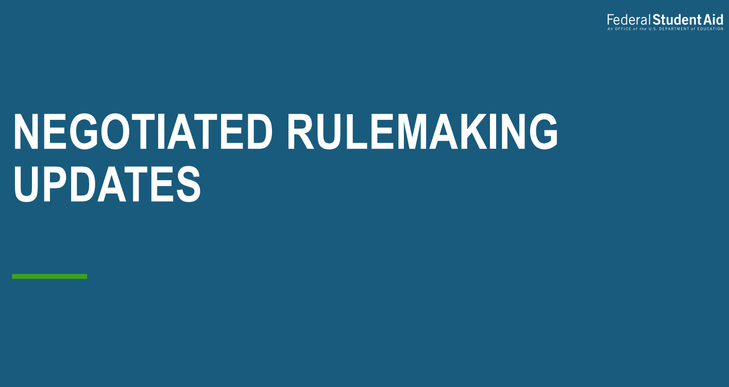

Slide 20
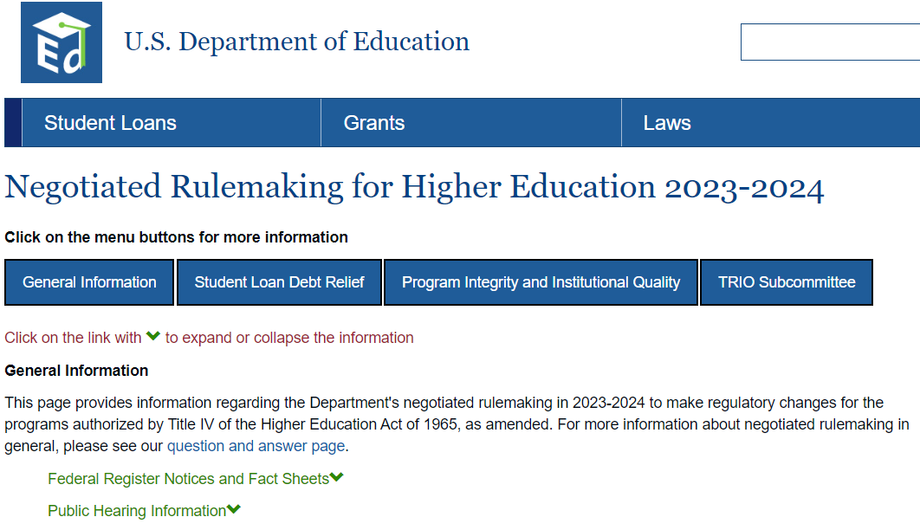
negotiated rulemaking
For
Higher Education
Student loan
debt relief
Committee

Slide 21

PENDING

Slide 22
negotiated rulemaking
For
Higher Education
Program Integrity
&
Institutional
Quality

Slide 23
PENDING

Slide 24
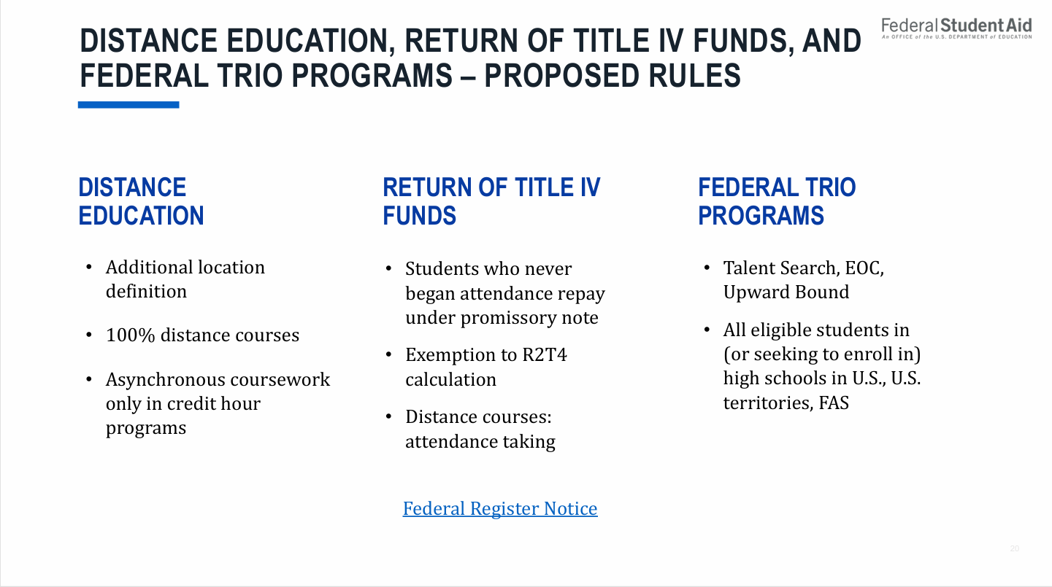
FEDERAL REGULATORY UPDATE
Federal Update

Slide 25


Slide 26
QUESTIONS TO BE SUBMITTED TO DEPARTMENT FOR
GENERAL SESSION PRESENTATION ON OCTOBER 31st
QUESTIONS SHARED THUS FAR…
The Department made revisions to the regulations requiring schools to have the same book and tax year end. This is a big issue for a significant group of institutions and their CPA firm. Is there any chance that we could meet with the Department and discuss an alternative solution?
By now many institutions and their CPA firm have submitted and had verified respectively, their 90/10 calculations under the revised methodology that went into effect with the July 2024 regulations. When might the community expect to see the initial publication of the data that has been collected?
Would the Department please provide additional guidance on how institutions are to implement the new Tilte IX regulations?

Slide 27
QUESTIONS TO BE SUBMITTED TO DEPARTMENT FOR
GENERAL SESSION PRESENTATION ON OCTOBER 31st
QUESTIONS SHARED THUS FAR…
A state higher education commission share with CSPEN that they would like to explore ways to improve the ability for non-degree granting entities to provide distance education (fully or partially), utilize federal funding sources and create a level of standards to establish trust and credibility which encourages transferability. They assured me that the support the requirement of accreditation and remaining in good standing with the state higher education commissions/coordinating bodies.
They suggested that, “collectively the triad really needs to update the definitions and provisions around non-credit programs to ensure they meet the expected quality and educational soundness required to ensure student success.”
Concluding with the question, Short of a mandate, what would the Department suggest that the community could do collectively to move forward with ensuring non-credit courses/programs are not excluded from federal funding sources and acceptable for transfer to degree granting institutions?

Slide 28


Slide 29

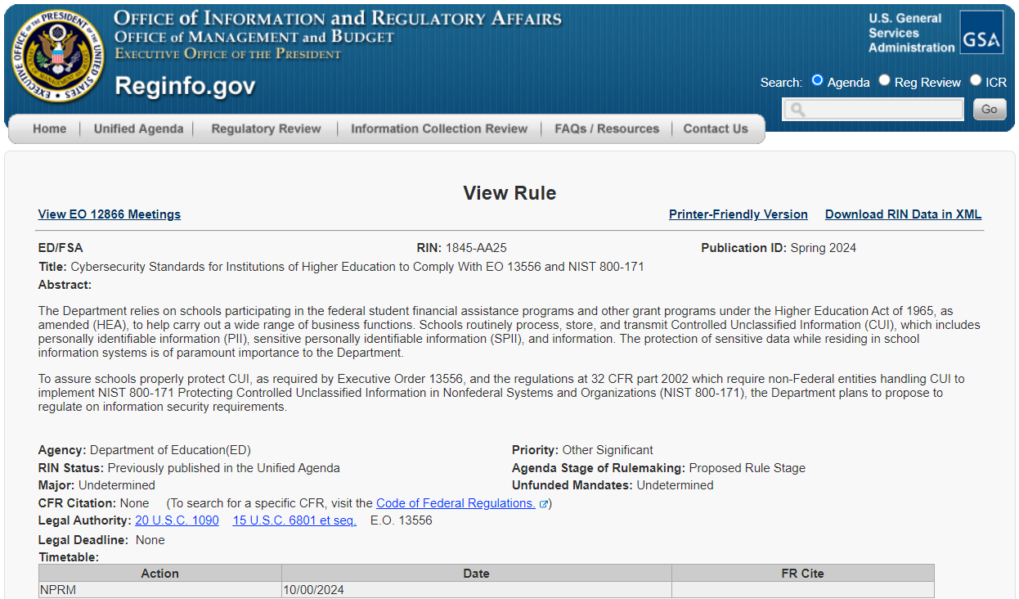

Slide 30

https://nc-sara.my.site.com/Policy/s/

Slide 31

GE Reporting Requirements

Slide 32


Slide 33
Title IX 26 STATE BLOCKADE
MULTIPLE CASES, TWENTY-SIX STATES
CURRENTLY REJECT IMPLEMENTATION OF NEW TITLE IX
September 2024
Alabama Kansas* Ohio West Virginia
Alaska Kentucky Oklahoma Wyoming
Arkansas Louisiana South Carolina
Florida Mississippi South Dakota
Georgia Missouri Tennessee
Idaho Montana Texas
Indiana Nebraska Utah
Iowa North Dakota Virginia
*Moms for Liberty, Young America’s Foundation, and Female Athletes United

Slide 34
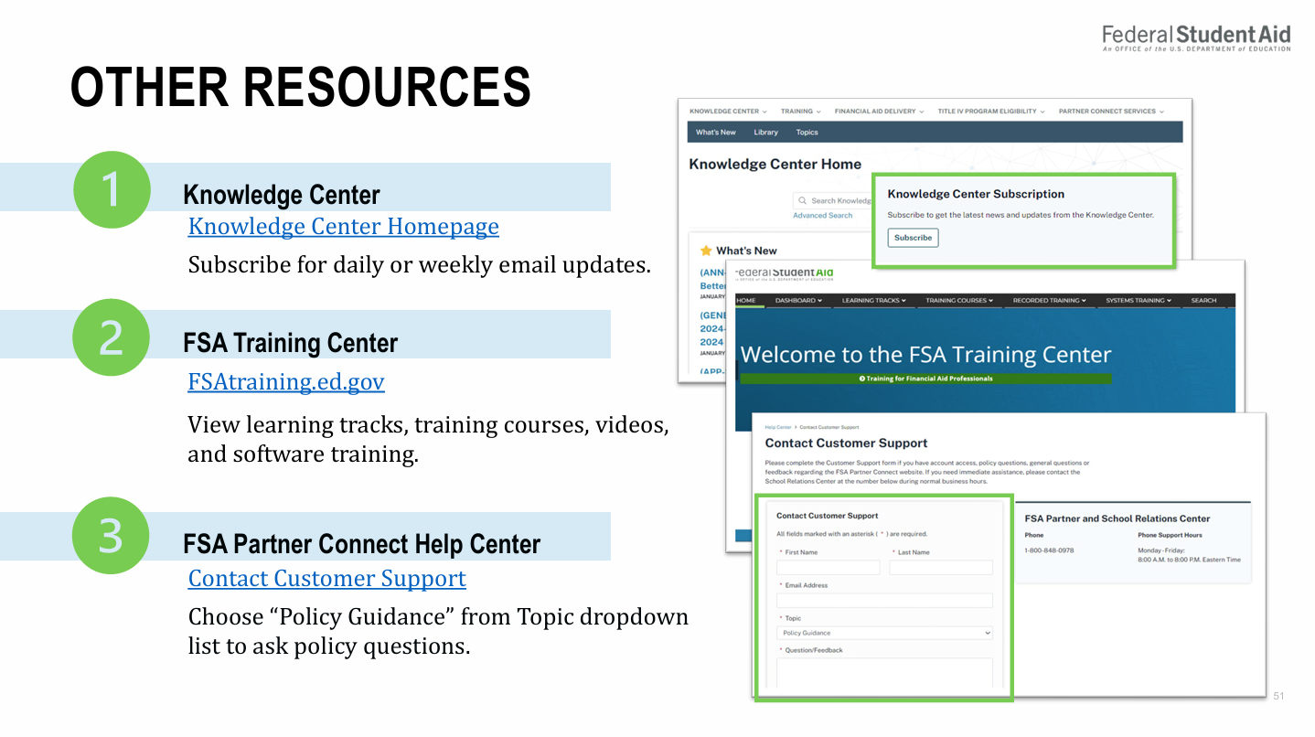
Federal Update

Slide 35
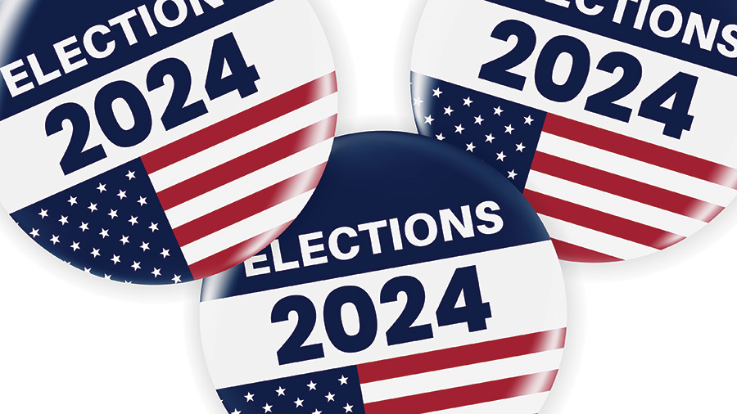

Slide 36


Slide 37
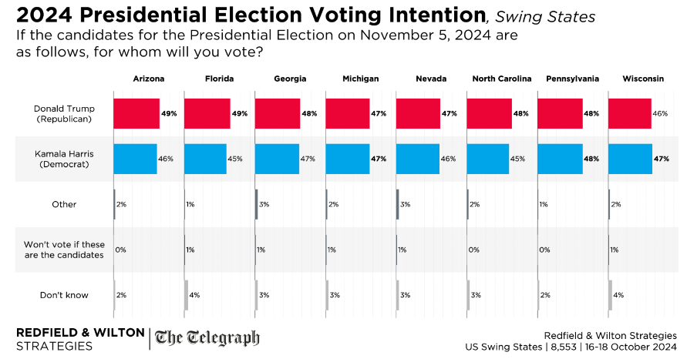

Slide 38
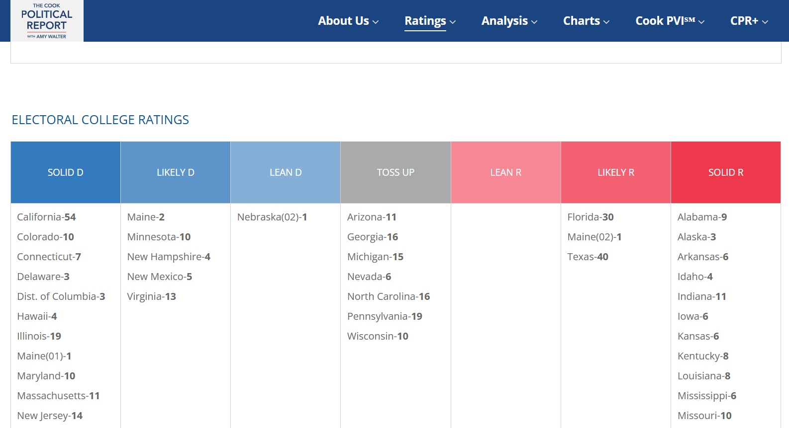

Slide 39
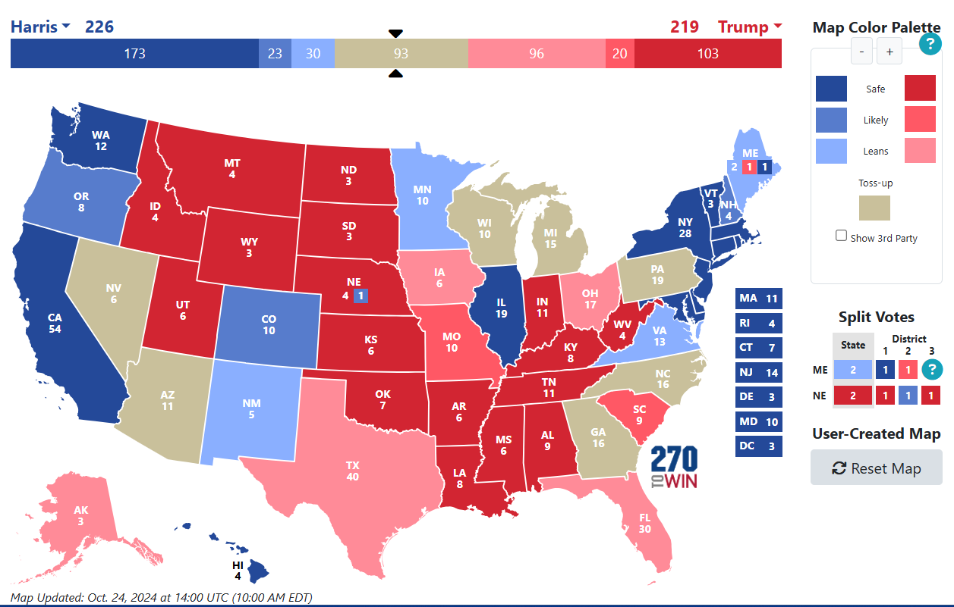

Slide 41
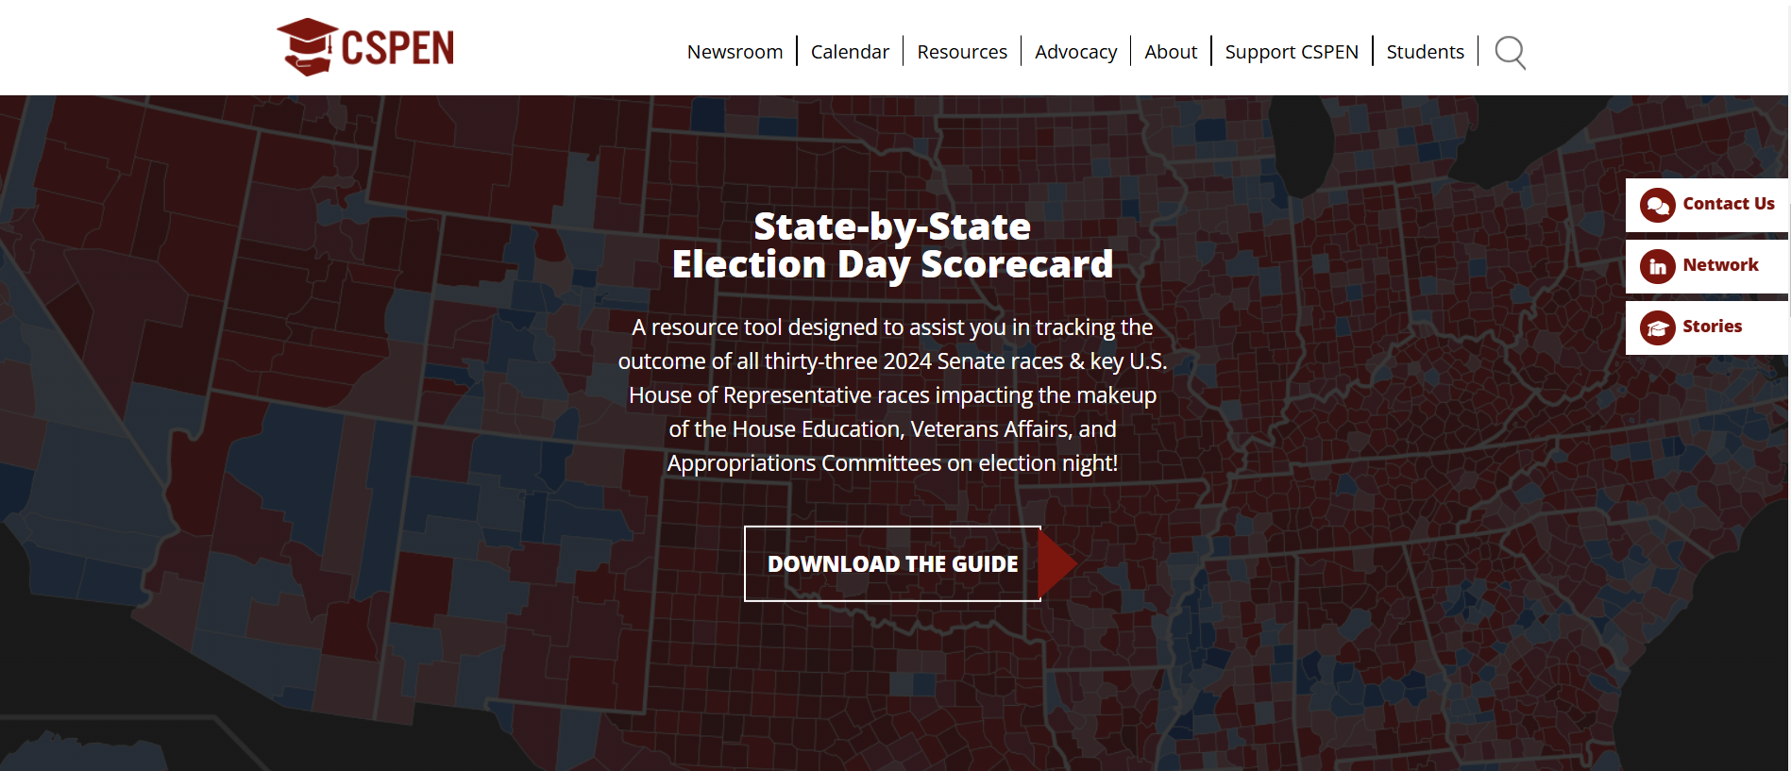
https://cspen.com/

Slide 42
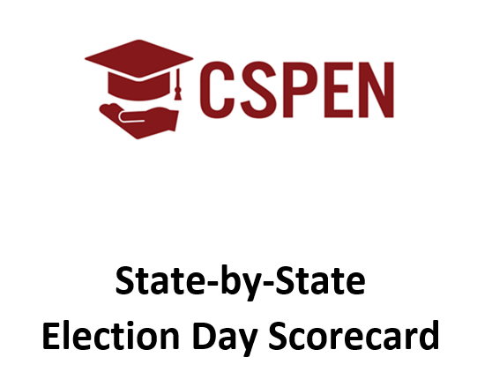

Slide 43

HOUSE EDUCATION & WORKFORCE COMMITTEE

Slide 44

HOUSE VETERANS AFFAIRS COMMITTEE

Slide 45

HOUSE APPROPRIATIONS COMMITTEE

Slide 46
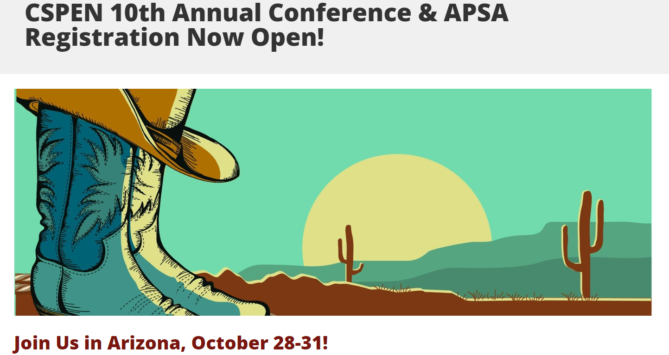

Slide 47


