Slide 1
Federal legislative & Regulatory Update
Thursday, January 23, 2025

Slide 2
AGENDA
New Trump Administration Moving Quickly
Executive Orders and Political Appointees
Top List of First Steps
President Trump Inaugural Update
Regulatory Update
Legislative Update
Q&A

Slide 3
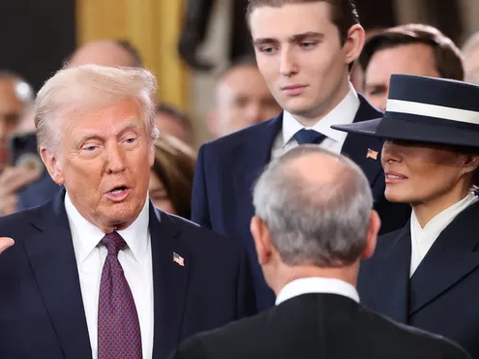
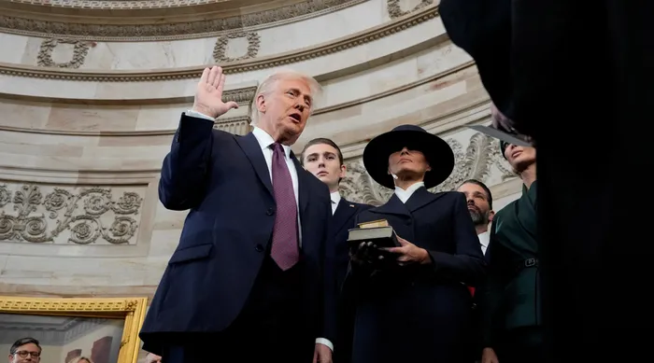
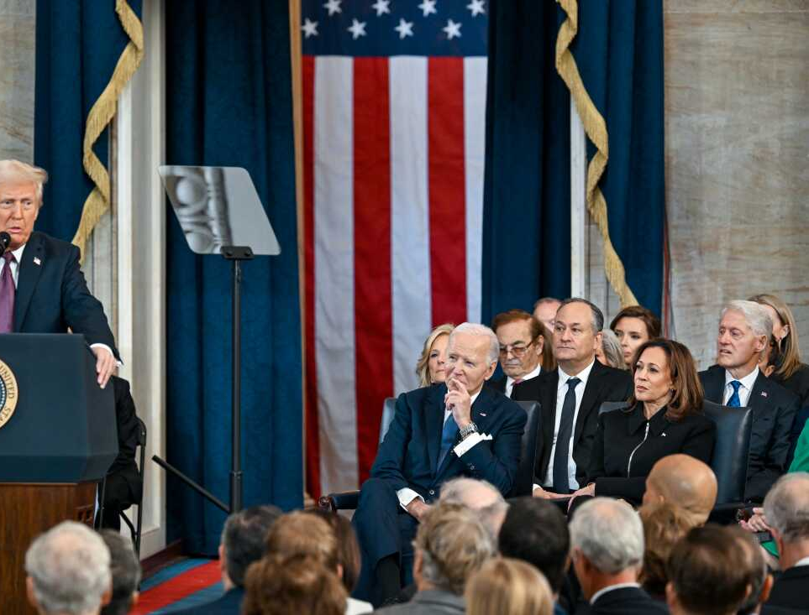

Slide 4
Trump Administrative Actions This Week

Slide 5
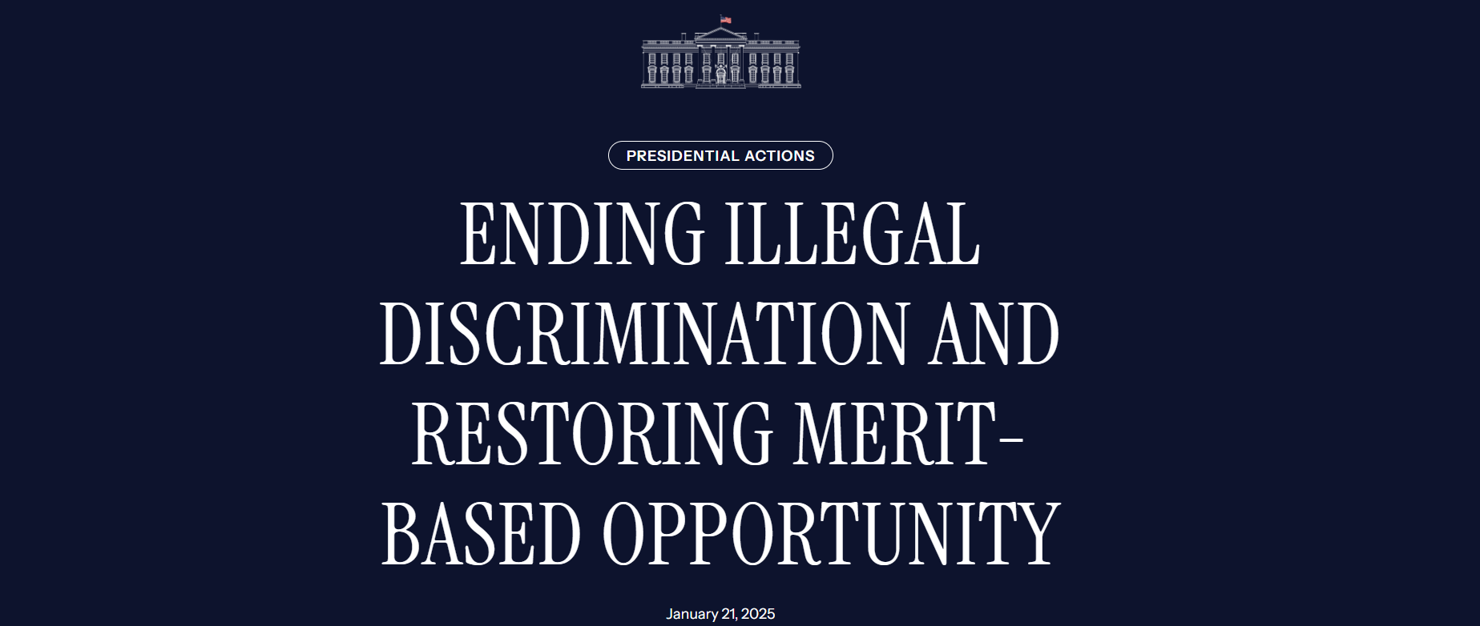
Executive Orders

Slide 6
Executive Orders

Slide 7
Executive Orders

Slide 8
Executive Orders

Slide 9
Executive Orders

Slide 10
Executive Orders

Slide 11
Executive Orders

Slide 12
Executive Orders

Slide 13
Executive Orders

Slide 14
Regulatory Freeze Pending Review
January 20, 2025
By the authority vested in me as President by the Constitution and the laws of the United States of America, I hereby order all executive departments and agencies to take the following steps:
(1) Do not propose or issue any rule in any manner, including by sending a rule to the Office of the Federal Register (the “OFR”), until a department or agency head appointed or designated by the President after noon on January 20, 2025, reviews and approves the rule. The department or agency head may delegate this power of review and approval to any other person so appointed or designated by the President, consistent with applicable law. The Director or Acting Director of the Office of Management and Budget (the “OMB Director”) may exempt any rule that he deems necessary to address emergency situations or other urgent circumstances, including rules subject to statutory or judicial deadlines that require prompt action.

Slide 15
Regulatory Freeze Pending Review
January 20, 2025
By the authority vested in me as President by the Constitution and the laws of the United States of America, I hereby order all executive departments and agencies to take the following steps:
(2) Immediately withdraw any rules that have been sent to the OFR but not published in the Federal Register, so that they can be reviewed and approved as described in paragraph 1, subject to the exceptions described in paragraph 1.
(3) Consistent with applicable law and subject to the exceptions described in paragraph 1, consider postponing for 60 days from the date of this memorandum the effective date for any rules that have been published in the Federal Register, or any rules that have been issued in any manner but have not taken effect, for the purpose of reviewing any questions of fact, law, and policy that the rules may raise. During this 60-day period, where appropriate and consistent with applicable law, consider opening a comment period to allow interested parties to provide comments about issues of fact, law, and policy raised by the rules postponed under this memorandum, and consider reevaluating pending petitions involving such rules. As appropriate and consistent with applicable law, and where necessary to continue to review these questions of fact, law, and policy, consider further delaying, or publishing for notice and comment, proposed rules further delaying such rules beyond the 60-day period.

Slide 16
Regulatory Freeze Pending Review
January 20, 2025
By the authority vested in me as President by the Constitution and the laws of the United States of America, I hereby order all executive departments and agencies to take the following steps:
(4) Following the postponement described in paragraph 3, no further action needs to be taken for those rules that raise no substantial questions of fact, law, or policy. For those rules that raise substantial questions of fact, law, or policy, agencies should notify and take further appropriate action in consultation with the OMB Director.
(5) Comply in all circumstances with any applicable Executive Orders concerning regulatory management.

Slide 17
Regulatory Freeze Pending Review
January 20, 2025
As used in this memorandum, “rule” has the definition set forth in section 551(4), title 5, United States Code. It also includes any “regulatory action,” as defined in section 3(e) of Executive Order 12866 of September 30, 1993, as amended, and any “guidance document” as defined in section 2(b) of Executive Order 13891 of October 9, 2019 (Promoting the Rule of Law Through Improved Agency Guidance Documents), when that order was in effect. Thus, the requirements of this memorandum apply not only to “rules” as defined in section 551(4) of title 5, but also to any substantive action by an agency (normally published in the Federal Register) that promulgates or is expected to lead to the promulgation of a final rule or regulation, including notices of inquiry, advance notices of proposed rulemaking, and notices of proposed rulemaking. They shall also apply to any agency statement of general applicability and future effect that sets forth a policy on a statutory, regulatory, or technical issue or an interpretation of a statutory or regulatory issue.

Slide 18
Regulatory Freeze Pending Review
January 20, 2025
The OMB Director shall oversee the implementation of this memorandum, and any communications regarding any matters pertaining to this review should be addressed to the OMB Director. The OMB Director is also authorized to establish a process to review pending collections of information under the Paperwork Reduction Act of 1995, as codified in chapter 35, title 44, United States Code, and to take actions that the OMB Director deems appropriate based on that review, consistent with applicable law.
Should actions be identified that were undertaken before noon on January 20, 2025, that frustrate the purpose underlying this memorandum, I may modify or extend this memorandum, to require that department and agency heads consider taking steps to address those actions.
The OMB Director is authorized and directed to publish this memorandum in the Federal Register.
This memorandum shall be implemented consistent with applicable law.

Slide 19
REGULATORY UPDATE

Slide 20
Department of Education Appointees
Appointees & Their Designations
Rachel Oglesby – Chief of Staff to Secretary of Education designee Linda McMahon
Jonathan Pidluzny – Deputy Chief of Staff for Policy and Programs, Office of Secretary
Mary-Christina Riley – (anticipated to be in Office of Legislative and Congressional Affairs)
David Samberg – (anticipated to be in Office of the General Counsel)
Nicholas Stone –
Craig Trainor – Deputy Assistant Secretary, Office of Civil Rights
Cherise Trump – (former Executive Director, Speech First - an organization that files litigation on behalf of its student members against universities that violate their free speech rights.)
Stephen Warzoha – Director & White House Liaison
Thomas Wheeler – Principal Deputy General Counsel, Office of the General Counsel
Madison Biedermann – Deputy Assistant Secretary, Office of Communications and Outreach

Slide 21
Department of Education Appointees
Appointees & Their Designations
Amber Davis –
Hannah Earl – Director, Center for Faith-Based and Neighborhood Partnerships
Virgina Forrester – Deputy Chief of Staff, Office of the Secretary
Virgina Gentles – (formerly with American Federation for Children)
Issac Hampton –
Julie Hartman –
Candice Jackson – Deputy General Counsel, Office of the General Counsel
Nicholas Kent – (formerly Deputy Secretary of Education, Commonwealth of Virginia)
Joshua Kleinfeld –
Savanna Newhouse – (formerly Communications Director, Sen. Marsha Blackburn)

Slide 22
GE Reporting DEADLINE

Slide 25
legislative UPDATE

Slide 27
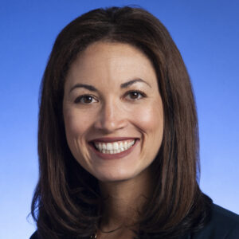
PRESIDENT TRUMP’S Key Selections Deputy SECRETARY OF EDUCATION Peggy Schwinn

Slide 28
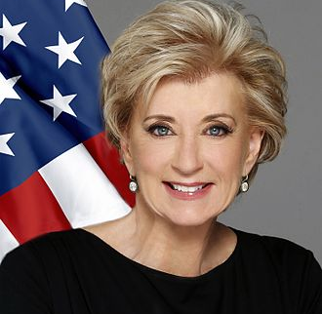
PRESIDENT TRUMP’S Key Selections SECRETARY OF EDUCATION LINDA McMAHON

Slide 29
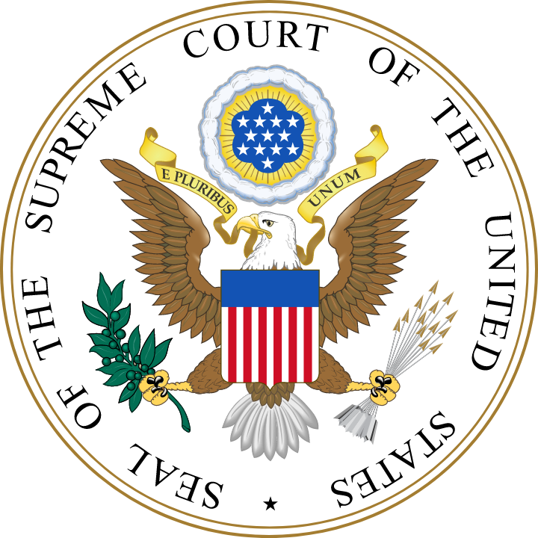
Judicial UPDATE

Slide 32
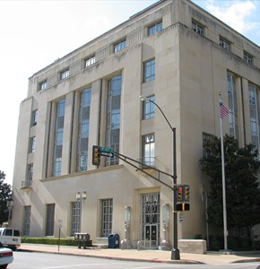
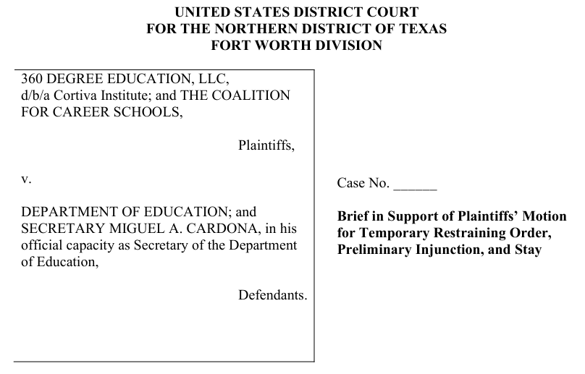

Slide 33
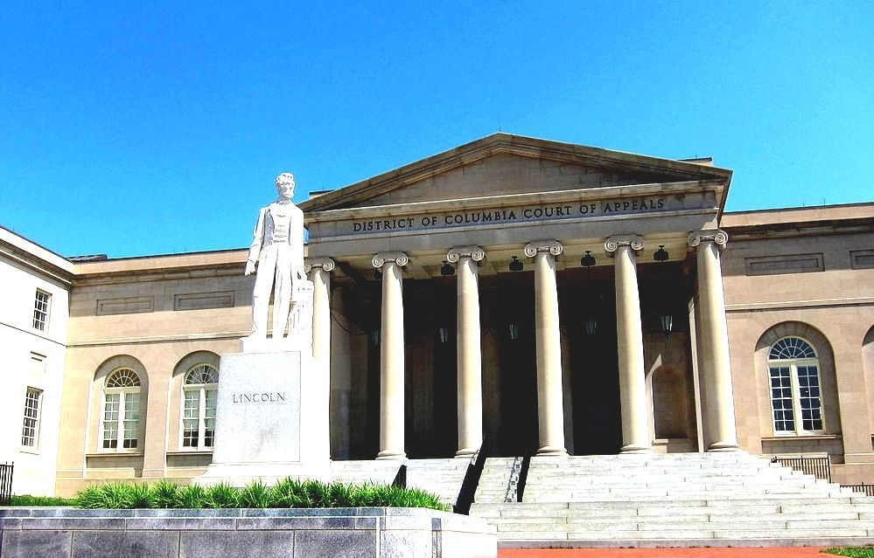
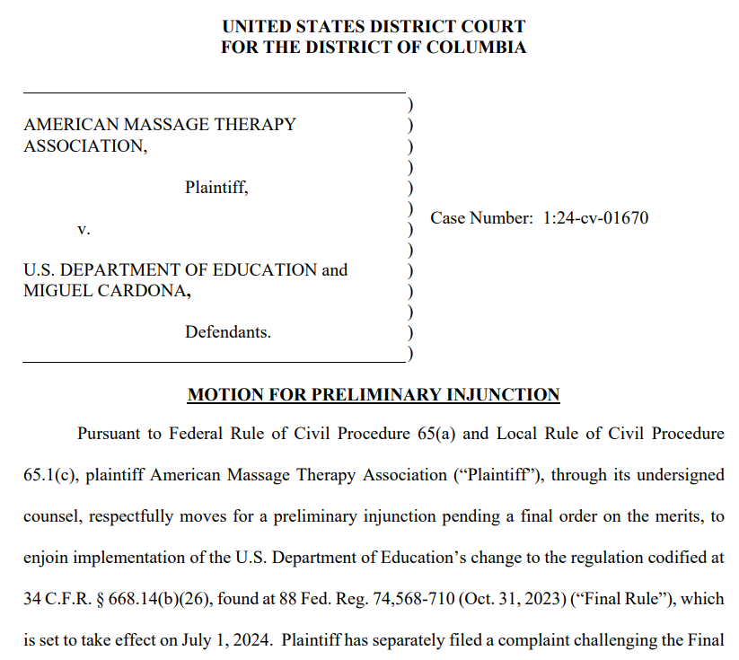

Slide 35
CSPEN 7th Annual HIGHER EDUCATION POLICY MEETING
https://cspen.com/

Slide 36
CSPEN 7th Annual HIGHER EDUCATION POLICY MEETING
https://cspen.com/events/cspen-7th-annual-higher-education-policy-meeting/

