Slide 1
Federal legislative & Regulatory Update
Thursday, January 23, 2025

Slide 2
AGENDA
Executive Order on Anti-Semitism
Office of Management & Budget Federal Funding Freeze
Latest Department of Education News
&
Congressional Education Agenda
President Trump – Week 2
Regulatory Update
Legislative Update
Q&A

Slide 3
Trump Administrative Actions This Week

Slide 5
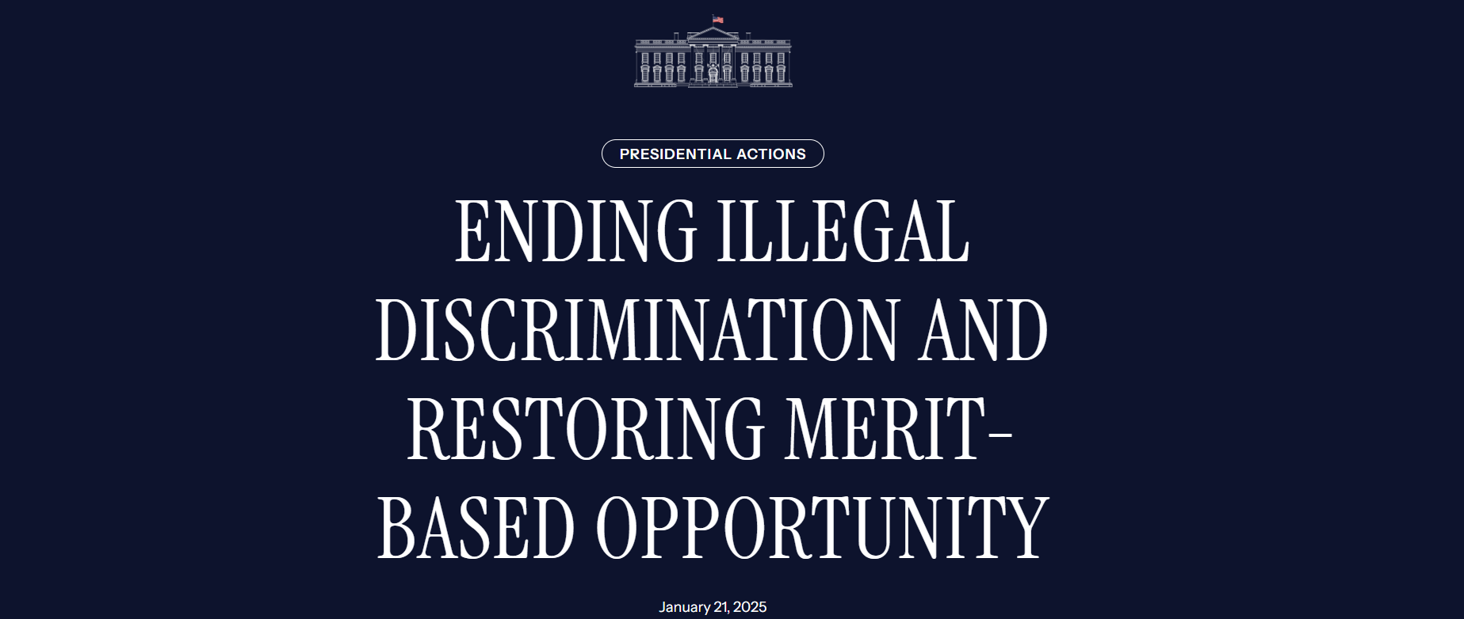
Executive Orders

Slide 6
FEDERAL FUNDING temporary pause
January 29, 2025
By the authority vested in me as President by the Constitution and the laws of the United States of America, it is hereby ordered:
Section 1. Purpose.
My Administration has fought and will continue to fight anti-Semitism in the United States and around the world. On December 11, 2019, I issued Executive Order 13899, my first Executive Order on Combating Anti-Semitism, finding that students, in particular, faced anti-Semitic harassment in schools and on university and college campuses. Executive Order 13899 provided interpretive assistance on the enforcement of the Nation’s civil rights laws to ensure that they would protect American Jews to the same extent to which all other American citizens are protected. The prior administration effectively nullified Executive Order 13899 by failing to give the terms of the order full force and effect throughout the Government. This order reaffirms Executive Order 13899 and directs additional measures to advance the policy thereof in the wake of the Hamas terrorist attacks of October 7, 2023, against the people of Israel. These attacks unleashed an unprecedented wave of vile anti-Semitic discrimination, vandalism, and violence against our citizens, especially in our schools and on our campuses. Jewish students have faced an unrelenting barrage of discrimination; denial of access to campus common areas and facilities, including libraries and classrooms; and intimidation, harassment, and physical threats and assault. A joint report by the House Committees on Education and the Workforce, Energy and Commerce, Judiciary, Oversight and Accountability, Veterans’ Affairs, and Ways and Means calls the Federal Government’s failure to fight anti-Semitism and protect Jewish students “astounding.” This failure is unacceptable and ends today.
https://www.whitehouse.gov/presidential-actions/2025/01/additional-measures-to-combat-anti-semitism/

Slide 7
FEDERAL FUNDING temporary pause
January 29, 2025
By the authority vested in me as President by the Constitution and the laws of the United States of America, it is hereby ordered:
Sec. 2. Policy.
It shall be the policy of the United States to combat anti-Semitism vigorously, using all available and appropriate legal tools, to prosecute, remove, or otherwise hold to account the perpetrators of unlawful anti-Semitic harassment and violence.
https://www.whitehouse.gov/presidential-actions/2025/01/additional-measures-to-combat-anti-semitism/

Slide 8
FEDERAL FUNDING temporary pause
January 29, 2025
By the authority vested in me as President by the Constitution and the laws of the United States of America, it is hereby ordered:
Sec. 3. Additional Measures to Combat Campus Anti-Semitism.
Within 60 days of the date of this order, the head of each executive department or agency (agency) shall submit a report to the President, through the Assistant to the President for Domestic Policy, identifying all civil and criminal authorities or actions within the jurisdiction of that agency, beyond those already implemented under Executive Order 13899, that might be used to curb or combat anti-Semitism, and containing an inventory and analysis of all pending administrative complaints, as of the date of the report, against or involving institutions of higher education alleging civil-rights violations related to or arising from post-October 7, 2023, campus anti-Semitism.
(b) The report submitted by the Attorney General under this section shall additionally include an inventory and an analysis of all court cases, as of the date of the report, against or involving institutions of higher education alleging civil-rights violations related to or arising from post-October 7, 2023, campus anti-Semitism and indicate whether the Attorney General intends to or has taken any action with respect to such matters, including filing statements of interest or intervention.
https://www.whitehouse.gov/presidential-actions/2025/01/additional-measures-to-combat-anti-semitism/

Slide 9
FEDERAL FUNDING temporary pause
January 29, 2025
By the authority vested in me as President by the Constitution and the laws of the United States of America, it is hereby ordered:
Sec. 3. Additional Measures to Combat Campus Anti-Semitism.
The Attorney General is encouraged to employ appropriate civil-rights enforcement authorities, such as 18 U.S.C. 241, to combat anti-Semitism.
The report submitted by the Secretary of Education under this section shall additionally include an inventory and an analysis of all Title VI complaints and administrative actions, including in K-12 education, related to anti-Semitism — pending or resolved after October 7, 2023 — within the Department’s Office for Civil Rights.
In addition to identifying relevant authorities to curb or combat anti-Semitism generally required by this section, the Secretary of State, the Secretary of Education, and the Secretary of Homeland Security, in consultation with each other, shall include in their reports recommendations for familiarizing institutions of higher education with the grounds for inadmissibility under 8 U.S.C. 1182(a)(3) so that such institutions may monitor for and report activities by alien students and staff relevant to those grounds and for ensuring that such reports about aliens lead, as appropriate and consistent with applicable law, to investigations and, if warranted, actions to remove such aliens.
https://www.whitehouse.gov/presidential-actions/2025/01/additional-measures-to-combat-anti-semitism/

Slide 10
FEDERAL FUNDING temporary pause
January 29, 2025
By the authority vested in me as President by the Constitution and the laws of the United States of America, it is hereby ordered:
Sec. 4. General Provisions.
(a) Nothing in this order shall be construed to impair or otherwise affect
(i) the authority granted by law to an executive department or agency, or the head thereof; or
(ii) the functions of the Director of the Office of Management and Budget relating to budgetary, administrative, or legislative proposals.
(b) This order shall be implemented consistent with applicable law and subject to the availability of appropriations.
(c) This order is not intended to, and does not, create any right or benefit, substantive or procedural, enforceable at law or in equity by any party against the United States, its departments, agencies, or entities, its officers, employees, or agents, or any other person.
https://www.whitehouse.gov/presidential-actions/2025/01/additional-measures-to-combat-anti-semitism/

Slide 11
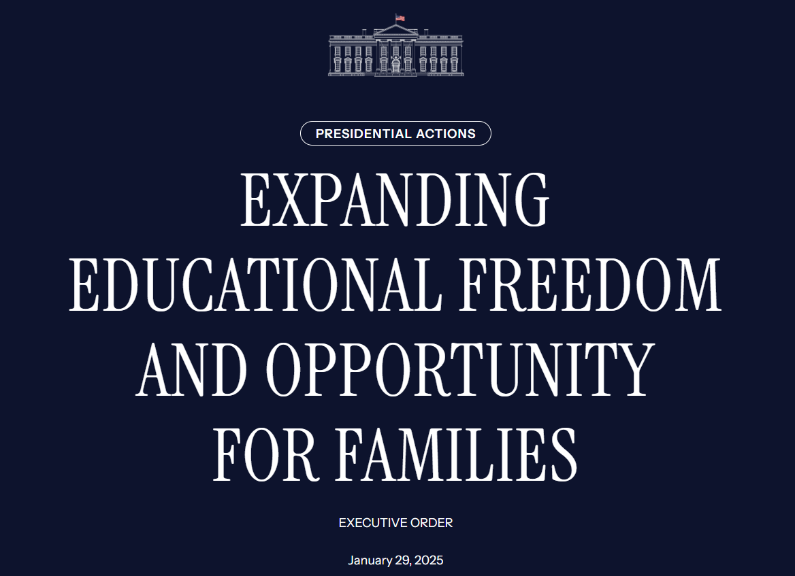
Executive Orders

Slide 12
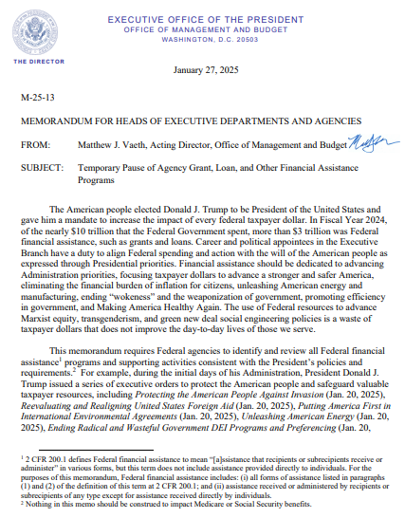
Executive MEMOS

Slide 13
FEDERAL FUNDING temporary pause
January 27, 2025
M-25-13
MEMORANDUM FOR HEADS OF EXECUTIVE DEPARTMENTS AND AGENCIES
FROM: Matthew J. Vaeth, Acting Director, Office of Management and Budget
SUBJECT: Temporary Pause of Agency Grant, Loan, and Other Financial Assistance Programs
The American people elected Donald J. Trump to be President of the United States and gave him a mandate to increase the impact of every federal taxpayer dollar. In Fiscal Year 2024, of the nearly $10 trillion that the Federal Government spent, more than $3 trillion was Federal financial assistance, such as grants and loans. Career and political appointees in the Executive
Branch have a duty to align Federal spending and action with the will of the American people as expressed through Presidential priorities. Financial assistance should be dedicated to advancing Administration priorities, focusing taxpayer dollars to advance a stronger and safer America, eliminating the financial burden of inflation for citizens, unleashing American energy and
manufacturing, ending “wokeness” and the weaponization of government, promoting efficiency in government, and Making America Healthy Again. The use of Federal resources to advance Marxist equity, transgenderism, and green new deal social engineering policies is a waste of taxpayer dollars that does not improve the day-to-day lives of those we serve.
https://s3.documentcloud.org/documents/25506186/m-25-13-temporary-pause-to-review-agency-grant-loan-and-other-financial-assistance-programs.pdf

Slide 14
FEDERAL FUNDING temporary pause
January 27, 2025
This memorandum requires Federal agencies to identify and review all Federal financial assistance programs and supporting activities consistent with the President’s policies and requirements. For example, during the initial days of his Administration, President Donald J. Trump issued a series of executive orders to protect the American people and safeguard valuable taxpayer resources, including Protecting the American People Against Invasion (Jan. 20, 2025), Reevaluating and Realigning United States Foreign Aid (Jan. 20, 2025), Putting America First in International Environmental Agreements (Jan. 20, 2025), Unleashing American Energy (Jan. 20, 2025), Ending Radical and Wasteful Government DEI Programs and Preferencing (Jan. 20, 2025), Defending Women from Gender Ideology Extremism and Restoring Biological Truth to the Federal Government (Jan. 20, 2025), and Enforcing the Hyde Amendment (Jan. 24, 2025).These executive orders ensure that Federal funds are used to support hardworking American families.
https://s3.documentcloud.org/documents/25506186/m-25-13-temporary-pause-to-review-agency-grant-loan-and-other-financial-assistance-programs.pdf

Slide 15
FEDERAL FUNDING temporary pause
January 27, 2025
To implement these orders, each agency must complete a comprehensive analysis of all of their Federal financial assistance programs to identify programs, projects, and activities that may be implicated by any of the President’s executive orders. In the interim, to the extent permissible under applicable law, Federal agencies must temporarily pause all activities related to obligation or disbursement of all Federal financial assistance, and other relevant agency activities that may be implicated by the executive orders, including, but not limited to, financial assistance for foreign aid, nongovernmental organizations, DEI, woke gender ideology, and the green new deal.
This temporary pause will provide the Administration time to review agency programs and determine the best uses of the funding for those programs consistent with the law and the President’s priorities. The temporary pause will become effective on January 28, 2025, at 5:00 PM. Even before completing their comprehensive analysis, Federal agencies must immediately
identify any legally mandated actions or deadlines for assistance programs arising while the pause remains in effect. Federal agencies must report this information to OMB along with an analysis of the requirement. OMB also directs Federal agencies to pause all activities associated with open NOFOs, such as conducting merit review panels.
https://s3.documentcloud.org/documents/25506186/m-25-13-temporary-pause-to-review-agency-grant-loan-and-other-financial-assistance-programs.pdf

Slide 16
FEDERAL FUNDING temporary pause
January 27, 2025
No later than February 10, 2025, agencies shall submit to OMB detailed information on any programs, projects or activities subject to this pause. Each agency must pause: (i) issuance of new awards; (ii) disbursement of Federal funds under all open awards; and (iii) other relevant agency actions that may be implicated by the executive orders, to the extent permissible by law,
until OMB has reviewed and provided guidance to your agency with respect to the information submitted.
OMB may grant exceptions allowing Federal agencies to issue new awards or take other actions on a case-by-case basis. To the extent required by law, Federal agencies may continue taking certain administrative actions, such as closeout of Federal awards (2 CFR 200.344), or recording obligations expressly required by law.
https://s3.documentcloud.org/documents/25506186/m-25-13-temporary-pause-to-review-agency-grant-loan-and-other-financial-assistance-programs.pdf

Slide 17
FEDERAL FUNDING temporary pause
January 27, 2025
Additionally, agencies must, for each Federal financial assistance program: (i) assign responsibility and oversight to a senior political appointee to ensure Federal financial assistance conforms to Administration priorities; (ii) review currently pending Federal financial assistance announcements to ensure Administration priorities are addressed, and, subject to program
statutory authority, modify unpublished Federal financial assistance announcements, withdraw any announcements already published, and, to the extent permissible by law, cancel awards already awarded that are in conflict with Administration priorities, and; (iii) ensure adequate oversight of Federal financial assistance programs and initiate investigations when warranted to identify underperforming recipients, and address identified issues up to and including
cancellation of awards.
https://s3.documentcloud.org/documents/25506186/m-25-13-temporary-pause-to-review-agency-grant-loan-and-other-financial-assistance-programs.pdf

Slide 18
Executive MEMOS

Slide 19
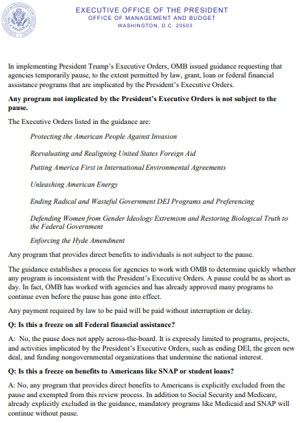
Executive MEMOS

Slide 20
federal funding temporary pause - guidance
January 28, 2025
In implementing President Trump’s Executive Orders, OMB issued guidance requesting that agencies temporarily pause, to the extent permitted by law, grant, loan or federal financial assistance programs that are implicated by the President’s Executive Orders.
Any program not implicated by the President’s Executive Orders is not subject to the pause.
The Executive Orders listed in the guidance are:
Protecting the American People Against Invasion
Reevaluating and Realigning United States Foreign Aid
Putting America First in International Environmental Agreements
Unleashing American Energy
Ending Radical and Wasteful Government DEI Programs and Preferencing
Defending Women from Gender Ideology Extremism and Restoring Biological Truth to the Federal Government
Enforcing the Hyde Amendment
file:///C:/Users/Tom/AppData/Local/Microsoft/Windows/INetCache/Content.Outlook/YJ3BN7YT/FILE_1892.pdf

Slide 21
federal funding temporary pause - guidance
January 28, 2025
Any program that provides direct benefits to individuals is not subject to the pause.
The guidance establishes a process for agencies to work with OMB to determine quickly whether any program is inconsistent with the President’s Executive Orders. A pause could be as short as day. In fact, OMB has worked with agencies and has already approved many programs to continue even before the pause has gone into effect.
Any payment required by law to be paid will be paid without interruption or delay.
file:///C:/Users/Tom/AppData/Local/Microsoft/Windows/INetCache/Content.Outlook/YJ3BN7YT/FILE_1892.pdf

Slide 22
federal funding temporary pause - guidance
January 28, 2025
Q: Is this a freeze on all Federal financial assistance?
A: No, the pause does not apply across-the-board. It is expressly limited to programs, projects, and activities implicated by the President’s Executive Orders, such as ending DEI, the green new deal, and funding nongovernmental organizations that undermine the national interest.
Q: Is this a freeze on benefits to Americans like SNAP or student loans?
A: No, any program that provides direct benefits to Americans is explicitly excluded from the pause and exempted from this review process. In addition to Social Security and Medicare, already explicitly excluded in the guidance, mandatory programs like Medicaid and SNAP will continue without pause.
Funds for small businesses, farmers, Pell grants, Head Start, rental assistance, and other similar programs will not be paused. If agencies are concerned that these programs may implicate the President’s Executive Orders, they should consult OMB to begin to unwind these objectionable policies without a pause in the payments.
file:///C:/Users/Tom/AppData/Local/Microsoft/Windows/INetCache/Content.Outlook/YJ3BN7YT/FILE_1892.pdf

Slide 23
federal funding temporary pause - guidance
January 28, 2025
Q: Is the pause of federal financial assistance an impoundment?
A: No, it is not an impoundment under the Impoundment Control Act. It is a temporary pause to give agencies time to ensure that financial assistance conforms to the policies set out in the President’s Executive Orders, to the extent permitted by law.
Temporary pauses are a necessary part of program implementation that have been ordered by past presidents to ensure that programs are being executed and funds spent in accordance with a new President’s policies and do not constitute impoundments.
Q: Why was this pause necessary?
A: To act as faithful stewards of taxpayer money, new administrations must review federal programs to ensure that they are being executed in accordance with the law and the new President’s policies.
file:///C:/Users/Tom/AppData/Local/Microsoft/Windows/INetCache/Content.Outlook/YJ3BN7YT/FILE_1892.pdf

Slide 24
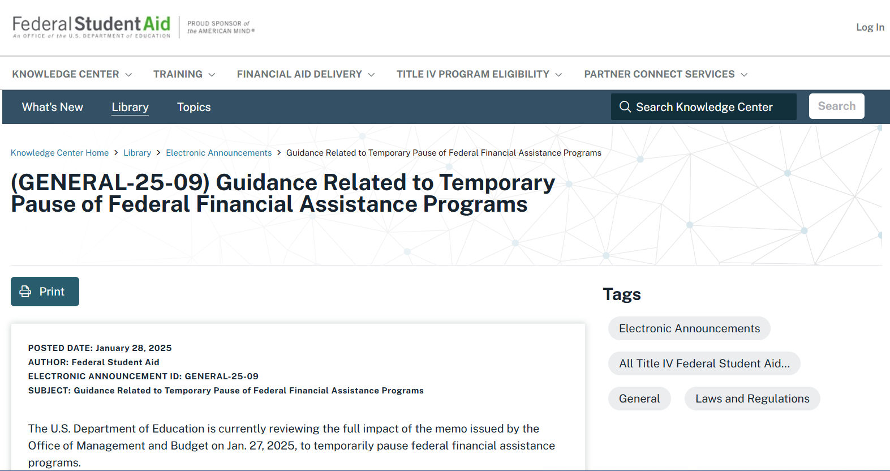
Department of education guidance
https://fsapartners.ed.gov/knowledge-center/library/electronic-announcements/2025-01-28/guidance-related-temporary-pause-federal-financial-assistance-programs

Slide 25
Department of education guidance
January 28, 2025
Posted Date January 28, 2025
Author Federal Student Aid
Electronic Announcement ID GENERAL-25-09
Subject Guidance Related to Temporary Pause of Federal Financial Assistance Programs
The U.S. Department of Education is currently reviewing the full impact of the memo issued by the Office of Management and Budget on Jan. 27, 2025, to temporarily pause federal financial assistance programs.
Per the memo, the pause does not impact “assistance received directly by individuals.” This includes Title IV, HEA funds, which are provided to individual students.
We will provide additional updates as they become available.

Slide 26
Executive MEMOS

Slide 27
federal funding temporary pause - Recission
January 29, 2025
M-25-13
MEMORANDUM FOR HEADS OF EXECUTIVE DEPARTMENTS AND AGENCIES
FROM: Matthew J. Vaeth, Acting Director, Office of Management and Budget
SUBJECT: Temporary Pause of Agency Grant, Loan, and Other Financial Assistance Programs
OMB Memorandum M-25-13 is rescinded. If you have questions about implementing the President's Executive Orders, please contact your agency General Counsel.

Slide 28
Executive Orders

Slide 29
Executive Orders

Slide 30
Executive Orders

Slide 31
Executive Orders

Slide 32
Executive Orders

Slide 33
Executive Orders

Slide 34
Executive Orders

Slide 35
Executive Orders

Slide 36
Executive Orders

Slide 37
Regulatory Freeze Pending Review
January 20, 2025
By the authority vested in me as President by the Constitution and the laws of the United States of America, I hereby order all executive departments and agencies to take the following steps:
(1) Do not propose or issue any rule in any manner, including by sending a rule to the Office of the Federal Register (the “OFR”), until a department or agency head appointed or designated by the President after noon on January 20, 2025, reviews and approves the rule. The department or agency head may delegate this power of review and approval to any other person so appointed or designated by the President, consistent with applicable law. The Director or Acting Director of the Office of Management and Budget (the “OMB Director”) may exempt any rule that he deems necessary to address emergency situations or other urgent circumstances, including rules subject to statutory or judicial deadlines that require prompt action.
https://www.whitehouse.gov/presidential-actions/2025/01/regulatory-freeze-pending-review/

Slide 38
Regulatory Freeze Pending Review
January 20, 2025
By the authority vested in me as President by the Constitution and the laws of the United States of America, I hereby order all executive departments and agencies to take the following steps:
(2) Immediately withdraw any rules that have been sent to the OFR but not published in the Federal Register, so that they can be reviewed and approved as described in paragraph 1, subject to the exceptions described in paragraph 1.
(3) Consistent with applicable law and subject to the exceptions described in paragraph 1, consider postponing for 60 days from the date of this memorandum the effective date for any rules that have been published in the Federal Register, or any rules that have been issued in any manner but have not taken effect, for the purpose of reviewing any questions of fact, law, and policy that the rules may raise. During this 60-day period, where appropriate and consistent with applicable law, consider opening a comment period to allow interested parties to provide comments about issues of fact, law, and policy raised by the rules postponed under this memorandum, and consider reevaluating pending petitions involving such rules. As appropriate and consistent with applicable law, and where necessary to continue to review these questions of fact, law, and policy, consider further delaying, or publishing for notice and comment, proposed rules further delaying such rules beyond the 60-day period.
https://www.whitehouse.gov/presidential-actions/2025/01/regulatory-freeze-pending-review/

Slide 39
Regulatory Freeze Pending Review
January 20, 2025
By the authority vested in me as President by the Constitution and the laws of the United States of America, I hereby order all executive departments and agencies to take the following steps:
(4) Following the postponement described in paragraph 3, no further action needs to be taken for those rules that raise no substantial questions of fact, law, or policy. For those rules that raise substantial questions of fact, law, or policy, agencies should notify and take further appropriate action in consultation with the OMB Director.
(5) Comply in all circumstances with any applicable Executive Orders concerning regulatory management.
https://www.whitehouse.gov/presidential-actions/2025/01/regulatory-freeze-pending-review/

Slide 40
Regulatory Freeze Pending Review
January 20, 2025
As used in this memorandum, “rule” has the definition set forth in section 551(4), title 5, United States Code. It also includes any “regulatory action,” as defined in section 3(e) of Executive Order 12866 of September 30, 1993, as amended, and any “guidance document” as defined in section 2(b) of Executive Order 13891 of October 9, 2019 (Promoting the Rule of Law Through Improved Agency Guidance Documents), when that order was in effect. Thus, the requirements of this memorandum apply not only to “rules” as defined in section 551(4) of title 5, but also to any substantive action by an agency (normally published in the Federal Register) that promulgates or is expected to lead to the promulgation of a final rule or regulation, including notices of inquiry, advance notices of proposed rulemaking, and notices of proposed rulemaking. They shall also apply to any agency statement of general applicability and future effect that sets forth a policy on a statutory, regulatory, or technical issue or an interpretation of a statutory or regulatory issue.
https://www.whitehouse.gov/presidential-actions/2025/01/regulatory-freeze-pending-review/

Slide 41
Regulatory Freeze Pending Review
January 20, 2025
The OMB Director shall oversee the implementation of this memorandum, and any communications regarding any matters pertaining to this review should be addressed to the OMB Director. The OMB Director is also authorized to establish a process to review pending collections of information under the Paperwork Reduction Act of 1995, as codified in chapter 35, title 44, United States Code, and to take actions that the OMB Director deems appropriate based on that review, consistent with applicable law.
Should actions be identified that were undertaken before noon on January 20, 2025, that frustrate the purpose underlying this memorandum, I may modify or extend this memorandum, to require that department and agency heads consider taking steps to address those actions.
The OMB Director is authorized and directed to publish this memorandum in the Federal Register.
This memorandum shall be implemented consistent with applicable law.
https://www.whitehouse.gov/presidential-actions/2025/01/regulatory-freeze-pending-review/

Slide 42
What could be next?

Slide 43
REGULATORY UPDATE

Slide 44
Department of Education Appointees
Appointees & Their Designations
Rachel Oglesby – Chief of Staff to Secretary of Education designee Linda McMahon
Jonathan Pidluzny – Deputy Chief of Staff for Policy and Programs, Office of Secretary
Mary-Christina Riley – (anticipated to be in Office of Legislative and Congressional Affairs)
David Samberg – (anticipated to be in Office of the General Counsel)
Nicholas Stone –
Craig Trainor – Deputy Assistant Secretary, Office of Civil Rights
Cherise Trump – (former Executive Director, Speech First - an organization that files litigation on behalf of its student members against universities that violate their free speech rights.)
Stephen Warzoha – Director & White House Liaison
Thomas Wheeler – Principal Deputy General Counsel, Office of the General Counsel
Madison Biedermann – Deputy Assistant Secretary, Office of Communications and Outreach

Slide 45
Department of Education Appointees
Appointees & Their Designations
Amber Davis –
Hannah Earl – Director, Center for Faith-Based and Neighborhood Partnerships
Virgina Forrester – Deputy Chief of Staff, Office of the Secretary
Virgina Gentles – (formerly with American Federation for Children)
Issac Hampton –
Julie Hartman –
Candice Jackson – Deputy General Counsel, Office of the General Counsel
Nicholas Kent – (formerly Deputy Secretary of Education, Commonwealth of Virginia)
Joshua Kleinfeld –
Savanna Newhouse – (formerly Communications Director, Sen. Marsha Blackburn)

Slide 46
GE Reporting DEADLINE

Slide 48
legislative UPDATE

Slide 50
House E&W Hearing

Slide 51
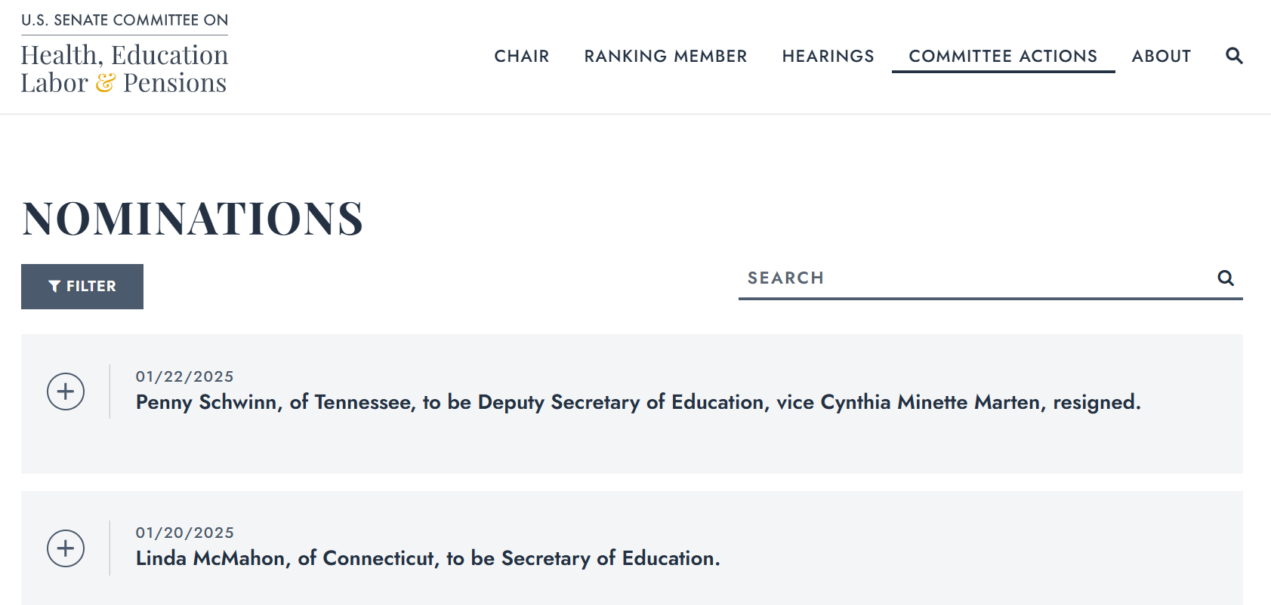

Slide 53
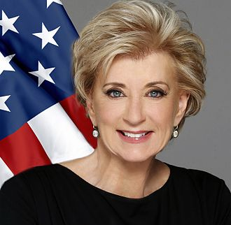
PRESIDENT TRUMP’S Key Selections SECRETARY OF EDUCATION LINDA McMAHON

Slide 54
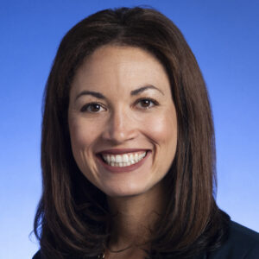
PRESIDENT TRUMP’S Key Selections Deputy SECRETARY OF EDUCATION Peggy Schwinn

Slide 55
Judicial UPDATE

Slide 58
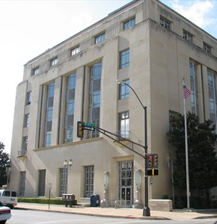
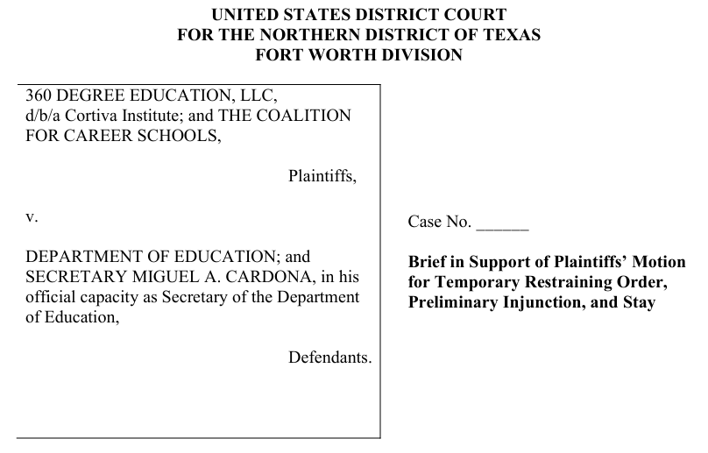

Slide 59
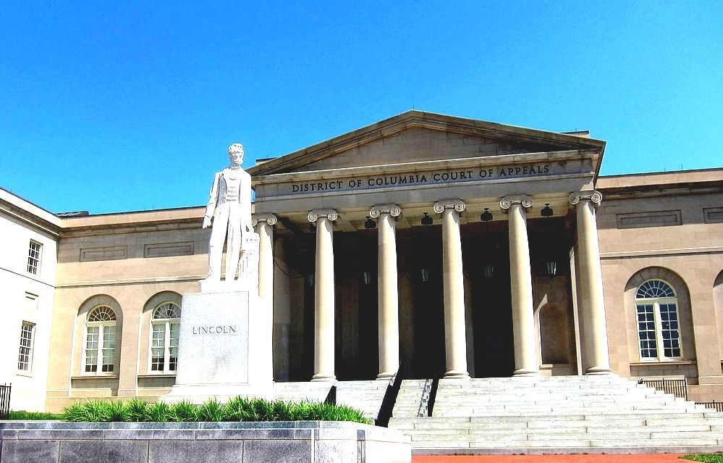
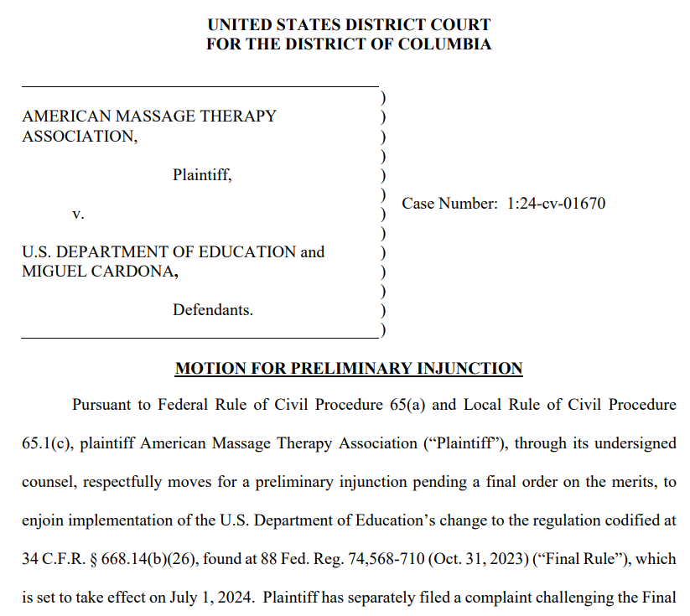

Slide 61
CSPEN 7th Annual HIGHER EDUCATION POLICY MEETING
https://cspen.com/

Slide 62
CSPEN 7th Annual HIGHER EDUCATION POLICY MEETING
https://cspen.com/events/cspen-7th-annual-higher-education-policy-meeting/

