Slide 1
Federal legislative & Regulatory Update
Thursday, February 6, 2025

Slide 2
AGENDA
Secretary Linda McMahon Confirmation Hearing Announced
Executive Orders
Latest Department of Education News
&
Congressional Education Hearing
President Trump – Week 3
Regulatory Update
Legislative Update
Q&A

Slide 5
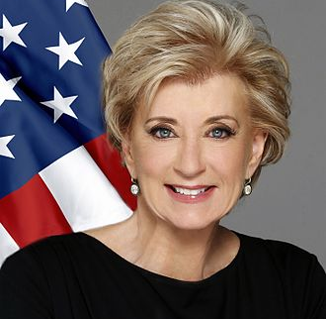
PRESIDENT TRUMP’S Key Selections SECRETARY OF EDUCATION LINDA McMAHON

Slide 6
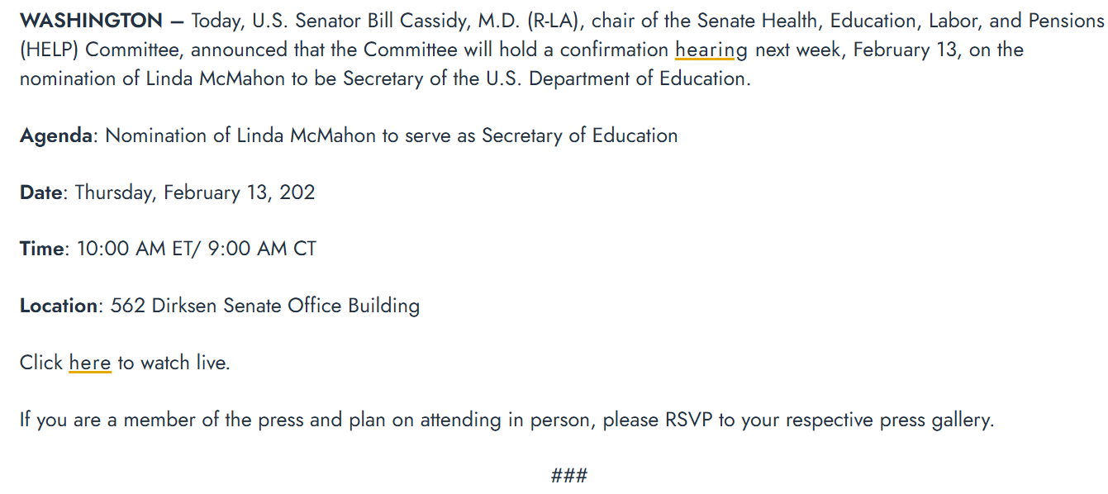
Secretary of Education Nomination Hearing
https://www.help.senate.gov/rep/newsroom/press/next-week-senate-help-committee-to-hold-confirmation-hearing-on-nomination-for-secretary-of-education

Slide 7
Trump Administrative Actions This Week

Slide 8
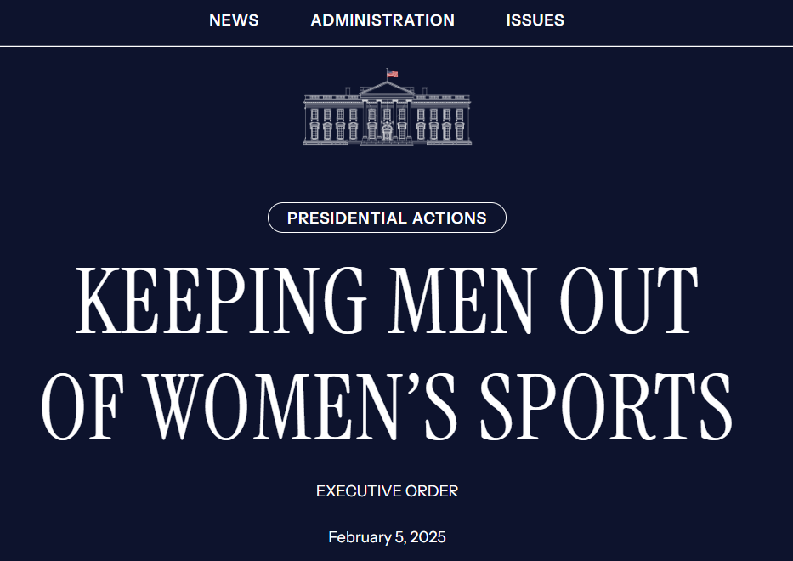
Executive Orders

Slide 9
Female sports participation
February 5, 2025
By the authority vested in me as President by the Constitution and the laws of the United States of America, and to protect opportunities for women and girls to compete in safe and fair sports, it is hereby ordered:
Section 1. Policy and Purpose. In recent years, many educational institutions and athletic associations have allowed men to compete in women’s sports. This is demeaning, unfair, and dangerous to women and girls, and denies women and girls the equal opportunity to participate and excel in competitive sports.
Moreover, under Title IX of the Education Amendments Act of 1972 (Title IX), educational institutions receiving Federal funds cannot deny women an equal opportunity to participate in sports. As some Federal courts have recognized, “ignoring fundamental biological truths between the two sexes deprives women and girls of meaningful access to educational facilities.” Tennessee v. Cardona, 24-cv-00072 at 73 (E.D. Ky. 2024). See also Kansas v. U.S. Dept. of Education, 24-cv-04041 at 23 (D. Kan. 2024) (highlighting “Congress’ goals of protecting biological women in education”).
https://www.whitehouse.gov/presidential-actions/2025/02/keeping-men-out-of-womens-sports/

Slide 10
Female sports participation
February 5, 2025
Therefore, it is the policy of the United States to rescind all funds from educational programs that deprive women and girls of fair athletic opportunities, which results in the endangerment, humiliation, and silencing of women and girls and deprives them of privacy. It shall also be the policy of the United States to oppose male competitive participation in women’s sports more broadly, as a matter of safety, fairness, dignity, and truth.
Sec. 2. Definitions. The definitions in Executive Order 14168 of January 20, 2025 (Defending Women from Gender Ideology Extremism and Restoring Biological Truth to the Federal Government), shall apply to this order.
https://www.whitehouse.gov/presidential-actions/2025/02/keeping-men-out-of-womens-sports/

Slide 11
Female sports participation
February 5, 2025
Sec.3. Preserving Women’s Sports in Education. (a) In furtherance of the purposes of Title IX, the Secretary of Education shall promptly:
(i) in coordination with the Attorney General, continue to comply with the vacatur of the rule entitled “Nondiscrimination on the Basis of Sex in Education Programs or Activities Receiving Federal Financial Assistance” of April 29, 2024, 89 FR 33474, see Tennessee v. Cardona, 24-cv-00072 at 13-15 (E.D. Ky. 2025), and take other appropriate action to ensure this regulation does not have effect;
(ii) take all appropriate action to affirmatively protect all-female athletic opportunities and all-female locker rooms and thereby provide the equal opportunity guaranteed by Title IX of the Education Amendments Act of 1972, including enforcement actions described in subsection (iii); to bring regulations and policy guidance into line with the Congress’ existing demand for “equal athletic opportunity for members of both sexes” by clearly specifying and clarifying that women’s sports are reserved for women; and the resolution of pending litigation consistent with this policy; and
https://www.whitehouse.gov/presidential-actions/2025/02/keeping-men-out-of-womens-sports/

Slide 12
Female sports participation
February 5, 2025
Sec.3. Preserving Women’s Sports in Education. (a) In furtherance of the purposes of Title IX, the Secretary of Education shall promptly:
(iii) prioritize Title IX enforcement actions against educational institutions (including athletic associations composed of or governed by such institutions) that deny female students an equal opportunity to participate in sports and athletic events by requiring them, in the women’s category, to compete with or against or to appear unclothed before males.
(b) All executive departments and agencies (agencies) shall review grants to educational programs and, where appropriate, rescind funding to programs that fail to comply with the policy established in this order.
(c) The Department of Justice shall provide all necessary resources, in accordance with law, to relevant agencies to ensure expeditious enforcement of the policy established in this order.
https://www.whitehouse.gov/presidential-actions/2025/02/keeping-men-out-of-womens-sports/

Slide 13
Female sports participation
February 5, 2025
Sec. 4. Preserving Fairness and Safety in Women’s Sports. Many sport-specific governing bodies have no official position or requirements regarding trans-identifying athletes. Others allow men to compete in women’s categories if these men reduce the testosterone in their bodies below certain levels or provide documentation of “sincerely held” gender identity. These policies are unfair to female athletes and do not protect female safety. To address these concerns, it is hereby ordered:
(a) The Assistant to the President for Domestic Policy shall, within 60 days of the date of this order:
(i) convene representatives of major athletic organizations and governing bodies, and female athletes harmed by such policies, to promote policies that are fair and safe, in the best interests of female athletes, and consistent with the requirements of Title IX, as applicable; and
(ii) convene State Attorneys General to identify best practices in defining and enforcing equal opportunities for women to participate in sports and educate them about stories of women and girls who have been harmed by male participation in women’s sports.
https://www.whitehouse.gov/presidential-actions/2025/02/keeping-men-out-of-womens-sports/

Slide 14
Female sports participation
February 5, 2025
Sec. 4. Preserving Fairness and Safety in Women’s Sports. Many sport-specific governing bodies have no official position or requirements regarding trans-identifying athletes. Others allow men to compete in women’s categories if these men reduce the testosterone in their bodies below certain levels or provide documentation of “sincerely held” gender identity. These policies are unfair to female athletes and do not protect female safety. To address these concerns, it is hereby ordered:
(b) The Secretary of State, including through the Bureau of Educational and Cultural Affairs’ Sports Diplomacy Division and the Representative of the United States of America to the United Nations, shall:
(i) rescind support for and participation in people-to-people sports exchanges or other sports programs within which the relevant female sports category is based on identity and not sex; and
(ii) promote, including at the United Nations, international rules and norms governing sports competition to protect a sex-based female sports category, and, at the discretion of the Secretary of State, convene international athletic organizations and governing bodies, and female athletes harmed by policies that allow male participation in women’s sports, to promote sporting policies that are fair, safe, and in furtherance of the best interests of female athletes.
https://www.whitehouse.gov/presidential-actions/2025/02/keeping-men-out-of-womens-sports/

Slide 15
Female sports participation
February 5, 2025
Sec. 4. Preserving Fairness and Safety in Women’s Sports. Many sport-specific governing bodies have no official position or requirements regarding trans-identifying athletes. Others allow men to compete in women’s categories if these men reduce the testosterone in their bodies below certain levels or provide documentation of “sincerely held” gender identity. These policies are unfair to female athletes and do not protect female safety. To address these concerns, it is hereby ordered:
(c) The Secretary of State and the Secretary of Homeland Security shall review and adjust, as needed, policies permitting admission to the United States of males seeking to participate in women’s sports, and shall issue guidance with an objective of preventing such entry to the extent permitted by law, including pursuant to section 212(a)(6)(C)(i) of the Immigration and Nationality Act (8 U.S.C. 1182(a)(6)(C)(i)).
(d) The Secretary of State shall use all appropriate and available measures to see that the International Olympic Committee amends the standards governing Olympic sporting events to promote fairness, safety, and the best interests of female athletes by ensuring that eligibility for participation in women’s sporting events is determined according to sex and not gender identity or testosterone reduction.
https://www.whitehouse.gov/presidential-actions/2025/02/keeping-men-out-of-womens-sports/

Slide 16
Female sports participation
February 5, 2025
Sec. 5. General Provisions. (a) Nothing in this order shall be construed to impair or otherwise affect:
(i) the authority granted by law to an executive department or agency, or the head thereof; or
(ii) the functions of the Director of the Office of Management and Budget relating to budgetary, administrative, or legislative proposals.
(b) This order shall be implemented consistent with applicable law and subject to the availability of appropriations.
(c) This order is not intended to, and does not, create any right or benefit, substantive or procedural, enforceable at law or in equity by any party against the United States, its departments, agencies, or entities, its officers, employees, or agents, or any other person.
(d) If any provision of this order, or the application of any provision to any person or circumstance, is held to be invalid, the remainder of this order and the application of its provisions to any other persons or circumstances shall not be affected thereby.
https://www.whitehouse.gov/presidential-actions/2025/02/keeping-men-out-of-womens-sports/

Slide 17
Executive Orders

Slide 18
Career and technical education month
February 3, 2025
Hardworking Americans are the backbone of our great Nation. Our workforce is the best in the world, and my Administration is dedicated to giving our students and workers the tools they need to succeed in a time where emerging technologies are advancing at an unprecedented pace. During Career and Technical Education Month, we reaffirm our belief in excellence by putting America first and investing in the best training and retraining opportunities that will result in a stronger workforce and a booming economy.
Under my leadership, America will once again champion a culture where hard work is rewarded and equip our people with real skills for real careers that our communities are in desperate need to fill. During my first term, I proudly signed the Strengthening Career and Technical Education for the 21st Century Act, which provided millions of students with excellent vocational opportunities. And we saw unparalleled growth and economic development, empowering students and workers to undertake new high-wage careers, especially in science, technology, and engineering. We will make technology work for Americans, not Americans for technology.
https://www.whitehouse.gov/presidential-actions/2025/02/career-and-technical-education-month-2025/

Slide 19
Career and technical education month
February 3, 2025
America is well-positioned at the forefront of innovation and entrepreneurship, and our history of ingenuity and grit is unrivaled. Over the next 4 years, we will rebuild our economy, raise wages, and strengthen families. My Administration will invest in the next generation and expand access to high-quality career and technical education for all Americans. We will unleash the enormous potential of the American people and provide students and workers with the necessary skills training to ensure that our Nation dominates the 21st century.
This February, we celebrate our incredible workers who are making America bigger, better, and more beautiful than ever before. By offering more alternatives to higher education, we will train college-aged kids in relevant skills for the 21st century economy. We will put America first, invest in our people, and lead the world into a new golden age.
NOW, THEREFORE, I, DONALD J. TRUMP, President of the United States of America, by virtue of the authority vested in me by the Constitution and the laws of the United States, do hereby proclaim February 2025 as Career and Technical Education Month.
IN WITNESS WHEREOF, I have hereunto set my hand this third day of February, in the year of our Lord two thousand twenty-five, and of the Independence of the United States of America the two hundred and forty-ninth.
https://www.whitehouse.gov/presidential-actions/2025/02/career-and-technical-education-month-2025/

Slide 20
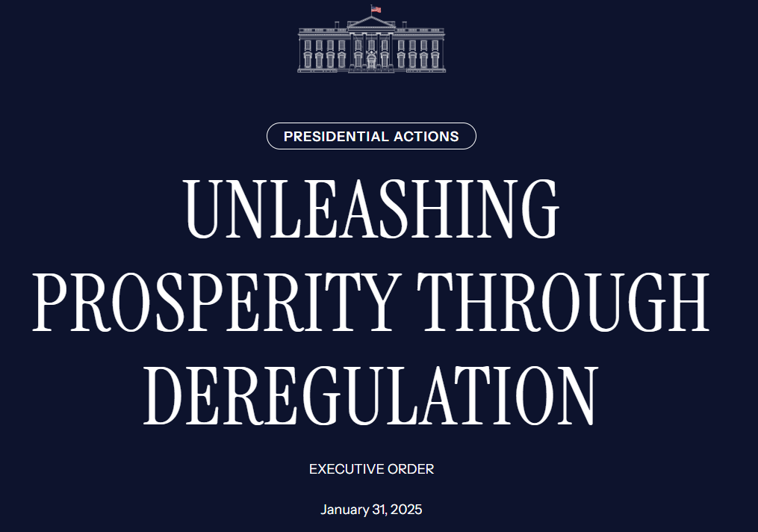
Executive Orders

Slide 21
DEREGULATION 10:1 Declaration
January 31, 2025
UNLEASHING PROSPERITY THROUGH DEREGULATION
By the authority vested in me as President by the Constitution and the laws of the United States of America, including the Budget and Accounting Act of 1921, as amended (31 U.S.C. 1101 et seq.), and in order to promote prudent financial management and alleviate unnecessary regulatory burdens, it is hereby ordered:
Section 1. Purpose. The ever-expanding morass of complicated Federal regulation imposes massive costs on the lives of millions of Americans, creates a substantial restraint on our economic growth and ability to build and innovate, and hampers our global competitiveness. Despite the magnitude of their impact, these measures are often difficult for the average person or business to understand, as they require synthesizing the collective meaning not just of formal regulations but also rules, memoranda, administrative orders, guidance documents, policy statements, and interagency agreements that are not subject to the Administrative Procedure Act, further increasing compliance costs and the risk of costs of non-compliance. It is the policy of my Administration to significantly reduce the private expenditures required to comply with Federal regulations to secure America’s economic prosperity and national security and the highest possible quality of life for each citizen. To that end, it is important that for each new regulation issued, at least 10 prior regulations be identified for elimination. This practice is to ensure that the cost of planned regulations is responsibly managed and controlled through a rigorous regulatory budgeting process.
https://www.whitehouse.gov/presidential-actions/2025/01/unleashing-prosperity-through-deregulation/

Slide 22
DEREGULATION 10:1 Declaration
January 31, 2025
UNLEASHING PROSPERITY THROUGH DEREGULATION
By the authority vested in me as President by the Constitution and the laws of the United States of America, including the Budget and Accounting Act of 1921, as amended (31 U.S.C. 1101 et seq.), and in order to promote prudent financial management and alleviate unnecessary regulatory burdens, it is hereby ordered:
Sec. 2. Policy. It is the policy of the executive branch to be prudent and financially responsible in the expenditure of funds, from both public and private sources, and to alleviate unnecessary regulatory burdens placed on the American people.
https://www.whitehouse.gov/presidential-actions/2025/01/unleashing-prosperity-through-deregulation/

Slide 23
DEREGULATION 10:1 Declaration
January 31, 2025
UNLEASHING PROSPERITY THROUGH DEREGULATION
Sec. 3. Regulatory Cap for Fiscal Year 2025. (a) Unless prohibited by law, whenever an executive department or agency (agency) publicly proposes for notice and comment or otherwise promulgates a new regulation, it shall identify at least 10 existing regulations to be repealed.
(b) For fiscal year 2025, which is in progress, the heads of all agencies are directed to ensure that the total incremental cost of all new regulations, including repealed regulations, being finalized this year, shall be significantly less than zero, as determined by the Director of the Office of Management and Budget (Director), unless otherwise required by law or instructions from the Director.
(c) In furtherance of the requirement of subsection (a) of this section, any new incremental costs associated with new regulations shall, to the extent permitted by law, be offset by the elimination of existing costs associated with at least 10 prior regulations.
https://www.whitehouse.gov/presidential-actions/2025/01/unleashing-prosperity-through-deregulation/

Slide 24
DEREGULATION 10:1 Declaration
January 31, 2025
UNLEASHING PROSPERITY THROUGH DEREGULATION
Sec. 3. Regulatory Cap for Fiscal Year 2025. (a) Unless prohibited by law, whenever an executive department or agency (agency) publicly proposes for notice and comment or otherwise promulgates a new regulation, it shall identify at least 10 existing regulations to be repealed.
(d) The Director shall provide the heads of agencies with guidance on the implementation of this section. Such guidance shall address, among other things, processes for standardizing the measurement and estimation of regulatory costs; standards for determining what qualifies as new and offsetting regulations; standards for determining the costs of existing regulations that are considered for elimination; processes for accounting for costs in different fiscal years; methods to oversee the issuance of rules with costs offset by savings at different times or different agencies; and emergencies and other circumstances that might justify individual waivers of the requirements of this section. The Director shall consider phasing in and updating these requirements.
https://www.whitehouse.gov/presidential-actions/2025/01/unleashing-prosperity-through-deregulation/

Slide 25
DEREGULATION 10:1 Declaration
January 31, 2025
UNLEASHING PROSPERITY THROUGH DEREGULATION
Sec. 4. Annual Regulatory Cost Submissions to the Office of Management and Budget. Beginning with the Regulatory Plans, as required under Executive Order 12866 of September 30, 1993 (Regulatory Planning and Review), as amended, or any successor order for fiscal year 2026, and for each fiscal year thereafter:
(a) The head of each agency shall identify on an aggregated basis, for regulations that increase incremental cost, the offsetting regulations described in section 3(c) of this order, and provide the agency’s best approximation of the total costs or savings associated with each new regulation or repealed regulation.
(b) Each regulation approved by the Director during the Presidential budget process shall be included in the Unified Regulatory Agenda required under Executive Order 12866, as amended, or any successor order. Unless otherwise required by law, no regulation shall be added to or removed from the Unified Regulatory Agenda without the approval of the Director. To accomplish the purposes of this order, the Director may also require additions to the Unified Regulatory Agenda and Regulatory Plan.
https://www.whitehouse.gov/presidential-actions/2025/01/unleashing-prosperity-through-deregulation/

Slide 26
DEREGULATION 10:1 Declaration
January 31, 2025
UNLEASHING PROSPERITY THROUGH DEREGULATION
Sec. 4. Annual Regulatory Cost Submissions to the Office of Management and Budget. Beginning with the Regulatory Plans, as required under Executive Order 12866 of September 30, 1993 (Regulatory Planning and Review), as amended, or any successor order for fiscal year 2026, and for each fiscal year thereafter:
(c) Unless otherwise required by law, no regulation shall be issued by an agency if it was not included in the most recent version or update of the published Unified Regulatory Agenda as required under Executive Order 12866, as amended, or any successor order, unless the issuance of such regulation was approved in advance in writing by the Director.
(d) During the Presidential budget process, the Director shall identify to agencies a total amount of incremental costs that will be allowed for each agency in issuing new regulations and repealing regulations for each fiscal year after fiscal year 2025. No regulations exceeding the agency’s total incremental cost allowance will be permitted in that fiscal year, unless required by law or approved in writing by the Director. The total incremental cost allowance may allow an increase or require a reduction in total regulatory cost.
(e) The Director shall provide the heads of agencies with guidance on the implementation of the requirements in this section.
https://www.whitehouse.gov/presidential-actions/2025/01/unleashing-prosperity-through-deregulation/

Slide 27
DEREGULATION 10:1 Declaration
January 31, 2025
UNLEASHING PROSPERITY THROUGH DEREGULATION
Sec. 5. Definition. For purposes of this order, the term “regulation” or “rule” means an agency statement of general or particular applicability and future effect designed to implement, interpret, or prescribe law or policy or to describe the procedure or practice requirements of an agency, including, without limitation, regulations, rules, memoranda, administrative orders, guidance documents, policy statements, and interagency agreements, regardless of whether the same were enacted through the processes in the Administrative Procedure Act, but does not include:
(a) regulations issued with respect to a military, national security, homeland security, foreign affairs, or immigration-related function of the United States;
(b) regulations related to agency organization, management, or personnel; or
(c) any other specific regulation or category of regulations exempted by the Director, who shall exempt those regulations or categories of regulations that impose minimal costs or burdens on the private sector or that are requested to be exempted by the Assistant to the President and Chief of Staff or the Assistant to the President and Deputy Chief of Staff for Policy.
https://www.whitehouse.gov/presidential-actions/2025/01/unleashing-prosperity-through-deregulation/

Slide 28
DEREGULATION 10:1 Declaration
January 31, 2025
UNLEASHING PROSPERITY THROUGH DEREGULATION
Sec. 6. Implementation. (a) The Director is charged with implementing this order, including by providing agencies with updated guidance on implementing the ten-for-one rule described in section 3(a) of this order, including processes for identifying regulations for elimination, determining what constitutes, generally and specifically, a “rule” or “regulation” for purposes of this order, estimating and standardizing regulatory costs, and ensuring compliance with the Administrative Procedure Act and other applicable laws.
(b) The Director shall revoke OMB Circular No. A-4 of November 9, 2023 (Regulatory Analysis), and all accompanying appendices, guidelines, and documents, and shall reinstate the prior version of Circular A-4, issued on September 17, 2003; and
(c) The Secretary of the Treasury and the Director shall reinstate the Memorandum of Agreement between the Department of the Treasury and the Office of Management and Budget of April 11, 2018, regarding review of tax regulations under Executive Order 12866.
https://www.whitehouse.gov/presidential-actions/2025/01/unleashing-prosperity-through-deregulation/

Slide 29
DEREGULATION 10:1 Declaration
January 31, 2025
UNLEASHING PROSPERITY THROUGH DEREGULATION
Sec. 7. Severability. If any provision of this order, or the application of any provision to any person or circumstance, is held to be invalid, the remainder of this order and the application of its provisions to any other persons or circumstances shall not be affected thereby.
Sec. 8. General Provisions. (a) Nothing in this order shall be construed to impair or otherwise affect:
(i) the authority granted by law to an executive department, agency, or the head thereof; or
(ii) the functions of the Director of the Office of Management and Budget relating to budgetary, administrative, or legislative proposals.
(b) This order shall be implemented consistent with applicable law and subject to the availability of appropriations.
(c) This order is not intended to, and does not, create any right or benefit, substantive or procedural, enforceable at law or in equity by any party against the United States, its departments, agencies, or entities, its officers, employees, or agents, or any other person.
https://www.whitehouse.gov/presidential-actions/2025/01/unleashing-prosperity-through-deregulation/

Slide 30
Executive Orders

Slide 31
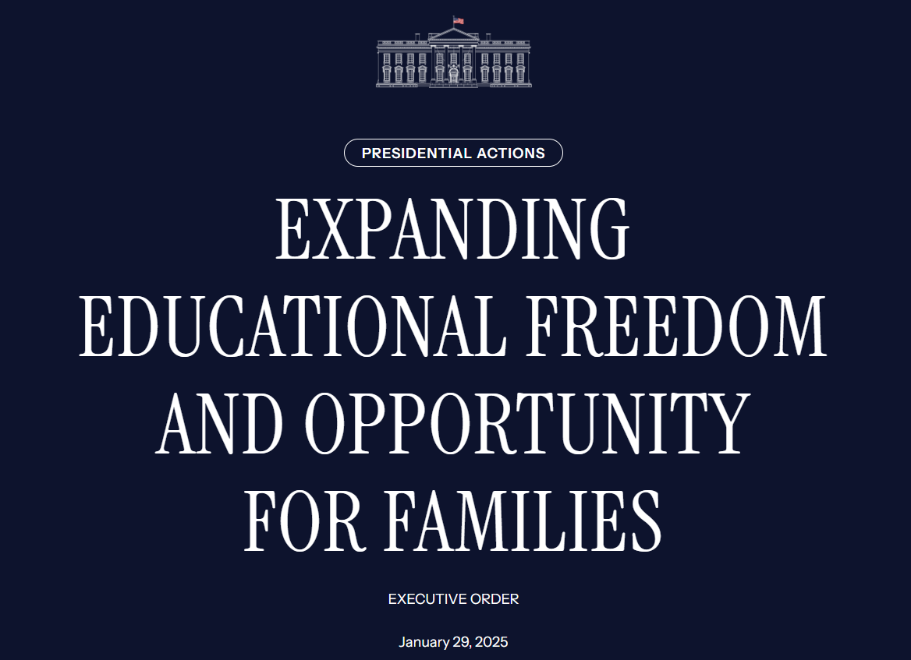
Executive Orders

Slide 32
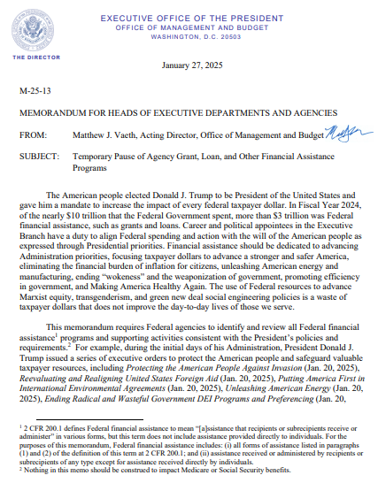
Executive MEMOS

Slide 33
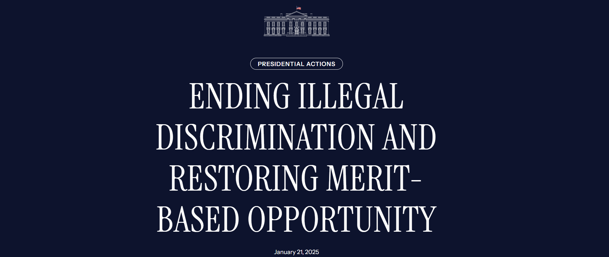
Executive Orders

Slide 34
Executive Orders

Slide 35
Executive Orders

Slide 36
Executive Orders

Slide 37
Executive Orders

Slide 38
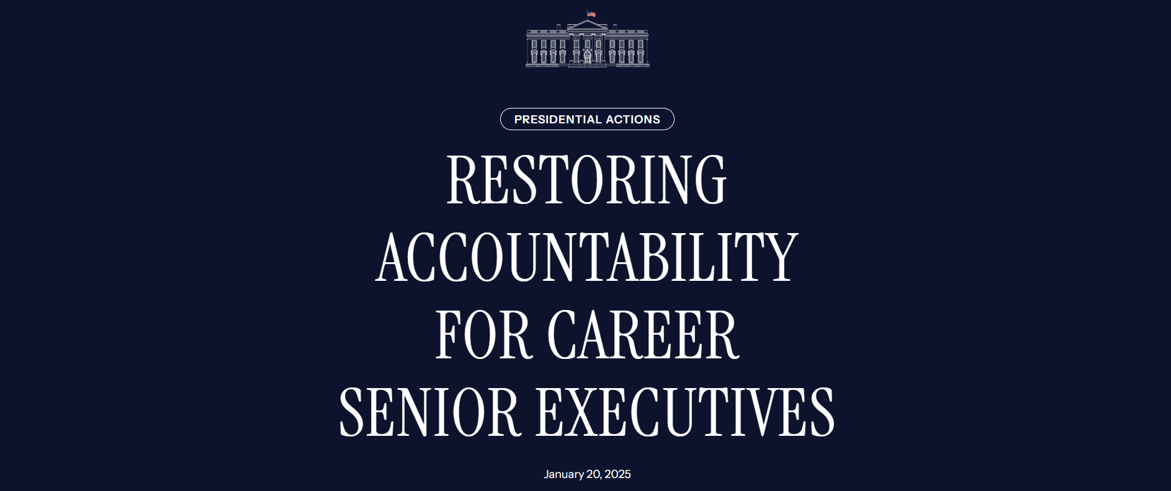
Executive Orders

Slide 39
Executive Orders

Slide 40
Executive Orders

Slide 41
Executive Orders

Slide 42
What could be next?

Slide 43
REGULATORY UPDATE

Slide 45
FAFSA UPDATE
February 4, 2025
Dear colleagues,
Today, the U.S. Department of Education published the information collection for the 2026-27 Free Application for Federal Student Aid (FAFSA®) form in the Federal Register, the first public step in the FAFSA development process. The Department is on track to launch the 2026-27 FAFSA form by Oct. 1, 2025 as mandated by the FAFSA Deadline Act. You can read more in our press release or electronic announcement.
The Department also announced that current and future FAFSA forms will rightfully reflect the biological reality that there are only two sexes: male and female. Department officials will remove “nonbinary” as a gender identification option from the current year’s FAFSA form.

Slide 46
FAFSA UPDATE
February 4, 2025
The public has 60 days to suggest improvements to the 2026–27 FAFSA form via the Federal Register. Following the 60-day period, the Department will review the suggested improvements and publish a revised draft for an additional round of public comments. This process puts the Department on track to meet the new statutory deadline and give parents and students enough time to prepare to complete and submit the form.

Slide 47
FAFSA UPDATE
February 4, 2025
Resolving Problems with the 2024–25 FAFSA Form
The Department is currently beta testing the ability of colleges and universities to make batch corrections to FAFSA forms, allowing colleges and universities to more efficiently update information on the form after it has been completed and submitted by the student and family. Batch corrections will reduce the university staff time spent on FAFSA edits. The Department plans to release full batch correction capability by the end of February, which is on schedule to the previously announced plan.
The Department also expects to complete the substantial backlog of features left incomplete by the Biden-Harris Administration in the coming months. This includes providing post-screening data from the National Student Loan Database System, notifying schools about changes in student eligibility, and other important changes.

Slide 48
FAFSA UPDATE
February 4, 2025
Commonsense Revisions to the 2025–26 FAFSA Form
Consistent with Executive Order 14168, the Department is modifying the current question about “gender” on the 2025–26 form to collect data about applicants’ sex.
Proposed Reforms to the 2026–27 FAFSA Form
The Department is proposing a redesign to the FAFSA contributor invite process, which is the source of the largest drop-off of students who decide not to complete the FAFSA form. The redesign will increase completion and satisfaction and ultimately reduce the volume of support calls.
Ensuring a timely and smooth FAFSA process is a top priority for the Trump Administration. The FAFSA technical team has been hard at work to improve the FAFSA form for all students and their families.

Slide 49
What could be next?

Slide 50
GE Reporting DEADLINE

Slide 52
legislative UPDATE

Slide 53
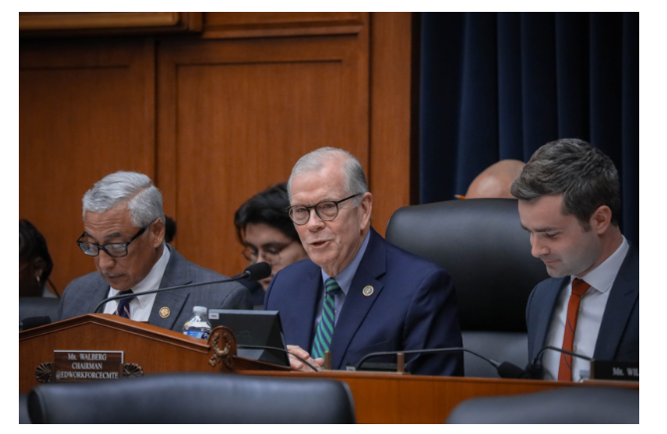
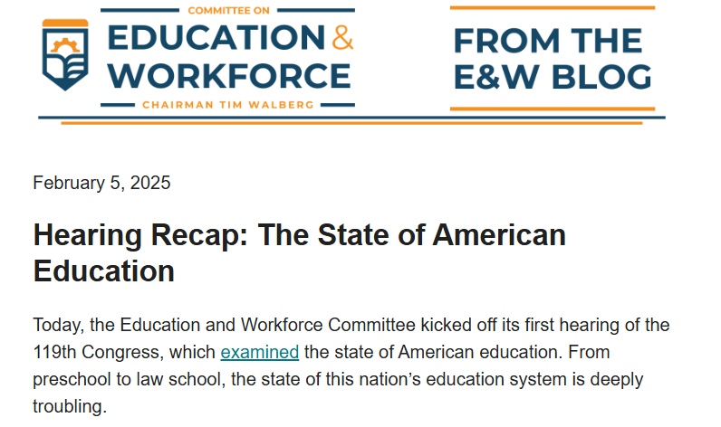
House E&W Hearing

Slide 54
State of American Education Hearing
February 5, 2025
Walberg’s Opening Statement
"Good morning, it is a pleasure to welcome you to the first hearing of the House Committee on Education and Workforce in the 119th Congress. "This morning, we’re here to discuss the state of American education. Unfortunately, many students are failing to graduate from high school or college with the skills needed to be successful. In too many places, education in core subjects like math and reading is being replaced by indoctrination. That must change. I’m pleased to see that the Trump administration is taking excellent steps to restore common sense, personal responsibility, and parental choice to our education system. But this is just the beginning.
https://edworkforce.house.gov/calendar/eventsingle.aspx?EventID=412165

Slide 55
State of American Education Hearing
February 5, 2025
Walberg’s Opening Statement
"Turning to higher education, we have seen rampant antisemitism and stifling of speech on campuses fueled by bloated DEI bureaucracies. And America’s adversaries are sending billions of foreign funds to schools to manipulate them. All of this has resulted in too many students being told what to think instead of how to think. It is also the case that our higher education financing system is at a critical inflection point. President Biden attempted to spend $1 trillion through executive actions on the federal student loan program alone. Transferring student loan responsibilities onto the backs of taxpayers will not solve the underlying issue that the federal student loan program is irreparably broken. What is needed now, more than ever, are real, lasting reforms that protect both students and taxpayers from debt they can’t afford. Our Committee has hard work ahead of us to ensure our nation’s higher education system remains the crown jewel of the world.”
https://edworkforce.house.gov/calendar/eventsingle.aspx?EventID=412165

Slide 56
State of American Education Hearing
February 5, 2025
Walberg’s Opening Statement
"We also must address our broken workforce system. We have about 8 million unfilled jobs in our country, so there is clearly a mismatch between the skills our workforce has and the skills our employers need. Unfortunately, the nation’s workforce system, authorized under the Workforce Innovation and Opportunity Act, or WIOA, is failing to fill in the gap. Fortunately, our Committee made tremendous strides last Congress in addressing these challenges. A Stronger Workforce for America Act passed the House with strong, bipartisan support and, after further negotiations with the Senate late last year, was poised for enactment. I want to thank former Chairwoman Virginia Foxx and Ranking Member Scott for their leadership on that bill, and I look forward to taking it back up in the new Congress.”
https://edworkforce.house.gov/calendar/eventsingle.aspx?EventID=412165

Slide 57
State of American Education Hearing
February 5, 2025
Walberg’s Opening Statement
"While we have great challenges ahead of us, we also have great opportunities in front of us, and I look forward to working with all of our Members to meet these challenges. That process starts today, and I am excited for the productive conversation we will have with this great panel of witnesses."
https://edworkforce.house.gov/calendar/eventsingle.aspx?EventID=412165

Slide 58
State of American Education Hearing
February 5, 2025
Witnesses
Mrs. Nicole Neily, President, Parents Defending Education
Dr. Preston Cooper, Senior Fellow, American Enterprise Institute
Mrs. Janai Nelson, President and Director-Counsel, NAACP Legal Defense Fund
Mr. Johnny C. Taylor, Jr., President and CEO, Society for Human Resource Management
https://edworkforce.house.gov/calendar/eventsingle.aspx?EventID=412165

Slide 59
State of American Education Hearing
Preston Cooper, Senior Fellow
American Enterprise Institute
Submitted Testimony
"The higher education system suffers from many problems, including excessive costs, low completion rates, uneven financial value for students, and high rates of student loan nonpayment. Federal government policies unintentionally exacerbate many of these issues, as taxpayers’ considerable investment in higher education comes with few quality controls or accountability to ensure that colleges and universities are delivering on their promises to students. Fortunately, this year’s budget reconciliation process presents a unique opportunity to remedy many of the policy problems that have led the higher education system astray
https://edworkforce.house.gov/uploadedfiles/2.5.25_cooper_testimony_house_ed_and_workforce_final.pdf

Slide 60
State of American Education Hearing
Preston Cooper, Senior Fellow
American Enterprise Institute
Submitted Testimony
The Problems Facing Higher Education
Americans are losing confidence in the higher education system. According to The Wall Street Journal’s polling, 56 percent of Americans believe that a four-year college education is no longer worth the cost. People are less likely to say that colleges and universities have a positive impact on the direction of the country. This changing
sentiment has translated into falling enrollment: The number of students attending college has dropped 12 percent since its peak in 2010.
https://edworkforce.house.gov/uploadedfiles/2.5.25_cooper_testimony_house_ed_and_workforce_final.pdf

Slide 61
State of American Education Hearing
Preston Cooper, Senior Fellow
American Enterprise Institute
Submitted Testimony
The Problems Facing Higher Education
Some of the public’s lack of confidence is justified. Higher education can be financially beneficial for students—but there are major exceptions. A large proportion of students who pursue higher education end up no better financially than if they had not attended college at all. My analysis of the financial value of college for the Foundation for Research on Equal Opportunity finds that 31 percent of federally funded higher education
programs leave the typical student worse off financially. For some credential types, including master’s degrees, the share of nonperforming programs is closer to one-half.
https://edworkforce.house.gov/uploadedfiles/2.5.25_cooper_testimony_house_ed_and_workforce_final.pdf

Slide 62
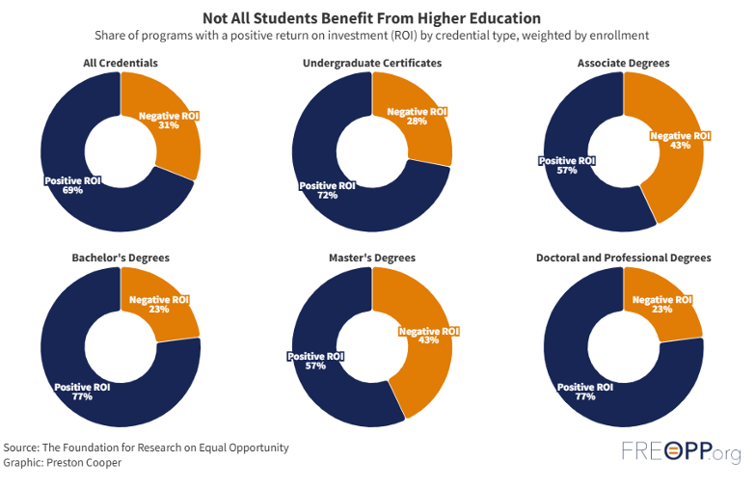
State of American Education Hearing
https://edworkforce.house.gov/uploadedfiles/2.5.25_cooper_testimony_house_ed_and_workforce_final.pdf

Slide 63
State of American Education Hearing
Preston Cooper, Senior Fellow
American Enterprise Institute
Submitted Testimony
The Problems Facing Higher Education
There are numerous reasons why some forms of higher education may not deliver a return on investment (ROI) for students. Students benefit from college when the financial returns (the expected increase in lifetime earnings from a college degree) justify the costs and risks (including tuition, fees, time spent out of the labor force, and the chance of noncompletion). But if earnings after enrollment are middling, costs are too high, or completion rates are too low, the decision to pursue postsecondary education becomes less of an investment and more of a gamble.
https://edworkforce.house.gov/uploadedfiles/2.5.25_cooper_testimony_house_ed_and_workforce_final.pdf

Slide 64
State of American Education Hearing
Preston Cooper, Senior Fellow
American Enterprise Institute
Submitted Testimony
The Problems Facing Higher Education
Unfortunately, all three of these conditions are often present in federally funded higher education programs. Many fields of study at the postsecondary level do not typically lead to middle- or high-wage jobs, meaning students often do not earn back the costs of their education. The cost of tuition has also risen over the last several decades; when college is more expensive, it’s less likely that a particular degree will pay off, all else being
equal. In addition, most of the value of a college degree is contingent on actually finishing the degree. Nationwide, however, only 62 percent of college students finish their credentials within six years, and some colleges have completion rates below 10 percent.
https://edworkforce.house.gov/uploadedfiles/2.5.25_cooper_testimony_house_ed_and_workforce_final.pdf

Slide 65
State of American Education Hearing
Preston Cooper, Senior Fellow
American Enterprise Institute
Submitted Testimony
The Problems Facing Higher Education
Yet the federal government continues to fund programs that typically do not pay off for students. Between 2018 and 2022, I estimate that at least $37 billion in Pell Grants and $86 billion in federal student loans flowed to higher education programs with a negative return on investment.8 This lavish funding of low-ROI programs contributes to the student loan crisis: When students pay too much for college relative to what they earn after leaving school, it becomes harder to pay down loan balances. Before the March 2020 pause on student loan payments, 11 million borrowers were either in default or more than 30 days delinquent on their debts.9 Millions more were taking advantage of income-driven repayment, loan forbearance, and other options to reduce or eliminate their monthly payments.10 Because of these programs, the Congressional Budget Office expects that taxpayers will lose $223 billion on student loans originated between 2025 and 2034—to say nothing of expected losses on outstanding loans.
https://edworkforce.house.gov/uploadedfiles/2.5.25_cooper_testimony_house_ed_and_workforce_final.pdf

Slide 66
State of American Education Hearing
Preston Cooper, Senior Fellow
American Enterprise Institute
Submitted Testimony
The Problems Facing Higher Education
Former President Joe Biden’s largely unsuccessful efforts to forgive federal student loans en masse did little to help matters. But at the same time, the federal student loan program’s problems predate the Biden administration. Setting the student loan program on a sustainable trajectory requires more than simply undoing the Biden administration’s executive actions. To repair the damage to higher education, Congress could undertake a more comprehensive overhaul of the student loan system to rein in fiscal costs, impose sensible limits on borrowing, and hold colleges accountable for their economic outcomes.
https://edworkforce.house.gov/uploadedfiles/2.5.25_cooper_testimony_house_ed_and_workforce_final.pdf

Slide 67
State of American Education Hearing
Preston Cooper, Senior Fellow
American Enterprise Institute
Submitted Testimony
Reforming Student Loan Repayment
The student loan repayment system has been broken for years now. Over 25 percent of student borrowers in some cohorts defaulted on their loans. In response, the Obama administration greatly expanded income-driven repayment (IDR) plans, which allowed borrowers to reduce their monthly payments. These plans proved popular: By the beginning of 2020, over half of direct loan balances were being repaid on an IDR plan. While IDR plans allowed some borrowers to avoid the worst consequences of student loan default, such as wage garnishment and negative credit reports, they did not fix the fundamental problem: Too many students used federal loans for postsecondary education where cost exceeded value.
https://edworkforce.house.gov/uploadedfiles/2.5.25_cooper_testimony_house_ed_and_workforce_final.pdf

Slide 68
State of American Education Hearing
Preston Cooper, Senior Fellow
American Enterprise Institute
Submitted Testimony
Reforming Student Loan Repayment
The Obama-era IDR plans allowed borrowers to slash their payments—sometimes to zero—and receive forgiveness of remaining balances after a set period of time (most commonly 20 years). In 2018, 36 percent of borrowers qualified for a $0 monthly payment. Since interest continued to accrue, borrowers whose payments did not fully cover interest saw their balances rise; during the 2010s, more than 75 percent of IDR users negatively amortized during their first six years on the repayment plan. In 2020, the Congressional Budget Office projected that the federal government would forgive more than $200 billion over a decade on loans being repaid through IDR plans—an estimate issued before the Biden administration announced changes to IDR that made the program even more costly.
https://edworkforce.house.gov/uploadedfiles/2.5.25_cooper_testimony_house_ed_and_workforce_final.pdf

Slide 69
State of American Education Hearing
Preston Cooper, Senior Fellow
American Enterprise Institute
Submitted Testimony
Reforming Student Loan Repayment
In 2023, President Biden’s Education Department announced changes to IDR that would cut monthly payments even further and accelerate loan cancellation for some borrowers. The new version of IDR, known as the Saving on a Valuable Education (SAVE) plan, could cost as much as $475 billion, according to the Penn Wharton Budget Model.18 (The SAVE plan is currently on hold pending the outcome of legal challenges.) As of February 2024, 57 percent of borrowers enrolled in the SAVE plan qualified for a $0 monthly payment. The vast majority of SAVE users are not expected to fully repay what they borrowed. In the words of economist Adam Looney, the SAVE plan “turn[s] student loans into untargeted grants.” In addition to fiscal costs, this dynamic threatens to create a moral hazard: If students do not need to repay what they borrowed in full, it becomes easier for colleges to hike tuition and capture the additional loan dollars. While the SAVE plan exacerbated this problem, it was already present to some extent in the Obama-era IDR plans.
https://edworkforce.house.gov/uploadedfiles/2.5.25_cooper_testimony_house_ed_and_workforce_final.pdf

Slide 70
State of American Education Hearing
Preston Cooper, Senior Fellow
American Enterprise Institute
Submitted Testimony
Reforming Student Loan Repayment
A responsible approach to student loan repayment would strike a balance between fiscal responsibility and preserving an appropriate safety net for lower-income borrowers. The College Cost Reduction Act (CCRA), introduced last year by Representative Virginia Foxx, offers one such approach.21 CCRA would create an income-driven repayment plan that would reverse SAVE’s ultralow payments and eliminate loan cancellation. In exchange, the CCRA plan would cap total interest accrual and offer low-income borrowers assistance in making their loan payments—ensuring that on-time payments always pay down principal, rather than being consumed by accrued interest. This would prevent the ballooning loan balances that so many borrowers complain about. The changes to loan repayment under CCRA would save $127 billion over ten years.
https://edworkforce.house.gov/uploadedfiles/2.5.25_cooper_testimony_house_ed_and_workforce_final.pdf

Slide 71
State of American Education Hearing
Preston Cooper, Senior Fellow
American Enterprise Institute
Submitted Testimony
Loan Origination and Price Transparency
The burdens to students and costs to taxpayers of the loan program are not just a product of the repayment system, but of loan origination policies. While loans to undergraduate students are capped, federal lending to parents of undergraduates and graduate students is effectively unlimited. (These groups may borrow up to the cost of attendance, as defined by the institution.) This enables colleges to charge higher tuition than they otherwise might, since students and parents will always be able to borrow more from taxpayers to cover it.
https://edworkforce.house.gov/uploadedfiles/2.5.25_cooper_testimony_house_ed_and_workforce_final.pdf

Slide 72
State of American Education Hearing
Preston Cooper, Senior Fellow
American Enterprise Institute
Submitted Testimony
Loan Origination and Price Transparency
Federal loans to parents of undergraduates, known as Parent PLUS loans, are a particular burden on low-income families. Parent PLUS loans carry a 9.08 percent interest rate and a 4.228 percent origination fee, and they are largely ineligible for the most generous IDR plans.24 A fifth of Parent PLUS borrowers have an expected family
contribution of zero, meaning the government has determined the parents have too low an income to contribute anything toward their children’s education.25 Yet wealthy institutions such as Baylor University have relied extensively on Parent PLUS loans, often pushing tens of thousands of dollars’ worth of the loans on lower-income parents who subsequently cannot pay down their balances. A small group of universities benefit the most from Parent PLUS loans: Just 10 percent of colleges took in more than 80 percent of Parent PLUS loan volume in the 2023–24 academic year.
https://edworkforce.house.gov/uploadedfiles/2.5.25_cooper_testimony_house_ed_and_workforce_final.pdf

Slide 73
State of American Education Hearing
Preston Cooper, Senior Fellow
American Enterprise Institute
Submitted Testimony
Loan Origination and Price Transparency
Loans to graduate students—which the Congressional Budget Office expects to make up around half of new student loans originated this fiscal year—are also effectively unlimited. Not coincidentally, inflation-adjusted average debt for graduate students rose from $58,920 in 2000 to $90,060 in 2020. Graduate loans are major source of the student loan program’s fiscal costs; taxpayers will lose $102 billion on lending to graduate students
over the coming decade.30 Moreover, Grad PLUS funds in particular flow overwhelmingly to wealthy universities. The richest one-fifth of schools use more than two-thirds of Grad PLUS loan volume. New York University and the University of Southern California each take in more Grad PLUS dollars than every Historically Black College and University in the nation, combined.
https://edworkforce.house.gov/uploadedfiles/2.5.25_cooper_testimony_house_ed_and_workforce_final.pdf

Slide 74
State of American Education Hearing
Preston Cooper, Senior Fellow
American Enterprise Institute
Submitted Testimony
Loan Origination and Price Transparency
Adding complications to this is the fact that colleges are not always upfront with students regarding the net prices students are expected to pay, or the volume of loans in their financial aid packages. A Government Accountability Office (GAO) investigation found that 91 percent of colleges do not list an accurate net price on financial aid offer letters; many financial aid offers do not even clearly label loans as “loans.” One offer letter GAO highlighted pushed nearly $25,000 in federal student loans on the recipient and his or her parents, despite never using the word “loan.”32 These opaque pricing practices often lead students to misunderstand how much debt they are taking on, and they make it more difficult for students to negotiate with institutions for a better deal.
https://edworkforce.house.gov/uploadedfiles/2.5.25_cooper_testimony_house_ed_and_workforce_final.pdf

Slide 75
State of American Education Hearing
Preston Cooper, Senior Fellow
American Enterprise Institute
Submitted Testimony
Loan Origination and Price Transparency
Fixing these issues will require a two-pronged approach. First, commonsense caps on federal loans are in order. The College Cost Reduction Act includes aggregate caps of $50,000 to undergraduate students, $100,000 to graduate students, and $150,000 to students in professional programs like medicine. The bill also includes program-specific annual loan limits based on the median cost of attendance for similar programs nationwide, which would constrain debt burdens for students in the most expensive programs. The Congressional Budget Office expects these limits will save $19 billion over ten years. Second, students need greater transparency around what they pay for college. CCRA requires institutions to use standardized financial aid award letters that clearly label loans as “loans,” and to guarantee tuition prices for students for a set period of time. The bill also
mandates the collection of more detailed data on net prices.
https://edworkforce.house.gov/uploadedfiles/2.5.25_cooper_testimony_house_ed_and_workforce_final.pdf

Slide 76
State of American Education Hearing
Preston Cooper, Senior Fellow
American Enterprise Institute
Submitted Testimony
Holding Colleges Accountable for Outcomes
Changes to student loan limits and loan repayment will improve the loan program. But the underlying problem is a lack of ROI for too many higher education programs. Fixing that problem will require changing the incentives facing colleges and universities, which means stronger accountability around student outcomes for institutions that participate in the student loan program. While there are some outcomes-based accountability policies in
the loan program, such as the Cohort Default Rate, these have largely lost their utility as institutions have figured out how to manipulate the metrics involved. A more comprehensive approach is needed, involving strong incentives for colleges.
https://edworkforce.house.gov/uploadedfiles/2.5.25_cooper_testimony_house_ed_and_workforce_final.pdf

Slide 77
State of American Education Hearing
Preston Cooper, Senior Fellow
American Enterprise Institute
Submitted Testimony
Holding Colleges Accountable for Outcomes
Ideally, the federal government would insist on student loan “risk sharing”—that is, when students can’t repay their loans in full, their institutions ought to bear some of the costs. This creates an incentive for institutions to ensure that student debt burdens do not become unmanageable, given students’ expected earnings after leaving school. Institutions can reduce their risk-sharing liabilities by limiting the amount of debt they foist on
students, adopting policies to ensure more students graduate and realize the benefits of higher education, and overhauling their program offerings to enroll more students in programs with a higher financial value. The goal of risk sharing is not to punish colleges financially, but to provide encouragement for schools to make these needed changes.
https://edworkforce.house.gov/uploadedfiles/2.5.25_cooper_testimony_house_ed_and_workforce_final.pdf

Slide 78
State of American Education Hearing
Preston Cooper, Senior Fellow
American Enterprise Institute
Submitted Testimony
Holding Colleges Accountable for Outcomes
Student loan risk sharing will save taxpayers money as the government collects risk sharing penalties and originates fewer bad loans in the first place. These funds can then be deployed in other ways to sharpen the incentives for colleges to improve ROI. The College Cost Reduction Act adopts such a two-pronged approach: It includes a risk-sharing system and allocates a portion of the savings to a new direct aid program known as the PROMISE Grant. PROMISE Grants would be awarded directly to institutions; the amount is determined through a formula based on the number of low-income students the institution enrolls and how well it serves them. Institutions qualify for larger PROMISE Grants if they maintain high graduation rates, produce high earnings for former students, and keep prices to a reasonable level. The PROMISE Grant serves as both an incentive and a source of funding for institutions to invest in expanding high-quality programs.
https://edworkforce.house.gov/uploadedfiles/2.5.25_cooper_testimony_house_ed_and_workforce_final.pdf

Slide 79
State of American Education Hearing
Preston Cooper, Senior Fellow
American Enterprise Institute
Submitted Testimony
Holding Colleges Accountable for Outcomes
Institutions which reduce their reliance on student loans, enroll healthy numbers of low-income students, and maintain strong student outcomes are likely to come out ahead financially even in the presence of student loan risk sharing. My analysis of CCRA finds that more than 80 percent of community colleges would see a net increase in funding under the Act, and community colleges with a strong vocational focus would especially benefit. This would not only reward these schools for their good outcomes but also encourage them to invest in expanding the high-quality vocational programs that have seen considerable increases in student demand in the last few years.
https://edworkforce.house.gov/uploadedfiles/2.5.25_cooper_testimony_house_ed_and_workforce_final.pdf

Slide 80
State of American Education Hearing
Preston Cooper, Senior Fellow
American Enterprise Institute
Submitted Testimony
Holding Colleges Accountable for Outcomes
These reforms would deliver savings for taxpayers as well. The Congressional Budget Office estimates that CCRA’s risk sharing and PROMISE Grant policies combined would save the federal government $18 billion over the coming decade.
https://edworkforce.house.gov/uploadedfiles/2.5.25_cooper_testimony_house_ed_and_workforce_final.pdf

Slide 81
State of American Education Hearing
Janai Nelson, President and Director
Legal Defense Fund
Submitted Testimony
Ms. Nelson’s testimony focused upon three major themes with specifics detailed under each theme. The three themes included:
Education as a Civil Right
Affirmative Vision – Fulfilling Brown’s Promise
Threats To Civil Rights and Education Equity and Economic Justice
https://edworkforce.house.gov/uploadedfiles/2.5.25_janai_nelson_ldf_final_testimony_-_house_education_and_the_workforce_hearing.pdf

Slide 82
State of American Education Hearing
Janai Nelson, President and Director
Legal Defense Fund
Submitted Testimony
Threats To Civil Rights and Education Equity and Economic Justice
Unfortunately, rather than setting forth a policy agenda that protects students’ constitutional rights and provides equal educational opportunities, the current administration has prioritized legislation and executive action that may further deny access to a quality education for all students.
https://edworkforce.house.gov/uploadedfiles/2.5.25_janai_nelson_ldf_final_testimony_-_house_education_and_the_workforce_hearing.pdf

Slide 83
State of American Education Hearing
Janai Nelson, President and Director
Legal Defense Fund
Submitted Testimony
Threats To Civil Rights and Education Equity and Economic Justice
Dismantling the Department of Education
One of the greatest threats to education is Project 2025’s proposal to restructure and abolish the Department of Education, sabotaging the federal government’s ability to protect the civil rights of all students, ranging from early childhood education to higher education. ED’s role is crucial to advance policies and practices that eliminate racial disparities and strengthen state and local compliance with federal civil rights laws, including Title VI of the Civil Rights Act of 1964, Title IX of the Education Amendments of 1972, Section 504 of the Rehabilitation Act of 1973, and Title II of the Americans with Disabilities Act of 1990. For decades, “states’ rights” has been weaponized to shield bad actors from accountability for maintaining segregated,
inequitable public schools. Abolishing ED will place Black students, and other students for whom the federal government is often the last line of defense, at greater risk of being denied the opportunity to receive a high-quality education in diverse classrooms with a positive school climate and rigorous academic instruction.
https://edworkforce.house.gov/uploadedfiles/2.5.25_janai_nelson_ldf_final_testimony_-_house_education_and_the_workforce_hearing.pdf

Slide 84
State of American Education Hearing
Janai Nelson, President and Director
Legal Defense Fund
Submitted Testimony
Threats To Civil Rights and Education Equity and Economic Justice
Dismantling the Department of Education
Through its work to enforce federal anti-discrimination law, ED’s Office for Civil Rights (OCR) utilizes a variety of policy enforcement tools to eliminate discriminatory barriers for nearly 80 million individuals that attend federally funded schools. During Fiscal Year 2024 alone, OCR received nearly 23,000 complaints overall— a new record high.38 Of those complaints, 37% (8,457) alleged disability discrimination and 19% (4,307) contained allegations of discrimination on the basis of race, color, or national origin. One example includes a complaint filed against the Southwick-Tolland Granville School District in Massachusetts where Black students were repeatedly called a racial epithet and were subjected to a racially hostile school environment where white students held a ”slave auction” where they could bid on the school’s Black students.
https://edworkforce.house.gov/uploadedfiles/2.5.25_janai_nelson_ldf_final_testimony_-_house_education_and_the_workforce_hearing.pdf

Slide 85
State of American Education Hearing
Janai Nelson, President and Director
Legal Defense Fund
Submitted Testimony
Threats To Civil Rights and Education Equity and Economic Justice
Dismantling the Department of Education
Similarly, LDF has represented impacted students and families against Carroll Independent School District in Texas alleging violations of Title VI (Complaint No. 06-21-1301) and of Title IX (Complaint No. 06-21-1302) based on egregious race and sex discrimination. One student was regularly called “nigger” and other slurs, including “porch monkey” and “Black fuck.” Another student was called “dumb cunt,” was subject to unwelcome and degrading sexual remarks, and physically attacked in the hallway. The local school district was aware of and failed to appropriately address and, in some instances, condoned the harassment. As a result, both students struggled in school and suffered from mental health harms.
https://edworkforce.house.gov/uploadedfiles/2.5.25_janai_nelson_ldf_final_testimony_-_house_education_and_the_workforce_hearing.pdf

Slide 86
State of American Education Hearing
Janai Nelson, President and Director
Legal Defense Fund
Submitted Testimony
Threats To Civil Rights and Education Equity and Economic Justice
Dismantling the Department of Education
While OCR has reported an increase in reporting of harassment on the basis of race, sexuality, and gender identity,40 school districts in states like Texas have rolled back anti discrimination policies, removing protected classes and examples from those policies. Any federal action to dismantle or defund OCR and eliminate enforcement tools will significantly hinder the ability of the federal government to provide remedies to students who have been impacted by various forms of systemic oppression, harassment, and discrimination.
https://edworkforce.house.gov/uploadedfiles/2.5.25_janai_nelson_ldf_final_testimony_-_house_education_and_the_workforce_hearing.pdf

Slide 87
State of American Education Hearing
Janai Nelson, President and Director
Legal Defense Fund
Submitted Testimony
Threats To Civil Rights and Education Equity and Economic Justice
Dismantling the Department of Education
Furthermore, Project 2025 directs ED and the Department of Justice (DOJ) to issue joint guidance asserting that each agency would no longer investigate Title VI cases based on disparate impact, and that the DOJ should enforce civil rights laws only in the courts, eliminating important administrative tools to address discrimination. The Supreme Court has repeatedly
affirmed that Title VI regulations extend beyond intentional discrimination to seemingly neutral policies or practices that have a discriminatory effect on historically disadvantaged communities. To weaken or terminate the ability of ED to investigate and resolve Title VI complaints based on disparate impact will significantly harm Black students and will exacerbate existing inequities for other students of color, including Latino, Asian American and Native American students. OCR should not only remain within ED but Congress should allocate additional funding to increase its capacity to resolve the historical number of complaints received by their office.
https://edworkforce.house.gov/uploadedfiles/2.5.25_janai_nelson_ldf_final_testimony_-_house_education_and_the_workforce_hearing.pdf

Slide 88
State of American Education Hearing
Janai Nelson, President and Director
Legal Defense Fund
Submitted Testimony
Threats To Civil Rights and Education Equity and Economic Justice
Higher Education: Federal Student Aid
People who are able to attain a college degree typically make over $40,000 in earnings more than those who hold a high school degree. Yet, due to the rising costs of college tuition, many students, particularly the majority of Black students, receive federal assistance via grants and loans to attend college. Seventy-two percent of Black students received a Pell Grant74 and student loan debt disproportionately impacts Black students Black students take on more student loans across all income groups.￼ Further, Black women hold the most student loan debt of any demographic. As a result, the impacts of indebtedness including anxiety, depression, insomnia.
https://edworkforce.house.gov/uploadedfiles/2.5.25_janai_nelson_ldf_final_testimony_-_house_education_and_the_workforce_hearing.pdf

Slide 89
State of American Education Hearing
Janai Nelson, President and Director
Legal Defense Fund
Submitted Testimony
Threats To Civil Rights and Education Equity and Economic Justice
Higher Education: Federal Student Aid
Moreover, even though Black students hold more debt on average than white students, Black students are less likely to earn comparable yearly salaries. Privatizing student loans, phasing out income-based repayment plans and loan forgiveness programs will intensify the education and wealth gap for Black students and workers. Congress must reject proposals to
remove protections like Borrow(er)’s Defense, student loan forgiveness and income-driven loan repayment for student loan borrowers and student loan relief programs.
https://edworkforce.house.gov/uploadedfiles/2.5.25_janai_nelson_ldf_final_testimony_-_house_education_and_the_workforce_hearing.pdf

Slide 90
State of American Education Hearing
Janai Nelson, President and Director
Legal Defense Fund
Submitted Testimony
Threats To Civil Rights and Education Equity and Economic Justice
Potential Discriminatory Impact of Recent Executive Actions
Since the first day of President Trump’s second and final term, his administration has sought to stretch the bounds of presidential authority by issuing executive orders and other directives designed to create chaos; hurt communities of color and other under-resourced groups; and chill lawful conduct designed to increase access to educational and other opportunities. Like other opponents of progress, the administration seeks to reframe equal opportunity as discrimination and to weaponize the U.S. Supreme Court’s decision in Students for Fair Admissions v. Harvard and Students for Fair Admissions v. University of North Carolina, 600 U.S. 181 (2023) (SFFA) to reverse and foreclose critical gains toward equality.
https://edworkforce.house.gov/uploadedfiles/2.5.25_janai_nelson_ldf_final_testimony_-_house_education_and_the_workforce_hearing.pdf

Slide 91
State of American Education Hearing
Janai Nelson, President and Director
Legal Defense Fund
Submitted Testimony
Threats To Civil Rights and Education Equity and Economic Justice
Potential Discriminatory Impact of Recent Executive Actions
However, President Trump cannot erase the experience of our communities by removing a website, and he cannot change civil rights laws with the stroke of a pen. Despite his edicts, policies that increase diversity, equity, inclusion, and accessibility; that respect the dignity of transgender, intersex, and non-binary people; and that allow students to learn about people from all backgrounds in a school environment that encourages belonging and respect remain lawful under the U.S. Constitution. By attacking diversity, equity, and inclusion, President Trump is attempting to make our country further divided and segregated, make access to opportunity more limited and less fair, and increase unearned advantages for the top one percent. In order for all students and our nation to succeed, we must reverse course.
https://edworkforce.house.gov/uploadedfiles/2.5.25_janai_nelson_ldf_final_testimony_-_house_education_and_the_workforce_hearing.pdf

Slide 92
State of American Education Hearing
Janai Nelson, President and Director
Legal Defense Fund
Submitted Testimony
Threats To Civil Rights and Education Equity and Economic Justice
Potential Discriminatory Impact of Recent Executive Actions
Attacks by opponents of progress on programs that increase diversity, equity, inclusion, and accessibility have already harmed Black students. Echoing President Trump’s rescinded 2020 executive order banning the federal government and federal grantees from promoting so called “divisive concepts,”82 more than twenty states have passed legislation prohibiting schools from teaching about race and gender inequalities and historical events or operating diversity, equity, inclusion, and accessibility offices and programs. As a result of these laws, certain teachings and discussions have been censored by school administrators, students have faced discriminatory restrictions on funding student programs, and student organizations have lost access to inclusive spaces that had welcomed Black and LGBTQIA+ students for years.
https://edworkforce.house.gov/uploadedfiles/2.5.25_janai_nelson_ldf_final_testimony_-_house_education_and_the_workforce_hearing.pdf

Slide 93
State of American Education Hearing
Janai Nelson, President and Director
Legal Defense Fund
Submitted Testimony
Threats To Civil Rights and Education Equity and Economic Justice
Potential Discriminatory Impact of Recent Executive Actions
For example, in 2023, Texas passed a sweeping law closing down diversity, equity, and inclusion offices on college campuses with harm falling most on Black students and other students of color. Since that law came into effect, universities have also started censoring professors and coursework. In the past several weeks, bills have been filed by Texas lawmakers that would expand the prohibition against diversity, equity, and inclusion initiatives to K-12 schools, historically utilized businesses, state government agencies, and state contractors. These laws infringe upon the constitutional rights of students and teachers, create hostile campus environments, and ultimately prevent schools from achieving their educational goals. LDF successfully blocked the implementation of similar legislation in Florida, and recently filed suit to halt similar statutes in Alabama and South Carolina.
https://edworkforce.house.gov/uploadedfiles/2.5.25_janai_nelson_ldf_final_testimony_-_house_education_and_the_workforce_hearing.pdf

Slide 94
State of American Education Hearing
Janai Nelson, President and Director
Legal Defense Fund
Submitted Testimony
Threats To Civil Rights and Education Equity and Economic Justice
Potential Discriminatory Impact of Recent Executive Actions
If fully implemented, President Trump’s executive orders attacking diversity, equity, inclusion, and accessibility and inclusive curricula could further undermine America’s ability to put all students on the path to success. President Trump’s executive orders direct the federal government to terminate diversity, equity, and inclusion offices, positions, and programs in the
federal government; end “equity-related” grants and contracts; and chill publicly traded corporations, large nonprofits, philanthropic foundations, and institutions of higher education from advancing equity by threatening legal action and other measures to challenge their programs.
https://edworkforce.house.gov/uploadedfiles/2.5.25_janai_nelson_ldf_final_testimony_-_house_education_and_the_workforce_hearing.pdf

Slide 95
State of American Education Hearing
Janai Nelson, President and Director
Legal Defense Fund
Submitted Testimony
Threats To Civil Rights and Education Equity and Economic Justice
Potential Discriminatory Impact of Recent Executive Actions
The Trump administration has also sought to erase inclusive curricula, instructional materials and programs that center the history and perspectives of Black and LGBTQIA+ people through vague and discriminatory restrictions under the guise of ensuring “parental oversight” and “sex-based rights.” This anti-truth sentiment is likely to chill the speech of educators and students in the classroom, decrease academic rigor, and may violate laws prohibiting the federal government from interfering with local control of school curricula.
https://edworkforce.house.gov/uploadedfiles/2.5.25_janai_nelson_ldf_final_testimony_-_house_education_and_the_workforce_hearing.pdf

Slide 96
State of American Education Hearing
Janai Nelson, President and Director
Legal Defense Fund
Submitted Testimony
Threats To Civil Rights and Education Equity and Economic Justice
Potential Discriminatory Impact of Recent Executive Actions
President Trump’s executive orders have already caused chaos and harm. In response to these executive orders, the Department of Education has already removed over two hundred pages of resources and guidance that helped schools create welcoming environments and comply with civil rights law. Moreover, in order to effectuate President Trump’s executive orders, including his directive to terminate “equity-related” grants and contracts, the Office of Management and Budget (OMB) issued a memorandum on January 27, 2025, freezing over 2,600 federal grants. This memorandum threw every corner of this country into chaos and demonstrated the danger that any further freezes might impose on equal access to education and other opportunities. While the OMB memorandum has since been rescinded, the administration has made it clear that it still intends to halt “equity-related” grants and contracts, potentially causing significant and irreversible harm to the nation’s public education system.
https://edworkforce.house.gov/uploadedfiles/2.5.25_janai_nelson_ldf_final_testimony_-_house_education_and_the_workforce_hearing.pdf

Slide 97
State of American Education Hearing
Janai Nelson, President and Director
Legal Defense Fund
Submitted Testimony
Threats To Civil Rights and Education Equity and Economic Justice
Potential Discriminatory Impact of Recent Executive Actions
While President Trump characterizes diversity, equity, inclusion, and accessibility as illegal, immoral, and unpatriotic, these are fundamental American values. Equal opportunity and antidiscrimination obligations are enshrined in the U.S. Constitution and our federal civil rights laws, including Title VI of the Civil Rights Act of 1964, which governs schools and other institutions that receive federal funding. Many diversity, equity, inclusion, and accessibility programs can help schools comply with these anti-discrimination laws by helping them identify and break down unfair barriers that impede student success, block equal employment opportunities, and create negative campus climates. The Supreme Court’s decision in SFFA did not alter the legality of initiatives that advance diversity, equity, inclusion, and accessibility and President Trump cannot change that by executive order. Nor can President Trump infringe upon Congress’ power by refusing to implement programs duly authorized and funded by legislation. We urge Congress to use its powers to make plain the harmful impact and challenge the unlawful implementation of these executive orders.
https://edworkforce.house.gov/uploadedfiles/2.5.25_janai_nelson_ldf_final_testimony_-_house_education_and_the_workforce_hearing.pdf

Slide 98
State of American Education Hearing
Janai Nelson, President and Director
Legal Defense Fund
Submitted Testimony
Threats To Civil Rights and Education Equity and Economic Justice
Deregulation: Block Granting
Congress must guard against the wholesale use of block grant funding to states and localities, which removes definitions of who the funding is intended to serve, making it difficult for Congress to hold recipients of funding accountable. 95 This ambiguity about the purpose of federal funding then makes it easier for the funding to be removed altogether. For example, when definitions of who should be served by federal funding are removed, those funds can be used for students who would otherwise not qualify for assistance and the most marginalized students do not receive the appropriate amount of federal assistance. Block granting of Title I and other federal programs so that funds can be diverted from marginalized children to their wealthier peers — meaning less support for children in concentrated poverty and exacerbated disparities based on family income, race, disability, and first language. Therefore, block grants may leave the most vulnerable students, who are often concentrated in schools that are already in most need of additional funding, in even greater need.
https://edworkforce.house.gov/uploadedfiles/2.5.25_janai_nelson_ldf_final_testimony_-_house_education_and_the_workforce_hearing.pdf

Slide 99
State of American Education Hearing
Janai Nelson, President and Director
Legal Defense Fund
Submitted Testimony
IV. Conclusion
Public schools in America must deliver quality education for all regardless of race, ethnicity, sexual orientation, gender identity, immigration status, disability, religion, or any other identifying characteristic. Decades of resistance to Brown’s mandate of desegregation, coupled with poor education policy, have resulted in critically underfunded school systems and underachieving schools. Congress must fulfill the promise of Brown by supporting a public education system that welcomes, includes, and is safe for all and provides equitable high quality academic instruction. Likewise, Congress must guard against attacks on public education like the privatization of public education, the rolling back of civil rights protections in the classroom, and the erosion of the Education Department’s funding and responsibilities. Education is a civil right and a public good for all. Congress must not abandon the project and promise of equal access to free, quality public education in the U.S. by siphoning funding to private entities and furthering harmful racial disparities among future generations of American stud
https://edworkforce.house.gov/uploadedfiles/2.5.25_janai_nelson_ldf_final_testimony_-_house_education_and_the_workforce_hearing.pdf

Slide 100
State of American Education Hearing
Johnny C. Taylor Jr., President & CEO
Society for Human Resource Management
Submitted Testimony
SHRM empowers people and workplaces by advancing HR practices and maximizing human potential. For over 75 years, we have been the trusted authority on all things work. SHRM is the foremost expert, researcher, advocate, and thought leader on issues and innovations impacting today’s evolving workplaces. With nearly 340,000 members in 180 countries, SHRM touches the lives of more than 362 million workers and their families globally.
Our members are not just at the front line, they ARE the front line of America’s workforce. This allows us to provide unparalleled insight into the current and future state of the workplace.
https://edworkforce.house.gov/uploadedfiles/2.5.25_shrm_testimony_house_ed_and_workforce.pdf

Slide 101
State of American Education Hearing
Johnny C. Taylor Jr., President & CEO
Society for Human Resource Management
Submitted Testimony
Members of the Committee, the education-to-employment pipeline is leaky, broken, and busted. This pipeline is a vital component of our efforts to mitigate the challenges of our current workplaces, to improve the lives and livelihoods of workers and their families, and to close the skills gap.
Imagine the pipelines in our homes—essential for delivering water and gas—developing leaks
and gaping holes. The workforce pipeline in the United States faces similar structural issues:
• Higher education is leaky,
• K-12 is broken, and
• The line to Untapped Talent Pools is busted.
https://edworkforce.house.gov/uploadedfiles/2.5.25_shrm_testimony_house_ed_and_workforce.pdf

Slide 102
State of American Education Hearing
Johnny C. Taylor Jr., President & CEO
Society for Human Resource Management
Submitted Testimony
Higher Education Pipeline is Leaking:
The U.S. has made significant investments in higher education, but there is a misalignment between academic programs and workforce demands. Many students enter college expecting it to be the best pathway to a career but graduate with degrees that fail to match labor market needs. At the same time, many jobs today do not require a college degree. Employers are beginning to focus on skills-based hiring, recognizing that practical experience and certifications often provide a better measure of job readiness and success than a traditional four-year degree. The rise of artificial intelligence (AI) and automation will further reshape the workforce, making it
essential for higher education institutions to realign their curricula to meet emerging job requirements.
https://edworkforce.house.gov/uploadedfiles/2.5.25_shrm_testimony_house_ed_and_workforce.pdf

Slide 103
State of American Education Hearing
Johnny C. Taylor Jr., President & CEO
Society for Human Resource Management
Submitted Testimony
Higher Education Pipeline is Leaking:
But we can learn from Michigan State University’s – Align Center Project. This initiative focuses on aligning educational programs with local workforce requirements to support community growth and employment opportunities. The project's goals are to create a unified resource center that addresses the gap in workforce training and local career development, especially for nontraditional clients overlooked by existing resources.
https://edworkforce.house.gov/uploadedfiles/2.5.25_shrm_testimony_house_ed_and_workforce.pdf

Slide 104
State of American Education Hearing
Johnny C. Taylor Jr., President & CEO
Society for Human Resource Management
Submitted Testimony
Higher Education Pipeline is Leaking:
North Carolina has a state educational attainment goal to ensure the state has a sufficient educated population to fully meet workforce demands by 2030 and beyond. The General Assembly requires myFutureNC to report annually on how the state is tracking toward the state’s goal to have 2 million 25-44-year-old North Carolinians having an industry-valued credential or college degree by 2030. The most recent data will be reported at the myFutureNC annual event hosting members of the General Assembly in Raleigh on February 20th and via simultaneous livestream to the public and other interested parties statewide and elsewhere in the United States.
https://edworkforce.house.gov/uploadedfiles/2.5.25_shrm_testimony_house_ed_and_workforce.pdf

Slide 105
State of American Education Hearing
Johnny C. Taylor Jr., President & CEO
Society for Human Resource Management
Submitted Testimony
Higher Education Pipeline is Leaking:
A recent SHRM survey found that nearly a quarter of organizations have eliminated college degree requirements for certain positions, embracing skills-based hiring as a solution to labor shortages. Additionally, data from the Bureau of Labor Statistics show that nearly 22% of all jobs in 2023 did not require any formal educational credential, emphasizing the need for alternative pathways to employment. That said, higher education and employment preparation are not mutually exclusive goals.
https://edworkforce.house.gov/uploadedfiles/2.5.25_shrm_testimony_house_ed_and_workforce.pdf

Slide 106
State of American Education Hearing
Johnny C. Taylor Jr., President & CEO
Society for Human Resource Management
Submitted Testimony
Higher Education Pipeline is Leaking:
Visionary higher education leaders continue to innovate to serve students, society, and the economy. They are recognizing the value of internships, joint degree programs, and “recapturing” adult students who have no degree, but adequate credits. We see institutions of higher education driving competitiveness through university-industry partnerships, integrating industry certifications with degrees, and aligning technology with talent development.
https://edworkforce.house.gov/uploadedfiles/2.5.25_shrm_testimony_house_ed_and_workforce.pdf

Slide 107
State of American Education Hearing
Johnny C. Taylor Jr., President & CEO
Society for Human Resource Management
Submitted Testimony
And the Line to the Untapped Talent Pool is Busted:
The SHRM Foundation, SHRM’s 501 (c) 3 philanthropic arm, defines Untapped Talent as military veterans, spouses, and caregivers; individuals ages 60 and older; people with disabilities; those with a criminal record; and opportunity youth (young adults who are not in school or working). While these workers bring unique skills and potential to the workforce, outdated policies and a lack of tailored strategies hinder their participation. Harnessing the potential of these talent pools requires a targeted approach that addresses these barriers and recognizes the value these workers can contribute. These segments of the workforce remain underutilized
despite their potential contributions. Below are a few highlights:
https://edworkforce.house.gov/uploadedfiles/2.5.25_shrm_testimony_house_ed_and_workforce.pdf

Slide 108
State of American Education Hearing
Johnny C. Taylor Jr., President & CEO
Society for Human Resource Management
Submitted Testimony
Older Workers: We are at a unique time in history when five generations simultaneously participate in the workforce. Sustaining business growth will require contributions from each of them. To get there, organizations must understand how a multigenerational workforce can best integrate into their workplace. Members of each generation or age cohort tend to have in common certain values and perceptions of work that arise from shared experiences of their formative years. Each group brings expectations regarding authority and hierarchy, work ethic, work behaviors and life issues; at times causing conflict or stress in multigenerational workplaces. SHRM and SHRM Foundation recognize older workers (aged 60 and above) as a valuable yet often overlooked talent pool. They emphasize that these mature employees bring extensive experience, honed skills, and reliability to the workforce. SHRM advocates for hiring practices that tap into this demographic to enhance organizational competitiveness and address labor shortages. By integrating older workers, companies can benefit from their mentorship capabilities and unique perspectives, leading to more robust and productive teams.
https://edworkforce.house.gov/uploadedfiles/2.5.25_shrm_testimony_house_ed_and_workforce.pdf

Slide 109
State of American Education Hearing
Johnny C. Taylor Jr., President & CEO
Society for Human Resource Management
Submitted Testimony
Our call to action to Congress: Supporting older workers means more than supporting laws on the books opposing age discrimination. There are also creative ideas to keep workers in the workforce longer. Some are within the jurisdiction of this Committee; some are outside its jurisdiction. Some relate to Social Security’s Retirement Earnings Test (RET) and trying to creatively see if we can incentivize some retirees to return to work by giving them freedom to earn more – while not prompting people to retire so early that they face a benefit reduction. Similarly, the labor and tax committees can work with the staff of the Joint Committee on Taxation to examine how the rules of the road for Phased Retirement can be clarified to see more widespread adoption of plans that give more options than “active or retired”. Phased retirement gives people the benefits of income and socialization along with opportunities for more leisure, time with family, rest and wellness, and community service. Critically, these plans hold potential to hang on to talent longer.
https://edworkforce.house.gov/uploadedfiles/2.5.25_shrm_testimony_house_ed_and_workforce.pdf

Slide 110
State of American Education Hearing
Johnny C. Taylor Jr., President & CEO
Society for Human Resource Management
Submitted Testimony
Opportunity Youth: Opportunity youth – young adults 16 to 24 who are not in school or working – represent nearly 4.7 million young people, or 12% of that cohort’s population.4 Unfortunately, many young adults have fallen through the cracks of the K-12 system, and without intervention, they remain disconnected from employment and education. By overlooking this talent pool, however, organizations are missing out on talent. SHRM Research shows that of those who have currently or previously worked with this talent pool, 77% of HR professionals report that opportunity youth perform as well as or better than other employees.5 Our call to action to Congress: We encourage you to maintain the momentum you built last Congress on the Workforce
Innovation and Opportunity Act (WIOA) reauthorization. In a challenging legislative environment, this committee marched through the storm to get a major bipartisan workforce package to the brink of passage. WIOA can help opportunity youth attain technical education and drive down a pathway toward a career.
https://edworkforce.house.gov/uploadedfiles/2.5.25_shrm_testimony_house_ed_and_workforce.pdf

Slide 111
State of American Education Hearing
Johnny C. Taylor Jr., President & CEO
Society for Human Resource Management
Submitted Testimony
Veterans: HR professionals agree (to any extent) that veterans can thrive in both team-based and
individual settings (98%), can thrive in both entry-level and managerial roles (96%), and are uniquely trained to work through chaotic times (95%).6 Veterans bring leadership, discipline, and specialized skills to the workforce, yet their resumes often do not translate easily to civilian job postings, leading to challenges in getting this group into skills-appropriate employment. Nearly a quarter (23%) of HR professionals said aligning veterans’ military skills to civilian job requirements is a significant hiring challenge for their organization. Despite the availability of military skills translation tools, only 2% of organizations use them, although nearly half of users (46%) report such tools have helped them successfully hire veterans they would have previously deemed unqualified.
https://edworkforce.house.gov/uploadedfiles/2.5.25_shrm_testimony_house_ed_and_workforce.pdf

Slide 112
State of American Education Hearing
Johnny C. Taylor Jr., President & CEO
Society for Human Resource Management
Submitted Testimony
Our call to action to Congress: When it comes to veterans’ employment, please encourage the federal government to recognize skills-based hiring as a model to mirror. Our veterans have been trained and they have the skills. Help them transfer their skills to employment. When skills-based hiring is practiced by state and federal government, it signals to the private sector that this is a viable and acceptable talent-acquisition tool. In addition, support legislation and efforts to allow the skills of military veterans to translate to other employment.
https://edworkforce.house.gov/uploadedfiles/2.5.25_shrm_testimony_house_ed_and_workforce.pdf

Slide 113
State of American Education Hearing
Johnny C. Taylor Jr., President & CEO
Society for Human Resource Management
Submitted Testimony
Workers with Disabilities: Overall labor force participation among people with a disability has risen sharply since the start of the pandemic9, whereas participation among people without a disability continues to be slightly below its pre-pandemic level. However, the unemployment rate among this audience (12.6%) is still substantially higher than among people without a disability (7.9%).
https://edworkforce.house.gov/uploadedfiles/2.5.25_shrm_testimony_house_ed_and_workforce.pdf

Slide 114
State of American Education Hearing
Johnny C. Taylor Jr., President & CEO
Society for Human Resource Management
Submitted Testimony
Our call to action to Congress: The federal government can certainly help with disability employment. The private sector needs to be with you too. SHRM along with Voya Financial and the National Down Syndrome Society (NDSS) is a co-founder of an organization called the CEO Commission for Disability Employment (the “CEO Commission”). The CEO Commission is designed to increase opportunities for people with disabilities to obtain and maintain employment. We aim to accomplish this by building a coalition of private-sector organizations, including businesses of different sizes, including both for-profit and non-profit entities. Through effective collaboration and research, the CEO Commission promotes best practices across the entire business community to decrease barriers individuals with disabilities face in accessing employment.
https://edworkforce.house.gov/uploadedfiles/2.5.25_shrm_testimony_house_ed_and_workforce.pdf

Slide 115
State of American Education Hearing
Johnny C. Taylor Jr., President & CEO
Society for Human Resource Management
Submitted Testimony
Where does Congress come in? To the extent you can, remove work disincentives – let people work. In many, many cases they want to do just that. In a means-testing world, that’s a policy conundrum.
At SHRM, we are proud to support individuals with disabilities, exemplified by one of our dedicated employees who is paraplegic and a vital member of our Customer Experience Team. Despite his disability, he has found meaningful employment at SHRM, a role he acknowledges would be challenging to secure elsewhere. Our commitment to consider untapped talent pools has enabled him perform his job with assistive technology, ensuring he can contribute effectively. This dedication to supporting untapped pools of talent, including individuals with disabilities, underscores SHRM's mission to foster employment opportunities.
https://edworkforce.house.gov/uploadedfiles/2.5.25_shrm_testimony_house_ed_and_workforce.pdf

Slide 116
State of American Education Hearing
Johnny C. Taylor Jr., President & CEO
Society for Human Resource Management
Submitted Testimony
Rural and Deserted Communities: SHRM would argue that there is another important untapped talent pool to look into as Rural America is experiencing a brain drain, as young professionals move to metropolitan areas for education and employment, leaving their hometowns with shrinking workforces and declining local economies. This trend also mirrors some urban areas where major employers have closed, such as in Detroit, leading to high unemployment rates and reduced economic opportunities. The Bureau of Labor Statistics reports that there are over 8 million unfilled jobs, yet 6.9 million unemployed people—indicating a skills mismatch that must
be addressed.
https://edworkforce.house.gov/uploadedfiles/2.5.25_shrm_testimony_house_ed_and_workforce.pdf

Slide 117
State of American Education Hearing
Johnny C. Taylor Jr., President & CEO
Society for Human Resource Management
Submitted Testimony
Our call to action to Congress: Hard-hit communities have job seekers. The connection still needs to be made between job seekers and employers. Training may be needed. How can the Congress help? Again, I call upon you to support skill-building programs and continue to complete the work you did on WIOA. Distressed, rural, and deserted communities can be reactivated and reinvigorated with support from government and the private sector
https://edworkforce.house.gov/uploadedfiles/2.5.25_shrm_testimony_house_ed_and_workforce.pdf

Slide 118
State of American Education Hearing
Johnny C. Taylor Jr., President & CEO
Society for Human Resource Management
Submitted Testimony
SHRM’s Solutions to Secure the Pipeline:
To address these challenges and stabilize the pipeline to bring qualified workers into the workforce, SHRM believes this must be a collaborative effort between government (federal, state, and local), employers, education institutions, and workers. Organizations like GlobalMindED are working to connect students with internships, apprenticeships, experiences, and job opportunities, equipping them with the personal and professional knowledge needed to fulfill their ambitions. Everyone must do their part and SHRM as the trusted authority on all things work is ready to partner with all stakeholders, including you, the policymakers.
https://edworkforce.house.gov/uploadedfiles/2.5.25_shrm_testimony_house_ed_and_workforce.pdf

Slide 119
State of American Education Hearing
Johnny C. Taylor Jr., President & CEO
Society for Human Resource Management
Submitted Testimony
SHRM’s Solutions to Secure the Pipeline:
SHRM’s 119th Congress legislative agenda is aimed at providing solutions to close the workforce participation gap; shape the future of work; and modernize pivotal workplace policies.
Closing the Workforce Participation Gap: SHRM is working to address the gap between the supply of available skilled workers and the demand in open positions. Addressing this is undoubtedly a daunting issue with multifaceted causes; however, this gap will only widen without properly addressing its root causes. The disparities in labor participation, demographic shifts, and the increasing skills misalignment highlight the urgent need for policies that incorporate both long-term and immediate solutions.
https://edworkforce.house.gov/uploadedfiles/2.5.25_shrm_testimony_house_ed_and_workforce.pdf

Slide 120
State of American Education Hearing
Johnny C. Taylor Jr., President & CEO
Society for Human Resource Management
Submitted Testimony
SHRM’s Solutions to Secure the Pipeline:
Our national rate of population growth has been on a downward trajectory for the past six decades. Spanning the past 100 years, the U.S. Census statistics confirm that the U.S. population growth rate peaked in 1960 (18.5%) and has increased more slowly in every decade since. Threatening our capacity to mobilize the requisite talent to propel business development and economic growth, the U.S. population only grew by 7.4% between 2010 and 2020, which was the second slowest rate of growth in our nation’s history. The slowest rate of growth occurred during the Great Depression when the nation’s population increased by 7.3%.
https://edworkforce.house.gov/uploadedfiles/2.5.25_shrm_testimony_house_ed_and_workforce.pdf

Slide 121
State of American Education Hearing
Johnny C. Taylor Jr., President & CEO
Society for Human Resource Management
Submitted Testimony
SHRM’s Solutions to Secure the Pipeline:
Looking ahead the Census Bureau projects that the U.S. population will continue to grow at a slower rate between now and 2058. Notably, the U.S. fertility rate has been below the replacement level required to maintain a stable population since 2008.
https://edworkforce.house.gov/uploadedfiles/2.5.25_shrm_testimony_house_ed_and_workforce.pdf

Slide 122
State of American Education Hearing
Johnny C. Taylor Jr., President & CEO
Society for Human Resource Management
Submitted Testimony
SHRM’s Solutions to Secure the Pipeline:
To address these demographic challenges, partnerships and open communication among employers, educational institutions, and government agencies are essential to addressing the busted untapped talent pipeline. SHRM research highlights key resources that can support organizations in hiring and retaining this talent. Employers should establish formal programs accessing these workers and adopt a skills-based hiring approach when they can. Collaboration with educational institutions and community organizations is vital to expand access to career
pathways. Additionally, the government must provide guidance, invest in public resources to support employment, and enact policies that connect these groups to skill-building opportunities.
https://edworkforce.house.gov/uploadedfiles/2.5.25_shrm_testimony_house_ed_and_workforce.pdf

Slide 123
State of American Education Hearing
Johnny C. Taylor Jr., President & CEO
Society for Human Resource Management
Submitted Testimony
SHRM’s Solutions to Secure the Pipeline:
For example, for veterans, HR professionals have highlighted their key resources to improve veteran hiring and retention, including tools to translate military skills to job roles (36%) and connections to local veteran support organizations (32%). Employers also seek guidance on job descriptions (30%), best practices for post-hire engagement (32%), and updates on laws affecting veteran hiring (26%).
https://edworkforce.house.gov/uploadedfiles/2.5.25_shrm_testimony_house_ed_and_workforce.pdf

Slide 124
State of American Education Hearing
Johnny C. Taylor Jr., President & CEO
Society for Human Resource Management
Submitted Testimony
SHRM’s Solutions to Secure the Pipeline:
For organizations that prioritize the recruitment and retention of Untapped Talent, SHRM research has noted a high return on investment where talent is optimized. For example, employees with disabilities perform well. SHRM research found that nearly all HR professionals (97%) and people managers (92%) say that employees with disabilities regularly perform the same or better than their peers without disabilities.
SHRM believes that to address the workforce participation gap, we must prioritize workforce development priorities that wisely invest in our workplaces by upskilling and reskilling – both present and future. SHRM research has found that employers still face significant challenges in finding qualified talent, including candidates lacking the necessary work experience, technical skills, and power skills.
https://edworkforce.house.gov/uploadedfiles/2.5.25_shrm_testimony_house_ed_and_workforce.pdf

Slide 125
State of American Education Hearing
Johnny C. Taylor Jr., President & CEO
Society for Human Resource Management
Submitted Testimony
SHRM’s Solutions to Secure the Pipeline:
Learning never stops – even when people leave the classroom. SHRM research has found that U.S. workers and HR professionals both identify learning and development as a key HR priority for 2025.16 It ranked third for both groups, with 25% of HR professionals and 24% of U.S. workers selecting it as a top three priority.
https://edworkforce.house.gov/uploadedfiles/2.5.25_shrm_testimony_house_ed_and_workforce.pdf

Slide 126
State of American Education Hearing
Johnny C. Taylor Jr., President & CEO
Society for Human Resource Management
Submitted Testimony
SHRM’s Solutions to Secure the Pipeline:
Ensuring workers have access to the right skills through pathways that best suit them will require innovative thinking from all stakeholders. For example, while traditional internships are seen as a common way for individuals to gain skills as they complete their studies, SHRM research noted the use of micro-internships, which are short-term, paid, professional projects for college students and recent graduates that allow them to build their resume without taking on a full-time internship. SHRM research found that organizations rate the effectiveness of internships and micro-internships similarly in terms of their ability to help address talent shortages, with longer term internships being rated as slightly more effective.
https://edworkforce.house.gov/uploadedfiles/2.5.25_shrm_testimony_house_ed_and_workforce.pdf

Slide 127
State of American Education Hearing
Johnny C. Taylor Jr., President & CEO
Society for Human Resource Management
Submitted Testimony
SHRM’s Solutions to Secure the Pipeline:
As I discussed earlier, SHRM appreciated the opportunity to work with this Committee during the last Congress in helping to shape legislation to reauthorize and modernize WIOA. We look forward to continuing to work with you in this Congress to ensure this legislation is enacted into law. Among the provisions we are particularly supportive of are those that support skills-based hiring; ensuring more funds go directly to support training; leveraging the efforts of employers to carry out training such as through critical industry skills fund and sector partnerships; and creating new skilling opportunities to dislocated workers through expanded individual training accounts. We strongly urge swift passage of this legislation.
https://edworkforce.house.gov/uploadedfiles/2.5.25_shrm_testimony_house_ed_and_workforce.pdf

Slide 128
State of American Education Hearing
Johnny C. Taylor Jr., President & CEO
Society for Human Resource Management
Submitted Testimony
SHRM’s Solutions to Secure the Pipeline:
SHRM supports bipartisan efforts like the Bipartisan Workforce Pell Act that expand access to Pell Grants for high-quality, short-term training programs which enable low-income students to more quickly gain the skills needed to enter the workforce and secure good-paying jobs. We are encouraged by the continued bipartisan commitment of this Committee to pursue this legislation and are hopeful for swift passage this year.
https://edworkforce.house.gov/uploadedfiles/2.5.25_shrm_testimony_house_ed_and_workforce.pdf

Slide 129
State of American Education Hearing
Johnny C. Taylor Jr., President & CEO
Society for Human Resource Management
Submitted Testimony
SHRM’s Solutions to Secure the Pipeline:
Although we recognize this Committee does not have jurisdiction over tax policies, we encourage you to work with the Ways and Means Committee on tax policies which could have a significant impact on the ability of employers to help build the skills of their workforce. Specifically, we support the expansion of Coverdell and 529 plans to cover older students and a broader array of education and workforce development opportunities. We also support the extension and expansion of Sec. 127 tax-free educational assistance benefits.
https://edworkforce.house.gov/uploadedfiles/2.5.25_shrm_testimony_house_ed_and_workforce.pdf

Slide 130
State of American Education Hearing
Johnny C. Taylor Jr., President & CEO
Society for Human Resource Management
Submitted Testimony
SHRM’s Solutions to Secure the Pipeline:
Public policy must prioritize economic, work, and education opportunities and include untapped talent pools. The American education system has a huge role to play in these efforts. This includes traditional paths to obtaining skills such as two and four-year universities—as well as pre-apprenticeship, apprenticeship, and skilled credentialing programs.
https://edworkforce.house.gov/uploadedfiles/2.5.25_shrm_testimony_house_ed_and_workforce.pdf

Slide 131
State of American Education Hearing
Johnny C. Taylor Jr., President & CEO
Society for Human Resource Management
Submitted Testimony
SHRM’s Solutions to Secure the Pipeline:
Strong labor participation is essential for economic sustainability and growth, as businesses depend on a diverse mix of skills, expertise, and perspectives to thrive in today’s competitive landscape. SHRM is dedicated to collaborating with all interested stakeholders, engaging individuals and organizations across the political spectrum, and fostering partnerships at every level of government. By working with businesses, educators, and policymakers, SHRM seeks to enhance workforce participation and bolster a resilient workforce.
https://edworkforce.house.gov/uploadedfiles/2.5.25_shrm_testimony_house_ed_and_workforce.pdf

Slide 132
State of American Education Hearing
Johnny C. Taylor Jr., President & CEO
Society for Human Resource Management
Submitted Testimony
SHRM’s Solutions to Secure the Pipeline:
Shaping the Future of Work: The future of work is a projection of how work, workers and the workplace will evolve in the years ahead. Governments, employers, educators and workers need to prepare now for the future which will include understanding and addressing the impact of Artificial Intelligence (AI) and AI displacement on workers. Forthcoming SHRM research uses data from the BLS Occupational Employment and Wage Statistics and O*NET to estimate the level of automation displacement risk faced by the current pool of U.S. employment in the near term. A key finding was that SHRM estimates that about 12.6% of current U.S. employment
https://edworkforce.house.gov/uploadedfiles/2.5.25_shrm_testimony_house_ed_and_workforce.pdf

Slide 133
State of American Education Hearing
Johnny C. Taylor Jr., President & CEO
Society for Human Resource Management
Submitted Testimony
SHRM’s Solutions to Secure the Pipeline:
Shaping the Future of Work: The future of work is a projection of how work, workers and the workplace will evolve in the years ahead. Governments, employers, educators and workers need to prepare now for the future which will include understanding and addressing the impact of Artificial Intelligence (AI) and AI displacement on workers. Forthcoming SHRM research uses data from the BLS Occupational Employment and Wage Statistics and O*NET to estimate the level of automation displacement risk faced by the current pool of U.S. employment in the near term. A key finding was that SHRM estimates that about 12.6% of current U.S. employment (19.2 million jobs) is at high to very high risk of displacement via automation in the near term, including 2.1% (3.2 million jobs) of employment facing very high risk. This risk varies tremendously across industries and occupational groups.
https://edworkforce.house.gov/uploadedfiles/2.5.25_shrm_testimony_house_ed_and_workforce.pdf

Slide 134
State of American Education Hearing
Johnny C. Taylor Jr., President & CEO
Society for Human Resource Management
Submitted Testimony
SHRM’s Solutions to Secure the Pipeline:
This is a substantial concern for workers. SHRM research found that over 1 in 3, U.S. workers fear AI could make their jobs obsolete - 37% of U.S. workers said that AI has the potential to make their current job obsolete, while 27% said AI is making their current job obsolete. At SHRM, we believe that the workforce can rise to this challenge. To meet this mark, America needs increasingly skilled workers to meet the needs of employers in the future. According to SHRM’s “2024 AI in the Workplace” research, 83% of HR leaders identify upskilling as critical in today’s AI-driven economy, and 76% of U.S. workers emphasize the necessity of acquiring new skills.
https://edworkforce.house.gov/uploadedfiles/2.5.25_shrm_testimony_house_ed_and_workforce.pdf

Slide 135
State of American Education Hearing
Johnny C. Taylor Jr., President & CEO
Society for Human Resource Management
Submitted Testimony
SHRM’s Solutions to Secure the Pipeline:
While AI will necessitate new skills, it can also be used as a tool to develop AI skills, as some use it to support learning and development activities. However, few organizations are leveraging AI to upskill, reskill, or identify skills gaps in their workforce. Among the 1 in 4 (26%) organizations that use AI to support HR-related activities, 43% use AI to support learning and development and 51% say it makes their learning and development programs more effective.
https://edworkforce.house.gov/uploadedfiles/2.5.25_shrm_testimony_house_ed_and_workforce.pdf

Slide 136
State of American Education Hearing
Johnny C. Taylor Jr., President & CEO
Society for Human Resource Management
Submitted Testimony
SHRM’s Solutions to Secure the Pipeline:
For organizations, the transformative impact of AI in the workplace underscores the importance of adopting responsible policies that mitigate potential job displacement while fostering innovation. For educators, this means integrating AI and emerging technologies into curricula at all levels, ensuring students and workers are prepared for the evolving demands of the job market. For federal policymakers, it requires supporting initiatives that promote AI adoption in key areas such as recruitment, learning and development, and performance management—helping organizations navigate the complexities of the modern workplace. This calls for clear guidelines for preventing unlawful bias and promoting responsible AI use, along with federal initiatives to educate stakeholders on both the benefits and risks of AI in the workplace.
https://edworkforce.house.gov/uploadedfiles/2.5.25_shrm_testimony_house_ed_and_workforce.pdf

Slide 137
State of American Education Hearing
Johnny C. Taylor Jr., President & CEO
Society for Human Resource Management
Submitted Testimony
SHRM’s Solutions to Secure the Pipeline:
To prepare workers for the future of work, there must be a strong connection between the business and education communities. That is the basis of SHRM’s E-Squared: Strengthening the Education-to-Employment Pipeline initiative. While it is impossible to predict with exact certainty where technology will lead the future of work, there is sufficient data now on what skills organizations are looking for, and an idea of how technology and trends will shape the future of work. This means being responsive to these changes. Greater investment in vocational and technical education at the K-12 level can help close the workforce skills gap. Additionally, SHRM strongly advocates for HR professionals to have designated seats on local workforce boards and ensuring that employer perspectives shape workforce training. I go even further and advocate for HR professionals serving on university and community college boards as HR professionals bring a wealth of knowledge in workforce alignment, talent pipeline development and strategic workforce planning, which are all essential to ensure graduates are job-ready.
https://edworkforce.house.gov/uploadedfiles/2.5.25_shrm_testimony_house_ed_and_workforce.pdf

Slide 138
State of American Education Hearing
Johnny C. Taylor Jr., President & CEO
Society for Human Resource Management
Submitted Testimony
SHRM’s Solutions to Secure the Pipeline:
One way to strengthen the education-to-employment pipeline is by increasing the limit on Section
127 of the Internal Revenue Code, which currently allows employers to provide up to $5,250 in
tax-free educational assistance, including student loan repayment, to employees. SHRM research
found that an increase to the $5,250 limit would be more likely to encourage organizations that
currently offer education assistance benefits to expand their offerings.
https://edworkforce.house.gov/uploadedfiles/2.5.25_shrm_testimony_house_ed_and_workforce.pdf

Slide 139
State of American Education Hearing
Johnny C. Taylor Jr., President & CEO
Society for Human Resource Management
Submitted Testimony
SHRM’s Solutions to Secure the Pipeline:
Modernizing Pivotal Workplace Policies: Finally, as part of SHRM’s “rebuilding the pipeline,” we will continue to advocate for the modernization of pivotal workplace policies. To close the workforce participation gap, workplace laws and regulations must allow organizations to shape strategies that advance the recruitment and retention of top talent.
https://edworkforce.house.gov/uploadedfiles/2.5.25_shrm_testimony_house_ed_and_workforce.pdf

Slide 140
State of American Education Hearing
Johnny C. Taylor Jr., President & CEO
Society for Human Resource Management
Submitted Testimony
SHRM’s Solutions to Secure the Pipeline:
I would be remiss in not mentioning the caregiving challenge for workplaces. According to SHRM research, at least 80% of working caregivers anticipate the care they provide to be long-term. Looking forward, within the next 5 years, 21% of current working caregivers anticipate taking on new or additional childcare responsibilities, 14% anticipate taking on new or additional adult care responsibilities, and 18% anticipate taking on new or additional eldercare responsibilities. Employers are recognizing that it’s good policy to support workers with caregiving responsibilities. Workers cannot build products and produce services unless they have met often
multigenerational caregiving responsibilities. Unfortunately, this also means that they cannot be upskilled if they do not have the time to expand their skill-set. Government and industry must be mindful of these challenges as we draw up our laws and policies.
https://edworkforce.house.gov/uploadedfiles/2.5.25_shrm_testimony_house_ed_and_workforce.pdf

Slide 141
State of American Education Hearing
Johnny C. Taylor Jr., President & CEO
Society for Human Resource Management
Submitted Testimony
Conclusion
Fixing the education-to-employment pipeline requires a coordinated effort between policymakers, educators, employers, and HR professionals. We must champion the policies that strengthen these as a solution to future workforce challenges. SHRM stands ready to lead this charge, advocating for solutions that prepare all Americans for meaningful employment. Workforce development is not just about filling jobs, it is about ensuring economic prosperity, national competitiveness, and the well-being of workers and their families. Simply put, it is
about lives and livelihoods.
https://edworkforce.house.gov/uploadedfiles/2.5.25_shrm_testimony_house_ed_and_workforce.pdf

Slide 142
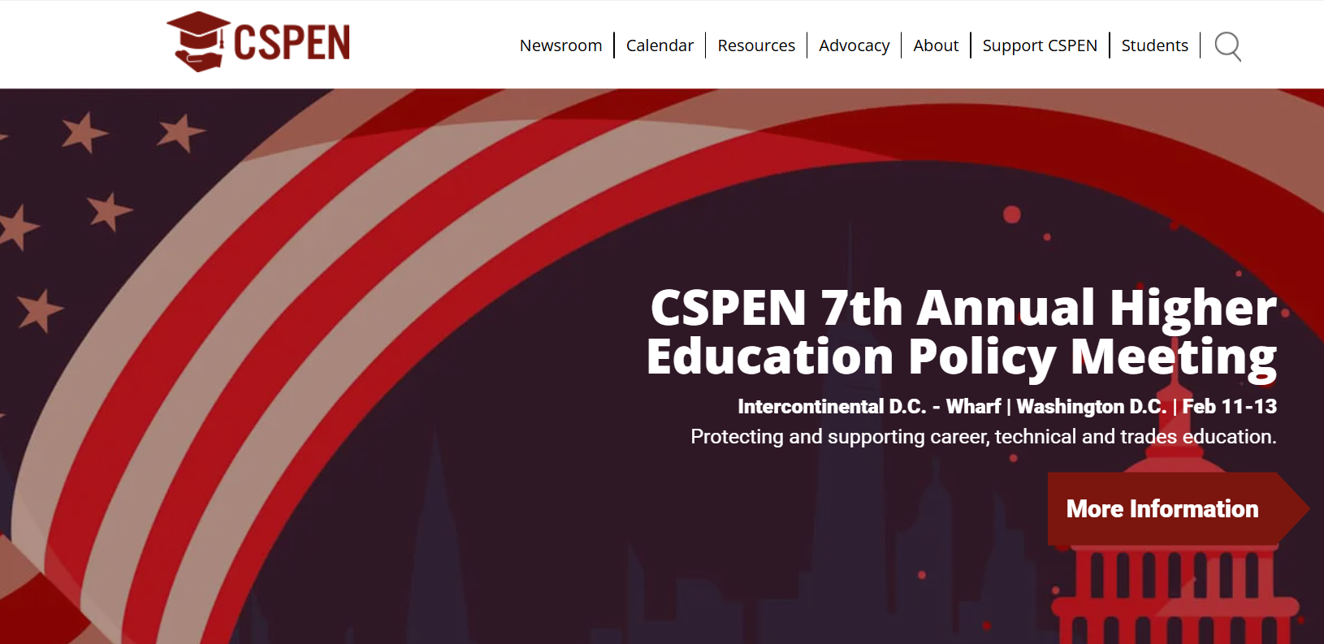
CSPEN 7th Annual HIGHER EDUCATION POLICY MEETING
https://cspen.com/

