Slide 1
Federal legislative & Regulatory Update
Thursday, May 15, 2025

Slide 2
AGENDA
Multiple Congress Hearings,
The Department of Education’s Motion on GE Litigation
&
Congressional Budget Reconciliation
Regulatory Update
President Trump’s Executive Orders
Legislative Update
Q&A

Slide 4
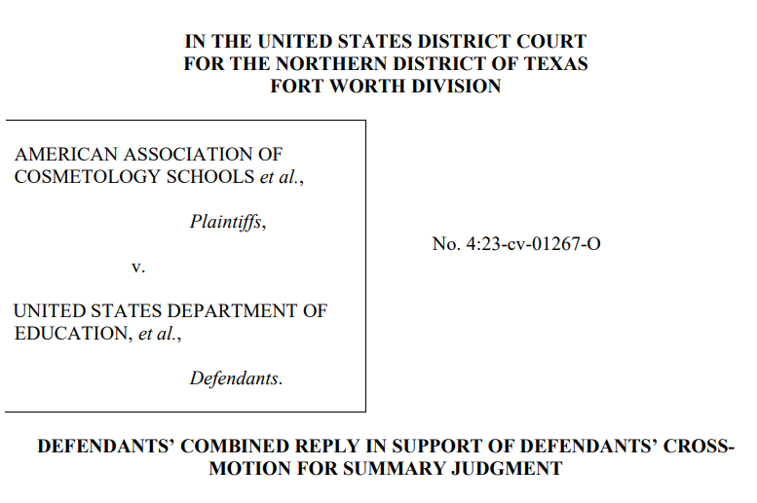
Gainful Employment Litigation Update

Slide 5
legislative UPDATE

Slide 7
SENATE HELP committee HEARING
Wednesday, May 21st

Slide 8
The State of Higher Education
CHAIRMAN CASSIDY’S OPENING STATEMENT
The American higher education system has lost its purpose. College students are not learning skills to succeed in the modern workforce. Studies show that the costs of college are quickly outpacing the value of students’ education.
In the last 30 years, tuition and fees at private non-profit colleges rose by 80 percent. At public four-year institutions, they’ve increased by 109 percent. Meanwhile, according to a nonpartisan analysis, 23 percent of bachelor’s degree programs and 43 percent of master’s degrees have a negative return on investment. This to say students pay more for their degrees than the increase in salaries they can expect.
This increased cost is not going to improve education. Instead, those dollars are being funneled to promote a DEI ideology, dividing students based on race and ethnicity. A report studying 65 colleges and universities found that the average institution was paying for 45 staff members to promote DEI policies. By the way, these programs are subsidized by taxpayers who contribute significant funding annually for universities.
https://www.help.senate.gov/rep/newsroom/press/chair-cassidy-delivers-remarks-during-hearing-on-state-of-higher-education

Slide 9
The State of Higher Education
CHAIRMAN CASSIDY’S OPENING STATEMENT
Instead of promoting academic excellence, many campuses have been ideologically captured; becoming hotbeds of hate and division. Students leave college woefully unprepared for the workforce while being saddled with insurmountable debt that they can’t pay back.
Comprehensive reform of higher education is needed. President Trump and Secretary McMahon are making progress, including fixing our broken student loan program. But, congressional action is needed to create lasting change.
Over the last several years, there have been multiple legislative efforts to improve higher ed to benefit students. This includes my bipartisan College Transparency Act, which allows students to compare the differences between prospective colleges and a major there to see if the value of the degree is worth the cost. I am leading this bill with Senator Warren.
https://www.help.senate.gov/rep/newsroom/press/chair-cassidy-delivers-remarks-during-hearing-on-state-of-higher-education

Slide 10
The State of Higher Education
CHAIRMAN CASSIDY’S OPENING STATEMENT
Senator Tuberville is leading the Graduate Opportunity and Affordable Loans (GOAL) Act to end Graduate PLUS loans, which have been inflationary to tuition costs. This bill puts downward pressure on rising college costs by limiting graduate school borrowing. There is also the Streamlining Accountability and Value in Education (SAVE) for Students Act, led by Senator Cornyn, which streamlines confusing repayment options for student loan borrowers from nine options to two; giving students and families clarity as to which repayment plan best fits their needs.
I look forward to discussing these and other policies in-depth today.
It is a given, but nonetheless, I will emphasize the power of education. It can transform lives, lifting not just the generation that attends out of poverty, but subsequent generations as well. It is a fountain of life-changing innovation and research, developing lifesaving cures and finding solutions to some of America’s biggest challenges.
https://www.help.senate.gov/rep/newsroom/press/chair-cassidy-delivers-remarks-during-hearing-on-state-of-higher-education

Slide 11
The State of Higher Education
CHAIRMAN CASSIDY’S OPENING STATEMENT
But when universities fail in their basic responsibility to ensure a safe learning environment; when students leave college in debt and without hope for a brighter future, the American people lose trust in higher ed.
There is no one who can advocate for higher education better than the institutions themselves. Universities must make the case to the American people as to why they are valuable to the nation and are worthy of taxpayer investment.
I thank Taylor University and Tuskegee University for being here. Rarely are HBCUs or religiously oriented universities mentioned in conversations about the landscape of and how to improve America’s higher education system. We will also hear from the Austin, TX Community College District, which offers an interesting perspective beyond traditional four-year universities.
https://www.help.senate.gov/rep/newsroom/press/chair-cassidy-delivers-remarks-during-hearing-on-state-of-higher-education

Slide 12
The State of Higher Education
CHAIRMAN CASSIDY’S OPENING STATEMENT
This is a great opportunity for all to share stories about the value you provide to students.
I’ll make one more comment. As I mentioned earlier, I think it's important that everyone has an opportunity to speak to the American people on this important topic. Every person and institution should have the right to make their case.
In light of that, I asked Harvard University to join today’s panel. Harvard University is world-famous for its cutting-edge research, which helps make not just our nation but the world healthier. But there have been recent episodes and a recent report on antisemitism embedded in Harvard’s culture. This would have been Harvard’s chance to tell the Committee and the country how it is addressing antisemitism, removing DEI from its university priorities; and highlight their value as a research institution. Unfortunately, they declined our invitation.
https://www.help.senate.gov/rep/newsroom/press/chair-cassidy-delivers-remarks-during-hearing-on-state-of-higher-education

Slide 13
The State of Higher Education
Andrew Gillen’s Testimony
The topic of this hearing is the state of higher education, and unfortunately the current state is the worst of my lifetime. Many are concerned about the value of higher education, the quality of the education provided relative to the cost, but many are also concerned about the values of higher education, the social and civic values it chooses to pass along to students and society.
The three areas Mr. Gillen focused upon were.
Affordability
Accountability
Innovation
https://www.help.senate.gov/imo/media/doc/2332dfe2-bb42-68d0-fb95-32cc6369563a/Gillen%20Testimony.pdf

Slide 14
The State of Higher Education
Andrew Gillen’s Testimony
Within the framework of each topic, Mr. Gillien provided a summary of the issue and proposals to address them.
For Affordability he suggested that “most of the aid takes the form of grants, loans, or tax benefits.”
He concludes that tax benefits should be eliminated.
That the “current loan system is badly designed. One of the main problems is that a substantial portion of this aid is harvested by colleges without making college more affordable. There is considerable evidence that colleges raise their prices and reduce institutional aid when federal financial aid is available. To address this issue he offers two recommendations:
Aid could be targeted only to low-income students who would otherwise not be able to afford to attend college; and
Aid programs should be capped.
https://www.help.senate.gov/imo/media/doc/2332dfe2-bb42-68d0-fb95-32cc6369563a/Gillen%20Testimony.pdf

Slide 15
The State of Higher Education
Andrew Gillen’s Testimony
Accountability
We know that accountability mechanisms can work. Of colleges sanctioned for having a Cohort Default Rate that was too high, 95% lost access to aid.8 And of the 38 programs at Vatterott College that failed the Obama administration’s gainful employment test, all were closed several years later. But while we technically have three accountability systems operating right now, none of them are effective. The first, Cohort Default Rates, is obsolete now that we use income driven repayment plans since such plans allow for $0 payments that don’t count as defaulting. The second, Gainful Employment regulations, are routinely implemented by Democratic administrations and are just as routinely scrapped by Republican administrations. The third, accreditation, has probably never been used. I don’t know of any college that has lost accreditation for being too expensive for students or losing too much taxpayer money.
https://www.help.senate.gov/imo/media/doc/2332dfe2-bb42-68d0-fb95-32cc6369563a/Gillen%20Testimony.pdf

Slide 16
The State of Higher Education
Andrew Gillen’s Testimony
Accountability
Focus on programs rather than institutions
Utilize labor market outcomes
Be applied universally rather than selectively
An accountability system should apply equally to all of higher education. There has been an unfortunate tendency with the Gainful Employment regulations to target only certain segments of higher education, notably the for-profit sector, while giving the vast majority of public and nonprofit higher education a free pass. But this is a fatal flaw in an accountability system because most failing programs were not located at for-profits. For example, applying the Obama administration’s gainful employment test to all of higher education revealed that only targeting for-profits would have missed “89% of failing programs and 73% of students graduating from a failing program.”
https://www.help.senate.gov/imo/media/doc/2332dfe2-bb42-68d0-fb95-32cc6369563a/Gillen%20Testimony.pdf

Slide 17
The State of Higher Education
Andrew Gillen’s Testimony
Accountability
4. Use both carrots and sticks Focus on programs rather than institutions
Accountability systems could use carrots too. In particular, high performing programs could earn performance bonuses or regulatory relief, including waivers of requirements to obtain accreditation and state authorization.
Use relative performance cutoffs instead of numerical cutoffs
Most accountability systems have used numerical cutoffs. For example, the Cohort Default Rate (CDR) has a cutoff of 30%, so a college with a CDR of 29.9% for three years has unlimited access to federal aid programs, whereas one with a CDR of 30% for three years loses all access to all aid programs. But it is difficult to determine a reasonable threshold, and historically, we’ve been too lenient. A CDR of 29% is still much too high to escape accountability.
https://www.help.senate.gov/imo/media/doc/2332dfe2-bb42-68d0-fb95-32cc6369563a/Gillen%20Testimony.pdf

Slide 18
The State of Higher Education
Andrew Gillen’s Testimony
Accountability
Use relative performance cutoffs instead of numerical cutoffs
A better approach would set thresholds of relative performance among programs (and combine this with
the use of carrots and sticks). Relative performance cutoffs are then determined based on a program’s
CDR relative to all other programs. Programs with the lowest CDRs could receive carrots, programs with
typical CDRs would receive neither carrots or sticks, and programs with the worst CDRs would receive
sticks. Tiers of three (each tier accounting for 33.33%), four (each tier accounting for 25%) or five (each
tier accounting for 20%) are simple, easy to understand, and provide opportunities to apply and scale
carrots and sticks.
https://www.help.senate.gov/imo/media/doc/2332dfe2-bb42-68d0-fb95-32cc6369563a/Gillen%20Testimony.pdf

Slide 19
The State of Higher Education
Andrew Gillen’s Testimony
Accountability
Use relative performance cutoffs instead of numerical cutoffs
The relative performance approach has several advantages over the numerical approach. To begin with,
it avoids the problem of choosing thresholds that are too stringent or too lenient. It also automatically
adjusts to common shocks. For example, when the economy enters a recession, CDRs might rise for all
programs, even if the quality remains unchanged. A numerical threshold would require Congressional
action to avoid becoming more stringent then intended, whereas the relative performance approach
would adjust to the recessionary environment automatically. Relative performance also encourages
continuous competition among programs – if a program’s peers improve, the program must improve too
to maintain its relative position.
https://www.help.senate.gov/imo/media/doc/2332dfe2-bb42-68d0-fb95-32cc6369563a/Gillen%20Testimony.pdf

Slide 20
The State of Higher Education
Andrew Gillen’s Testimony
Accountability
Use relative performance cutoffs instead of numerical cutoffs
The relative performance approach has several advantages over the numerical approach. To begin with,
it avoids the problem of choosing thresholds that are too stringent or too lenient. It also automatically
adjusts to common shocks. For example, when the economy enters a recession, CDRs might rise for all
programs, even if the quality remains unchanged. A numerical threshold would require Congressional
action to avoid becoming more stringent then intended, whereas the relative performance approach
would adjust to the recessionary environment automatically. Relative performance also encourages
continuous competition among programs – if a program’s peers improve, the program must improve too
to maintain its relative position.
https://www.help.senate.gov/imo/media/doc/2332dfe2-bb42-68d0-fb95-32cc6369563a/Gillen%20Testimony.pdf

Slide 21
The State of Higher Education
Andrew Gillen’s Testimony
Accountability
Earnings floors
Earnings floors would terminate aid eligibility for programs where students don’t earn enough. Floors are
easy to understand and would eliminate some of the most problematic underperforming programs. But
earnings floors ignore debt. Programs that just barely pass the floor but load students with excessive
student loan debt could have low or even negative returns while still passing an earnings floor test.
Earnings floors are certainly a good start, but they can’t do the job alone.
https://www.help.senate.gov/imo/media/doc/2332dfe2-bb42-68d0-fb95-32cc6369563a/Gillen%20Testimony.pdf

Slide 22
The State of Higher Education
Andrew Gillen’s Testimony
Accountability
Repayment rates
Repayment rates are arguably the most natural choice for an accountability mechanism for student loans. The main problem with using repayment rates is that there is very little information about current repayment rates, which would make setting reasonable numerical thresholds difficult. This can be overcome by using relative repayment rates, with programs with repayment rates above the median being rewarded with various carrots, while programs with repayment rates below the median face sticks of increasing severity.
https://www.help.senate.gov/imo/media/doc/2332dfe2-bb42-68d0-fb95-32cc6369563a/Gillen%20Testimony.pdf

Slide 23
The State of Higher Education
Andrew Gillen’s Testimony
Accountability
Gainful employment for all
Another option would be to apply gainful employment like debt to earnings tests across all of higher education. The metrics are familiar, and we’ll soon have almost all the data needed to implement this due to the Financial Value Transparency regulations. But it could be argued that GE arbitrarily defines excessive debt. Are the 8% and 20% cutoffs in the most recent version the right numbers? If we implement GE for all, I recommend scrapping the current numerical cutoffs and implementing relative performance thresholds instead. I would also recommend introducing carrots for high performing programs.
https://www.help.senate.gov/imo/media/doc/2332dfe2-bb42-68d0-fb95-32cc6369563a/Gillen%20Testimony.pdf

Slide 24
The State of Higher Education
Andrew Gillen’s Testimony
Accountability
Risk sharing
Risk sharing or skin in the game systems require colleges to reimburse the government when students fail to repay their loans. The best feature of these systems is that they align the college’s incentives with those of the students and government. A college can longer profit from offering an education the leaves the student and government worse off.
The main problem with risk sharing proposals is that they tend to hit sympathetic colleges hard. For example, community colleges tend to face high risk sharing payments because they are open access and many students drop out before graduating, leading to repayment problems. This can be addressed by introducing safe harbors or compensating funding, but this tends to make the system more complex.
https://www.help.senate.gov/imo/media/doc/2332dfe2-bb42-68d0-fb95-32cc6369563a/Gillen%20Testimony.pdf

Slide 25
The State of Higher Education
Andrew Gillen’s Testimony
Accountability
Risk sharing
For example, the House recently introduced a risk sharing system where colleges would be required to reimburse the government for a portion of losses when students fail to repay their loans. The reimbursement share essentially creates a safe harbor for community colleges, and the Promise grants provide additional funding to compensate for their remaining risk sharing payments.
Some argue that the risk sharing system proposed by the House is too complicated. This concern has some validity but is largely overstated. The House’s risk sharing metrics are no more complicated than the debt to earning metrics in gainful employment. The main GE formula is debt / earnings. The main risk sharing formula is earnings / price paid. These are comparable in their level of complication.
https://www.help.senate.gov/imo/media/doc/2332dfe2-bb42-68d0-fb95-32cc6369563a/Gillen%20Testimony.pdf

Slide 26
The State of Higher Education
Andrew Gillen’s Testimony
Accountability
Risk sharing
For example, the House recently introduced a risk sharing system where colleges would be required to reimburse the government for a portion of losses when students fail to repay their loans. The reimbursement share essentially creates a safe harbor for community colleges, and the Promise grants provide additional funding to compensate for their remaining risk sharing payments.
Some argue that the risk sharing system proposed by the House is too complicated. This concern has some validity but is largely overstated. The House’s risk sharing metrics are no more complicated than the debt to earning metrics in gainful employment. The main GE formula is debt / earnings. The main risk sharing formula is earnings / price paid. These are comparable in their level of complication.
https://www.help.senate.gov/imo/media/doc/2332dfe2-bb42-68d0-fb95-32cc6369563a/Gillen%20Testimony.pdf

Slide 27
The State of Higher Education
Andrew Gillen’s Testimony
Accountability
Risk sharing
Moreover, the House version could be amended to make is simpler. The risk sharing payments currently take government losses on a program’s loans (consisting of missed payments, waived interest, and forgiven loans) and then apply the reimbursement percentage based on earnings / price paid. But the reimbursement percentage could instead be based on relative performance of the government’s losses per student. One simple formula that would accomplish this is: reimbursement percentage = (program’s relative performance – 50%) * 2, with a cap at 0%. So the first 50% of programs that have the lowest government losses per student would have a 0% reimbursement percentage. The 51% program would have a reimbursement percentage of (51%-50%)*2 = 2%. The program with the highest government losses per student would have a reimbursement rate of (100%-50%)*2 = 100%. This would protect open access community colleges (since they tend to have low debt per student), while requiring risk sharing payments from the worst offenders.
https://www.help.senate.gov/imo/media/doc/2332dfe2-bb42-68d0-fb95-32cc6369563a/Gillen%20Testimony.pdf

Slide 28
The State of Higher Education
Andrew Gillen’s Testimony
Innovation
While individual professors and even departments or entire colleges can be quite innovative, the industry as a whole is remarkably stagnant. One of the primary drivers of this stagnation are government policies that suppress innovation, with accreditation being the key impediment.
Accreditation erects enormous barriers to entry for new colleges, which prevents new innovative colleges from emerging. Over 20 years, the seven largest accreditors approved only 9 new public four year colleges, less than one new college every two years.
https://www.help.senate.gov/imo/media/doc/2332dfe2-bb42-68d0-fb95-32cc6369563a/Gillen%20Testimony.pdf

Slide 29
The State of Higher Education
Andrew Gillen’s Testimony
Innovation
Accreditation also largely requires all colleges to use the traditional recipe of inputs and processes of existing colleges. If there are innovative models to deliver a higher quality and more affordable education, the accreditation system ensures that we won’t find and adopt it.
Unfortunately, the potential replacements for accreditation are likely even worse, so our best course of action is an overhaul of the accreditation system. The most important reforms are to increase competition among accreditors and to ensure that accreditation decisions are made based on outputs and outcomes rather than inputs and processes.
https://www.help.senate.gov/imo/media/doc/2332dfe2-bb42-68d0-fb95-32cc6369563a/Gillen%20Testimony.pdf

Slide 30
The State of Higher Education
Andrew Gillen’s Testimony
Innovation
Unfortunately, the potential replacements for accreditation are likely even worse, so our best course of
action is an overhaul of the accreditation system. The most important reforms are to increase competition among accreditors and to ensure that accreditation decisions are made based on outputs and outcomes rather than inputs and processes.
https://www.help.senate.gov/imo/media/doc/2332dfe2-bb42-68d0-fb95-32cc6369563a/Gillen%20Testimony.pdf

Slide 31
The State of Higher Education
TOPICS POSED DURING THE Q&A
Rising Cost of Higher Education
Federal Pell Grants
Parent PLUS
FVT/GE
https://www.help.senate.gov/imo/media/doc/2332dfe2-bb42-68d0-fb95-32cc6369563a/Gillen%20Testimony.pdf

Slide 32
APPROPTIATIONS subcommittee HEARING
Wednesday, May 21st

Slide 33
Secretary of Education Linda McMahon’s Testimony on Higher Education
Treating Postsecondary Education as an Investment in America’s Future
To better serve these high school graduates, the FY 2026 budget strengthens postsecondary education by prioritizing affordability, accountability, and opportunity while responsibly managing Federal resources. In it, we continue to support Pell Grants for low-income students and Career and Technical Education grants, aligning with this Administration’s vision— expressed in multiple executive orders—of postsecondary pathways that include both four-year college and non-college options, such as work-based learning and apprenticeship opportunities.
To rectify the disarray of our $1.6 trillion student loan portfolio, we are enforcing return-to repayment policies, not debt bailouts that drive up the cost of college. This effort involves working with the U.S. Department of Treasury to restart involuntary collections and proactively reaching out to struggling borrowers to help them get out—and stay out—of default. We will no longer allow borrowers to transfer their student loan debt to taxpayers. And, we are introducing cost savings by following the commonsense policy of excluding non-citizens from all forms of Federal higher education assistance.

Slide 34
Secretary of Education Linda McMahon’s Testimony on Higher Education
Treating Postsecondary Education as an Investment in America’s Future
Working with Congress and through executive action, we are also tackling the root causes of soaring college costs. We have begun a wholesale reform of higher education regulations through the negotiated rulemaking process to promote competition and innovation while ensuring institutions meet rigorous standards. Colleges must be transparent and accountable to students so they can ascertain whether a particular program will yield a good return on investment. Matching college costs with career outcomes and high-paying jobs will ensure that
the student loan portfolio does not slip into mass non-payment again in the future.

Slide 35
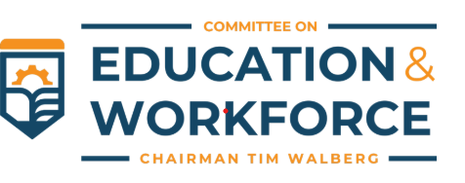
HOuse subcommittee HEARING
Wednesday, May 21st

Slide 36
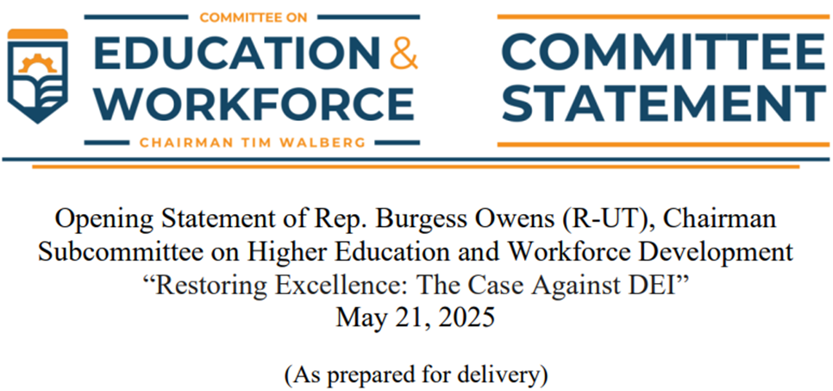
Subcommittee Chairman Owen’s Opening remarks

Slide 37
Subcommittee Chairman’s Owens Opening remarks
Whitewashing history. Creating a conservative boogeyman. Using a racist dog-whistle.
These are the Left’s accusations whenever Americans call out the toxic ideology known as “diversity, equity, and inclusion,” or D-E-I. DEI supporters promise it will break barriers, promote opportunity, and right our historical wrongs. It is an ideology that takes its inspiration from Karl Marx, who was honest in his vision of historical theft – “the first battleground is the rewriting of history.”
With its historical and philosophical roots nourished in the seedbed of Marxism, DEI states that our surrounding social construct determines our destiny. Not effort, tenacity, grit, dreams, or character but instead our ancestry, history, and color. Demeaning and racist to its core, DEI claims that based on your color, you are either an evil oppressor or a hopeless, hapless, weak and oppressed victim. It teaches that all societal ills can be traced to an oppressor – a segment of people to which prejudice and hate is always justified. We see the results of this teaching on our college campuses throughout our country where Jews are placed, by Marxist professors, at the very top of its “oppressor” spectrum. Antisemitism therefore runs rampant and unashamed.

Slide 38
Subcommittee Chairman’s Owens Opening remarks
The vision of our educational institutions, from our country’s founding, has been to prepare every succeeding generation to be wise stewards of our nation’s commitment to become a more perfect union.
Despite the Supreme Court ruling against affirmative action, it appears universities are still playing semantic word games with their admissions processes. They are continuing to discriminate against students based on their race but under different names. DEI adherence in these institutions continues to be a large factor in staff promotion and tenure and continues to feed the lack of ideological diversity among faculty. Students are forced to participate in DEI programming in order to graduate. Accreditors, instead of holding institutions accountable for student outcomes, are imposing on them DEI requirements.
The most disastrous outcome of this divisive ideology is the impact it’s had on the low-income, “underrepresented” populations that Democrats claim to care about. As college costs remain sky high, self-confidence drops to a new low, and students often leave worse off than if they had never attended in the first place. In the strongholds of DEI, students are left to doubt whether their personal accomplishments are due to their merit or to their skin color.

Slide 39
Subcommittee Chairman’s Owens Opening remarks
There is no worse area for DEI than in medical education. Instead of a focus on the best medical care for each patient, health care disparities are quickly blamed on “oppression.” The DEI “solution” therefore to discrimination is more discrimination resulting in racist health care policies that in the real world have life and death consequences. From day one the Trump administration has taken a strong stance against DEI, recognizing that it is contrary to the American ideals of hard work, merit, and equality. This administration has undone countless discriminatory Biden-Harris executive orders and worked to ensure DEI has no place in our universities.
I’m excited to see states across the country, including my home state of Utah, work to end this evil presence.
To the institutions who believe you can simply change the name of your DEI offices and continue to teach hatred and discrimination – as a heads up – this Committee will not be silent.
We owe it to the next generation to teach them that due to our American DNA based on faith, family, the free market, and education, there are always reasons to be hopeful and never hopeless. I look forward to our
discussion today, and with that I yield to the Ranking Member.

Slide 40
HOuse subcommittee HEARING
Tuesday, May 20th

Slide 41
Budget reconciliation

Slide 44
Nominees FOR KEY DEPARTMENT OF EDUCATION POSIITONS In TODAY”S CONFIRMATION HEARING
Nicholas Kent

Slide 45
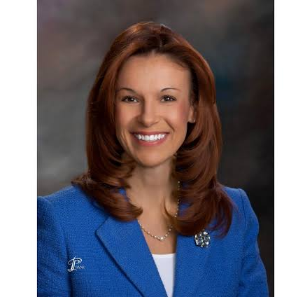
Nominees FOR KEY DEPARTMENT OF EDUCATION POSIITONS In TODAY”S CONFIRMATION HEARING
Kirsten Baesler

Slide 46
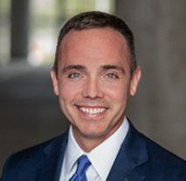
Nominees FOR KEY DEPARTMENT OF EDUCATION POSIITONS In TODAY”S CONFIRMATION HEARING
Kevin O’Farrell

Slide 47
What could be next?

Slide 48
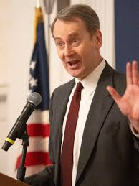
Nominee to assume the role of Assistant Secretary of postsecondary education
DAVID BARKER

Slide 49
REGULATORY UPDATE

Slide 51
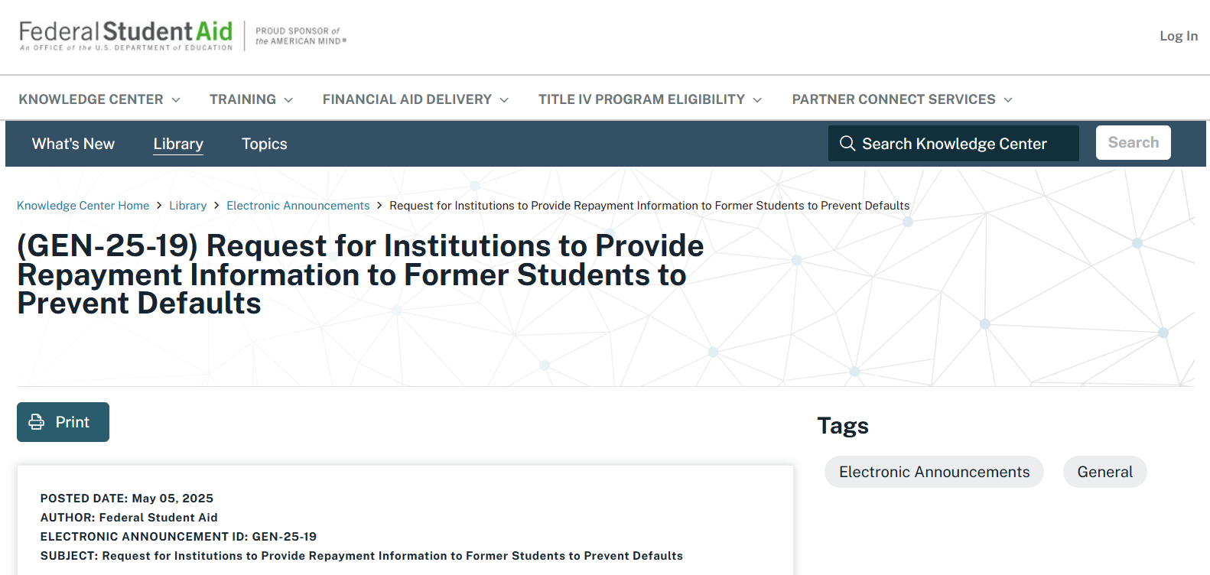
https://fsapartners.ed.gov/knowledge-center/library/electronic-announcements/2025-05-05/request-institutions-provide-repayment-information-former-students-prevent-defaults

Slide 52
student loan repayment
May 5, 2025
Overview
The United States faces critical challenges related to the federal student loan programs. According to estimates from the U.S. Department of Education (Department), only 38% of Direct Loan and Department-held Federal Family Education Loan Program borrowers are in repayment and current on their student loans. We also estimate that almost 25% of the entire portfolio is either in default or a late stage of delinquency.
Given these challenges, the Department is taking immediate steps to engage student borrowers and support the repayment of their federal student loans. As announced in an April 21, 2025, press release, today, the Department will resume collections on its defaulted federal student loan portfolio with the restart the Treasury Offset Program and, later this summer, Administrative Wage Garnishment. The Department has also initiated an outreach campaign to remind all borrowers of their repayment obligations and provide resources and support to assist them in selecting the best repayment plan for their circumstances. The Department has also launched an enhanced income-driven repayment (IDR) plan process, simplifying how borrowers enroll in IDR plans and eliminating the need for many borrowers to manually recertify their income each year.
https://fsapartners.ed.gov/knowledge-center/library/electronic-announcements/2025-05-05/request-institutions-provide-repayment-information-former-students-prevent-defaults

Slide 53
student loan repayment
May 5, 2025
Role of Institutions in Loan Repayment
Maintaining the integrity of the Title IV, Higher Education Act of 1965 (HEA) loan programs has always been a shared responsibility among student borrowers, the Department, and participating institutions. Although borrowers have the primary responsibility for repaying their student loans, institutions play a key role in the Department’s ongoing efforts to improve loan repayment outcomes, especially as the cost of college set solely by institutions has continued to skyrocket. Institutions are responsible for providing clear and accurate information about repayment to borrowers through entrance and exit counseling, and colleges and universities are responsible for disclosing annual tuition and fees and the net price to students and their families on the costs of a postsecondary education. The financial aid community has demonstrated its commitment to providing direct advice and counsel to students regarding their borrowing, but institutions must refocus and expand these efforts as pandemic flexibilities come to an end.
https://fsapartners.ed.gov/knowledge-center/library/electronic-announcements/2025-05-05/request-institutions-provide-repayment-information-former-students-prevent-defaults

Slide 54
student loan repayment
May 5, 2025
Role of Institutions in Loan Repayment
Under section 435 of the HEA, institutions are required to keep their cohort default rates (CDR) low and will lose eligibility for federal student assistance, including Pell Grants and federal student loans, if their CDR exceeds 40% for a single year or 30% for three consecutive years. The Department reminds institutions that the repayment pause on student loans ended in October 2023, and CDRs published in 2026 will include borrowers who entered repayment in 2023 and defaulted in 2023, 2024, or 2025. The Department further reminds institutions that those borrowers whose delinquency or default status was reset in September 2024 could enter technical default status / be delinquent on their loans for more than 270 days beginning in June and default this summer. As such, we strongly urge all institutions to begin proactive and sustained outreach to former students who are delinquent or in default on their loans to ensure that such institutions will not face high CDRs next year and lose access to federal student aid.
https://fsapartners.ed.gov/knowledge-center/library/electronic-announcements/2025-05-05/request-institutions-provide-repayment-information-former-students-prevent-defaults

Slide 55
student loan repayment
May 5, 2025
Outreach to Former Students to Prevent Defaults
Given the urgent need to ensure that more student borrowers enter repayment and stay current on their loans, the Secretary urges each participating institution to provide the following information to all borrowers who ceased to be enrolled at the institution since January 1, 2020, and for whom they have contact information:
Remind the borrower that he or she is obligated to repay any federal student loans that have not been repaid and are not in deferment or forbearance;
Suggest that the borrower review information on StudentAid.gov about repayment options; and
Request that the borrower log into StudentAid.gov using their StudentAid.gov username and password to update their profile with current contact information and ensure that their loans are in good standing.
https://fsapartners.ed.gov/knowledge-center/library/electronic-announcements/2025-05-05/request-institutions-provide-repayment-information-former-students-prevent-defaults

Slide 56
student loan repayment
May 5, 2025
Outreach to Former Students to Prevent Defaults
The Department urges that this outreach be performed no later than June 30, 2025. We do not stipulate how institutions reach out to borrowers, nor the specific information provided, as long as it covers the three categories described above.
We also encourage institutions to focus their initial outreach on students who are delinquent on one or more of their loans in order to prevent defaults. We will provide additional information in the future to assist schools with identifying and communicating with these borrowers.
https://fsapartners.ed.gov/knowledge-center/library/electronic-announcements/2025-05-05/request-institutions-provide-repayment-information-former-students-prevent-defaults

Slide 57
student loan repayment
May 5, 2025
Publishing Loan Non-Repayment by Institutions
The Department is committed to overseeing the federal student loan programs with fairness and integrity for students, institutions, and taxpayers. To that end, the Department believes that greater transparency is needed regarding institutional success in counseling borrowers and helping them get into good standing on their loans.
The Department maintains data on the repayment status of federal student loan borrowers and in the past has provided information in the College Scorecard about the status of each institution’s borrowers at several intervals after they enter repayment. The Department plans to use this data to calculate rates of nonpayment by institution and will publish this information on the Federal Student Aid Data Center later this month. The Department will provide more information about this publication process soon.
Thank you for your continued efforts to maintain the integrity of the Title IV, HEA loan programs. The Department values its institutional partners and looks forward to continued collaboration to place borrowers on the path to sustainable repayment of their loans.
https://fsapartners.ed.gov/knowledge-center/library/electronic-announcements/2025-05-05/request-institutions-provide-repayment-information-former-students-prevent-defaults

