Slide 1


Federal legislative
&
Regulatory
Update
Thursday, July 10, 2025

Slide 2
AGENDA
On-going Assessment of H.R. 1 – The One Big Beautiful Bill Act, As Amended
&
Important Regulatory Directives Coming from the Department
Legislative Update
Regulatory Update
Q&A

Slide 3



legislative
UPDATE

Slide 4
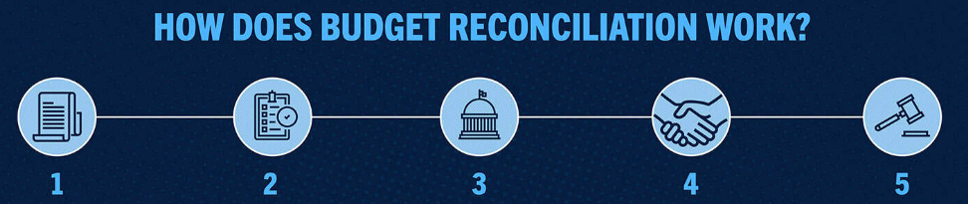
Budget reconciliation

Slide 5




Slide 6
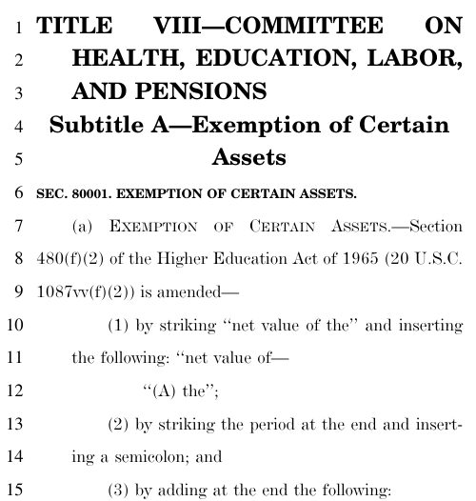
FINAL
Budget RECONCILIATION
HIGHER EDUCATION
PROVISIONS

Slide 7
TITLE VIII - SENATE LABOR, HHS, EDUCATION & RELATED AGENCIES
Final BUDGET RECONCILIATION PROPOSALS
SECTION-BY-SECTION – Subtitle A—Student Eligibility
Sec. 80001. Exemption of Farm and Small Business Assets
Farm fix: Exclude farm, small business, and fishing business assets from aid eligibility formula

Slide 8
TITLE VIII - SENATE LABOR, HHS, EDUCATION & RELATED AGENCIES
Final BUDGET RECONCILIATION PROPOSALS
SECTION-BY-SECTION – Subtitle B—Loan Limits
Sec. 81001. Establishment of Loan Limits
Cap graduate lending:
  Eliminate Grad PLUS loans and cap unsubsidized graduate (e.g., masters) borrowing at $20,500 per year ($100,000 lifetime) and professional (e.g., law, medicine) borrowing at $50,000 per year ($200,000 lifetime); graduate limits are in addition to undergraduate limits
Cap parent borrowing:
  Cap loans to parents of undergraduates (parent PLUS) at $20,000 per student per year ($65,000 per student lifetime); (parents can borrow for multiple students)
Prorate loans:
  Set lower limits for part-time students (e.g., half-time student eligible for half the maximum loan); this aligns with how the Pell Grant is distributed
Institutional discretion:
Allow institutions to set lower loan limits as long as they do so consistently within programs

Slide 9
TITLE VIII - SENATE LABOR, HHS, EDUCATION & RELATED AGENCIES
Final BUDGET RECONCILIATION PROPOSALS
SECTION-BY-SECTION – Subtitle C—Loan Repayment
Sec. 82001. Loan Repayment
Simplify repayment for new borrowers:
  Loans made starting July 1, 2026, can be repaid using only two plans: a new standard plan and one of three income-driven repayment (IDR) plans through July 1, 2026; including a new Repayment Assistance Plan. After July 1, 2026 there will be two repayment options:
  New standard plan: borrowers make fixed payments for 10-25 years based on amount borrowed
  Repayment Assistance Plan: New income-driven plan where payments are 1-10% of income depending on income level, with a minimum monthly payment of $10; payments are reduced by $50 per dependent; borrowers who make on-time payments always see their balance go down, as unpaid interest is waived and there is a principal match of up to $50; any remaining balance is forgiven after 30 years
Streamline income-driven repayment for existing borrowers:
  Beginning July 1, 2028, existing borrowers (with loans taken before July 1, 2026) will have access to the Repayment Assistance Plan and the income-based repayment (IBR) plan created by Congress; under IBR, pre-2014 borrowers pay 15% of discretionary income (income above 150% of the Federal Poverty Line) with forgiveness after 25 years; post-2014 borrowers pay 10% of discretionary income with forgiveness after 20 years

Slide 10
TITLE VIII - SENATE LABOR, HHS, EDUCATION & RELATED AGENCIES
Final BUDGET RECONCILIATION PROPOSALS
SECTION-BY-SECTION – Subtitle C—Loan Repayment
Sec. 82002. Deferment and Forbearance
Streamline deferments:
  Sunset economic hardship and unemployment deferments effective July 1, 2027, to encourage borrowers to use options (such as income-driven repayment) that are better for them
Limit forbearances:
  Limit availability of discretionary forbearances to no more than 9 months during any 24-month period beginning after July 1, 2027
Sec. 82003. Loan Rehabilitation
Loan rehabilitation:
  Beginning on July 1, 2027, allow borrowers to rehabilitate defaulted loans twice instead of once; set required monthly payment for rehabilitation at $10 instead of $5

Slide 11
TITLE VIII - SENATE LABOR, HHS, EDUCATION & RELATED AGENCIES
Final BUDGET RECONCILIATION PROPOSALS
SECTION-BY-SECTION – Subtitle C—Loan Repayment
Sec. 82004. Public Service Loan Forgiveness
Repayment Assistance Plan:
  Allow payments made under the Repayment Assistance Plan to count toward PSLF eligibility
Sec. 82005. Student Loan Servicing
Additional funds:
  Provide funds to the Department of Education $1,000,000,000 for costs associated with returning borrowers back into repayment on their loans and to help with the costs of building the new repayment plans; the funds are available until expended

Slide 12
TITLE VIII - SENATE LABOR, HHS, EDUCATION & RELATED AGENCIES
Final BUDGET RECONCILIATION PROPOSALS
SECTION-BY-SECTION – Subtitle D—Pell Grants
Sec. 83001. Eligibility
Foreign income:
  Require foreign income to be included in the income calculation for the purposes of calculating Pell Grant eligibility
Exclusion of higher-income families:
  Exclude families with a Student Aid Index more than twice the maximum Pell grant from receiving Pell
Sec. 83002. Workforce Pell
Workforce Pell Grants:
  Beginning with the award year of July 1, 2026, expand eligibility for Pell Grants to students enrolled in short-term (150 599 clock hours), high-quality, workforce aligned programs; include guardrails for student outcomes including earnings, completion rates, and job placement rates; limited to accredited institutions

Slide 13
TITLE VIII - SENATE LABOR, HHS, EDUCATION & RELATED AGENCIES
Final BUDGET RECONCILIATION PROPOSALS
SECTION-BY-SECTION – Subtitle D—Pell Grants
Sec. 83003. Pell Shortfall
Reduce shortfall:
  Provide $10,500,000,000 additional funding for the Pell Grant program in FY26 to address the funding shortfall
Sec. 83004. Limits for Students with Full Scholarships
Limit Pell for full-ride Students:
  Beginning on July 1, 2026 exclude students receiving full cost-of-attendance scholarships from Pell eligibility

Slide 14
TITLE VIII - SENATE LABOR, HHS, EDUCATION & RELATED AGENCIES
Final BUDGET RECONCILIATION PROPOSALS
SECTION-BY-SECTION – Subtitle E—Accountability
Sec. 84001. Ineligibility Based on Low Earning Outcomes
Establish “do no harm” standard:
  End federal loan eligibility for programs that leave students worse off than if they had never gone
  Prohibit new federal student loans from paying for undergraduate degree programs where the majority of completers earn less than the median high school graduate in the same state
  Prohibit new federal student loans from paying for graduate programs where the majority of completers earn less than the median bachelor’s degree recipient in the same field in the same state
  Programs lose eligibility if they fail to meet the standard for two years in a three-year period.

Slide 15
TITLE VIII - SENATE LABOR, HHS, EDUCATION & RELATED AGENCIES
Final BUDGET RECONCILIATION PROPOSALS
SECTION-BY-SECTION – Subtitle F—Regulatory Relief
Sec. 85001. Borrower Defense to Repayment
Rule Delay:
  Delay Biden expansion of Borrower Defense to Repayment regulation for 10 years, restoring regulation from first Trump Administration
Sec. 85002. Closed School Discharge
Rule Delay:
  Delay Biden expansion of Closed School Discharge regulation for 10 years, restoring regulation from first Trump Administration

Slide 16
SENATE LABOR, HHS, EDUCATION & RELATED AGENCIES BUDGET RECONCILIATION PROPOSAL
SECTION-BY-SECTION – Subtitle G—Limitation on Authority
Sec. 86001. Limit Authority to Issue Regulations
Limit authority:
  Restrict the Secretary of Education’s ability to issue regulations and executive actions that increase costs, or subsidies, in the Federal Student Aid programs

Slide 17


Slide 18
SENATE LABOR, HHS, EDUCATION & RELATED AGENCIES BUDGET RECONCILIATION PROPOSAL
Section 84001—Ineligibility Based on Low Earnings Outcomes
(c) INELIGIBILITY FOR CERTAIN PROGRAMS BASED ON LOW EARNING OUTCOMES.—
IN GENERAL.—Notwithstanding section 481(b), an institution of higher education subject to this subsection shall not use funds under this part for student enrollment in an educational program of offered by the institution that is described in paragraph (2).
(2) LOW-EARNING OUTCOME PROGRAMS DESCRIBED.—
An educational program at an institution is described in this paragraph if the program awards an undergraduate degree, graduate or professional degree, or graduate certificate, for which the median earnings (as determined by the Secretary) of the
programmatic cohort of students who received funds under this title for enrollment in such program, who completed such program during the academic year that is 4 years before the year of the determination, who are not enrolled in any institution of higher education, and who are working, are, for not less than 2 of the 3 years immediately preceding the date of the determination, less than the median earnings of a working adult described in paragraph (3) for the corresponding year.

Slide 19
SENATE LABOR, HHS, EDUCATION & RELATED AGENCIES BUDGET RECONCILIATION PROPOSAL
Section 84001—Ineligibility Based on Low Earnings Outcomes
(c) INELIGIBILITY FOR CERTAIN PROGRAMS BASED ON LOW EARNING OUTCOMES.—
(3) CALCULATION OF MEDIAN EARNINGS.—
WORKING ADULT.—
For purposes of applying paragraph (2) to an educational pro gram at an institution, a working adult described in this paragraph is a working adult who, for the corresponding year—
  (i) is aged 25 to 34;
  (ii) is not enrolled in an institution of higher education; and
  (iii)(I) in the case of a determination made for an educational program that awards a baccalaureate or lesser degree, has only a high school diploma or its recognized equivalent; or
  (II) in the case of a determination made for a graduate or professional program, has only a baccalaureate degree.

Slide 20
SENATE LABOR, HHS, EDUCATION & RELATED AGENCIES BUDGET RECONCILIATION PROPOSAL
Section 84001—Ineligibility Based on Low Earnings Outcomes
(c) INELIGIBILITY FOR CERTAIN PROGRAMS BASED ON LOW EARNING OUTCOMES.—
(3) CALCULATION OF MEDIAN EARNINGS.—
(B) SOURCE OF DATA.—
For purposes of applying paragraph (2) to an educational program at an institution, the median earnings of a working adult, as described in subparagraph (A), shall be based on data from the Bureau of the Census—
(i) with respect to an educational program that awards a baccalaureate or lesser degree—
  for the State in which the institution is located; or
  if fewer than 50 percent of the students enrolled in the institution reside in the State where the institution is located, for the entire United States; and

Slide 21
SENATE LABOR, HHS, EDUCATION & RELATED AGENCIES BUDGET RECONCILIATION PROPOSAL
Section 84001—Ineligibility Based on Low Earnings Outcomes
(c) INELIGIBILITY FOR CERTAIN PROGRAMS BASED ON LOW EARNING OUTCOMES.—
(3) CALCULATION OF MEDIAN EARNINGS.—
(B) SOURCE OF DATA.—
For purposes of applying paragraph (2) to an educational program at an institution, the median earnings of a working adult, as described in subparagraph (A), shall be based on data from the Bureau of the Census—
(ii) with respect to an educational program that is a graduate or professional program—
  (I) for the lowest median earnings of—
    (aa) a working adult in the State in which the institution is located;
    (bb) a working adult in the same field of study (as deter mined by the Secretary, such as by using the 2-digit CIP code) in
    the State in which the institution is located; and
    (cc) a working adult in the same field of study (as so determined) in the entire United States; or

Slide 22
SENATE LABOR, HHS, EDUCATION & RELATED AGENCIES BUDGET RECONCILIATION PROPOSAL
Section 84001—Ineligibility Based on Low Earnings Outcomes
(c) INELIGIBILITY FOR CERTAIN PROGRAMS BASED ON LOW EARNING OUTCOMES.—
(3) CALCULATION OF MEDIAN EARNINGS.—
(B) SOURCE OF DATA.—
For purposes of applying paragraph (2) to an educational program at an institution, the median earnings of a working adult, as described in subparagraph (A), shall be based on data from the Bureau of the Census—
(ii) with respect to an educational program that is a graduate or professional program—
  (II) if fewer than 50 percent of the students enrolled in the institution reside in the State where the institution is located, for the lower median earnings of—
    (aa) a working adult in the entire United States; or
    (bb) a working adult in the same field of study (as so determined) in the entire United States.

Slide 23
SENATE LABOR, HHS, EDUCATION & RELATED AGENCIES BUDGET RECONCILIATION PROPOSAL
Section 84001—Ineligibility Based on Low Earnings Outcomes
(c) INELIGIBILITY FOR CERTAIN PROGRAMS BASED ON LOW EARNING OUTCOMES.—
(4) SMALL PROGRAMMATIC COHORTS.—
For any year for which the programmatic cohort described in paragraph (2) for an educational program of an institution is fewer than 30 individuals, the Secretary shall—
(A) first, aggregate additional years of programmatic data in order to achieve a cohort of at least 30 individuals; and
(B) second, in cases in which the cohort (including the individuals added under subparagraph (A)) is still fewer than 30 individuals, aggregate additional cohort years of programmatic data for educational programs of equivalent length in order to achieve a cohort of at least 30 individuals.

Slide 24
SENATE LABOR, HHS, EDUCATION & RELATED AGENCIES BUDGET RECONCILIATION PROPOSAL
Section 84001—Ineligibility Based on Low Earnings Outcomes
(c) INELIGIBILITY FOR CERTAIN PROGRAMS BASED ON LOW EARNING OUTCOMES.—
(5) APPEALS PROCESS.—
An educational program shall not lose eligibility under this subsection unless the institution has had the opportunity to ap
peal the programmatic median earnings of students working and not enrolled determination under paragraph (2), through a process established by the Secretary. During such appeal, the Secretary may permit the educational program to continue to participate in the program under this part.

Slide 25
SENATE LABOR, HHS, EDUCATION & RELATED AGENCIES BUDGET RECONCILIATION PROPOSAL
Section 84001—Ineligibility Based on Low Earnings Outcomes
(c) INELIGIBILITY FOR CERTAIN PROGRAMS BASED ON LOW EARNING OUTCOMES.—
(6) NOTICE TO STUDENTS.—
(A) IN GENERAL.—If an educational program of an institution of higher education subject to this subsection does not meet the cohort median earning requirements, as described in paragraph (2), for one year during the applicable covered period but has not yet failed to meet such requirements for 2 years during such covered period, the institution shall promptly inform each student enrolled in the educational program of the eligible program’s low cohort median earnings and that the educational pro
gram is at risk of losing its eligibility for funds under this part.
‘‘(B) COVERED PERIOD.—
In this para graph, the term ‘covered period’ means the period of the 3 years immediately preceding the date of a determination made under paragraph (2).

Slide 26
SENATE LABOR, HHS, EDUCATION & RELATED AGENCIES BUDGET RECONCILIATION PROPOSAL
Section 84001—Ineligibility Based on Low Earnings Outcomes
(c) INELIGIBILITY FOR CERTAIN PROGRAMS BASED ON LOW EARNING OUTCOMES.—
(7) REGAINING PROGRAMMATIC ELIGIBILITY.—
The Secretary shall establish a process by which an institution of higher education that has an educational program that has lost eligibility under this subsection may, after a period of not less than 2 years of such program’s ineligibility, apply to re
gain such eligibility, subject to the requirements established by the Secretary that further the purpose of this subsection.’’.

Slide 27
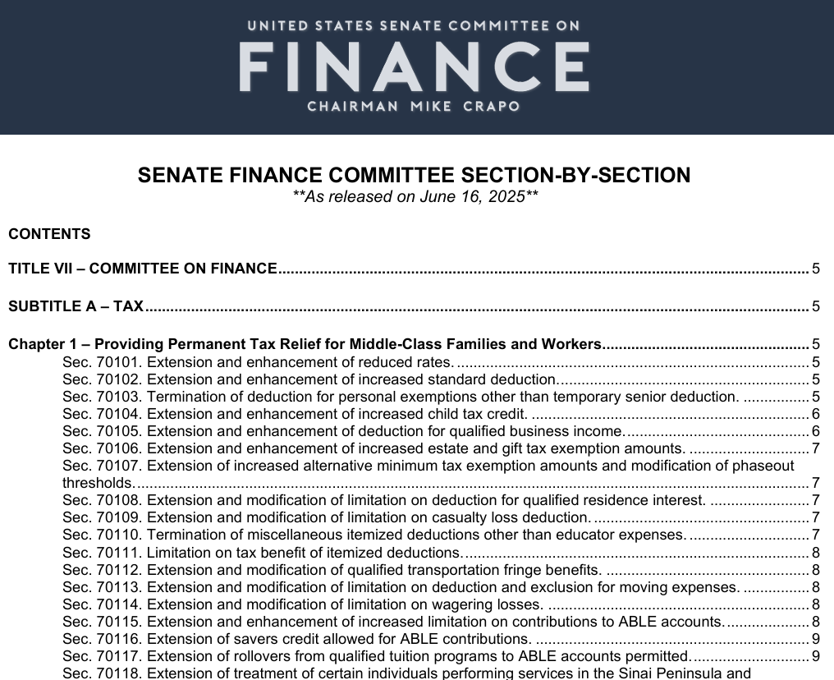
FINAL
Budget RECONCILIATION
HIGHER EDUCATION
PROVISIONS

Slide 28
SENATE FINANCE reconciliation PROPOSAL
Title VII – COMMITTEE ON FINANCE
SUBTITLE A - TAX
Chapter 1 – Providing Permanent Tax Relief for Middle Class Families and Workers
Section 70101. Extension and enhancement of reduced rates.
This provision makes permanent the modified federal income tax bracket schedule and lower tax rates created by the Tax Cuts and Jobs Act. The provision also adds an additional year of inflation adjustment to the 10 percent, 12 percent and 22 percent brackets.
Section 70102. Extension and enhancement of increased standard deduction
This provision makes permanent the nearly doubled standard deduction created by the Tax Cuts and Jobs Act. Additionally, for taxable years beginning after 2025, the standard deduction is increased to $16,000 for a single filer, $24,000 for a head of household and $32,000 for married individuals filing jointly and adjusted for inflation thereafter.
Finance Committee Section-by-Section Title VII

Slide 29
SENATE FINANCE reconciliation PROPOSAL
Title VII – COMMITTEE ON FINANCE
SUBTITLE A - TAX
Chapter 1 – Providing Permanent Tax Relief for Middle Class Families and Workers
Section 70103. Termination of deduction for personal exemptions other than temporary senior deduction
This provision permanently reduces the deduction for personal exemptions to zero and temporarily adds a deduction for seniors of $6,000 for each qualified individual. The senior deduction begins to phase out when the taxpayer’s modified adjusted gross income exceeds $75,000 ($150,000 in the case of a joint return). A qualified individual means a taxpayer who has attained age 65 (and in the case of a joint return, the taxpayer’s spouse, if such spouse has attained age 65). No senior deduction is allowed unless the qualified individual includes his or her social security number (SSN) on the tax return for the tax year (and if the qualified individual is married, such tax return must also include the SSN of such individual’s spouse). The senior deduction is allowed for taxable years 2025 through 2028.
Finance Committee Section-by-Section Title VII

Slide 30
SENATE FINANCE reconciliation PROPOSAL
Title VII – COMMITTEE ON FINANCE
SUBTITLE A - TAX
Chapter 1 – Providing Permanent Tax Relief for Middle Class Families and Workers
Section 70104. Extension and enhancement of increased child tax credit.
This provision makes permanent the doubled child tax credit of $2,000 per child and also makes permanent the refundable child tax credit of $1,400, adjusted for inflation ($1,700 in 2025). It also makes permanent the increased income phase-out threshold amounts of $200,000 ($400,000 in the case of a joint return), as well as the $500 nonrefundable credit for each dependent of the taxpayer other than a qualifying child.
Additionally, this provision permanently increases the nonrefundable child tax credit to $2,200 per child beginning in tax year 2025 and also permanently indexes the nonrefundable credit amount for inflation beginning after tax year 2025 (rounded down to the nearest $100).
Further, the requirement that the child’s SSN be provided for purposes of claiming the credit is made permanent and expanded upon to require the taxpayer’s SSN and, for joint filers, at least one of the spouse’s SSNs, in order to claim the credit. The SSNs provided must be considered work-eligible in order to claim the credit.
Finance Committee Section-by-Section Title VII

Slide 31
SENATE FINANCE reconciliation PROPOSAL
Title VII – COMMITTEE ON FINANCE
SUBTITLE A - TAX
Chapter 1 – Providing Permanent Tax Relief for Middle Class Families and Workers
Section 70105. Extension and enhancement of deduction for qualified business income.
This provision makes the deduction for qualified business income permanent.
This provision also expands the deduction limit phase-in range by increasing the $50,000 (non-joint returns) and $100,000 (joint returns) amounts to $75,000 and $150,000, respectively. The provision eases the impact of the limitations for both SSTBs and those pass-through entities subject to the wage and investment limitation.
Additionally, this provision introduces a new, inflation-adjusted, minimum deduction of $400 for taxpayers who have at least $1,000 of QBI from one or more active trades or businesses in which the taxpayer materially participates. This ensures small business owners with a certain QBI level are entitled to an enhanced baseline deduction.
Finance Committee Section-by-Section Title VII

Slide 32
SENATE FINANCE reconciliation PROPOSAL
Title VII – COMMITTEE ON FINANCE
SUBTITLE A - TAX
Chapter 1 – Providing Permanent Tax Relief for Middle Class Families and Workers
Section 70106. Extension and enhancement of increased estate and gift tax exemption amounts.
This provision permanently extends the estate and lifetime gift tax exemption, increases the exemption amount to $15 million for single filers ($30 million for married filing jointly) in 2026 and indexes the exemption amount for inflation thereafter.
Section 70107. Extension of increased alternative minimum tax exemption amounts and modification of phaseout thresholds.
This provision permanently extends the increased individual alternative minimum tax exemption amounts and reverts the exemption phaseout thresholds to 2018 levels of $500,000 ($1,000,000 in the case of a joint return), indexed for inflation thereafter.
Finance Committee Section-by-Section Title VII

Slide 33
SENATE FINANCE reconciliation PROPOSAL
Title VII – COMMITTEE ON FINANCE
SUBTITLE A - TAX
Chapter 1 – Providing Permanent Tax Relief for Middle Class Families and Workers
Section 70106. Extension and enhancement of increased estate and gift tax exemption amounts.
This provision permanently extends the estate and lifetime gift tax exemption, increases the exemption amount to $15 million for single filers ($30 million for married filing jointly) in 2026 and indexes the exemption amount for inflation thereafter.
Section 70107. Extension of increased alternative minimum tax exemption amounts and modification of phaseout thresholds.
This provision permanently extends the increased individual alternative minimum tax exemption amounts and reverts the exemption phaseout thresholds to 2018 levels of $500,000 ($1,000,000 in the case of a joint return), indexed for inflation thereafter.
Finance Committee Section-by-Section Title VII

Slide 34
SENATE FINANCE reconciliation PROPOSAL
Title VII – COMMITTEE ON FINANCE
SUBTITLE A - TAX
Chapter 1 – Providing Permanent Tax Relief for Middle Class Families and Workers
Section 70108. Extension and modification of limitation on deduction for qualified residence interest.
This provision permanently lowers the deduction for qualified residence interest to the first $750,000 in home mortgage acquisition debt and the exclusion of interest on home equity indebtedness from the definition of qualified residence interest is made permanent. Additionally, the provision treats certain mortgage insurance premiums on acquisition indebtedness as qualified residence interest.
Section 70109. Extension and modification of limitation on casualty loss deduction.
This provision permanently limits the itemized deduction for personal casualty losses to such losses
resulting from federally declared disasters and certain state-declared disasters.
Finance Committee Section-by-Section Title VII

Slide 35
SENATE FINANCE reconciliation PROPOSAL
Title VII – COMMITTEE ON FINANCE
SUBTITLE A - TAX
Chapter 1 – Providing Permanent Tax Relief for Middle Class Families and Workers
Section 70110. Termination of miscellaneous itemized deductions other than educator expenses.
This provision permanently repeals the Pease limitation and replaces it with a new overall limitation on the tax benefit of itemized deductions. This provision caps the value of each dollar of otherwise allowable itemized deductions at $0.35, in most cases, and applies only to taxpayers in the highest individual income tax bracket. This new limitation is effective for taxable years beginning after December 31, 2025.
Section 70112. Extension and modification of qualified transportation fringe benefits.
This provision permanently eliminates the qualified bicycle commuting reimbursement exclusion; for qualified transportation fringe benefits other than the qualified bicycle commuting reimbursement, the provision adds an additional year of inflation adjustment.
Finance Committee Section-by-Section Title VII

Slide 36
SENATE FINANCE reconciliation PROPOSAL
Title VII – COMMITTEE ON FINANCE
SUBTITLE A - TAX
Chapter 1 – Providing Permanent Tax Relief for Middle Class Families and Workers
Section 70113. Extension and modification of limitation on deduction and exclusion for moving expenses.
This provision permanently repeals both the exclusion for qualified moving expenses reimbursement and the deduction for moving expenses, except for active-duty members of the Armed Forces and members of the Intelligence Community.
Section 70114. Extension and modification of limitation on wagering losses.
This provision permanently clarifies that the term “losses from wagering transactions” includes any deduction otherwise allowable under chapter 1 of the Code incurred in carrying on any wagering transactions and further limits the term “losses from wagering transactions” to 90 percent of the amount of such losses, only to the extent of the gains from such transactions.
Section 70115. Extension and enhancement of increased limitation on contributions to ABLE accounts.
The provision permanently allows this additional contribution to ABLE accounts. The provision also provides an additional year of inflation adjustment for the base amount of the limit.
Finance Committee Section-by-Section Title VII

Slide 37
SENATE FINANCE reconciliation PROPOSAL
Title VII – COMMITTEE ON FINANCE
SUBTITLE A - TAX
Chapter 1 – Providing Permanent Tax Relief for Middle Class Families and Workers
Section 70116. Extension of savers credit allowed for ABLE contributions.
This provision permanently allows designated beneficiaries who make qualified contributions to their ABLE account to qualify for the Saver’s Credit.
Section 70117. Extension of rollovers from qualified tuition programs to ABLE accounts permitted.
This provision permanently allows tax-free rollovers of amounts in Section 529 qualified tuition programs to qualified ABLE programs.
Section 70118. Extension of treatment of certain individuals performing services in the Sinai Peninsula and enhancement to include additional areas.
This provision permanently lists the Sinai Peninsula, in addition to Kenya, Mali, Burkina Faso and Chad, as a qualified hazardous duty area for tax purposes.
Finance Committee Section-by-Section Title VII

Slide 38
SENATE FINANCE reconciliation PROPOSAL
Title VII – COMMITTEE ON FINANCE
SUBTITLE A - TAX
Chapter 2 – Delivering on Presidential Priorities to Provide New Middel-Class Tax Relief
Section 70201 No Tax on Tips
This provision provides a deduction of up to $25,000 for qualified tips received by an individual in an occupation which customarily and regularly receives tips during a given taxable year. The deduction is allowed for both employees receiving a W-2 and independent contractors receiving a 1099-K, 1099-NEC or reported by the taxpayer on Form 4317. The deduction is allowed for both itemizers and non-itemizers. The deduction begins to phase out when the taxpayer’s modified adjusted gross income exceeds $150,000 ($300,000 in the case of a joint return). Qualified tips are defined as any cash tip received by an individual in an occupation which customarily and regularly received tips on or before December 31, 2024, as provided by the Secretary of the Treasury. The list of those occupations is to be published by the Secretary of the Treasury within 90 days of enactment. In order to be considered a qualified tip, the tip amount must be paid voluntarily, is not subject to negotiation and is determined by the payor. Furthermore, qualified tips do not include any amount received in the course of a specified service trade or business. No tip deduction is allowed unless the individual receiving the tips includes his or her SSN on the tax return for the tax year (and if the individual is married, such tax return must also include the SSN of such individual’s spouse). The deduction is allowed from taxable years 2025 through 2028.
Finance Committee Section-by-Section Title VII

Slide 39
SENATE FINANCE reconciliation PROPOSAL
Title VII – COMMITTEE ON FINANCE
SUBTITLE A - TAX
Chapter 2 – Delivering on Presidential Priorities to Provide New Middel-Class Tax Relief
Section 70202. No tax on overtime.
This provision provides a deduction of up to $12,500 ($25,000 in the case of a joint return) for qualified overtime compensation received by an individual during a given tax year. The deduction is allowed for both itemizers and non-itemizers. The deduction begins to phase out when the taxpayer’s modified adjusted gross income exceeds $150,000 ($300,000 in the case of a joint return). Qualified overtime compensation is defined as overtime compensation paid to an individual required under Section 7 of the Fair Labor Standards Act of 1938 that is in excess of the regular rate (as used in such section) at which such individual is employed. Overtime deductions are only allowed for qualified overtime compensation if the total amount of qualified overtime compensation is reported separately on the Form W-2. No overtime deduction is allowed unless the individual receiving the qualified overtime compensation includes his or her SSN on the tax return for the tax year (and if the individual is married, such tax return must also include the SSN of such individual’s spouse). The deduction is allowed from taxable years 2025 through 2028.
Finance Committee Section-by-Section Title VII

Slide 40
SENATE FINANCE reconciliation PROPOSAL
Title VII – COMMITTEE ON FINANCE
SUBTITLE A - TAX
Chapter 2 – Delivering on Presidential Priorities to Provide New Middel-Class Tax Relief
Section 70203. No tax on car loan interest.
This provision provides a deduction of up to $12,500 ($25,000 in the case of a joint return) for qualified overtime compensation received by an individual during a given tax year. The deduction is allowed for both itemizers and non-itemizers. The deduction begins to phase out when the taxpayer’s modified adjusted gross income exceeds $150,000 ($300,000 in the case of a joint return). Qualified overtime compensation is defined as overtime compensation paid to an individual required under Section 7 of the Fair Labor Standards Act of 1938 that is in excess of the regular rate (as used in such section) at which such individual is employed. Overtime deductions are only allowed for qualified overtime compensation if the total amount of qualified overtime compensation is reported separately on the Form W-2. No overtime deduction is allowed unless the individual receiving the qualified overtime compensation includes his or her SSN on the tax return for the tax year (and if the individual is married, such tax return must also include the SSN of such individual’s spouse). The deduction is allowed from taxable years 2025 through 2028.
Finance Committee Section-by-Section Title VII

Slide 41
SENATE FINANCE reconciliation PROPOSAL
Title VII – COMMITTEE ON FINANCE
SUBTITLE A - TAX
Chapter 2 – Delivering on Presidential Priorities to Provide New Middel-Class Tax Relief
Section 70204. Trump accounts and contribution pilot program.
This provision reflects the text included in the House-passed H.R. 1 to establish Trump accounts, a new kind of savings account designed to build financial security for the next generation. The accounts are administered by a bank or similar financial institution and the overall program is overseen by the Department of Treasury.
Starting January 1, 2026, parents of any child under the age of eight years old may open a Trump account for their child. These accounts are eligible to receive contributions from parents, relatives, and other taxable entities as well as non-profit and government entities facilitated by the Treasury Department. To be eligible to open an account, the child must be a U.S. citizen and at least one parent must provide their SSN. The SSN provided must be considered work-eligible in order to open an account. Trump account funds must be invested in a diversified fund that tracks an established index of U.S. equities.
Finance Committee Section-by-Section Title VII

Slide 42
SENATE FINANCE reconciliation PROPOSAL
Title VII – COMMITTEE ON FINANCE
SUBTITLE A - TAX
Chapter 2 – Delivering on Presidential Priorities to Provide New Middel-Class Tax Relief
Section 70204. Trump accounts and contribution pilot program.
Contributions:
Taxable entities may contribute up to $5,000 annually of after-tax dollars to a Trump account. The $5,000 contribution limit is indexed for inflation.
Contributions provided to Trump accounts from tax exempt entities, such as private foundations, are not subject to the $5,000 annual limit. These contributions from unrelated third parties must be provided to all children within a qualified group (i.e. all children in a state, specific school district or educational institution, etc.). No additional contributions of any kind shall be made to Trump accounts after the beneficiary has attained age 18.
Finance Committee Section-by-Section Title VII

Slide 43
SENATE FINANCE reconciliation PROPOSAL
Title VII – COMMITTEE ON FINANCE
SUBTITLE A - TAX
Chapter 2 – Delivering on Presidential Priorities to Provide New Middel-Class Tax Relief
Section 70204. Trump accounts and contribution pilot program.
Distributions:
Trump account holders may not take distributions until age 18. Between age 18 and age 25, account holders may access up to 50 percent of funds for higher education, training programs, small business loans, or first time home purchases. At age 25, accountholders may withdraw any amount up to the full balance of the account for these limited purposes. At age 30, account holders have access to the full balance of the account for any purpose.
Distributions taken for qualified purposes are taxed as long-term capital gains, while distributions for any other purposes are taxed as ordinary income.
Finance Committee Section-by-Section Title VII

Slide 44
SENATE FINANCE reconciliation PROPOSAL
Title VII – COMMITTEE ON FINANCE
SUBTITLE A - TAX
Chapter 2 – Delivering on Presidential Priorities to Provide New Middel-Class Tax Relief
Section 70204. Trump accounts and contribution pilot program.
Pilot Program:
This provision builds off of the previous section and creates a newborn pilot program for Trump accounts.
For U.S. citizens born between January 1, 2024, and December 31, 2028, the federal government will contribute $1,000 per child into every eligible account. For newborns, Trump accounts may be opened by parents or guardians. To be eligible to open an account and receive the $1,000 contributions, the child must be a U.S. citizen at birth and both parents must provide their SSNs. The SSNs provided must be considered work eligible in order to claim the credit.
Finance Committee Section-by-Section Title VII

Slide 45
SENATE FINANCE reconciliation PROPOSAL
Title VII – COMMITTEE ON FINANCE
SUBTITLE A - TAX
Chapter 2 – Delivering on Presidential Priorities to Provide New Middel-Class Tax Relief
Section 70204. Trump accounts and contribution pilot program.
Pilot Program:
If the Secretary of Treasury determines that an eligible individual does not have an account opened for them by the first tax return where the child is claimed as a qualifying child, the Secretary shall establish an account on the child’s behalf, taking into account, to the extent possible, the parents’ preferred custodian and investment fund. Parents will be provided the option to opt out of the account.
Further refinements to the text included in the House-passed H.R. 1 with respect to the Trump accounts program continue to be developed and finalized in coordination with the Trump Administration.
Finance Committee Section-by-Section Title VII

Slide 46
SENATE FINANCE reconciliation PROPOSAL
Title VII – COMMITTEE ON FINANCE
SUBTITLE A - TAX
Chapter 4 – Investing in American Families, Communities, and Small Businesses
Subchapter A – Permanent Investments in Families and Children
Section 70401. Enhancement of employer-provided child care credit.
This provision permanently increases the employer-provided child care credit, creates a separate credit amount for qualified small businesses and indexes the maximum credit amounts for inflation.
Sec. 70402. Enhancement of adoption credit.
This provision makes the adoption tax credit partially refundable up to $5,000 (indexed for inflation) beginning in taxable years starting after December 31, 2024. The refundable portion of the credit cannot be carried forward.
Finance Committee Section-by-Section Title VII

Slide 47
SENATE FINANCE reconciliation PROPOSAL
Title VII – COMMITTEE ON FINANCE
SUBTITLE A - TAX
Chapter 4 – Investing in American Families, Communities, and Small Businesses
Subchapter A – Permanent Investments in Families and Children
Section 70403. Recognizing Indian tribal governments for purposes of determining whether a child has
special needs for purposes of the adoption credit.
This provision provides parity to Indian tribal governments, giving them the same ability as state governments to determine whether a child has special needs for the purposes of the adoption tax credit.
Section 70404. Enhancement of the dependent care assistance program.
This provision increases the exclusion for dependent care assistance up to $7,500 annually ($3,750 in the case of a married individual filing separately), effective for taxable years beginning after December 31, 2025.
Finance Committee Section-by-Section Title VII

Slide 48
SENATE FINANCE reconciliation PROPOSAL
Title VII – COMMITTEE ON FINANCE
SUBTITLE A - TAX
Chapter 4 – Investing in American Families, Communities, and Small Businesses
Subchapter A – Permanent Investments in Families and Children
Section 70405. Enhancement of child and dependent care tax credit.
This provision increases the maximum credit rate to 50 percent (currently 35 percent), reduced by one percentage point, but not below 35 percent, for each $2,000 or fraction thereof by which the taxpayer’s AGI exceeds $15,000. For AGIs between $43,001 and $75,000 ($86,001 and $150,000, respectively, in the case of a joint return), the credit rate is 35 percent. This credit rate is further phased down to 20 percent for AGIs between $75,001 and $105,000 ($150,001 and $210,000, respectively, in the case of a joint return). This provision is effective for taxable years after December 31, 2025.
Finance Committee Section-by-Section Title VII

Slide 49
SENATE FINANCE reconciliation PROPOSAL
Title VII – COMMITTEE ON FINANCE
SUBTITLE A - TAX
Chapter 4 – Investing in American Families, Communities, and Small Businesses
Subchapter B – Permanent Investments in Students and Reforms to Tax-Exempt Institutions
Section 70411. Tax credit for contributions of individuals to scholarship granting organizations.
This provision creates a new income tax credit for charitable contributions made to scholarship granting organizations, tax-exempt organizations that provide scholarships to elementary and secondary school students. The credit allowed to a taxpayer for a taxable year may not exceed the greater of 10 percent of the taxpayer’s adjusted gross income or $5,000. An individual is allowed the credit only to the extent that the Secretary of the Treasury, subject to an aggregate volume cap described below, allocates the credit to the individual. Students who benefit from the scholarships must be members of a household with an income not greater than 300 percent of the area median gross income and be eligible to enroll in a public elementary or
secondary school.
Finance Committee Section-by-Section Title VII

Slide 50
SENATE FINANCE reconciliation PROPOSAL
Title VII – COMMITTEE ON FINANCE
SUBTITLE A - TAX
Chapter 4 – Investing in American Families, Communities, and Small Businesses
Subchapter B – Permanent Investments in Students and Reforms to Tax-Exempt Institutions
Section 70411. Tax credit for contributions of individuals to scholarship granting organizations.
This provision would establish a permanent program with an aggregate annual volume cap on the total amount
of credits at $4 billion. The provision is effective for taxable years beginning after December 31, 2026 in order
to allow Treasury sufficient time to establish the program.
Finance Committee Section-by-Section Title VII

Slide 51
SENATE FINANCE reconciliation PROPOSAL
Title VII – COMMITTEE ON FINANCE
SUBTITLE A - TAX
Chapter 4 – Investing in American Families, Communities, and Small Businesses
Subchapter B – Permanent Investments in Students and Reforms to Tax-Exempt Institutions
Section 70412. Exclusion for employer payments of student loans.
Current Law: Under current law, an employee may exclude from gross income and the employer may exclude from wages for employment tax purposes up to $5,250 annually of educational assistance provided by the employer to the employee. Employer-provided educational assistance includes the payment, by an employer, of an employee’s educational expenses (including, but not limited to, tuition, fees, and similar payments, books, supplies, and equipment). Only student loan payments made before January 1, 2026, qualify as educational assistance.
Provision: This provision removes the requirement that a student loan payment must be made before January 1, 2026, to qualify as educational assistance and thus makes the exclusion permanent. This provision would also inflation adjust the maximum exclusion for taxable years beginning after 2026.
Finance Committee Section-by-Section Title VII

Slide 52
SENATE FINANCE reconciliation PROPOSAL
Title VII – COMMITTEE ON FINANCE
SUBTITLE A - TAX
Chapter 4 – Investing in American Families, Communities, and Small Businesses
Subchapter B – Permanent Investments in Students and Reforms to Tax-Exempt Institutions
Section 70413. Additional expenses treated as qualified higher education expenses for purposes of 529 accounts.
Current Law: Under current law, 529 savings plans are tax-advantaged accounts designed to fund education expenses, with federal law allowing tax-free withdrawals for the following qualified expenses: tuition (including up to $10,000 annually for K-12 education), fees, books, supplies, equipment required for enrollment, room and board (for students enrolled at least half-time), computers, software, internet access, special needs services and costs for registered apprenticeship programs.
This provision allows tax-exempt distributions from 529 savings plans to be used for additional educational expenses in connection with enrollment or attendance at an elementary or secondary school, including:
  • curriculum and curricular materials;
  • books or other instructional materials;
  • online educational materials;
  • tutoring or educational classes outside the home;
  • certain testing fees;
  • fees for dual enrollment in an institution of higher education; and
  • certain educational therapies for students with disabilities.
The provision applies to distributions made after the date of enactment.
Finance Committee Section-by-Section Title VII

Slide 53
SENATE FINANCE reconciliation PROPOSAL
Title VII – COMMITTEE ON FINANCE
SUBTITLE A - TAX
Chapter 4 – Investing in American Families, Communities, and Small Businesses
Subchapter B – Permanent Investments in Students and Reforms to Tax-Exempt Institutions
Section 70414. Certain postsecondary credentialing expenses treated as qualified higher education expenses for purposes of 529 accounts.
Current Law: Under current law, 529 savings plans are tax-advantaged accounts designed to fund education expenses, with federal law allowing tax-free withdrawals for the following qualified expenses: tuition (including up to $10,000 annually for K-12 education), fees, books, supplies, equipment required for enrollment, room
and board (for students enrolled at least half-time), computers, software, internet access, special needs services and costs for registered apprenticeship programs.
Provision: This provision allows tax-exempt distributions from 529 savings plans, made after the date of enactment, to be used for additional qualified higher education expenses, including “qualified postsecondary credentialing expenses” in connection with “recognized postsecondary credential programs” and “recognized postsecondary credentials”. The provision applies to distributions made after the date of enactment.
Finance Committee Section-by-Section Title VII

Slide 54
SENATE FINANCE reconciliation PROPOSAL
Title VII – COMMITTEE ON FINANCE
SUBTITLE A - TAX
Chapter 4 – Investing in American Families, Communities, and Small Businesses
Subchapter B – Permanent Investments in Students and Reforms to Tax-Exempt Institutions
Section 70415. Modification of excise tax on investment income of certain private colleges and universities.
Current Law: Under current law, Section 4968 imposes an excise tax on an applicable educational institution for each taxable year equal to 1.4 percent of the net investment income of the institution for the taxable year. An applicable educational institution is an eligible education institution: (1) that has at least 500 tuition-paying students during the preceding taxable year; (2) more than 50 percent of the tuition-paying students of which are located in the United States; (3) that is not described in the first sentence of section 511(a)(2)(B) (generally describing State colleges and universities); and (4) the aggregate fair market value of the assets of which at the end of the preceding taxable year (other than those assets that are used directly in carrying out the institution’s exempt purpose) is at least $500,000 per student. For these purposes, the number of students of an institution is based on the average daily number of full-time students attending the institution, with parttime students being taken into account on a full-time student equivalent basis.
Finance Committee Section-by-Section Title VII

Slide 55
SENATE FINANCE reconciliation PROPOSAL
Title VII – COMMITTEE ON FINANCE
SUBTITLE A - TAX
Chapter 4 – Investing in American Families, Communities, and Small Businesses
Subchapter B – Permanent Investments in Students and Reforms to Tax-Exempt Institutions
Section 70415. Modification of excise tax on investment income of certain private colleges and universities.
The proposal amends the current excise tax on net investment income framework for certain private colleges and universities under Section 4968 with a tiered system based on an institution’s student-adjusted endowment (see table below). For purposes of calculating an institution's student-adjusted endowment, this provision amends such calculation by excluding students who do not meet the requirements under Section 484(a)(5) of the Higher Education Act of 1965. Additionally, the proposal modifies the term “applicable educational institution” to mean an eligible education institution (as defined in Section 25A(f)(2)): (1) that has at least 500 tuition-paying students during the preceding taxable year; (2) more than 50 percent of the tuition paying students of which are located in the United States; (3) that is not described in the first sentence of Section 511(a)(2)(B) (generally describing State colleges and universities); (4) that is not a qualified religious institution; (5) the student adjusted endowment of which is at least $500,000; and (6) has participated in a program under title IV of the Higher Education Act of 1965. Finally, this provision includes student loan interest income and certain royalty income for the purposes of calculating a school’s net investment income.
Finance Committee Section-by-Section Title VII

Slide 56
SENATE FINANCE reconciliation PROPOSAL
Title VII – COMMITTEE ON FINANCE
SUBTITLE A - TAX
Chapter 4 – Investing in American Families, Communities, and Small Businesses
Subchapter B – Permanent Investments in Students and Reforms to Tax-Exempt Institutions
Section 70416. Expanding application of tax on excess compensation within tax-exempt organizations.
Current Law: Under current law, Section 4960 imposes an excise tax on excess compensation paid to certain
highly compensated employees by applicable tax-exempt organizations. The excise tax rate is equal to the
corporate tax rate multiplied by the sum of (1) any remuneration in excess of $1 million paid to a covered
employee for a taxable year, and (2) any excess parachute payment paid to a covered employee.
Provision: This provision strikes the text following “means any employee (including any former employee) of an
applicable tax-exempt organization” from the definition of “Covered Employee” under Section 4960(c)(2). As a
result, a covered employee includes any employee of an applicable tax-exempt organization that receives
remuneration in excess of $1 million.
Finance Committee Section-by-Section Title VII

Slide 57
SENATE FINANCE reconciliation PROPOSAL
Title VII – COMMITTEE ON FINANCE
SUBTITLE A - TAX
Chapter 4 – Investing in American Families, Communities, and Small Businesses
Subchapter B – Permanent Investments in Students and Reforms to Tax-Exempt Institutions
Section 70416. Expanding application of tax on excess compensation within tax-exempt organizations.
The proposal amends the current excise tax on net investment income framework for certain private colleges and universities under Section 4968 with a tiered system based on an institution’s student-adjusted endowment (see table below). For purposes of calculating an institution's student-adjusted endowment, this provision amends such calculation by excluding students who do not meet the requirements under Section 484(a)(5) of the Higher Education Act of 1965. Additionally, the proposal modifies the term “applicable educational institution” to mean an eligible education institution (as defined in Section 25A(f)(2)): (1) that has at least 500 tuition-paying students during the preceding taxable year; (2) more than 50 percent of the tuition paying students of which are located in the United States; (3) that is not described in the first sentence of Section 511(a)(2)(B) (generally describing State colleges and universities); (4) that is not a qualified religious institution; (5) the student adjusted endowment of which is at least $500,000; and (6) has participated in a program under title IV of the Higher Education Act of 1965. Finally, this provision includes student loan interest income and certain royalty income for the purposes of calculating a school’s net investment income.
Finance Committee Section-by-Section Title VII

Slide 58

What could be next?

Slide 59

REGULATORY
UPDATE

Slide 60


Slide 61
90/10 – Questions and Answers
90/10 – General Questions
90/10-Q1: What fiscal years do the new 90/10 regulations apply to?
90/10-A1: The new regulations apply to fiscal years starting on or after January 1, 2023.
[Guidance issued 4/24/23]
90/10-Q2: An institution is aware of Federal funds that are not included in the Federal Register notice that outlines Federal education assistance funds to include as Federal Revenue (87 FR 78096). Is the institution required to include those funds in its 90/10 calculation?
90/10-A2: Yes, except in cases where the Federal funds are specifically awarded directly to students to cover charges other than tuition, fees, or other institutional charges. See 34 C.F.R. § 668.28(a)(1). As discussed at 87 FR 78096: “If an institution is aware of Federal education assistance funds not included on this list that were provided either to the institution or directly to a student to cover tuition and fees or other institutional charges, the institution must obtain the necessary information to account for those funds in its 90/10 revenue calculation.” [Guidance issued 4/24/23]

Slide 62
90/10 – Questions and Answers
90/10 – General Questions
90/10-Q3: When would the liability described in 34 C.F.R. § 668.28(c)(5), which states that an institution is responsible for repaying any Title IV, HEA program funds disbursed after the last day of the fiscal year it becomes ineligible to participate in the Title IV, HEA program, excluding any funds it was entitled to disburse, apply?
90/10-A3: The liability begins on the first day of the fiscal year immediately following an institution’s second consecutive 90/10 failure. See 87 FR 65455.
[Guidance issued 4/24/23]
90/10-Q4: Can an institution include revenue from non-institutional charges, such as charges for additional materials or a replacement student ID, in its 90/10 calculation?
90/10-A4: No. Institutions are prohibited from including costs for materials that are not assessed as tuition, fees, or other institutional charges in their 90/10 calculation. See 34 C.F.R. § 668.28(a)(6)(v). Institutions should reference the latest Federal Student Aid handbook for guidance on what charges can and should be assessed as institutional charges.
[Guidance issued 4/24/23]

Slide 63
90/10 – Questions and Answers
90/10 – General Questions
90/10 - Q5: Should the CH 33 Monthly Housing Allowance be included in the 90/10 rule? Veteran benefits generally count as the 90% not the 10%, so how does it relate to the Monthly Housing Allowance since that goes directly to the student veteran and not the school.
90/10 – A5: If the student is living in institutionally provided housing and the institution includes the institutionally provided housing in institutional charges, then the Monthly Housing Allowance (MHA) funds, which are included in the Post-9/11 Veterans Educational Assistance, should be included as Federal funds in the 90/10 Attestation. This determination would be made on a student-by-student basis.
If an institution does not have institutionally provided housing that is included in institutional charges, or if the student is living in off-campus housing that is not institutionally provided housing, then the MHA funds would not be included in the 90/10 Attestation. [Guidance issued 2/10/25]

Slide 64
90/10 – Questions and Answers
90/10 – General Questions
90/10 – Q6: An institution’s compliance with the matching yearends (July 2024 regulation) and 90.10 failures -- one complete year 90.10 failure and second year failure for an overlapping year. Does the Department recognize this as two-year failure?
90/10 – A6: If an institution failed 90.10 for June 30 and December 31, 2024, it would not constitute two years of failure since it is not two complete years. However, the institution would be required to submit attestations for both June 30 and December 31, 2025, and if the institution failed either the June or December 2025 then it would have two consecutive years failure.
If an institution failed June 30, 2024, and passes December 31, 2024, then passes June 30, 2025, and fails December 31, 2025, the institution only has one year failure for December 31, 2025. However, if the December 31, 2026, failed that would be second consecutive year.
[Guidance issued 3/6/25]

Slide 65
90/10 – Questions and Answers
90/10 – Ineligible Programs
IP-Q1: If an institution has developed a new program that is approved by a State licensing agency and its accrediting agency but not by the Department, can the cash payments from that program be included in the 10 side of the 90/10 calculation? Likewise, in what instances can institutions count revenue generated from programs that provide Continuing Education Units and are approved by the relevant State agency?
IP-A1: The institution can count revenue from an ineligible program if it meets the criteria described in a, b, c, and d below:
The program does not include any courses offered in a Title IV eligible program. This also means that the courses in the ineligible program cannot transfer or be applied to a Title IV program if the institution wants to include revenue from the ineligible program in its 90/10 calculation. In addition, courses in an ineligible program that require participation in or completion of a Title IV program at the institution as a requisite for taking the ineligible course cannot be included.

Slide 66
90/10 – Questions and Answers
90/10 – Ineligible Programs
IP-Q1: If an institution has developed a new program that is approved by a State licensing agency and its accrediting agency but not by the Department, can the cash payments from that program be included in the 10 side of the 90/10 calculation? Likewise, in what instances can institutions count revenue generated from programs that provide Continuing Education Units and are approved by the relevant State agency?
IP-A1: The institution can count revenue from an ineligible program if it meets the criteria described in a, b, c, and d below:
The program is provided by the institution and taught by the institution’s instructors, which means instructors that are employed by the institution, not 1099 contractors or any other contract arrangement for instruction. Further, the program must be taught at the institution’s main campus or one of its approved additional locations, at another school facility approved by the appropriate State agency or accrediting agency, or at an employer facility. This excludes fully distance education programs or programs offered in-part through distance education.

Slide 67
90/10 – Questions and Answers
90/10 – Ineligible Programs
IP-Q1: If an institution has developed a new program that is approved by a State licensing agency and its accrediting agency but not by the Department, can the cash payments from that program be included in the 10 side of the 90/10 calculation? Likewise, in what instances can institutions count revenue generated from programs that provide Continuing Education Units and are approved by the relevant State agency?
IP-A1: The institution can count revenue from an ineligible program if it meets the criteria described in a, b, c, and d below:
The program must meet at least one of the below requirements:
  Be approved or licensed by the appropriate State agency;
  Be accredited by an accrediting agency recognized by the Secretary under 34 C.F.R. part 602;
  Provide an industry-recognized credential or certification;
  Provide training needed for students to maintain State licensing requirements; or
  Provide training needed for students to meet additional licensing requirements for specialized training for practitioners who already meet the general licensing requirements in that field.

Slide 68
90/10 – Questions and Answers
90/10 – Ineligible Programs
IP-Q1: If an institution has developed a new program that is approved by a State licensing agency and its accrediting agency but not by the Department, can the cash payments from that program be included in the 10 side of the 90/10 calculation? Likewise, in what instances can institutions count revenue generated from programs that provide Continuing Education Units and are approved by the relevant State agency?
IP-A1: The institution can count revenue from an ineligible program if it meets the criteria described in a, b, c, and d below:
Finally, institutions are prohibited from including in their 90/10 calculation revenue from either eligible or ineligible programs where they merely provide facilities for test preparation courses, act as a proctor, or oversee a course of self-study. Revenue from proctoring entrance exams for enrollment in a Title IV program cannot be included.
  [Guidance issued 12/16/22; technical edit 4/24/23]

Slide 69
90/10 – Questions and Answers
90/10 – Ineligible Programs
IP-Q2: Can institutions count revenue from non-Title IV eligible programs that are part of a Title IV eligible program but can also be offered as a stand-alone program?
IP-A2: No. As 34 C.F.R. § 668.28(a)(3)(iii) states, institutions can only count revenue from ineligible programs that do not include any courses included in a Title IV program. Likewise, the program cannot include courses that can be transferred or counted in a Title IV eligible program. In addition, courses in an ineligible program that require participation in or completion of a Title IV program at the institution as a requisite for taking the ineligible course cannot be included.
[Guidance issued 12/16/22; technical edit 4/24/23]

Slide 70
90/10 – Questions and Answers
90/10 – Ineligible Programs
IP-Q3: Can the Department provide more clarity on what it means by ineligible programs cannot include any courses from Title IV eligible programs, if the institution wants to count revenue from that ineligible program in its 90/10 calculation?
IP-A3: Ineligible programs should not offer courses that are offered in Title IV eligible programs. For example, if a course titled Course 101 is offered in a Title IV eligible program, an institution cannot count revenue from an ineligible program that offers Course 101 or its equivalent. Simply changing the name or numbering of a course when the course content is the same will result in the revenue from the ineligible program not counting for the 90/10 calculation. Further, if courses in the ineligible program are transferred or applied to a Title IV eligible program, no revenue from the ineligible program may be counted as revenue in the institution’s 90/10 calculation. In addition, courses in an ineligible program that require participation in or completion of a Title IV program at the institution as a requisite for taking the ineligible course cannot be included.
[Guidance issued 12/16/22]

Slide 71
90/10 – Questions and Answers
90/10 – Ineligible Programs
IP-Q4: If a student that is enrolled in a non-Title IV program receives non-Title IV Federal education assistance funds, must the institution include those Federal education assistance funds in its 90/10 calculation?
IP-A4: Yes, institutions are required to include all Federal education assistance funds received by the institution or their students to attend the institution in their 90/10 calculation.
[Guidance issued 4/24/23]
IP-Q5: If an institution uses Federal funds to satisfy charges both for Title IV-eligible courses and courses that are not eligible for Title IV, how should an institution account for the Federal funds applied towards the non-Title IV eligible courses in its 90/10 calculation and reflect this in its end of year audit?
IP-A5: As set forth in the regulations, institutions must presume in 90/10 calculations that all Federal funds for the fiscal year are first applied to tuition, fees, and other institutional charges for eligible programs. 34 C.F.R. § 668.28(a)(4). Further, institutions are not allowed to intentionally or unintentionally shift Federal funds from programs included in the 90/10 calculation to programs that are not included.
[Guidance issued 4/24/23]

Slide 72
90/10 – Questions and Answers
90/10 – Ineligible Programs
IP-Q4: If a student that is enrolled in a non-Title IV program receives non-Title IV Federal education assistance funds, must the institution include those Federal education assistance funds in its 90/10 calculation?
IP-A4: Yes, institutions are required to include all Federal education assistance funds received by the institution or their students to attend the institution in their 90/10 calculation.
[Guidance issued 4/24/23]
IP-Q5: If an institution uses Federal funds to satisfy charges both for Title IV-eligible courses and courses that are not eligible for Title IV, how should an institution account for the Federal funds applied towards the non-Title IV eligible courses in its 90/10 calculation and reflect this in its end of year audit?
IP-A5: As set forth in the regulations, institutions must presume in 90/10 calculations that all Federal funds for the fiscal year are first applied to tuition, fees, and other institutional charges for eligible programs. 34 C.F.R. § 668.28(a)(4). Further, institutions are not allowed to intentionally or unintentionally shift Federal funds from programs included in the 90/10 calculation to programs that are not included.
[Guidance issued 4/24/23]

Slide 73
90/10 – Questions and Answers
90/10 – Ineligible Programs
IP-Q6: If an institution offers an ineligible program where students can attend either virtually or in-person and meets all other requirements outlined in 34 C.F.R. § 668.28(a)(3)(iii), can the institution count revenue from that program in its 90/10 calculation?
IP-A6: No. The ineligible program must be conducted on campus, at a facility under the institution’s control, or at an employer facility. 34 C.F.R. § 668.28(a)(3)(ii)(A). An institution cannot include revenue from an ineligible program where students have the option to take any portion of the program through distance education. This limitation includes making up missed course content via distance education.
[Guidance issued 4/24/23; updated 5/31/23]

Slide 74
90/10 – Questions and Answers
90/10 – Ineligible Programs
IP-Q7: If an institution acquires another institution, can the acquiring institution include revenue from ineligible programs that are offered by the purchased institution in its 90/10 calculation? Should it add those programs to its Electronic Certification Approval Report (ECAR)?
IP-A7: No. Institutions should not include an ineligible program on their ECAR.
Ineligible programs must meet all the requirements set forth in 34 C.F.R. § 668.28(a)(3)(iii). An institution can only count revenue in its 90/10 calculation from ineligible programs it provides at approved physical locations and that are taught by the eligible institution’s instructors. In order for an eligible institution to include any part of a purchased institution as an additional location of the eligible institution, those locations must be wholly owned by the eligible institution. If the purchased institution and its locations do not meet all of the Department’s requirements to be considered recognized eligible locations of the eligible institution by the Department, no revenue from the programs provided by the purchased institution may be included in the 90/10 calculation. If both criteria for ineligible program revenue to be included in the 90/10 calculation are not met, no revenue from the ineligible program may be included in the 90/10 calculation.
[Guidance issued 4/24/23]

Slide 75


Slide 76
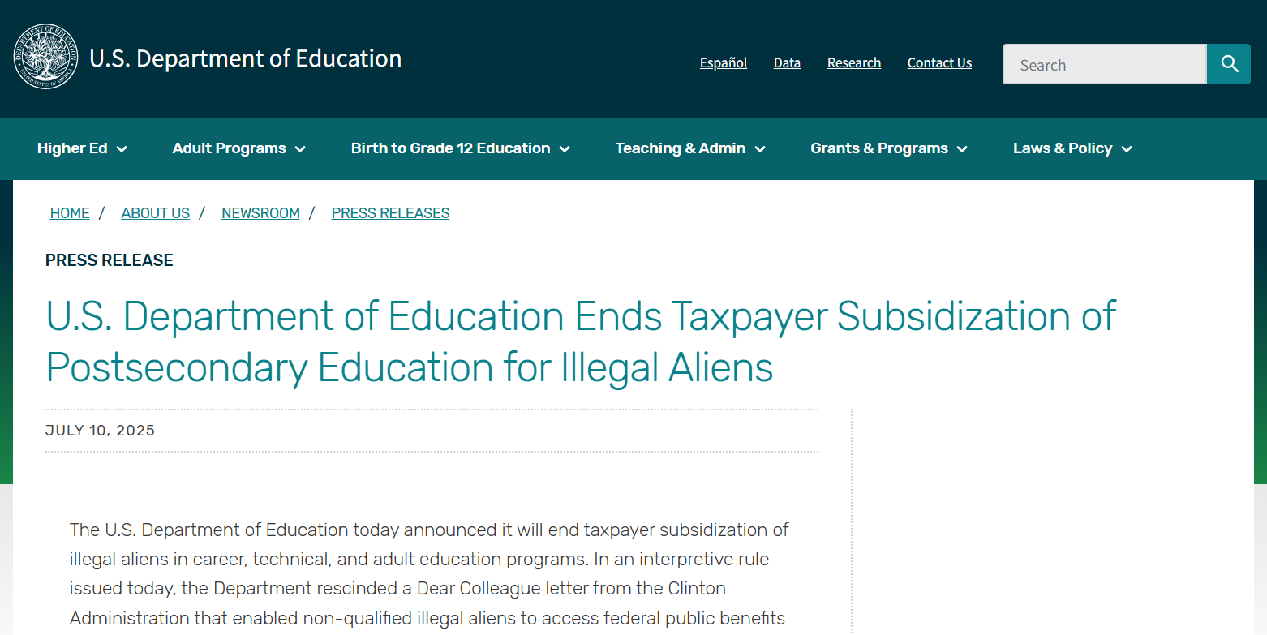

Slide 77
repeal of taxpayer Subsidies for illegal
U.S. Department of Education Ends Taxpayer Subsidization of Postsecondary Education for Illegal Aliens
July 10, 2025
The U.S. Department of Education today announced it will end taxpayer subsidization of illegal aliens in career, technical, and adult education programs. In an interpretive rule issued today, the Department rescinded a Dear Colleague letter from the Clinton Administration that enabled non-qualified illegal aliens to access federal public benefits in contravention of the Personal Responsibility and Work Opportunity Reconciliation Act (PRWORA). The interpretive rule also ensures that postsecondary education programs authorized under the Higher Education Act (HEA), such as Pell Grants and student loans, continue to be inaccessible to illegal immigrants.
“Postsecondary education programs funded by the federal government should benefit American citizens, not illegal aliens,” said U.S. Secretary of Education Linda McMahon. “Under President Trump's leadership, hardworking American taxpayers will no longer foot the bill for illegal aliens to participate in our career, technical, or adult education programs or activities. The Department will ensure that taxpayer funds are reserved for citizens and individuals who have entered our country through legal means who meet federal eligibility criteria.”

Slide 78
repeal of taxpayer Subsidies for illegal
U.S. Department of Education Ends Taxpayer Subsidization of Postsecondary Education for Illegal Aliens
July 10, 2025
The Notice of Interpretation published in the Federal Register today states that federal programs that provide postsecondary education and other similar benefits, including career and technical education (CTE) programs under the Carl D. Perkins Career and Technical Education Act (Perkins V), and adult education programs under Title II of the Adult Education and Family Literacy Act (AEFLA) of the Workforce Innovation and Opportunity Act (WIOA), are federal public benefits subject to the requirements of PRWORA.
The Notice reminds grantees and subgrantees of their obligations to verify the eligibility of participants to ensure that limited federal funding is not being improperly distributed to noneligible individuals or used to support programs and services that serve illegal aliens. The Department drafted the Notice of Interpretation in response to the President’s Executive Order 14218 titled, Ending Taxpayer Subsidization of Open Borders.
The Notice also rescinds a portion of a previous Dear Colleague Letter issued in November 1997 that mischaracterized federal public benefits.

Slide 79
repeal of taxpayer Subsidies for illegal
U.S. Department of Education Ends Taxpayer Subsidization of Postsecondary Education for Illegal Aliens
July 10, 2025
Background:
Title IV of the Personal Responsibility and Work Opportunity Reconciliation Act generally limits eligibility for “federal public benefits” to U.S. citizens, permanent residents, and certain categories of “qualified aliens.” PRWORA defines federal public benefits to include any retirement, welfare, health, disability, public or assisted housing, postsecondary education, food assistance, unemployment benefits, or any similar benefits for which payments or assistance are provided to an individual, household, or family eligibility unit.
In 1997, the Clinton Administration issued a Dear Colleague Letter that erroneously exempted career, technical, and adult education programs from being subject to PRWORA. In doing so, the Department’s interpretation mischaracterized the law by creating artificial distinctions between federal benefit programs based upon the method of assistance. Congress made no such distinction in PRWORA.
In conjunction with the Notice of Interpretation, the Department will send letters to all Perkins V, AEFLA, and HEA grantees discussing eligibility verification. Interpretive rules cannot have effective dates and are not binding on the public or the Department. The interpretive rule represents the Department’s current position on the issue and may be referenced when enforcing or monitoring grantee and subgrantee compliance with PRWORA. In general, the Department does not have any plans to take enforcement actions against any grantee or subgrantee under PRWORA prior to August 9, 2025.

Slide 80
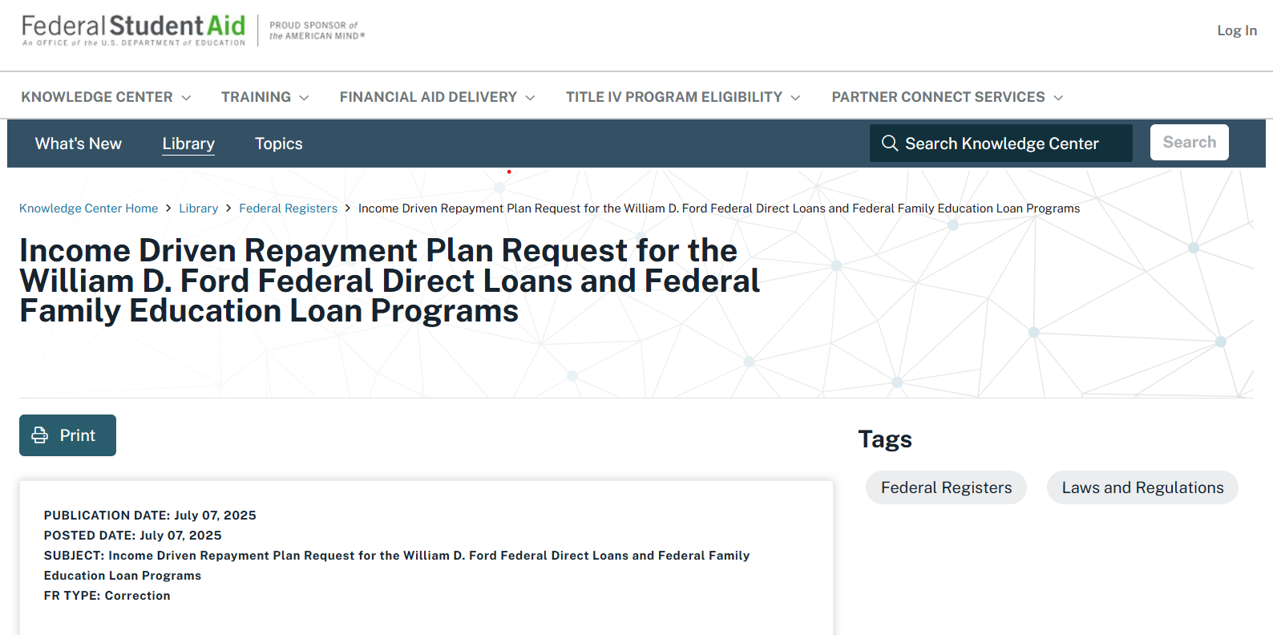

Slide 81
What could be next?

Slide 82


