Slide 1


Federal legislative
&
Regulatory
Update
Tuesday, August 12, 2025

Slide 2
AGENDA
Focus On One Big Beautiful Bill Act Negotiated Rulemaking
American Council on Education’s Perspective & More
One Big Beautiful Bill Enactment
Federal Register Announcement on Intent to Establish Two Negotiating Committees
Summary of the American Council on Education’s Analysis and Talking Points
What's Next6
Q&A

Slide 3


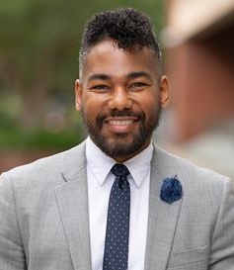

DR. Emmanual guillory
Senior Director, Government Relations
Emmanual A. Guillory is an advocate, policy expert, and motivational speaker who currently serves as the Senior Director of Government Relations at the American Council on Education (ACE). In this role, he manages an extensive portfolio of legislative and regulatory issues as a primary government relations resource for the broader higher education community to the United States Congress, the White House, the United States Department of Education, and other agencies as warranted. His portfolio includes a primary emphasis on the reauthorization of the Higher Education Act (HEA)—especially Title IV programs—and the budget and appropriations process. Other issues within his portfolio include accreditation; college costs; student aid; institutional accountability; institutional aid in Titles III and V of the HEA; oversight; privacy; technology; accessibility; and disability, among others.
EGuillory@acenet.edu

Slide 4

CONGRATULATIONS EMMANUAL

Slide 5
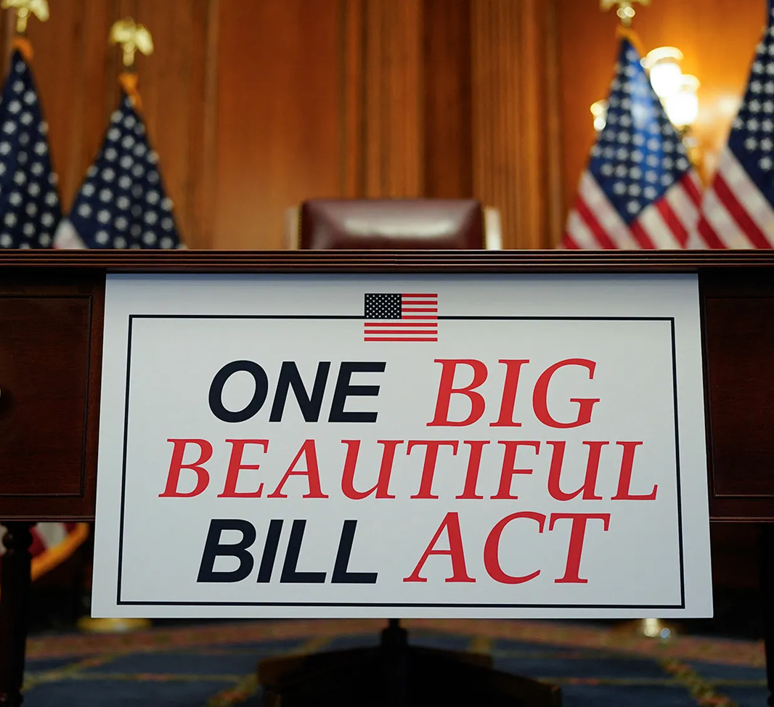
Budget reconciliation

Slide 6
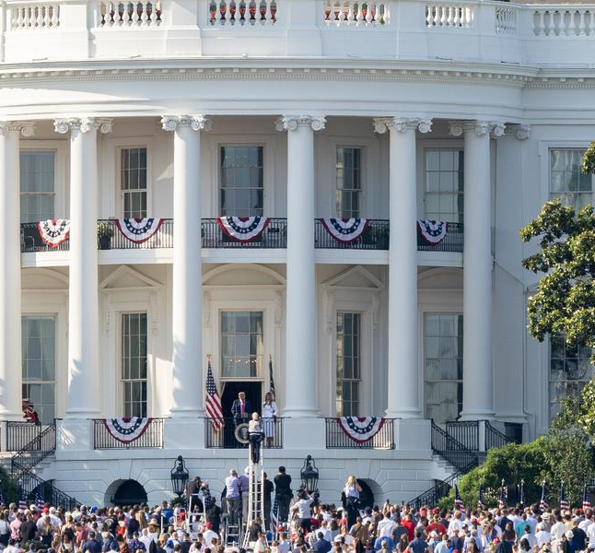
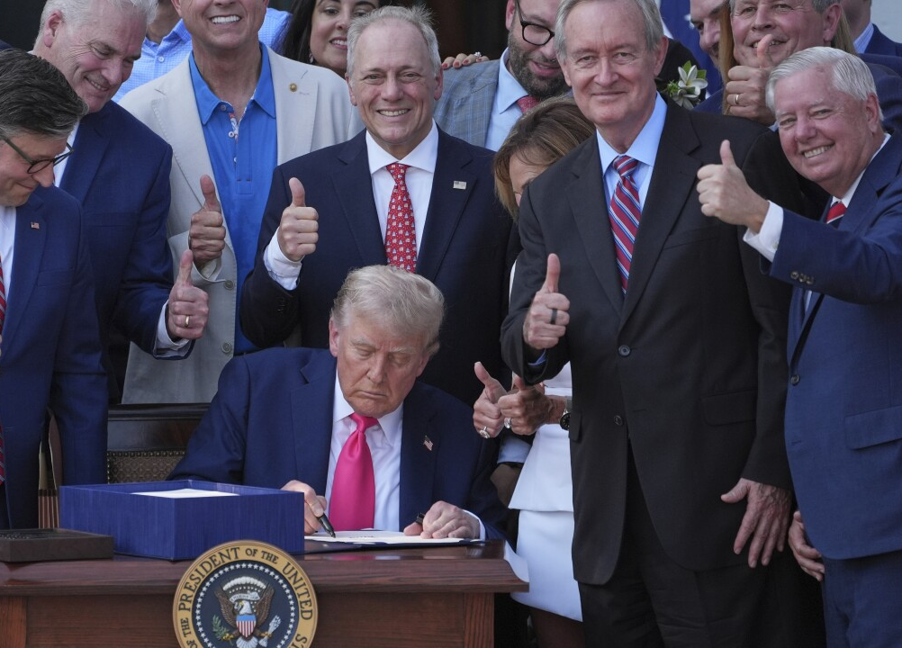
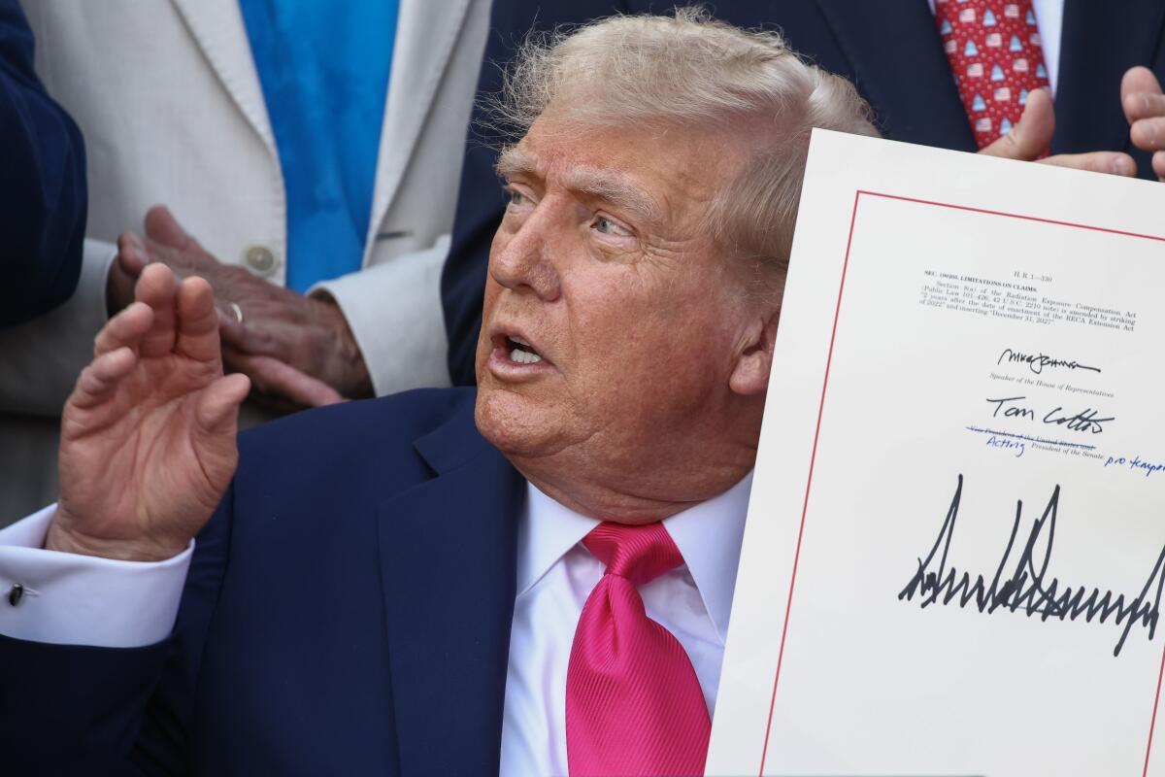

Slide 7

REGULATORY
UPDATE

Slide 8


Slide 9
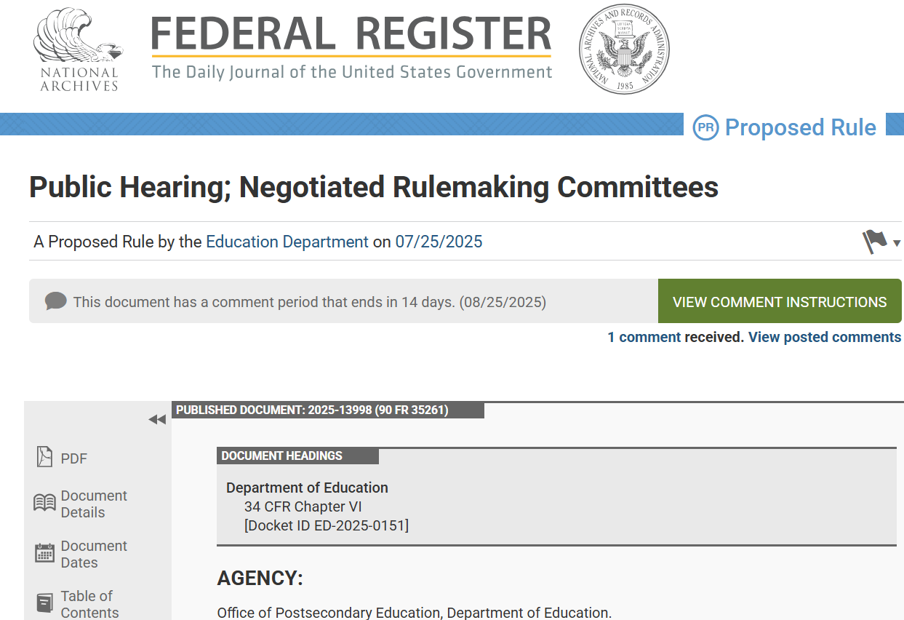
https://www.federalregister.gov/documents/2025/07/25/2025-13998/public-hearing-negotiated-rulemaking-committees

Slide 10
OBBB Federal negotiated rulemaking
Intent
We announce our intention to establish two negotiated rulemaking committees to prepare regulations for the Federal student financial assistance programs authorized under Title IV of the Higher Education Act (HEA) of 1965, as amended (Title IV, HEA programs). One committee will consider changes to the Federal student loan programs and the other committee will consider changes to institutional and programmatic accountability, the Pell Grant Program, and other changes to the Title IV, HEA programs.
This rulemaking is necessary to implement recent statutory changes to the Title IV, HEA programs included in Pub. L. 119-21, known as the One Big Beautiful Bill Act, that President Trump signed into law on July 4, 2025, as well as to implement other Administration priorities.
https://www.federalregister.gov/documents/2025/07/25/2025-13998/public-hearing-negotiated-rulemaking-committees

Slide 11
OBBB Federal negotiated rulemaking
Negotiated Rulemaking Committees & Issues Proposed For Discussion
Reimagining and Improving Student Education (RISE) Committee
  Phase-out of graduate and professional PLUS Loans.
  Establishment of new annual loan limits for graduate and professional students and parent borrowers, and implementation of new lifetime borrowing caps.
  Simplification of student loan repayment plans into a standard repayment plan and a single income-based Repayment Assistance Plan (RAP) for new borrowers, elimination of the Income-Contingent Repayment (ICR) plan, and streamlining requirements for Income-Based Repayment plans for existing borrowers.
  Institutional flexibility to apply lower annual limits for student and parent borrowers for selected programs of study.
  Modifications to loan rehabilitation, including allowing defaulted borrowers to rehabilitate their loans a second time and setting minimum monthly payment amounts for such loans, phase-out of unemployment and economic hardship deferments, and limitations on a borrower's ability to receive a general forbearance.
  Other provisions included in Public Law 119-21 that are effective upon enactment, on July 1, 2026, on July 1, 2027, or on July 1, 2028.
https://www.federalregister.gov/documents/2025/07/25/2025-13998/public-hearing-negotiated-rulemaking-committees

Slide 12
OBBB Federal negotiated rulemaking
Negotiated Rulemaking Committees & Issues Proposed For Discussion
Accountability in Higher Education and Access through Demand-driven Workforce Pell (AHEAD) Committee
  Changes in institutional and programmatic accountability measures, including loss of Direct Loan eligibility for certain programs with low earnings outcomes for 2 out of 3 years, and Financial Value Transparency and Gainful Employment.
  Establishment of program eligibility requirements for a new Workforce Pell Grant for students enrolled in programs that last a duration of 8-15 weeks, are transferable to a recognized postsecondary credential or degree, are approved by the state governor, and have strong outcomes.
  Exclusion of Pell Grant assistance for students who receive grant or scholarship aid covering their entire cost of attendance or for students with a Student Aid Index in excess of twice the maximum Pell Grant award.
  Other provisions included in Public Law 119-21 that are effective upon enactment, on July 1, 2026, on July 1, 2027, or on July 1, 2028.
https://www.federalregister.gov/documents/2025/07/25/2025-13998/public-hearing-negotiated-rulemaking-committees

Slide 13
OBBB Federal negotiated rulemaking
Negotiated Rulemaking Committees Dates
Reimagining and Improving Student Education (RISE) Committee
Session 1: September 29, September 30, October 1, October 2, and October 3, 2025
Session 2: November 3, November 4, November 5, November 6, and November 7, 2025
Accountability in Higher Education and Access through Demand-driven Workforce Pell (AHEAD) Committee
Session 1: December 8, December 9, December 10, December 11, and December 12, 2025
Session 2: January 5, January 6, January 7, January 8, and January 9, 2026
https://www.federalregister.gov/documents/2025/07/25/2025-13998/public-hearing-negotiated-rulemaking-committees

Slide 14
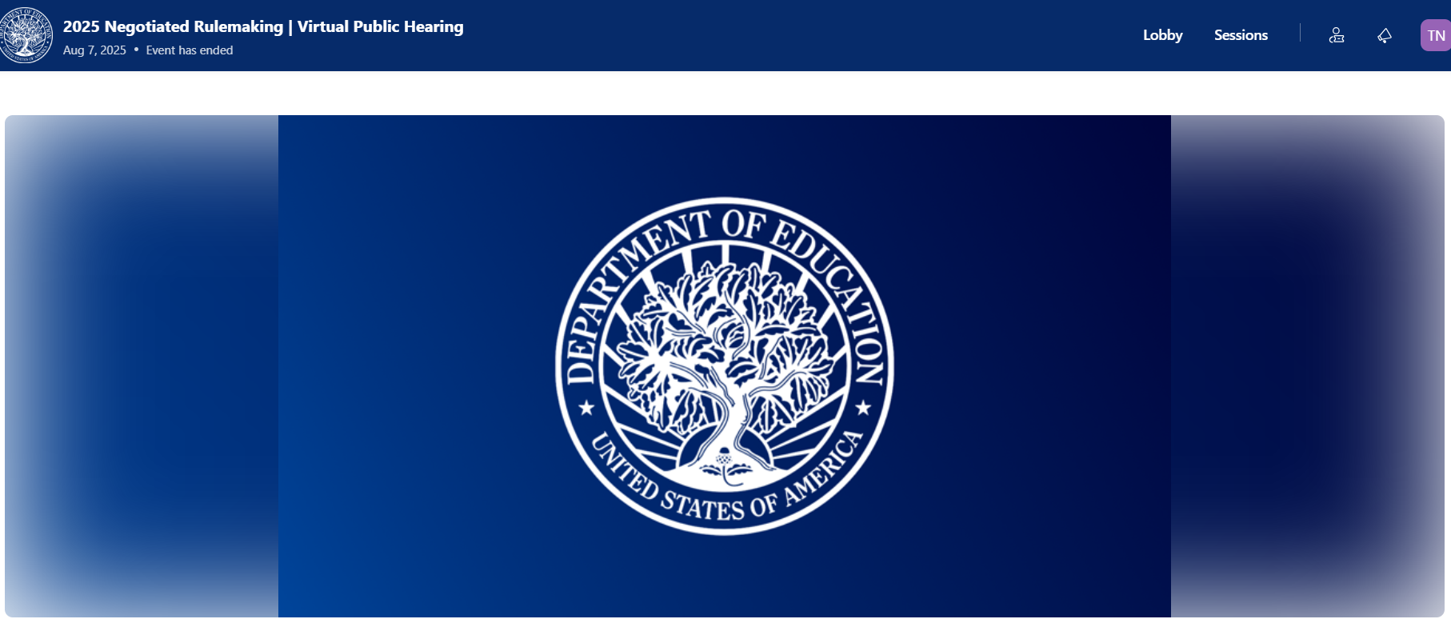
OBBB Federal negotiated rulemaking

Slide 15
TALKING POINTS
NEGOTIATED RULEMAKING
ON
ONE BIG BEAUTIFUL BILL ACT
IMPLEMENTATION

Slide 16
ACE’s TALKING POINTS
Negotiated rulemaking on the one big beautiful bill Act implementation
Clear and Direct Communication Is Critical for Students, Borrowers, and Families to Understand the New Annual and Aggregate Loan Limits and the New Student Loan Repayment Plans
Over 6.8 million students use federal student loans to finance their postsecondary education.2 These loans include federal subsidized and unsubsidized loans, along with Grad PLUS and Parent PLUS loans.
Currently, over 3.6 million students are using subsidized student loans (interest does not accrue while they are enrolled in college); over 5 million students are using unsubsidized loans; and over 900,000 students are using PLUS loans.3
The Department of Education (Department) should ensure that all internal software is updated in a timely fashion to adhere to the changes in the law and provide clear instructions, to include relevant resources, to Financial Aid Administrators (FAAs) to allow them to properly notify students and families. Also, the Department should clarify whether the new loans limits apply to loans that were originated or disbursed on or after July 1, 2026. 0/10-Q1: What fiscal years do the new 90/10 regulations apply to?
Talking-Points-OBBB-Implemetation-080525.pdf

Slide 17
ACE’s TALKING POINTS
Negotiated rulemaking on the one big beautiful bill Act implementation
The Department Should Create and Disseminate an Exhaustive List of Professional Degree Programs
The OBBB changes annual loan limits for professional students from $20,500 to $50,000 and changes aggregate loan limits from $138,500 to $200,000 for first-time professional degree-seeking students.
The law refers to the Code of Federal Regulations (CFR) to define a professional degree; however, the definition given in the CFR is non-exhaustive and only provides a few examples of degrees that would be considered professional degrees.
The Department should create and disseminate a comprehensive list of programs that would be considered professional degree programs. At the very least, the list should include nursing-related programs and programs identified in the Federal Register as meeting the definition of “qualifying graduate program” in the financial value transparency (FVT) final regulations because these programs are identified as needing professional licensure.
Talking-Points-OBBB-Implemetation-080525.pdf

Slide 18
ACE’s TALKING POINTS
Negotiated rulemaking on the one big beautiful bill Act implementation
Proper Staffing Should Be in Place to Implement the Full Scope of the OBBB
The Department has moved forward with reducing its career staff by nearly half its workforce. This reduction in staff has already led to disruptions and delays of key services for institutions of higher education, students, and families, including trouble accessing FSA User ID and passwords, FSA regional office closures, and difficulties accessing the Free Application for Federal Student Aid (FAFSA) Processing System Helpdesk.
With an additional $1 billion in funding for student aid administration, the Department should retain a sufficient workforce to ensure a smooth transition for all current students, families, borrowers, and institutions of higher education.
Talking-Points-OBBB-Implemetation-080525.pdf

Slide 19
ACE’s TALKING POINTS
Negotiated rulemaking on the one big beautiful bill Act implementation
The Data Used to Determine the Median Earnings for Each Program
Should Be Made Publicly Available in a Clear and Concise Manner
The OBBB subjects each program at an institution of higher education to the loss of Title IV loans if the program fails an earnings test for two out of three years.
Removing access to Title IV loans for certain programs will prohibit students from using loans to attend those programs, limiting access and potentially increasing the cost of college.
Given these potentially devastating impacts, students and institutions require access to the data that is being used to hold programs accountable. Having access to this data would allow for these students and institutions to better understand why they may no longer have access to federal student loans and would help them make more informed decisions about their enrollment options.
Talking-Points-OBBB-Implemetation-080525.pdf

Slide 20
ACE’s TALKING POINTS
Negotiated rulemaking on the one big beautiful bill Act implementation
Further Guidance Is Needed on the Requirement for Institutions to
Package Non-Federal Grant Aid Before the Pell Grant and on Institutional Accountability Reporting
The Pell Grant currently operates as a first-dollar program when packaging aid, but the OBBB has changed this structure. Students who receive non-federal grant aid covering the full cost of attendance (COA) are not allowed to access the Pell Grant.
On first read, this may seem like the Pell Grant is now being considered after all non-federal grant aid regardless of whether it covers full COA. However, the intent of Congress is for the Pell Grant to remain a first-dollar program when packaging all aid—to include state aid, institutional aid, and aid from private sources—except in the one narrow instance that the aid covers full COA. Further guidance clarifying this to institutions of higher education is needed.
The OBBB does not require institutional reporting of data regarding accountability. However, institutions are able to appeal the earnings data if they believe it is needed. Further guidance is needed regarding what data, and in what manner, Institutions should report to appeal the median earnings data from the U.S. Census Bureau. Also, the Department should consider processes from the FVT regulations and prior gainful employment regulations to determine small programmatic cohorts, the appeals process, and ways that institutions can regain programmatic eligibility.
Talking-Points-OBBB-Implemetation-080525.pdf

Slide 21
ACE’s TALKING POINTS
Negotiated rulemaking on the one big beautiful bill Act implementation
The Negotiated Rulemaking Committee Should Add Additional Constituency Groups
On college campuses, FAAs serve as the main connection point at an institution of higher education for students and families when helping them decide on how to finance their postsecondary education.
Over 7 million students receive a Pell Grant, the cornerstone of federal financial aid. On college campuses, FAAs help award and disburse federal student aid that includes the Pell Grant and other federal student aid programs such as the Federal Work-Study program and Federal Supplemental Educational Opportunity Grant program.
On college campuses, FAAs also disburse student loans. Over 5 million undergraduate students, over 1.4 million graduate students, and over 567,000 parents took out loans in award year (AY) 2023-2024.
The negotiated rulemaking committee consists of two committees: the Reimagining and Improving Student Education (RISE) Committee and the Accountability in Higher Education and Access through Demand-driven Workforce Pell (AHEAD) Committee.
Talking-Points-OBBB-Implemetation-080525.pdf

Slide 22
ACE’s TALKING POINTS
Negotiated rulemaking on the one big beautiful bill Act implementation
The Negotiated Rulemaking Committee Should Add Additional Constituency Groups
The RISE committee will be considering the phase out of Grad PLUS loans, the changes in the annual/aggregate loan limits, and the simplification of the student loan repayment program, among other things. The AHEAD committee will consider the changes to how the Pell Grant is awarded, among other things.
Both negotiated rulemaking committees address key issue topics that fall directly in the purview of FAAs and not having their expertise on the committee will greatly hinder the overall outcome to ensure proper implementation of the OBBB.
It is important to include a separate category for FAAs so that campus leaders can speak to the broad range of issues the committees will be considering, while also allowing for the expertise of FAAs on matters of financial aid administration specifically.
Talking-Points-OBBB-Implemetation-080525.pdf

Slide 23
ACE’s TALKING POINTS
Negotiated rulemaking on the one big beautiful bill Act implementation
The Negotiated Rulemaking Committee Should Add Additional Constituency Groups.
In addition, the prior Trump administration included the following categories of institutions that each had a seat on a negotiated rulemaking committee, and we recommend that these seats, at the very least, be added for a full and diverse representation of the higher education community:
  Institutions of higher education eligible to receive federal assistance under Title III, parts A, B and F, and Title V of the HEA, which include Historically Black Colleges and Universities, American Indian Tribally Controlled Colleges and Universities, Hispanic-Serving Institutions, Alaska Native and Native Hawaiian-Serving Institutions, and other institutions with a substantial enrollment of needy students as defined in Title III of the HEA;
  Two-year public institutions of higher education;
  Four-year public institutions of higher education;
  Private, nonprofit institutions of higher education; and
  Private, proprietary institutions of higher education
Talking-Points-OBBB-Implemetation-080525.pdf

Slide 24


Slide 25

What could be next?

Slide 26

CSPEN NEG REG TIMELINE
Thursday, August 14th
CSPEN Federal Legislative & Regulatory Update Webinar
On-going Information Gathering and Sharing on
Wednesday, August 20th
CSPEN Draft Written Comments Completed
Thursday, August 21st
CSPEN Federal Legislative & Regulatory Update Webinar
Summary of CSPEN Draft Comments & Request for Community Feedback
Thursday, August 28th
CSPEN Final Comments Completed

Slide 27


