Slide 1


Federal legislative & Regulatory Update
Thursday, November 20, 2025

Slide 2
AGENDA
AHEAD Committee Listening Session Summation
2025-26 Federal Negotiated Rulemaking Update
&
FY26 Labor, HHS & Education Appropriations Update
Federal Regulatory Update
Federal Legislative Update
Q&A

Slide 3



REGULATORY UPDATE

Slide 4


Slide 5


Slide 6


Slide 7
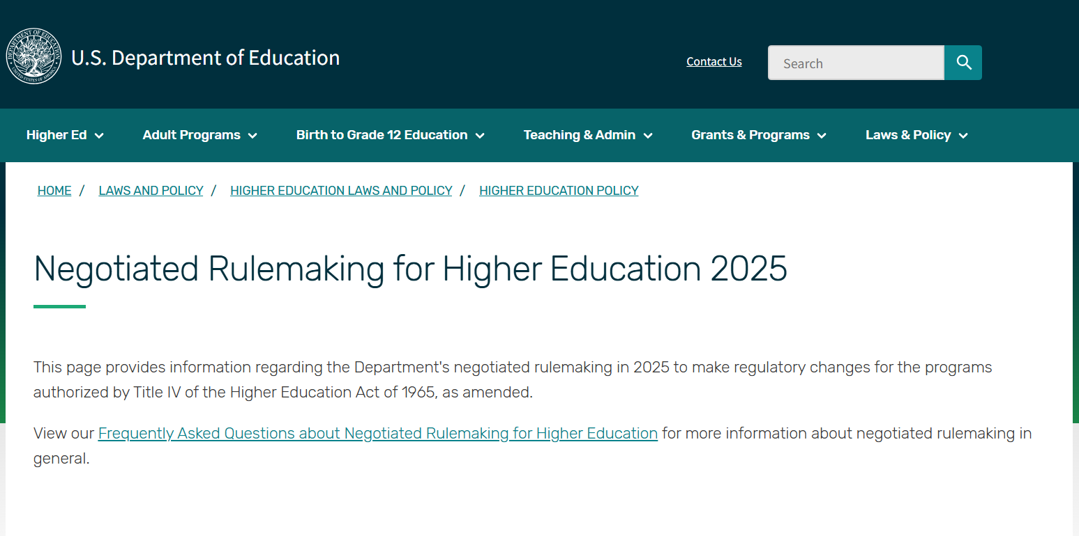
https://www.ed.gov/laws-and-policy/higher-education-laws-and-policy/higher-education-policy/negotiated-rulemaking-for-higher-education-2025-2026

Slide 8

ACCOUNTABILITY IN HIGHER EDUCATION AND ACCESS THROUGH DEMAND-DRIVEN WORKFORCE PELL (AHEAD) Committee

Slide 9
ACCOUNTABILITY IN HIGHER EDUCATION AND ACCESS THROUGH DEMAND-DRIVEN WORKFORCE PELL (AHEAD) Committee
Proposed Issues
Changes in institutional and programmatic accountability measures, including loss of Direct Loan eligibility for certain programs with low earnings outcomes for 2 out of 3 years, and Financial Value Transparency and Gainful Employment.
Establishment of program eligibility requirements for a new Workforce Pell Grant for students enrolled in programs that last a duration of 8-15 weeks, are transferable to a recognized postsecondary credential or degree, are approved by the state governor, and have strong outcomes.
Exclusion of Pell Grant assistance for students who receive grant or scholarship aid covering their entire cost of attendance or for students with a Student Aid Index in excess of twice the maximum Pell Grant award.
Other provisions included in Public Law 119-21 that are effective upon enactment, on July 1, 2026, on July 1, 2027, or on July 1, 2028.

Slide 10
ACCOUNTABILITY IN HIGHER EDUCATION AND ACCESS THROUGH DEMAND-DRIVEN WORKFORCE PELL (AHEAD) Committee
Session Dates
The AHEAD Committee will meet in-person for two multi-day sessions on the following dates:
Session 1: December 8-12, 2025 – New Workforce Pell Grants & Federal Pell Grant Scholarship Exclusion Issues
Session 2: January 5-9, 2026 – Institutional & Programmatic Accountability Measure

Slide 11
ACCOUNTABILITY IN HIGHER EDUCATION AND ACCESS THROUGH DEMAND-DRIVEN WORKFORCE PELL (AHEAD) Committee
Constituency Groups
Students who are currently enrolled and receiving assistance from the Title IV, HEA programs.
Students who are veterans, U.S. military service members or groups representing them.
Employers and groups representing the business community, including small, medium, and large businesses.
Legal assistance organizations that represent students, consumer advocates, and civil rights groups that represent students.
Public institutions of higher education, including institutions eligible to receive Federal assistance under Title III and Title V of the HEA, Tribal Colleges and Universities, and Historically Black Colleges and Universities.
Private nonprofit institutions of higher education including institutions eligible to receive Federal assistance under Title III and Title V of the HEA, Tribal Colleges and Universities, and Historically Black Colleges and Universities.
Proprietary institutions of higher education, as defined in34 CFR 600.5.
State workforce agencies and workforce development boards.
State grant agencies, and other state and non-profit higher education financing organizations.
State higher education executive officers, State authorizing agencies, and other State regulators.
Accrediting agencies recognized by the Secretary of Education.
Organizations representing taxpayers and the public interest.
https://www.federalregister.gov/documents/2025/07/25/2025-13998/public-hearing-negotiated-rulemaking-committees

Slide 12


AHEAD Committee
Proprietary Institutions of Higher Education Negotiators
Primary/Lead Negotiator:
Jeff Arthur, chief regulatory officer, ECPI university
Alternate Negotiator:
RYAN claybaugh, Vice President of Regulatory Compliance and Financial Aid, Post University

Slide 13


AHEAD Committee
PRIVATE NONProfit Institutions of Higher Education Negotiators
Primary/Lead Negotiator:
Aaron Lacey, Thompson Coburn LLP
Alternate Negotiator:
JOANNA ROUSH, Liberty University

Slide 14


AHEAD Committee
Public Institutions of Higher Education Negotiators
Primary/Lead Negotiator:
Kristin Hultquist, HCM Strategies
Alternate Negotiator:
Tonjua Williams, st. Petersburg college

Slide 15

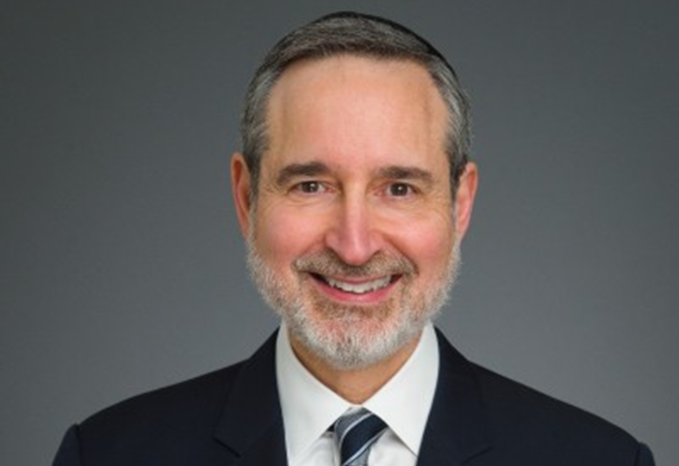
AHEAD Committee
ACCREDITING Agency Negotiators
Primary/Lead Negotiator:
Michale McComis, Accrediting commission of careeR schools and colleges (ACCSC)
Alternate Negotiator:
Gary litke, association of advanced rabbinical and Talmudic Schools

Slide 16
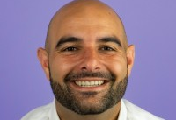
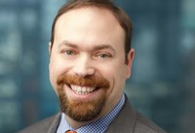
AHEAD Committee
BUSINESS COMMUNITY Negotiators
Primary/Lead Negotiator:
David kafafian, CLASP
Alternate Negotiator:
Dennis Cariello, Hogan, Marren, Babbo & Rose

Slide 17
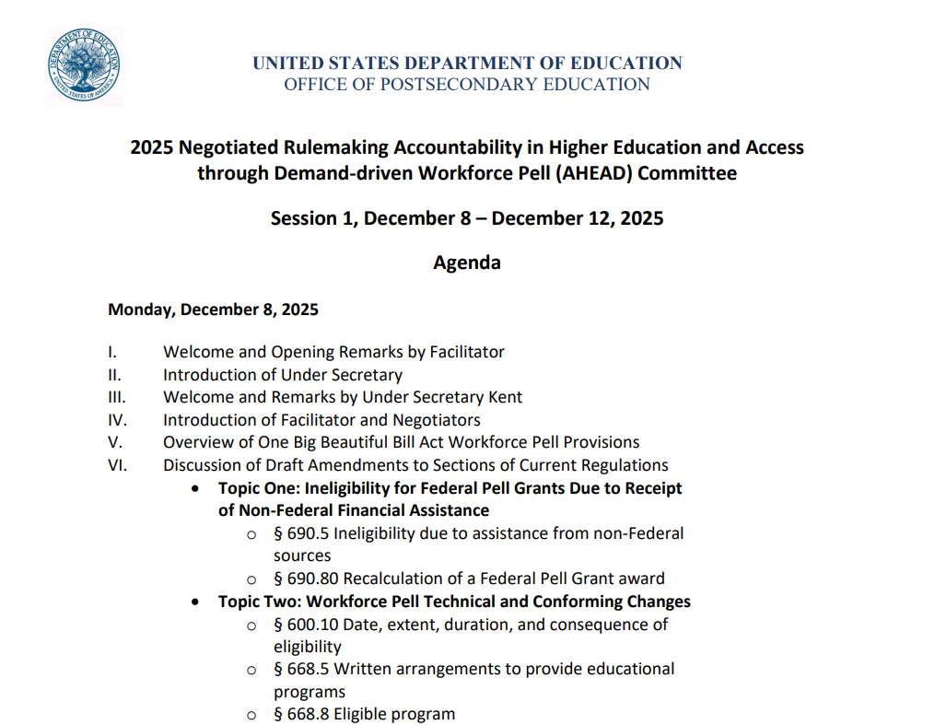

Slide 18
ACCOUNTABILITY IN HIGHER EDUCATION AND ACCESS THROUGH DEMAND-DRIVEN WORKFORCE PELL (AHEAD) Committee
Agenda
Monday, December 8, 2025
I. Welcome and Opening Remarks by Facilitator
II. Introduction of Under Secretary
III. Welcome and Remarks by Under Secretary Kent
IV. Introduction of Facilitator and Negotiators
V. Overview of One Big Beautiful Bill Act Workforce Pell Provisions

Slide 19
ACCOUNTABILITY IN HIGHER EDUCATION AND ACCESS THROUGH DEMAND-DRIVEN WORKFORCE PELL (AHEAD) Committee
Agenda
Monday, December 8, 2025
VI. Discussion of Draft Amendments to Sections of Current Regulations
Topic One: Ineligibility for Federal Pell Grants Due to Receipt of Non-Federal Financial Assistance
§ 690.5 Ineligibility due to assistance from non-Federal sources
§ 690.80 Recalculation of a Federal Pell Grant award
Topic Two: Workforce Pell Technical and Conforming Changes
§ 600.10 Date, extent, duration, and consequence of eligibility
§ 668.5 Written arrangements to provide educational programs
§ 668.8 Eligible program
§ 668.20 Limitations on remedial coursework that is eligible for Title IV, HEA program assistance
§ 668.32 Student eligibility
§ 690.2 Definitions
§ 690.6 Duration of student eligibility
§ 690.11 Concurrent Federal Pell Grant payments

Slide 20
ACCOUNTABILITY IN HIGHER EDUCATION AND ACCESS THROUGH DEMAND-DRIVEN WORKFORCE PELL (AHEAD) Committee
Agenda
Monday, December 8, 2025
VIII. Discussion of Draft Workforce Pell Regulations
Topic Three: Workforce Pell Definitions
§ 690.90 Scope and purpose
§ 690.91 Definitions
§ 690.92 Eligible workforce program
Topic Four: Governor Approval of Eligible Workforce Programs
§ 690.93 Components determined by Governors
IX. Questions/Wrap-Up

Slide 21
ACCOUNTABILITY IN HIGHER EDUCATION AND ACCESS THROUGH DEMAND-DRIVEN WORKFORCE PELL (AHEAD) Committee
Agenda
Tuesday, December 9, 2025
I. Welcome and Facilitator Remarks
II. Discussion of Draft Workforce Pell Regulations (Continued)
Topic Five: Secretary of Education Approval of Eligible Workforce Programs
§ 690.94 Components determined by the Secretary
Topic Six: Value-Added Earnings Calculation
§ 690.95 Value-added earnings
IV. Discussion of Draft Workforce Pell Regulations (Continued)
Topic Seven: Losing and Regaining Eligibility
§ 690.96 Loss of eligibility
§ 690.97 Regaining eligibility
V. Continued Discussion of Draft Regulations
VI. Wrap-Up and Closing Remarks

Slide 22
ACCOUNTABILITY IN HIGHER EDUCATION AND ACCESS THROUGH DEMAND-DRIVEN WORKFORCE PELL (AHEAD) Committee
Agenda
Wednesday, December 10, 2025
I. Welcome and Facilitator Remarks
II. Continued Discussion of Draft Regulations
III. Pulse Checks
IV. Lunch Break
V. Continued Discussion of Draft Regulations
VI. Pulse Checks (if needed)
VII. Wrap-Up and Closing Remarks

Slide 23
ACCOUNTABILITY IN HIGHER EDUCATION AND ACCESS THROUGH DEMAND-DRIVEN WORKFORCE PELL (AHEAD) Committee
Agenda
Thursday, December 11, 2025
I. Welcome and Facilitator Remarks
II. Continued Discussion of Draft Regulations
III. Pulse Checks
IV. Lunch Break
V. Continued Discussion of Draft Regulations
VI. Pulse Checks (if needed)
VII. Wrap-Up and Closing Remarks

Slide 24
ACCOUNTABILITY IN HIGHER EDUCATION AND ACCESS THROUGH DEMAND-DRIVEN WORKFORCE PELL (AHEAD) Committee
Agenda
Friday, December 12, 2025
I. Welcome and Facilitator Remarks
II. Continued Discussion of Draft Regulations (if needed)
III. Caucus report to committee (if needed)
IV. Discussion of Department Revisions/Negotiator Alternatives (if needed)
V. Lunch Break
VI. Continued Review of New Language and/or Discussion of Additional Outstanding Issues (if needed)
VII. Final Consensus Vote on Workforce Pell Provisions
VIII. Wrap-up and Closing Remarks
IX. Committee Adjournment

Slide 25



Slide 26
ACCOUNTABILITY IN HIGHER EDUCATION AND ACCESS THROUGH DEMAND-DRIVEN WORKFORCE PELL (AHEAD) Committee
Session Discussion Areas
Session 1: Federal Pell Grant Program Provisions
Establishment of program eligibility requirements for a new Workforce Pell Grant for students enrolled in programs that last a duration of 8-15 weeks, are transferable to a recognized postsecondary credential or degree, are approved by the state governor, and have strong outcomes.
Exclusion of Pell Grant assistance for students who receive grant or scholarship aid covering their entire cost of attendance or for students with a Student Aid Index in excess of twice the maximum Pell Grant award.

Slide 27
OB3 – Title VIII LABOR, HHS, EDUCATION & RELATED AGENCIES Subtitle D—Pell Grants
Section 83001—Foreign Income and Federal Pell Grant Eligibility
(a) Foreign Income and Federal Pell Grant Eligibility.—
(1) Adjusted gross income defined.—Section 401(a)(2)(A) of the Higher Education Act of 1965 (20 U.S.C. 1070a(a)(2)(A)) is amended to read as follows:
(A) the term “adjusted gross income” means—
(i) in the case of a dependent student, for the second tax year preceding the academic year—
(I) the adjusted gross income (as defined in section 62 of the Internal Revenue Code of 1986) of the student’s parents; plus
(II) for Federal Pell Grant determinations made for academic years beginning on or after July 1, 2026, the foreign income (as described in section 480(b)(5)) of the student’s parents; and
(ii) in the case of an independent student, for the second tax year preceding the academic year—
(I) the adjusted gross income (as defined in section 62 of the Internal Revenue Code of 1986) of the student (and the student’s spouse, if applicable); plus
(II) for Federal Pell Grant determinations made for academic years beginning on or after July 1, 2026, the foreign income (as described in section 480(b)(5)) of the student (and the student’s spouse, if applicable);
(2) Sunset.—Section 401(b)(1)(D) of the Higher Education Act of 1965 (20 U.S.C. 1070a(b)(1)(D)) is amended—
by striking “A student” and inserting “For each academic year beginning before July 1, 2026, a student”; and
by inserting “, as in effect for such academic year,” after “section 479A(b)(1)(B)(v)”.
https://www.congress.gov/bill/119th-congress/house-bill/1/text

Slide 28
OB3 – Title VIII LABOR, HHS, EDUCATION & RELATED AGENCIES Subtitle D—Pell Grants
Section 83001—Foreign Income and Federal Pell Grant Eligibility
(b) Federal Pell Grant Ineligibility Due to a High Student Aid Index.—
In general.—Section 401(b)(1) of the Higher Education Act of 1965 (20 U.S.C. 1070a(b)(1)) is amended by adding at the end the following:
“(F) Ineligibility of students with a high student aid index.—Notwithstanding subparagraphs (A) through (E), a student shall not be eligible for a Federal Pell Grant under this subsection for an academic year in which the student has a student aid index that equals or exceeds twice the amount of the total maximum Federal Pell Grant for such academic year.”
https://www.congress.gov/bill/119th-congress/house-bill/1/text

Slide 29
OB3 – Title VIII LABOR, HHS, EDUCATION & RELATED AGENCIES Subtitle D—Pell Grants
Section 83002—Workforce Pell Grants
(k) Workforce Pell Grant Program.—
Effective date.
In general.—For the award year beginning on July 1, 2026, and each subsequent award year, the Secretary shall award grants (to be known as ‘Workforce Pell Grants’) to eligible students under paragraph (2) in accordance with this subsection.
(2) Eligible students.—To be eligible to receive a Workforce Pell Grant under this subsection for any period of enrollment, a student shall meet the eligibility requirements for a Federal Pell Grant under this section, except that the student—
(A) shall be enrolled, or accepted for enrollment, in an eligible program under section 481(b)(3) (hereinafter referred to as an ‘eligible workforce program’); and
(B) may not—
(i) be enrolled, or accepted for enrollment, in a program of study that leads to a graduate credential; or
(ii) have attained such a credential.
https://www.congress.gov/bill/119th-congress/house-bill/1/text

Slide 30
OB3 – Title VIII LABOR, HHS, EDUCATION & RELATED AGENCIES Subtitle D—Pell Grants
Section 83002—Workforce Pell Grants
(k) Workforce Pell Grant Program.—
(3) Terms and conditions of awards.—The Secretary shall award Workforce Pell Grants under this subsection in the same manner and with the same terms and conditions as the Secretary awards Federal Pell Grants under this section, except that—
(A) each use of the term ‘eligible program’ (except in subsection (b)(9)(A)) shall be substituted by ‘eligible workforce program under section 481(b)(3)’;
(B) the provisions of subsection (d)(2) shall not be applicable to eligible workforce programs; and
(C) a student who is eligible for a grant equal to less than the amount of the minimum Federal Pell Grant because the eligible workforce program in which the student is enrolled or accepted for enrollment is less than an academic year (in hours of instruction or weeks of duration) may still be eligible for a Workforce Pell Grant in an amount that is prorated based on the length of the program.
(4) Prevention of double benefits.—No eligible student described in paragraph (2) may concurrently receive a grant under both this subsection and—
(A) subsection (b); or
(B) subsection (c).
(5) Duration limit.—Any period of study covered by a Workforce Pell Grant awarded under this subsection shall be included in determining a student’s duration limit under subsection (d)(5).”
https://www.congress.gov/bill/119th-congress/house-bill/1/text

Slide 31
OB3 – Title VIII LABOR, HHS, EDUCATION & RELATED AGENCIES Subtitle D—Pell Grants
Section 83002—Workforce Pell Grants
(k) Workforce Pell Grant Program.—
(b) Program Eligibility for Workforce Pell Grants.—
(3)(A) A program is an eligible program for purposes of the Workforce Pell Grant program under section 401(k) only if—
(i) it is a program of at least 150 clock hours of instruction, but less than 600 clock hours of instruction, or an equivalent number of credit hours, offered by an eligible institution during a minimum of 8 weeks, but less than 15 weeks;
(ii) it is not offered as a correspondence course, as defined in 600.2 of title 34, Code of Federal Regulations (as in effect on July 1, 2021);
(iii) the Governor of a State, after consultation with the State board, determines that the program—
(I) provides an education aligned with the requirements of high-skill, high-wage (as identified by the State pursuant to section 122 of the Carl D. Perkins Career and Technical Education Act (20 U.S.C. 2342)), or in-demand industry sectors or occupations;
(II) meets the hiring requirements of potential employers in the sectors or occupations described in subclause (I);
https://www.congress.gov/bill/119th-congress/house-bill/1/text

Slide 32
OB3 – Title VIII LABOR, HHS, EDUCATION & RELATED AGENCIES Subtitle D—Pell Grants
Section 83002—Workforce Pell Grants
(k) Workforce Pell Grant Program.—
(b) Program Eligibility for Workforce Pell Grants.—
(3)(A) (iii) the Governor of a State, after consultation with the State board, determines that the program—
(III) either—
(aa) leads to a recognized postsecondary credential that is stackable and portable across more than one employer; or
(bb) with respect to students enrolled in the program—
(AA) prepares such students for employment in an occupation for which there is only one recognized postsecondary credential; and
(BB) provides such students with such a credential upon completion of such program; and
(IV) prepares students to pursue 1 or more certificate or degree programs at 1 or more institutions of higher education (which may include the eligible institution providing the program), including by ensuring—
(aa) that a student, upon completion of the program and enrollment in such a related certificate or degree program, will receive academic credit for the Workforce Pell program that will be accepted toward meeting such certificate or degree program requirements; and
(bb) the acceptability of such credit toward meeting such certificate or degree program requirements; and
https://www.congress.gov/bill/119th-congress/house-bill/1/text

Slide 33
OB3 – Title VIII LABOR, HHS, EDUCATION & RELATED AGENCIES Subtitle D—Pell Grants
Section 83002—Workforce Pell Grants
(k) Workforce Pell Grant Program.—
(b) Program Eligibility for Workforce Pell Grants.—
(3)(A) (iv) after the Governor of such State makes the determination that the program meets the requirements under clause (iii), the Secretary determines that—
(I) the program has been offered by the eligible institution for not less than 1 year prior to the date on which the Secretary makes a determination under this clause;
(II) for each award year, the program has a verified completion rate of at least 70 percent, within 150 percent of the normal time for completion;
(III) for each award year, the program has a verified job placement rate of at least 70 percent, measured 180 days after completion; and
(IV) for each award year, the total amount of the published tuition and fees of the program for such year is an amount that does not exceed the value-added earnings of students who received Federal financial aid under this title and who completed the program 3 years prior to the award year, as such earnings are determined by calculating the difference between—
(aa) the median earnings of such students, as adjusted by the State and metropolitan area regional price parities of the Bureau of Economic Analysis based on the location of such program; and
(bb) 150 percent of the poverty line applicable to a single individual as determined under section 673(2) of the Community Services Block Grant Act (42 U.S.C. 9902(2)) for such year.
https://www.congress.gov/bill/119th-congress/house-bill/1/text

Slide 34
OB3 – Title VIII LABOR, HHS, EDUCATION & RELATED AGENCIES Subtitle D—Pell Grants
Section 83004—Federal Pell Grant Exclusion Relating to Other Grant Aid
(6) Exclusion.—Beginning on July 1, 2026, and notwithstanding this subsection or subsection (b), a student shall not be eligible for a Federal Pell Grant under subsection (b) during any period for which the student receives grant aid from non-Federal sources, including States, institutions of higher education, or private sources, in an amount that equals or exceeds the student’s cost of attendance for such period.
https://www.congress.gov/bill/119th-congress/house-bill/1/text

Slide 35


Slide 36
ACCOUNTABILITY IN HIGHER EDUCATION AND ACCESS THROUGH DEMAND-DRIVEN WORKFORCE PELL (AHEAD) Committee
Session Discussion Areas
Session 2: Institutional & Program Accountability
Changes in institutional and programmatic accountability measures, including loss of Direct Loan eligibility for certain programs with low earnings outcomes for 2 out of 3 years, and Financial Value Transparency and Gainful Employment.
Other provisions included in Public Law 119-21 that are effective upon enactment, on July 1, 2026, on July 1, 2027, or on July 1, 2028.

Slide 37
OB3 – Title VIII LABOR, HHS, EDUCATION & RELATED AGENCIES Subtitle E—Accountability
Section 84001—Ineligibility Based on Low Earnings Outcomes
(c) INELIGIBILITY FOR CERTAIN PROGRAMS BASED ON LOW EARNING OUTCOMES.—
IN GENERAL.—Notwithstanding section 481(b), an institution of higher education subject to this subsection shall not use funds under this part for student enrollment in an educational program of offered by the institution that is described in paragraph (2).
(2) LOW-EARNING OUTCOME PROGRAMS DESCRIBED.—
An educational program at an institution is described in this paragraph if the program awards an undergraduate degree, graduate or professional degree, or graduate certificate, for which the median earnings (as determined by the Secretary) of the
programmatic cohort of students who received funds under this title for enrollment in such program, who completed such program during the academic year that is 4 years before the year of the determination, who are not enrolled in any institution of higher education, and who are working, are, for not less than 2 of the 3 years immediately preceding the date of the determination, less than the median earnings of a working adult described in paragraph (3) for the corresponding year.
https://www.congress.gov/bill/119th-congress/house-bill/1/text

Slide 38
OB3 – Title VIII LABOR, HHS, EDUCATION & RELATED AGENCIES Subtitle E—Accountability
Section 84001—Ineligibility Based on Low Earnings Outcomes
(c) INELIGIBILITY FOR CERTAIN PROGRAMS BASED ON LOW EARNING OUTCOMES.—
(3) CALCULATION OF MEDIAN EARNINGS.—
WORKING ADULT.—
For purposes of applying paragraph (2) to an educational program at an institution, a working adult described in this paragraph is a working adult who, for the corresponding year—
(i) is aged 25 to 34;
(ii) is not enrolled in an institution of higher education; and
(iii)(I) in the case of a determination made for an educational program that awards a baccalaureate or lesser degree, has only a high school diploma or its recognized equivalent; or
(II) in the case of a determination made for a graduate or professional program, has only a baccalaureate degree.
https://www.congress.gov/bill/119th-congress/house-bill/1/text

Slide 39
OB3 – Title VIII LABOR, HHS, EDUCATION & RELATED AGENCIES Subtitle E—Accountability
Section 84001—Ineligibility Based on Low Earnings Outcomes
(c) INELIGIBILITY FOR CERTAIN PROGRAMS BASED ON LOW EARNING OUTCOMES.—
(3) CALCULATION OF MEDIAN EARNINGS.—
(B) SOURCE OF DATA.—
For purposes of applying paragraph (2) to an educational program at an institution, the median earnings of a working adult, as described in subparagraph (A), shall be based on data from the Bureau of the Census—
(i) with respect to an educational program that awards a baccalaureate or lesser degree—
for the State in which the institution is located; or
if fewer than 50 percent of the students enrolled in the institution reside in the State where the institution is located, for the entire United States; and
https://www.congress.gov/bill/119th-congress/house-bill/1/text

Slide 40
OB3 – Title VIII LABOR, HHS, EDUCATION & RELATED AGENCIES Subtitle E—Accountability
Section 84001—Ineligibility Based on Low Earnings Outcomes
(c) INELIGIBILITY FOR CERTAIN PROGRAMS BASED ON LOW EARNING OUTCOMES.—
(3) CALCULATION OF MEDIAN EARNINGS.—
(B) SOURCE OF DATA.—
For purposes of applying paragraph (2) to an educational program at an institution, the median earnings of a working adult, as described in subparagraph (A), shall be based on data from the Bureau of the Census—
(ii) with respect to an educational program that is a graduate or professional program—
(I) for the lowest median earnings of—
(aa) a working adult in the State in which the institution is located;
(bb) a working adult in the same field of study (as determined by the Secretary, such as by using the 2-digit CIP code) in the State in which the institution is located; and
(cc) a working adult in the same field of study (as so determined) in the entire United States; or
https://www.congress.gov/bill/119th-congress/house-bill/1/text

Slide 41
OB3 – Title VIII LABOR, HHS, EDUCATION & RELATED AGENCIES Subtitle E—Accountability
Section 84001—Ineligibility Based on Low Earnings Outcomes
(c) INELIGIBILITY FOR CERTAIN PROGRAMS BASED ON LOW EARNING OUTCOMES.—
(3) CALCULATION OF MEDIAN EARNINGS.—
(B) SOURCE OF DATA.—
For purposes of applying paragraph (2) to an educational program at an institution, the median earnings of a working adult, as described in subparagraph (A), shall be based on data from the Bureau of the Census—
(ii) with respect to an educational program that is a graduate or professional program—
(II) if fewer than 50 percent of the students enrolled in the institution reside in the State where the institution is located, for the lower median earnings of—
(aa) a working adult in the entire United States; or
(bb) a working adult in the same field of study (as so determined) in the entire United States.
https://www.congress.gov/bill/119th-congress/house-bill/1/text

Slide 42
OB3 – Title VIII LABOR, HHS, EDUCATION & RELATED AGENCIES Subtitle E—Accountability
Section 84001—Ineligibility Based on Low Earnings Outcomes
(c) INELIGIBILITY FOR CERTAIN PROGRAMS BASED ON LOW EARNING OUTCOMES.—
(4) SMALL PROGRAMMATIC COHORTS.—
For any year for which the programmatic cohort described in paragraph (2) for an educational program of an institution is fewer than 30 individuals, the Secretary shall—
(A) first, aggregate additional years of programmatic data in order to achieve a cohort of at least 30 individuals; and
(B) second, in cases in which the cohort (including the individuals added under subparagraph (A)) is still fewer than 30 individuals, aggregate additional cohort years of programmatic data for educational programs of equivalent length in order to achieve a cohort of at least 30 individuals.
https://www.congress.gov/bill/119th-congress/house-bill/1/text

Slide 43
OB3 – Title VIII LABOR, HHS, EDUCATION & RELATED AGENCIES Subtitle E—Accountability
Section 84001—Ineligibility Based on Low Earnings Outcomes
(c) INELIGIBILITY FOR CERTAIN PROGRAMS BASED ON LOW EARNING OUTCOMES.—
(5) APPEALS PROCESS.—
An educational program shall not lose eligibility under this subsection unless the institution has had the opportunity to appeal the programmatic median earnings of students working and not enrolled determination under paragraph (2), through a process established by the Secretary. During such appeal, the Secretary may permit the educational program to continue to participate in the program under this part.
https://www.congress.gov/bill/119th-congress/house-bill/1/text

Slide 44
OB3 – Title VIII LABOR, HHS, EDUCATION & RELATED AGENCIES Subtitle E—Accountability
Section 84001—Ineligibility Based on Low Earnings Outcomes
(c) INELIGIBILITY FOR CERTAIN PROGRAMS BASED ON LOW EARNING OUTCOMES.—
(6) NOTICE TO STUDENTS.—
(A) IN GENERAL.—If an educational program of an institution of higher education subject to this subsection does not meet the cohort median earning requirements, as described in paragraph (2), for one year during the applicable covered period but has not yet failed to meet such requirements for 2 years during such covered period, the institution shall promptly inform each student enrolled in the educational program of the eligible program’s low cohort median earnings and that the educational pro
gram is at risk of losing its eligibility for funds under this part.
(B) COVERED PERIOD.—
In this para graph, the term ‘covered period’ means the period of the 3 years immediately preceding the date of a determination made under paragraph (2).
https://www.congress.gov/bill/119th-congress/house-bill/1/text

Slide 45
OB3 – Title VIII LABOR, HHS, EDUCATION & RELATED AGENCIES Subtitle E—Accountability
Section 84001—Ineligibility Based on Low Earnings Outcomes
(c) INELIGIBILITY FOR CERTAIN PROGRAMS BASED ON LOW EARNING OUTCOMES.—
(7) REGAINING PROGRAMMATIC ELIGIBILITY.—
The Secretary shall establish a process by which an institution of higher education that has an educational program that has lost eligibility under this subsection may, after a period of not less than 2 years of such program’s ineligibility, apply to re
gain such eligibility, subject to the requirements established by the Secretary that further the purpose of this subsection.’’.
https://www.congress.gov/bill/119th-congress/house-bill/1/text

Slide 46

Reimagining and Improving Student Education (RISE) Committee

Slide 47


Slide 48


Slide 49
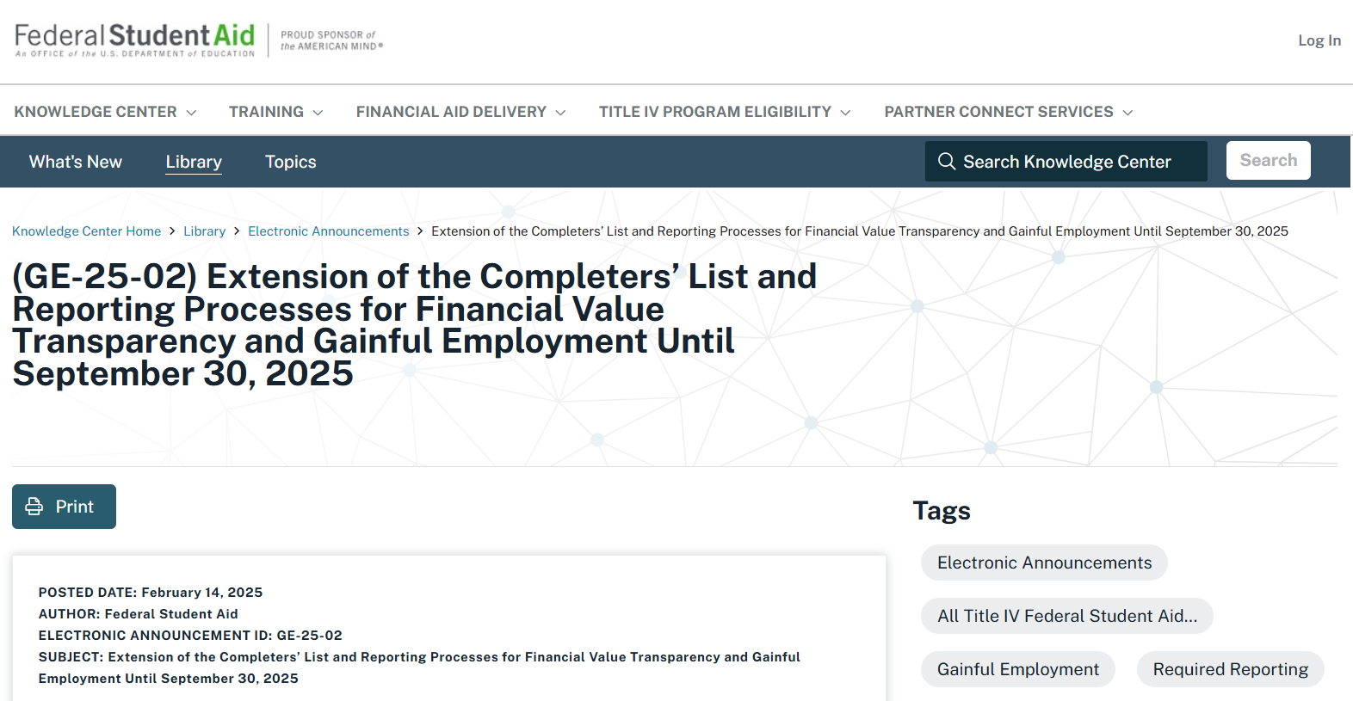

Slide 50
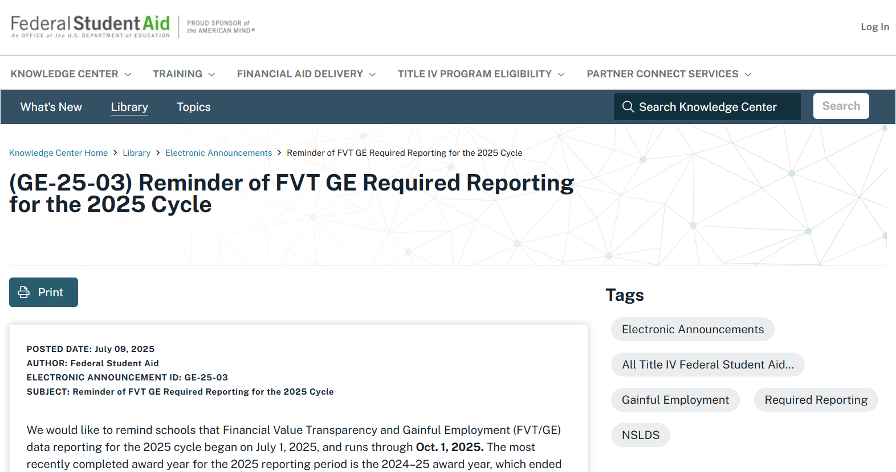

Slide 51


Slide 52

legislative UPDATE

Slide 53
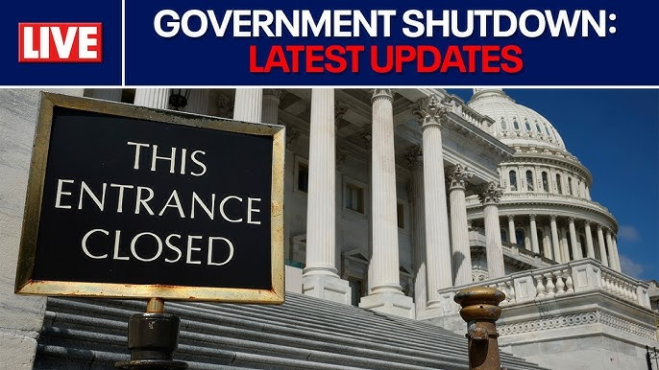

Slide 54
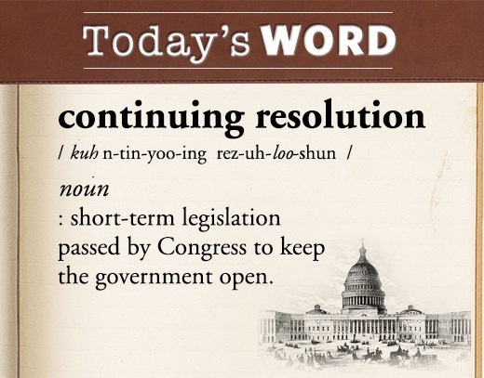
Continuing REsolution

Slide 55


Slide 56

Fiscal Year 2026 appropriations

Slide 57
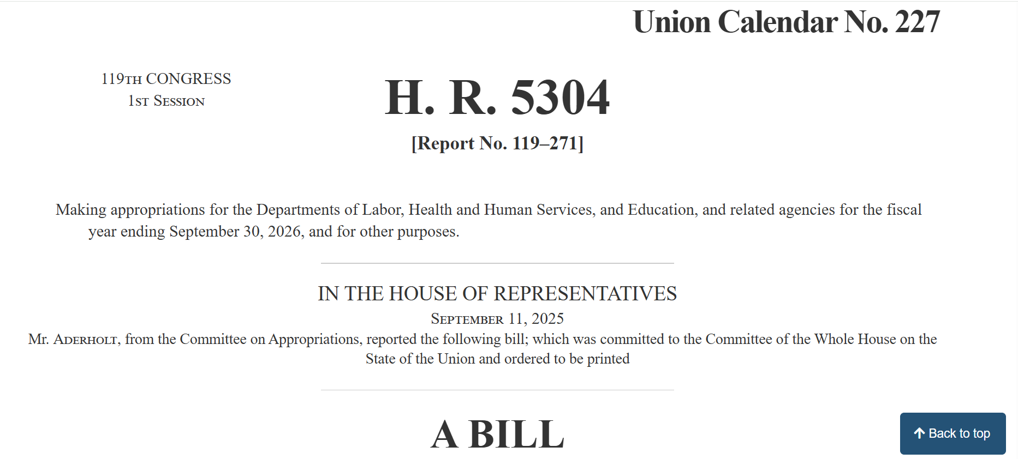
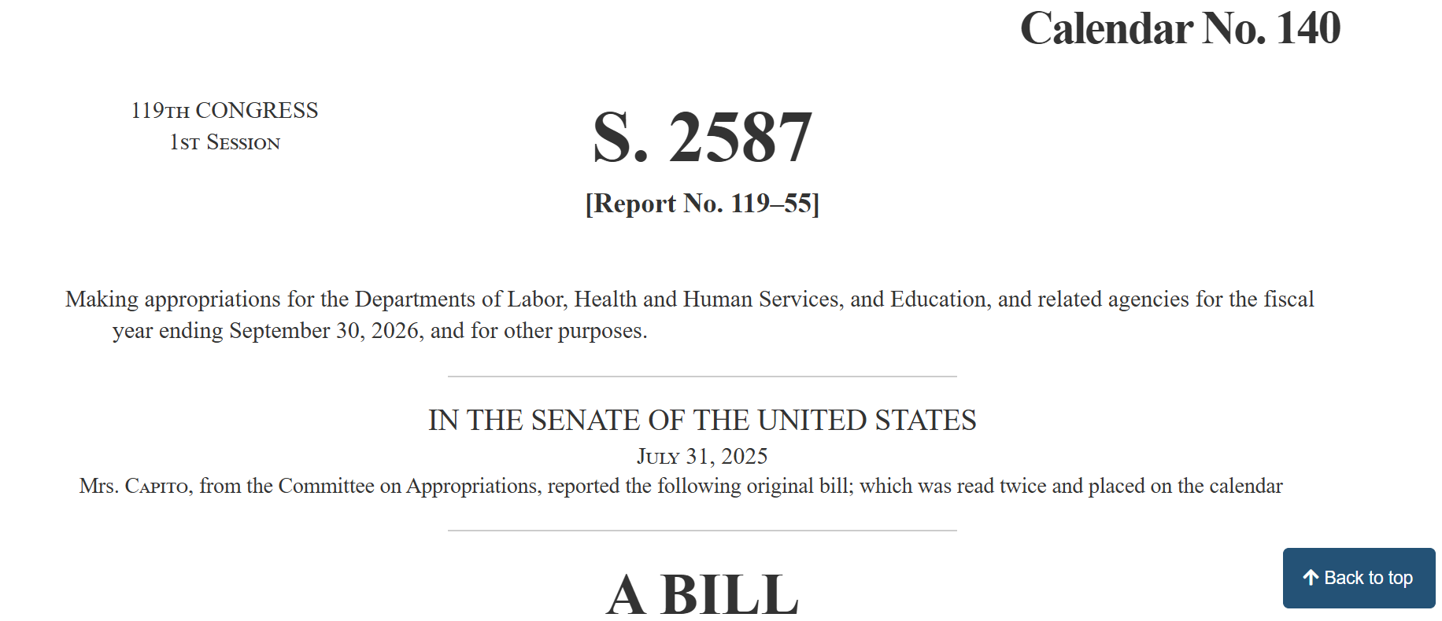
House & Senate Appropriations Bills

Slide 58
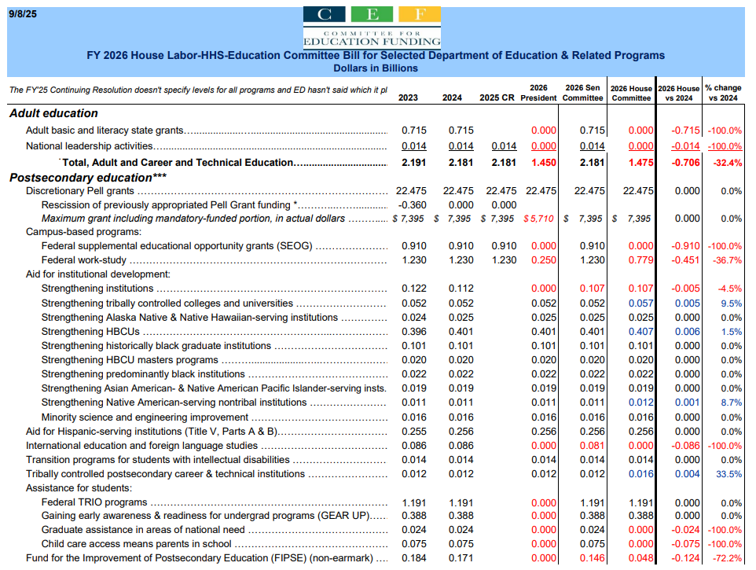

Slide 59
House funding prohibitions
Title III – Department of Education
SEC. 314. None of the funds made available by this Act may be used to—
implement the modifications of statutory and regulatory provisions relating to debt discharge described in the rule published by the Department of Education in the Federal Register on October 12, 2022 (87 Fed. Reg. 61514), or take any substantially similar action;
(2) implement, administer, or enforce section 682.215 or section 685 of title 34, Code of Federal Regulations (relating to income-based repayment and income-driven repayment), as amended by the final regulations published by the Department of Education in the Federal Register on July 10, 2023 (88 Fed. Reg. 43820 et seq.) or take any substantially similar action;
(3) implement, administer, or enforce section 685.401 of title 34, Code of Federal Regulations (relating to borrower defense to repayment), as amended by the final regulations published by the Department of Education in the Federal Register on November 1, 2022 (87 Fed. Reg. 65904 et seq.) or take any substantially similar action;

Slide 60
House funding prohibitions
Title III – Department of Education
SEC. 314. None of the funds made available by this Act may be used to—
(4) implement, administer, or enforce section 668.28 of title 34, Code of Federal Regulations (relating to the 90/10 rule), as added or amended by the final regulations published by the Department of Education in the Federal Register on October 28, 2022 (87 Fed. Reg. 65426 et. seq.) or take any substantially similar action;
(5) implement, administer, or enforce sections 600.10, 600.21, 668.2, 668.13, 668.43, 668.91, 668.402 through 668.409 (excluding section 668.408), and 668.601 through 668.606 of title 34, Code of Federal Regulations (relating to financial value transparency and gainful employment), as added or amended by the final regulations published by the Department of Education in the Federal Register on October 10, 2023 (88 Fed. Reg. 70004 et. seq.) or take any substantially similar action; or
(6) finalize, implement, administer, or enforce the proposed rule titled “Student Debt Relief for the William D. Ford Federal Direct Loan Program (Direct Loans), the Federal Family Education Loan (FFEL) Program, the Federal Perkins Loan (Perkins) Program, and the Health Education Assistance Loan (HEAL) Program” published by the Department of Education in the Federal Register on April 17, 2024 (89 FR 27564) or any substantially similar rule.

Slide 61
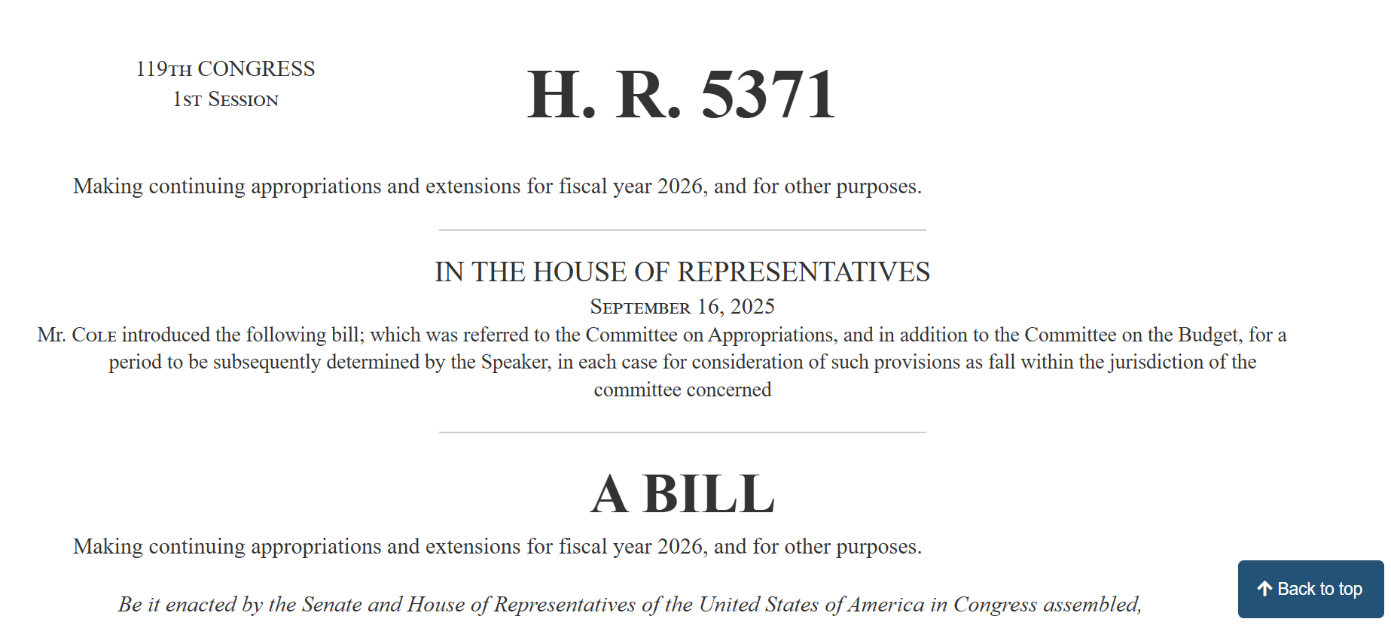

Slide 62

House Veterans Affairs Committee Hearing
Strengthening the Workforce
of Veterans in America

Slide 63


Slide 64

https://www.ed.gov/about/news/press-release/us-secretary-of-education-linda-mcmahon-participates-white-house-roundtable-left-wing-ideological-capture-of-universities

Slide 65

What could be next?

Slide 66


