Slide 1

Current State of Federal Student Loan Repayment
Prepared for CSPEN – March 10, 2026
Alex Ricci, President
National Council of Higher Education Resources
ncher.org

Slide 2
***Disclosures***
Presentation represents the views of NCHER’s president, not any of NCHER’s members.
Nothing in this presentation constitutes legal advice. Consult your attorney before taking any action based on information in this slide deck.
Some images were prepared with the help of agentic artificial intelligence and may contain inaccuracies.

Slide 3
Roadmap
Current state of federal student loan repayment
Near-term outlook, implementation of H.R. 1
What colleges and universities should be thinking about

Slide 4
Current State of Student Loan Repayment (Post-COVID 19)
Direct Loan portfolio (as of the end of Q4, 2025):
In school – 2.9 million borrowers, $113 billion
In repayment – 32.5 million borrowers, $1.2+ trillion
Nearly 16 million borrowers, $500+ billion in standard repayment plans
3+ million borrowers, $100+ billion in graduated repayment plans
12.5 million borrowers, $725 billion in an IDR plan
Including 7.43 million borrowers, $410 billion enrolled in SAVE Plan.
In forbearance/deferment – 2.5 million borrowers, $160 billion
In delinquency – 6.4 million borrowers, $168 billion
31-90 days – 1.4 million borrowers, $40 billion
91-180 days – 1 million borrowers, $24 billion
181-270 days – 850 thousand borrowers, $21 billion
271-360 days – 3.4 million borrowers, $83 billion
In default as of September 2025 – 5.5 million borrowers, $116 billion

Slide 5
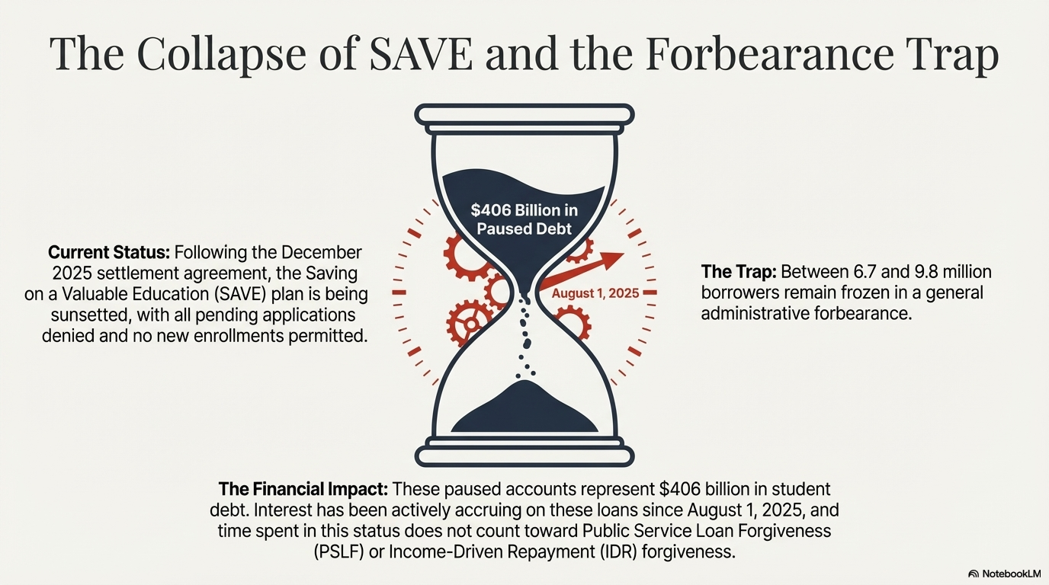

Slide 6
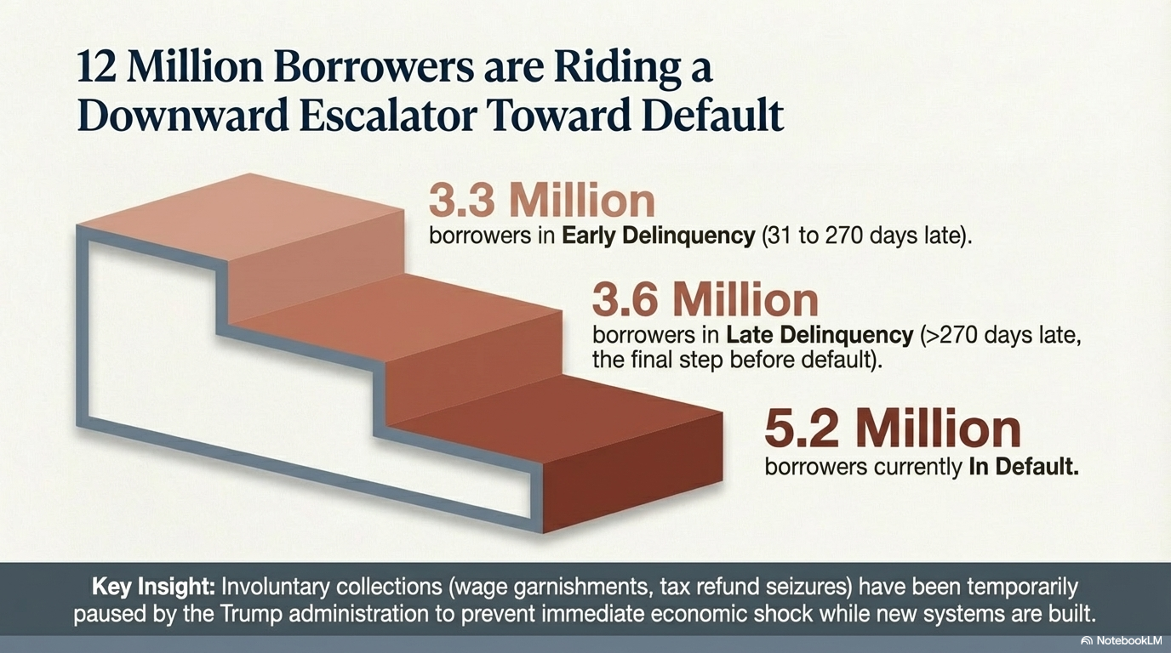

Slide 7

Just 40% of the ED-held student loan portfolio is in active repayment

Slide 8
Near-Term Outlook of Student Loan Repayment and Transition to H.R. 1

Slide 9
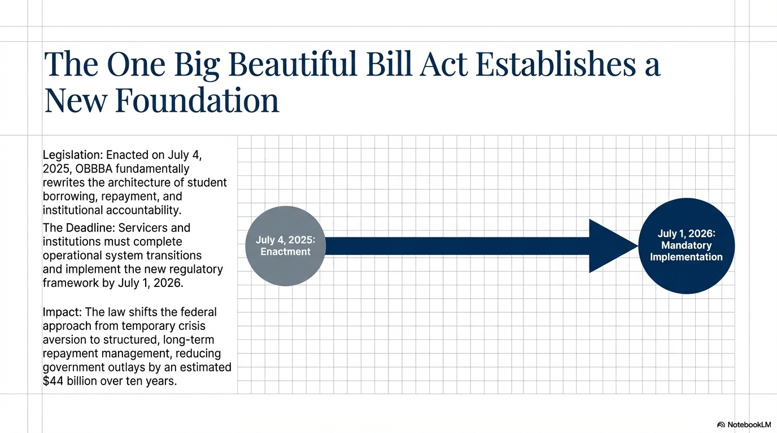

Slide 10
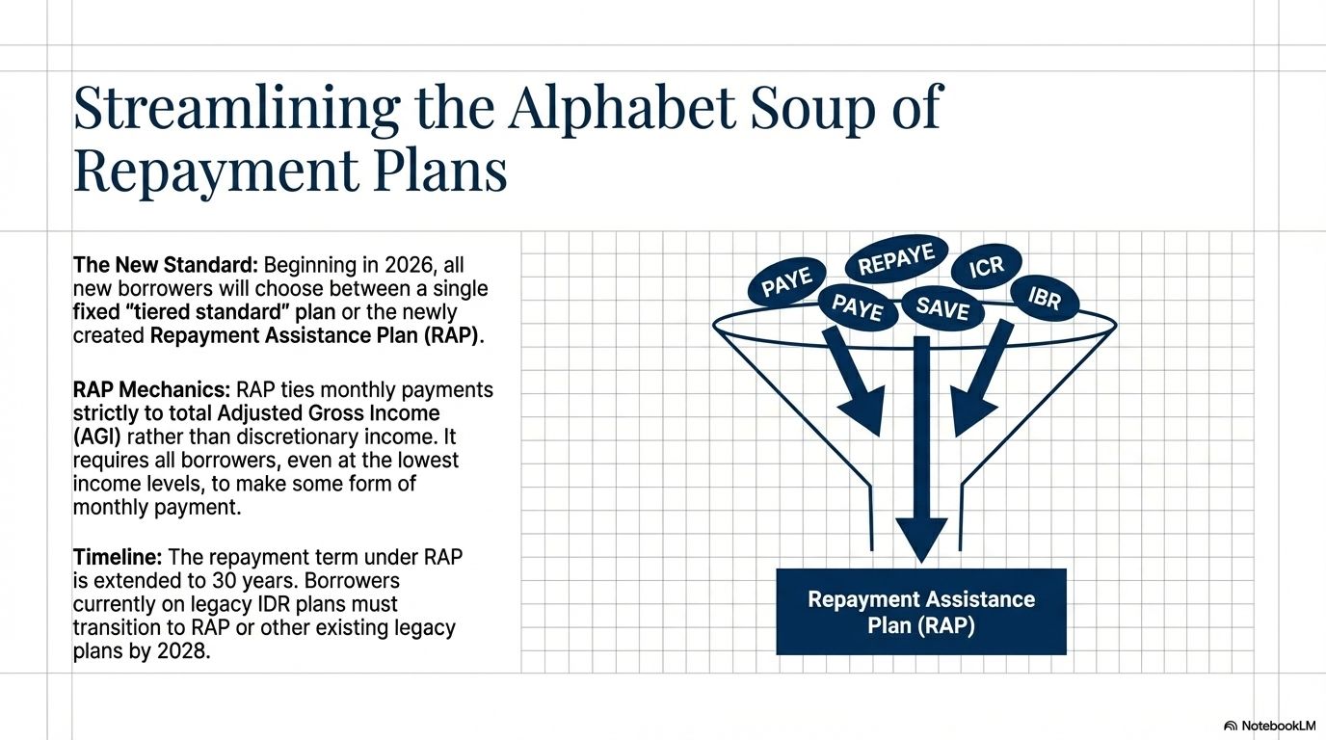

Slide 11
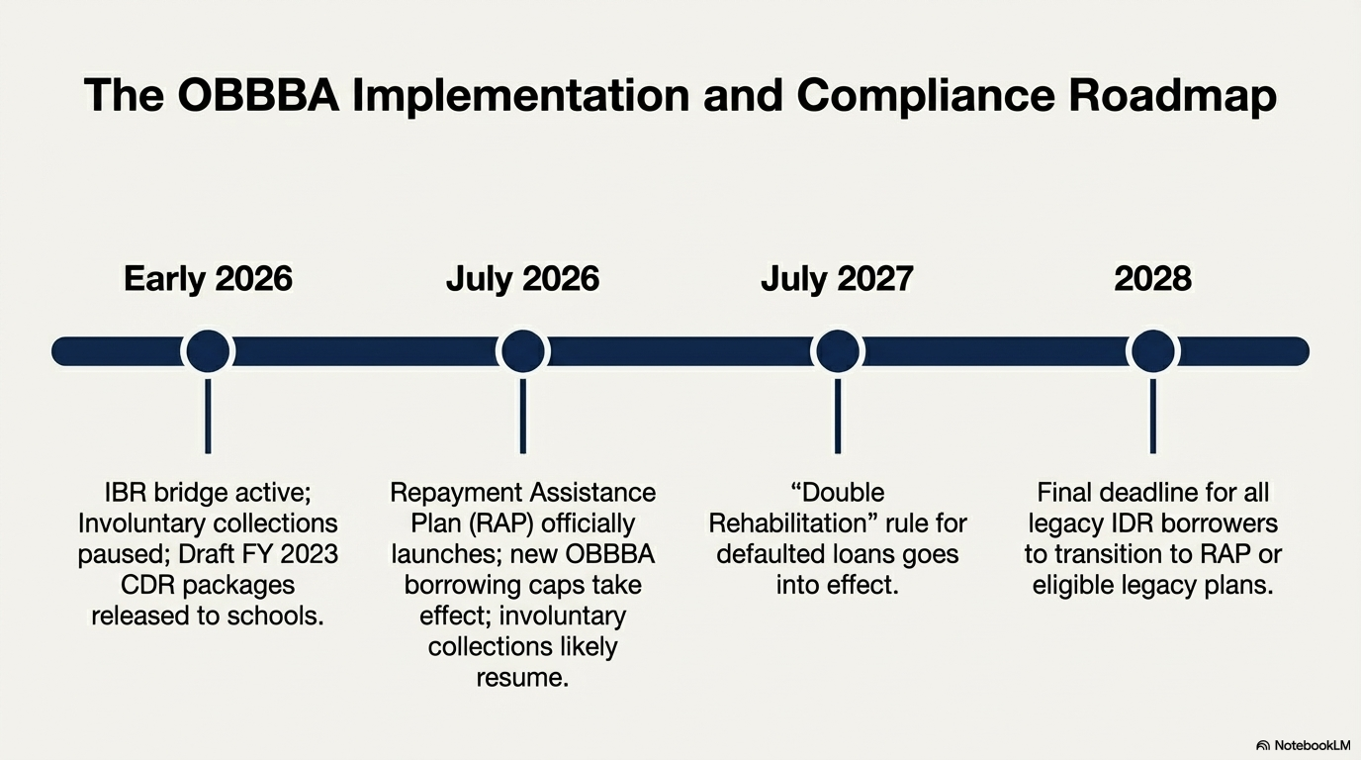

Slide 12
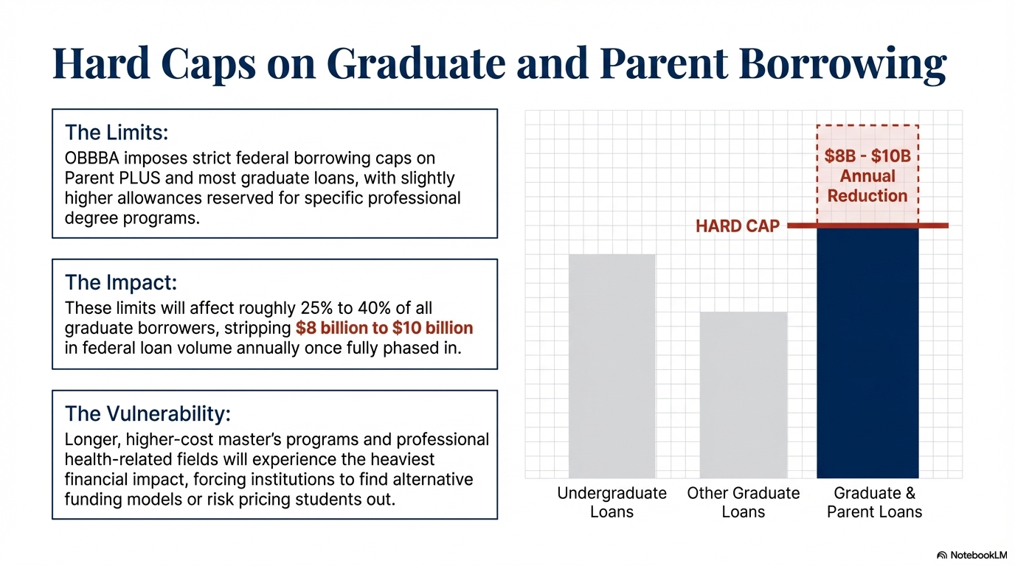

Slide 13

What Colleges and Universities Should Be Doing

Slide 14
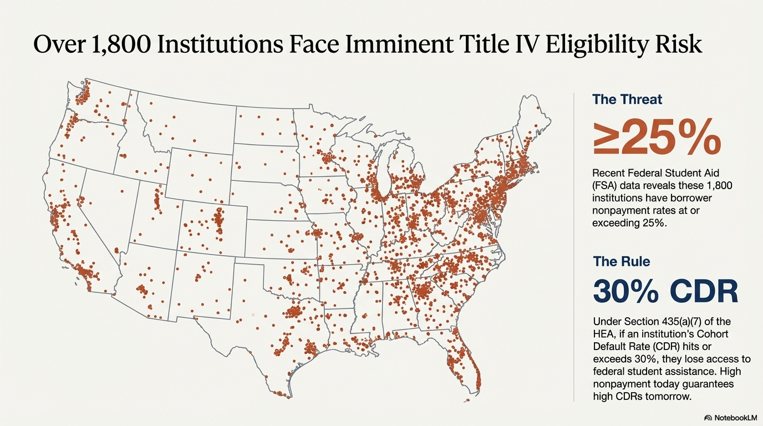

Slide 15
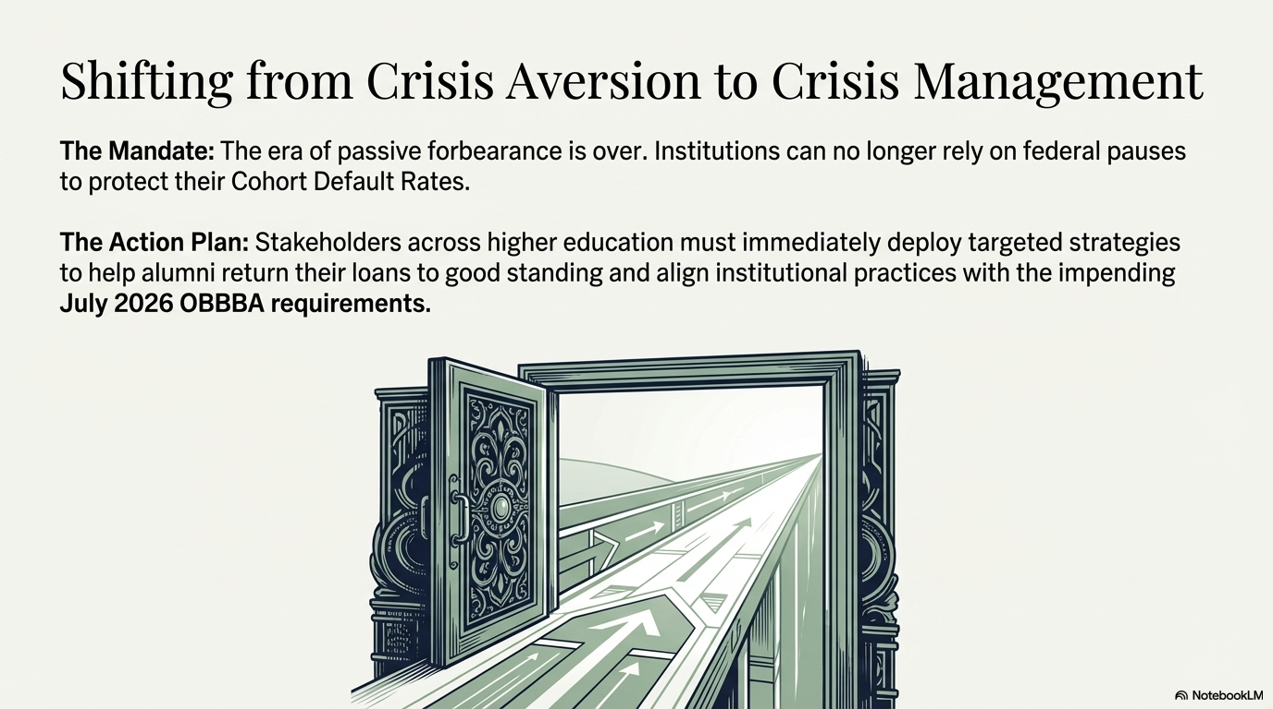

Slide 16
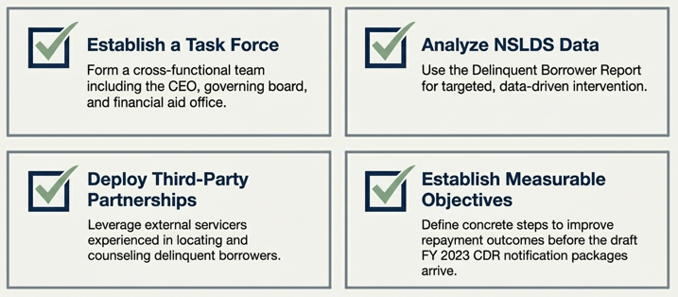

Slide 17
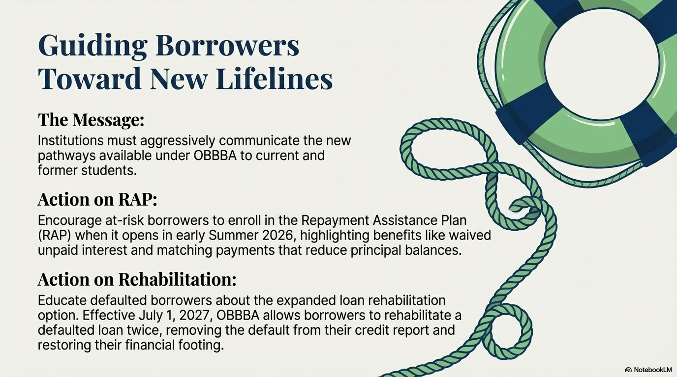

Slide 18

Inform Parent Borrowers (Past, Current, and Future) of How July 1, 2026, Impacts Them
New annual/aggregate loan limits
Additional borrowing effects loan repayment plan eligibility
Including, possibly, the parents’ undergraduate loans.

Slide 19

Two Other Loan Limit Factors for Institutions to Monitor
Loan “schedule of reductions” for less-than-full-time enrollment
School-determined annual loan limits by program of study

Slide 20
Questions?

