Slide 1


Federal legislative
&
Regulatory
Update
Thursday, June 11, 2026

Slide 2
AGENDA
Department of Education
Student Loan Reduction for Less Than Full Time Enrollment Webinar
&
House FY27 Appropriations and Fraud Preventions Legislation Summaries
Federal Regulatory Update
Federal Legislative Update
Q&A

Slide 3



REGULATORY
UPDATE

Slide 4


Slide 5
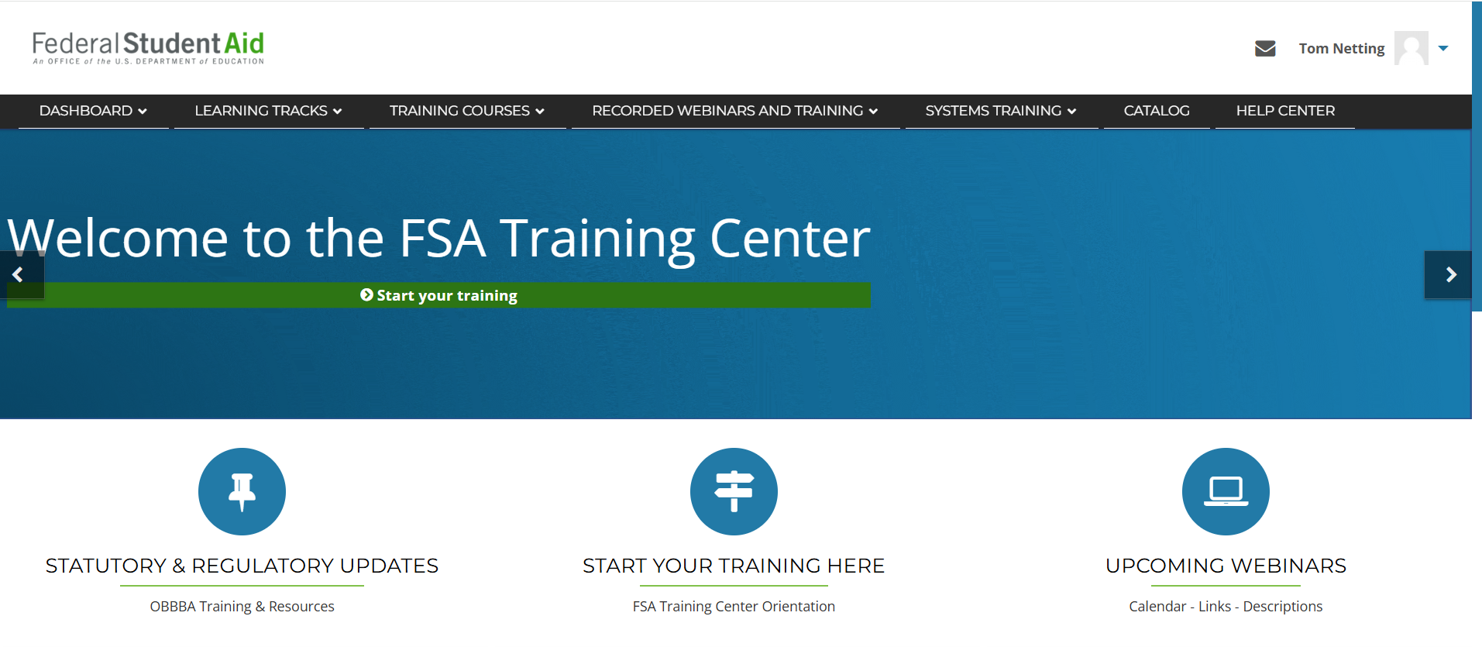
https://fsatraining.ed.gov/

Slide 6
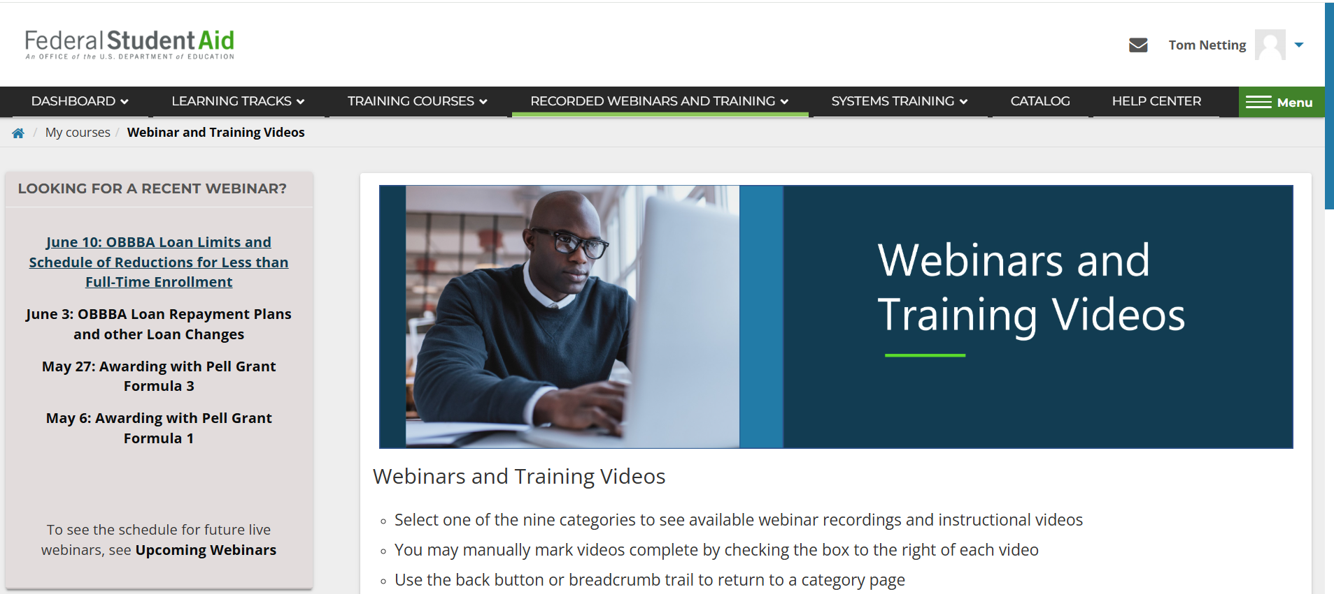
https://fsatraining.ed.gov/course/view.php?id=107

Slide 7
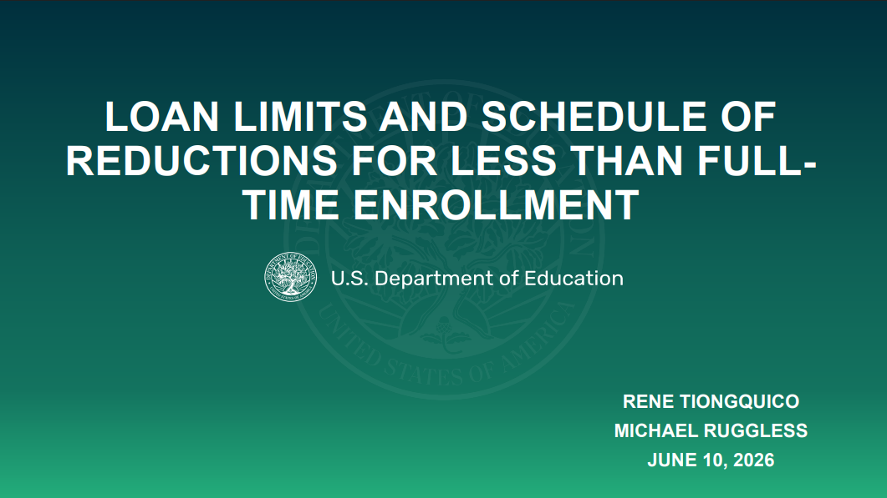

Slide 8
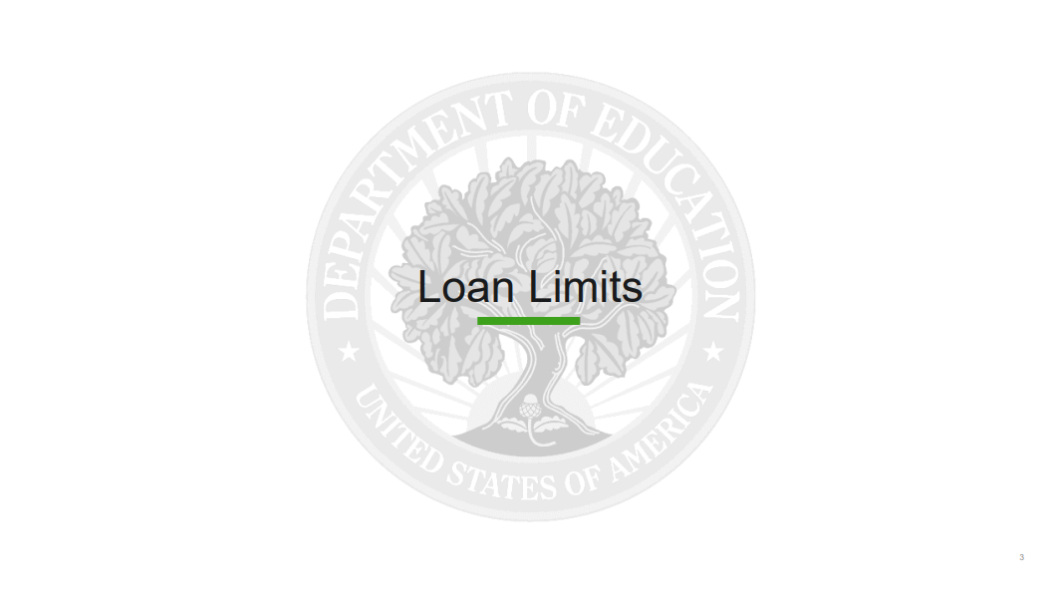

Slide 9
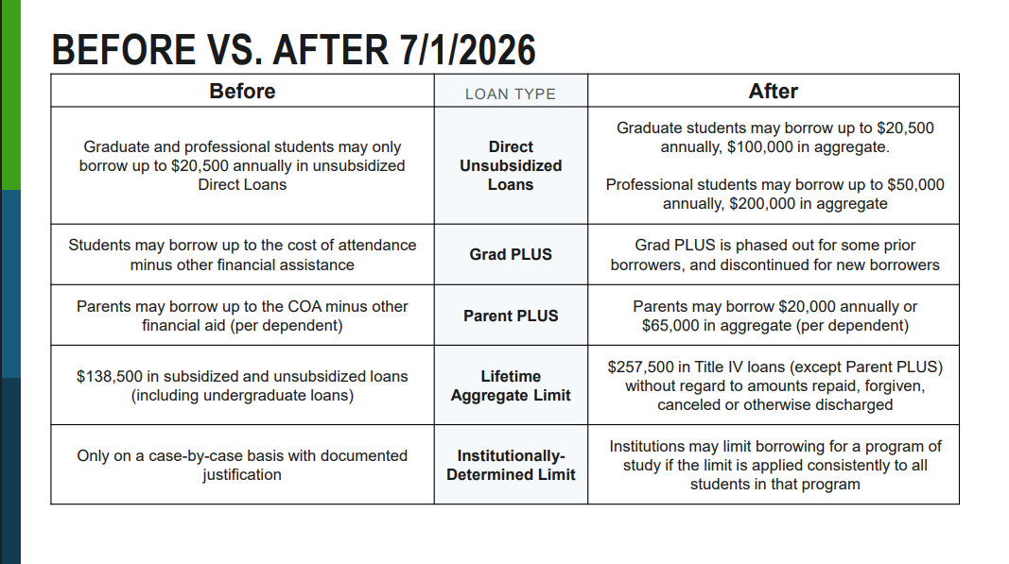

Slide 10
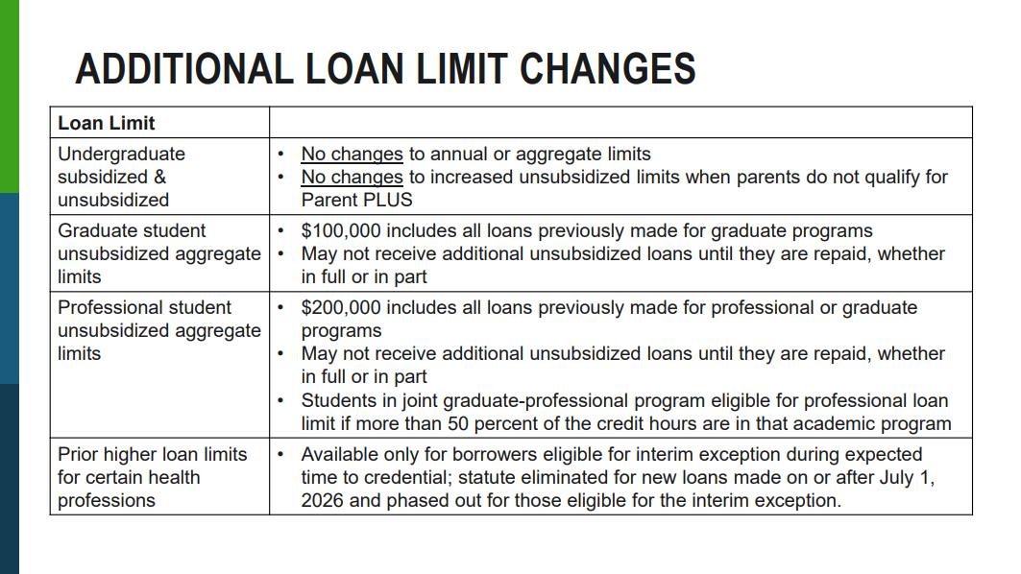

Slide 11
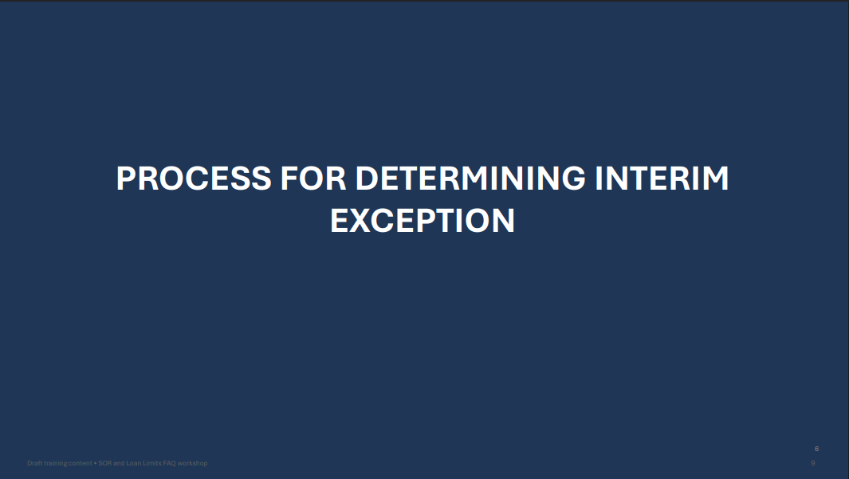

Slide 12
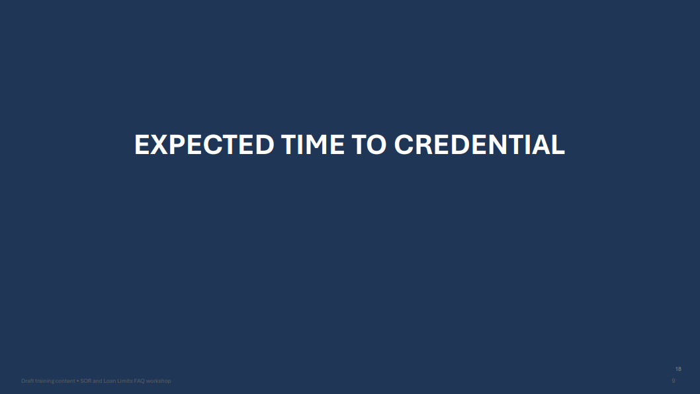

Slide 13
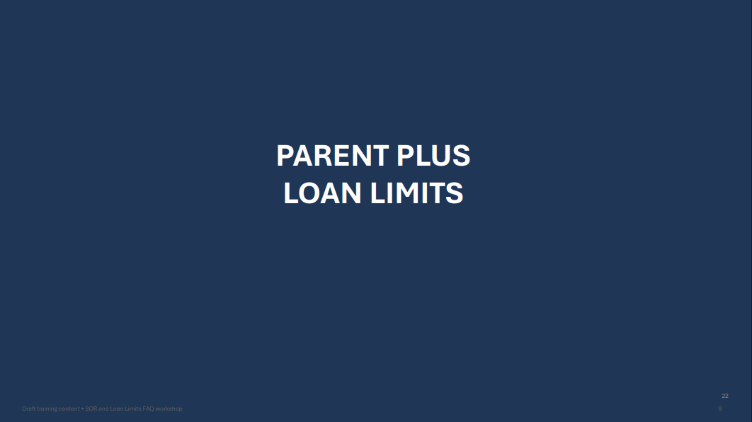

Slide 14
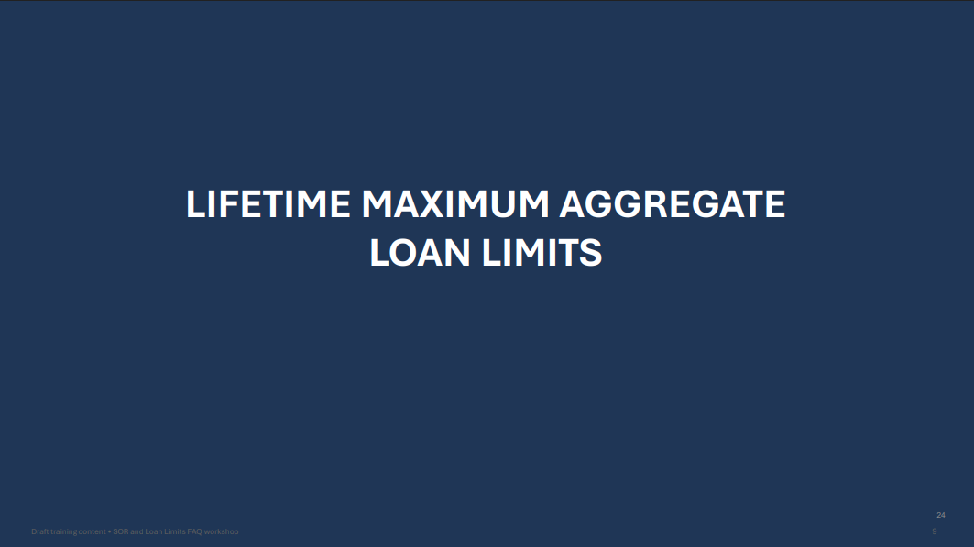

Slide 15
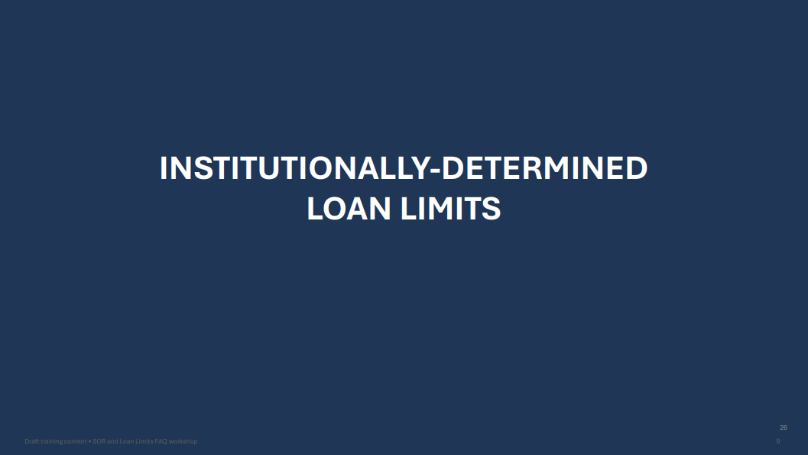

Slide 16
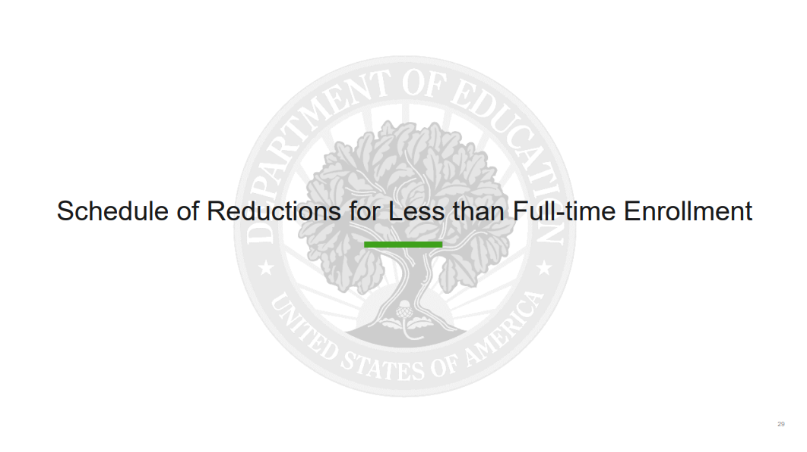

Slide 17
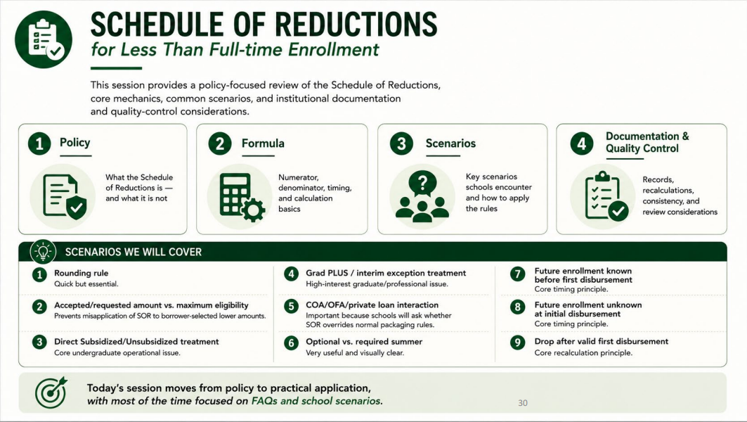

Slide 18
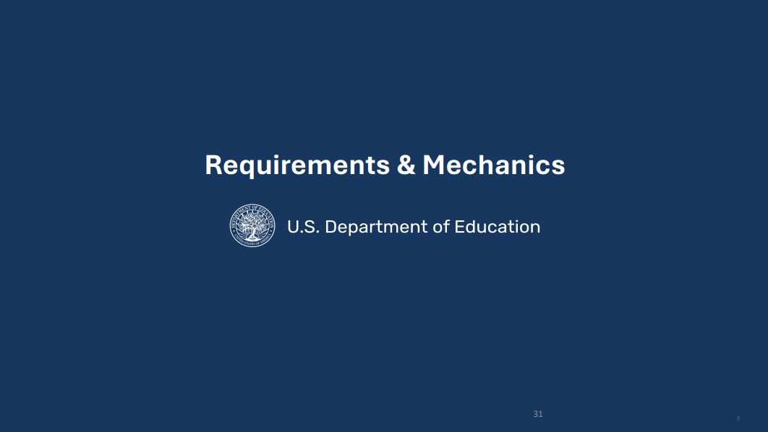

Slide 19
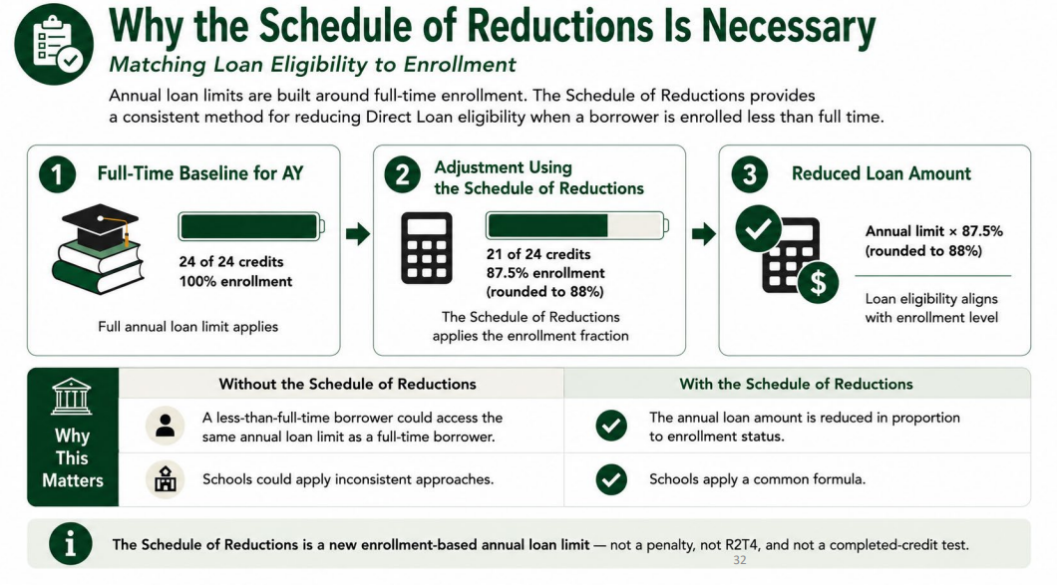

Slide 20
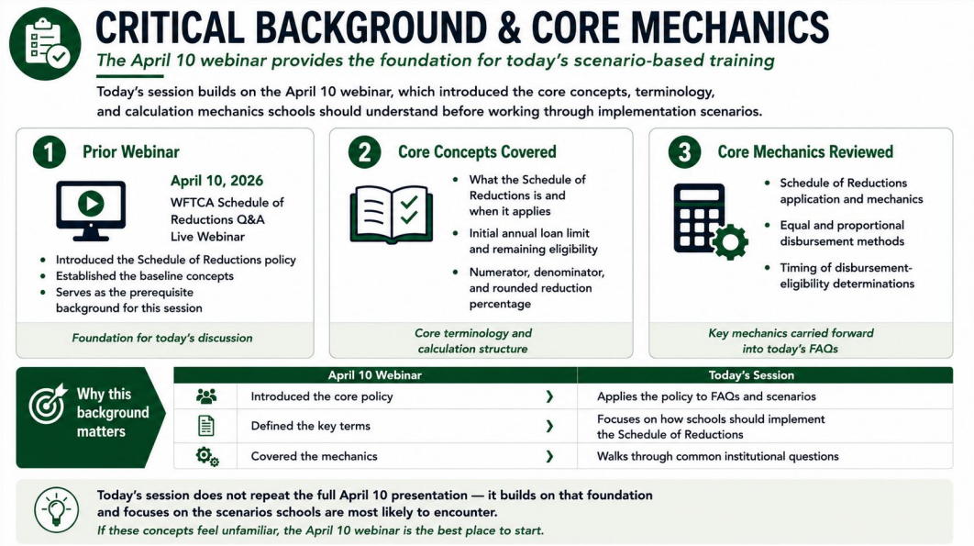

Slide 21
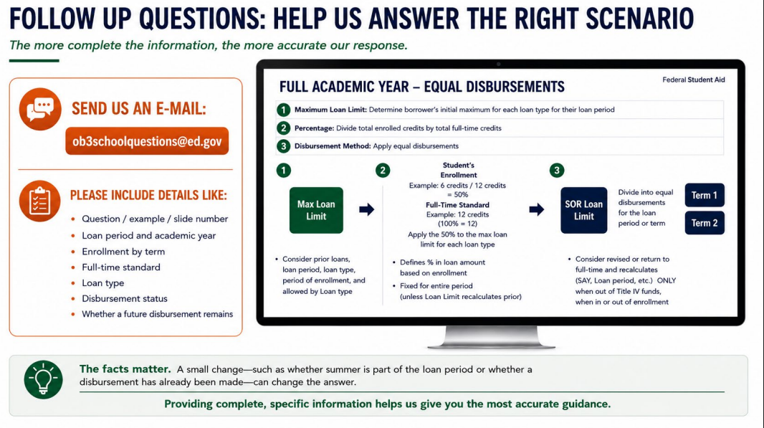

Slide 22
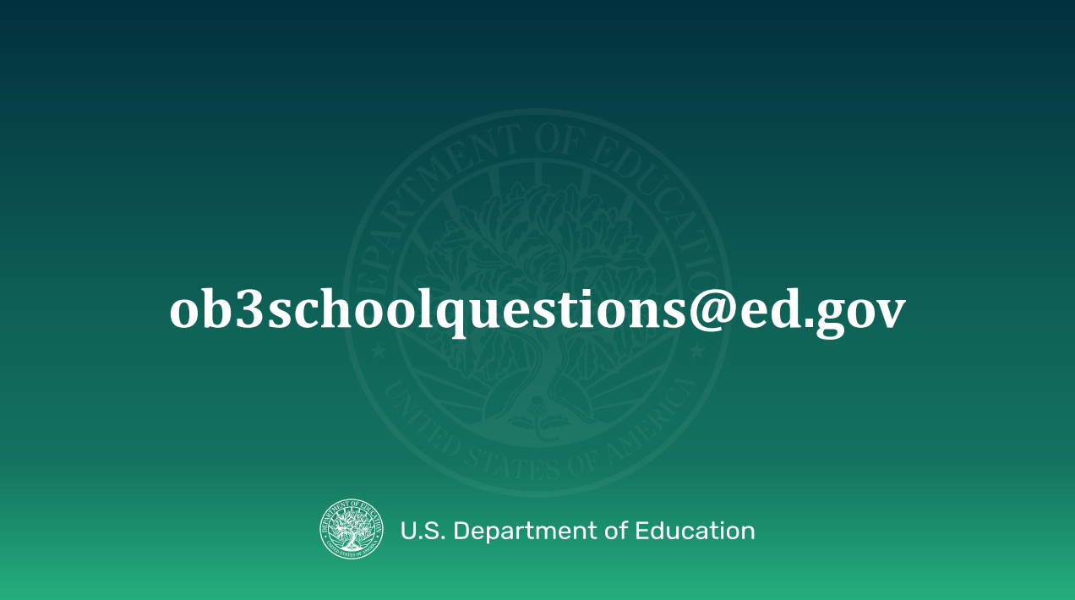

Slide 23


Slide 24


Slide 25
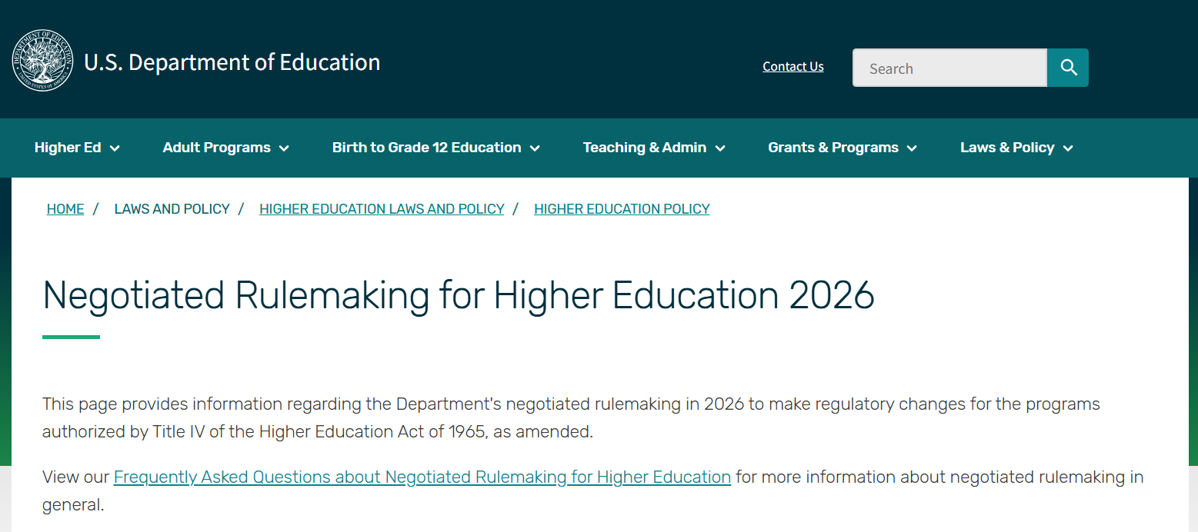
https://www.ed.gov/laws-and-policy/higher-education-laws-and-policy/higher-education-policy/negotiated-rulemaking-higher-education-2026

Slide 26
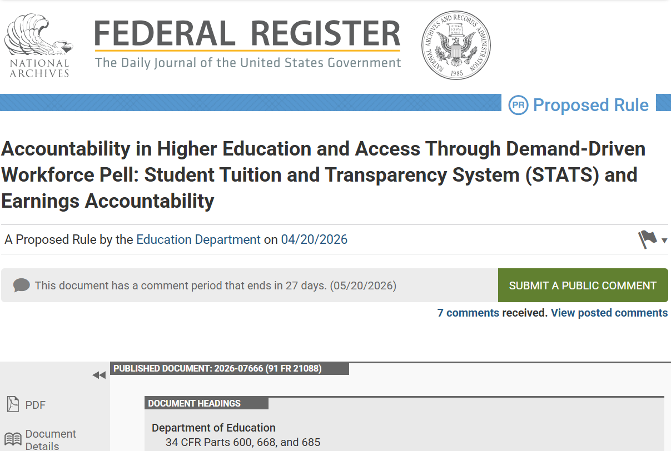
https://www.federalregister.gov/documents/2026/04/20/2026-07666/accountability-in-higher-education-and-access-through-demand-driven-workforce-pell-student-tuition

Slide 27
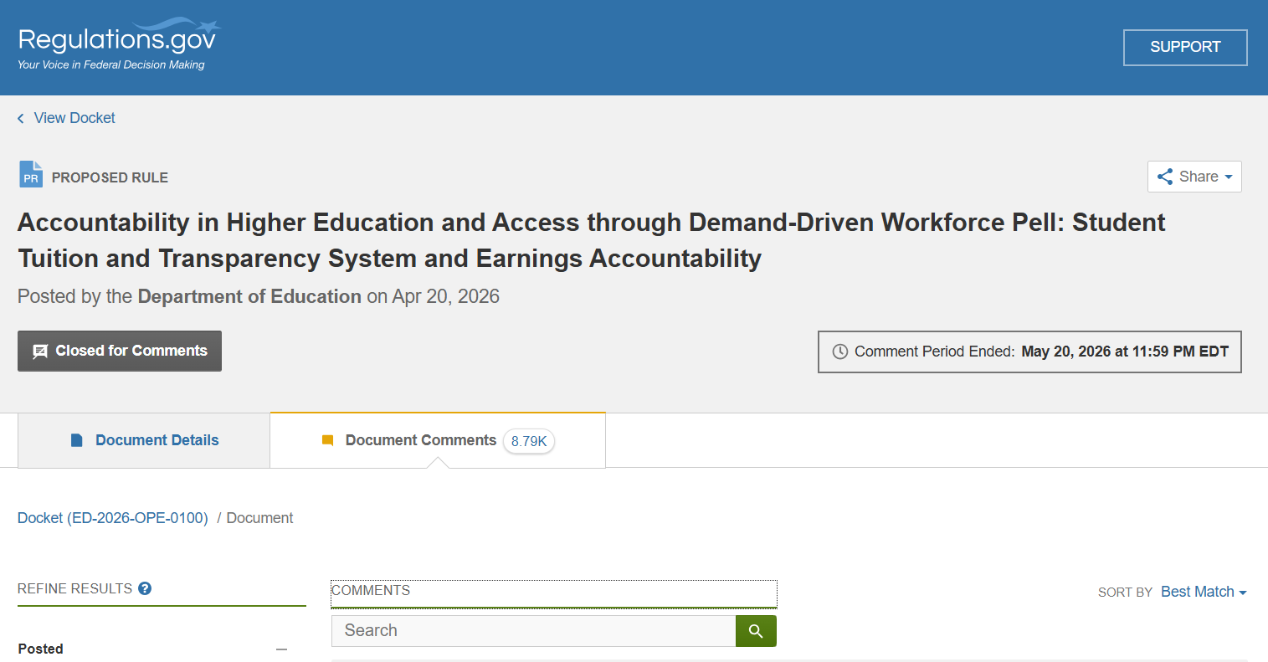
https://www.regulations.gov/document/ED-2026-OPE-0100-0001/comment

Slide 28


Slide 29
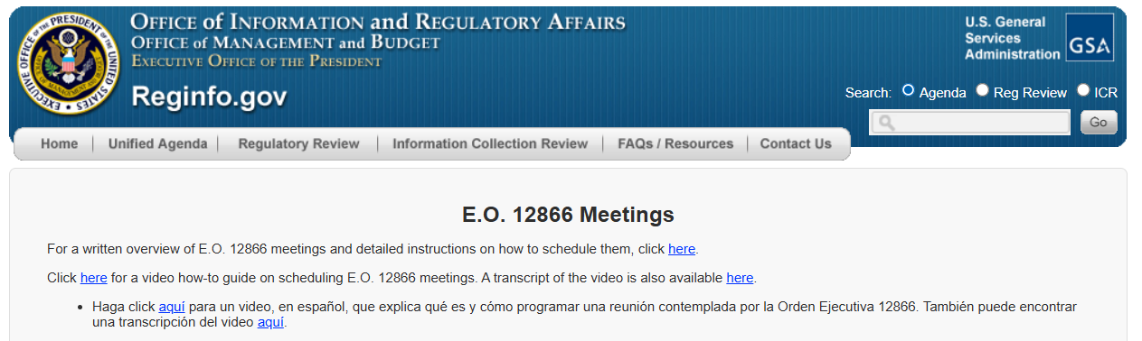

Slide 30
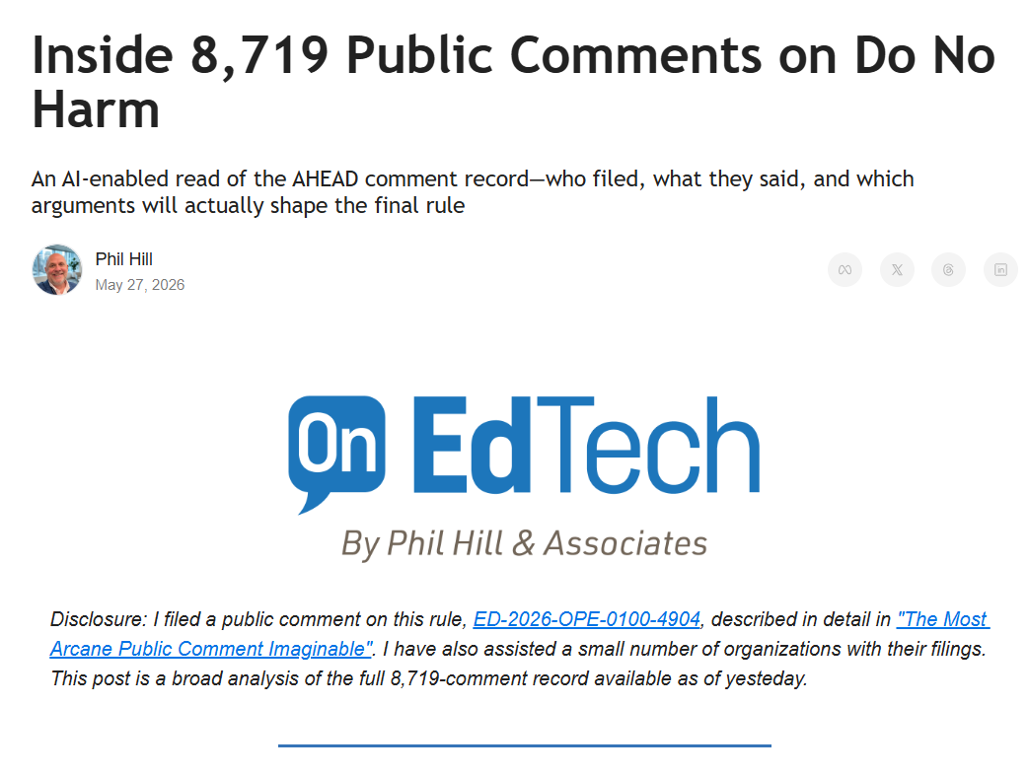
https://onedtech.philhillaa.com/p/inside-8-719-public-comments-on-do-no-harm?utm_source=onedtech.philhillaa.com&utm_medium=newsletter&utm_campaign=inside-8-719-public-comments-on-do-no-harm&_bhlid=2b4073c777ed3c034ecbc3614ca9023d1f706805

Slide 31


Slide 32
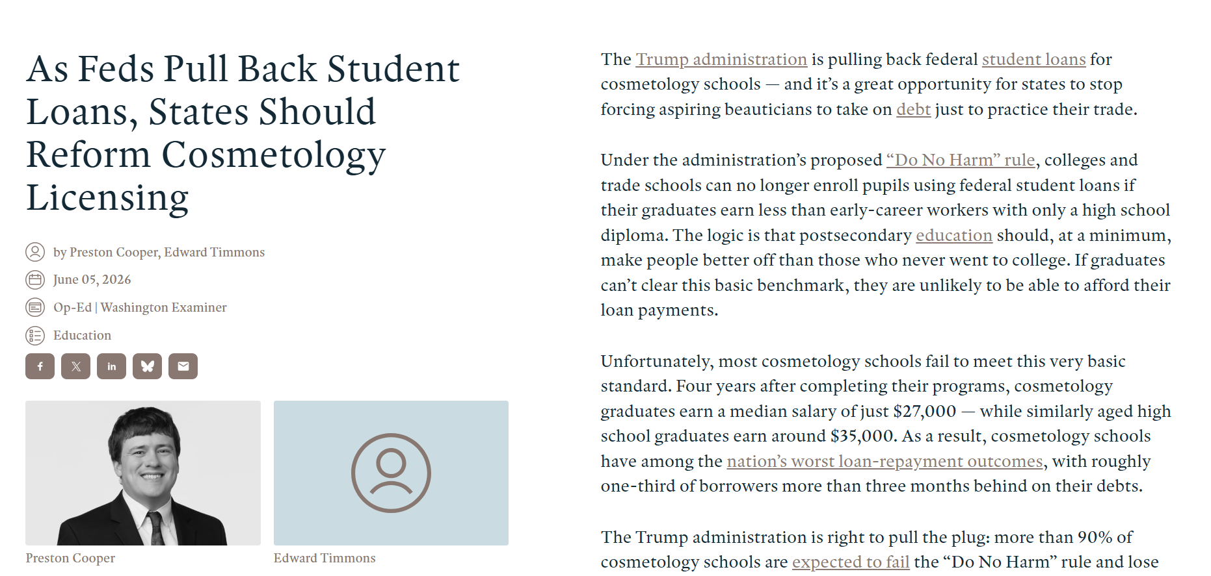
https://www.aei.org/op-eds/as-feds-pull-back-student-loans-states-should-reform-cosmetology-licensing/

Slide 33
American Enterprise Institute op ed
The Trump administration is pulling back federal student loans for cosmetology schools — and it’s a great opportunity for states to stop forcing aspiring beauticians to take on debt just to practice their trade.
Under the administration’s proposed “Do No Harm” rule, colleges and trade schools can no longer enroll pupils using federal student loans if their graduates earn less than early-career workers with only a high school diploma. The logic is that postsecondary education should, at a minimum, make people better off than those who never went to college. If graduates can’t clear this basic benchmark, they are unlikely to be able to afford their loan payments.
Unfortunately, most cosmetology schools fail to meet this very basic standard. Four years after completing their programs, cosmetology graduates earn a median salary of just $27,000 — while similarly aged high school graduates earn around $35,000. As a result, cosmetology schools have among the nation’s worst loan-repayment outcomes, with roughly one-third of borrowers more than three months behind on their debts.
https://www.aei.org/op-eds/as-feds-pull-back-student-loans-states-should-reform-cosmetology-licensing/

Slide 34
American Enterprise Institute op ed
The Trump administration is right to pull the plug: more than 90% of cosmetology schools are expected to fail the “Do No Harm” rule and lose access to federal loans. That will protect hundreds of thousands of students from unaffordable debt. Meanwhile, taxpayers will no longer have to eat the cost when those borrowers inevitably fail to repay.
But the Do No Harm rule should be only the beginning of a broader conversation about how to change the way barbers, hairstylists, and manicurists prepare for their careers. Every state licenses these professions; some, including Nebraska and West Virginia, require them to undergo over 1,800 hours of training before earning the right to work. The federal government has effectively subsidized these excessive training requirements through unconditional student loan subsidies — but now that funding stream is winding down.
States should take the opportunity to cut the number of required training hours to become a licensed cosmetologist. Research has shown that recent reductions in mandated required training hours have reduced tuition and increased enrollment. Some evidence even suggests that the ensuing enrollment increases improve cosmetology schools’ profits.
https://www.aei.org/op-eds/as-feds-pull-back-student-loans-states-should-reform-cosmetology-licensing/

Slide 35
American Enterprise Institute op ed
Utah is one example of a state taking significant steps to reform cosmetology licensing requirements. With the enactment of SB 330 last year, most cosmetology education requirements were cut from 1,600 to 1,250 hours. Barbers can now obtain a license to work in Utah with just 130 hours of education. Aspiring workers may also substitute apprentice hours for beauty school hours.
But states could go even further and end cosmetologist licensure entirely. Cosmetologist licensing is not ubiquitous worldwide. More than 119 million people in the UK and Spain live without cosmetologist licensing. Several Canadian provinces, including British Columbia, also do not require cosmetology licensing. Instead, regulation often occurs at the shop level. Beauty salons may need to register their business and be subject to random inspections. This way, the public is offered protection without overly cumbersome regulation that limits entry to the profession, which research has shown fails to prevent accidents and bad actors.
Cosmetology schools could still exist in a world without licensure. But rather than relying on state training mandates, they would need to demonstrate their educational value to attract voluntary paying customers. Beauty schools, which effectively teach students to become better at their craft — and achieve higher wages — could thrive. But those that exist mainly as a box for aspiring beauticians to check on the road to licensure would need to reform.
https://www.aei.org/op-eds/as-feds-pull-back-student-loans-states-should-reform-cosmetology-licensing/

Slide 36

American Enterprise Institute op ed
Heavy licensing requirements for cosmetologists were supposed to protect the public. Instead, licensing has sentenced barbers and hairstylists to unaffordable student debt. By reducing or even eliminating cosmetology licensing, states can address the student debt crisis and expand opportunity in one blow.
https://www.aei.org/op-eds/as-feds-pull-back-student-loans-states-should-reform-cosmetology-licensing/

Slide 37
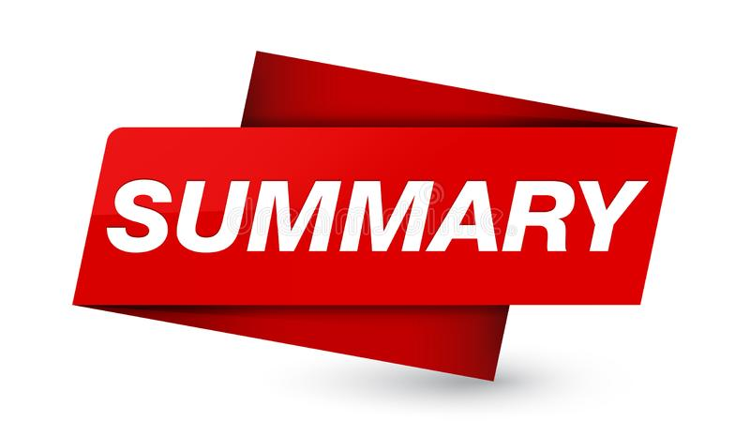

Slide 38

public service loan forgiveness
Final Regulations Published
10/31/2025

Slide 39
Reimagining and
Improving
Student Education
(RISE)
Committee
Final Regulations Published
5/1/2026

Slide 40
ACCOUNTABILITY IN HIGHER EDUCATION
AND ACCESS
THROUGH
DEMAND-DRIVEN WORKFORCE PELL (AHEAD) Committee
Federal workforce Pell
& other Pell issues
Final Regulations Published
May 19, 2026

Slide 41
ACCOUNTABILITY IN HIGHER EDUCATION
AND ACCESS
THROUGH
DEMAND-DRIVEN WORKFORCE PELL (AHEAD) Committee
Student tuition and Transparency system
& earnings accountability
Notice of Proposed Rulemaking
Public Comment Period Closed
May 20, 2026

Slide 42
Accreditation, Innovation, and modernization
COMMITTEE
Committee Reached Concensus
On Proposed Regulatory Package
May 21 ,2026

Slide 43


Slide 44
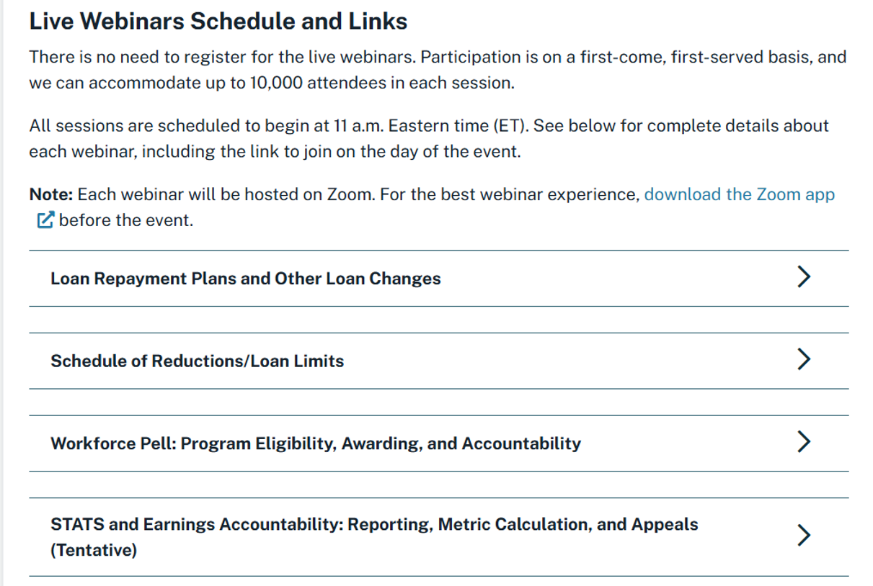
https://fsapartners.ed.gov/knowledge-center/library/dear-colleague-letters/2026-05-21/live-webinars-and-virtual-office-hours-obbba-implementing-regulations-training-series-may-july-2026

Slide 45
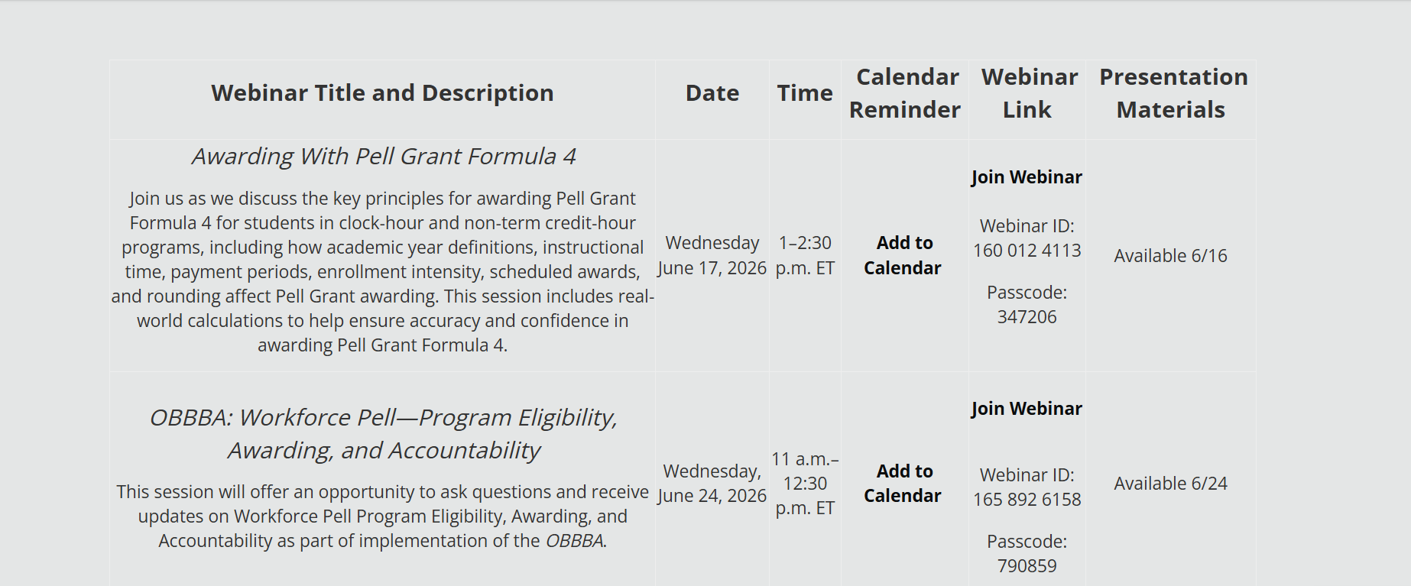

Slide 46
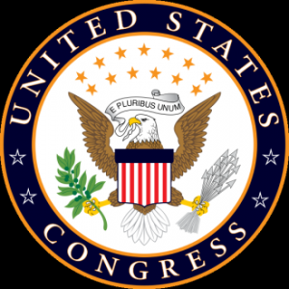
legislative
UPDATE

Slide 47
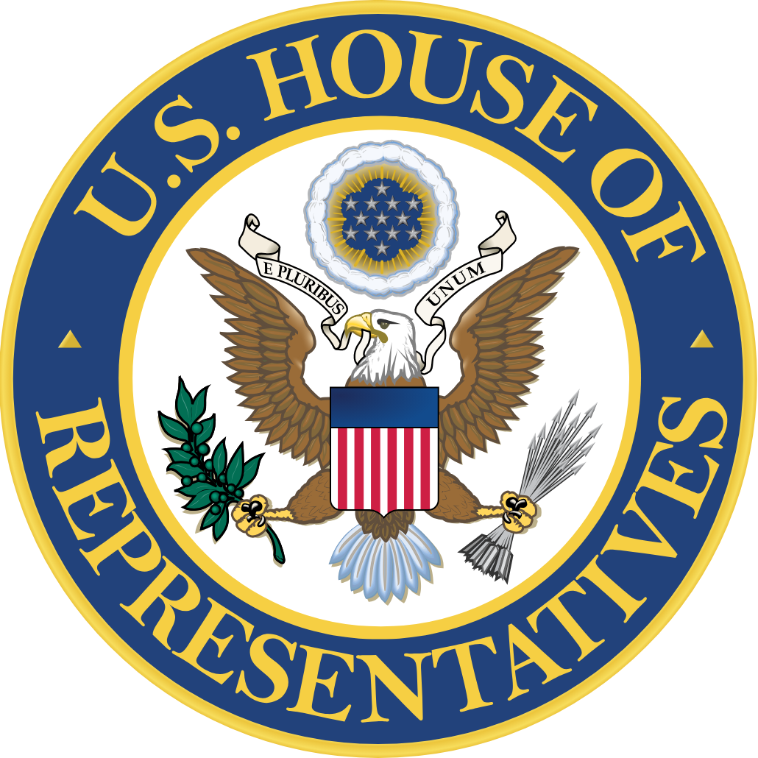
U.S.
House of Representatives

Slide 48
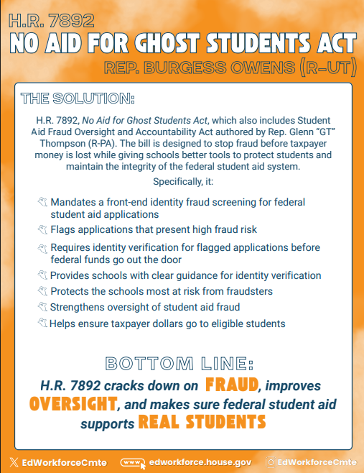
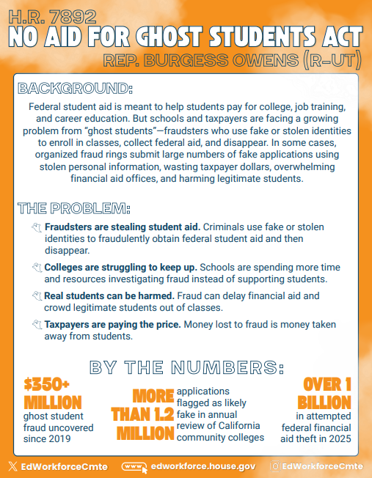

Slide 49
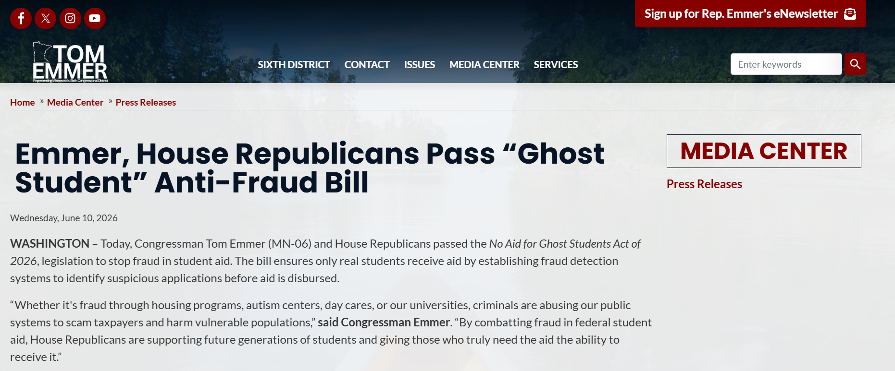
https://emmer.house.gov/media-center/press-releases/emmer-house-republicans-pass-ghost-student-anti-fraud-bill

Slide 50
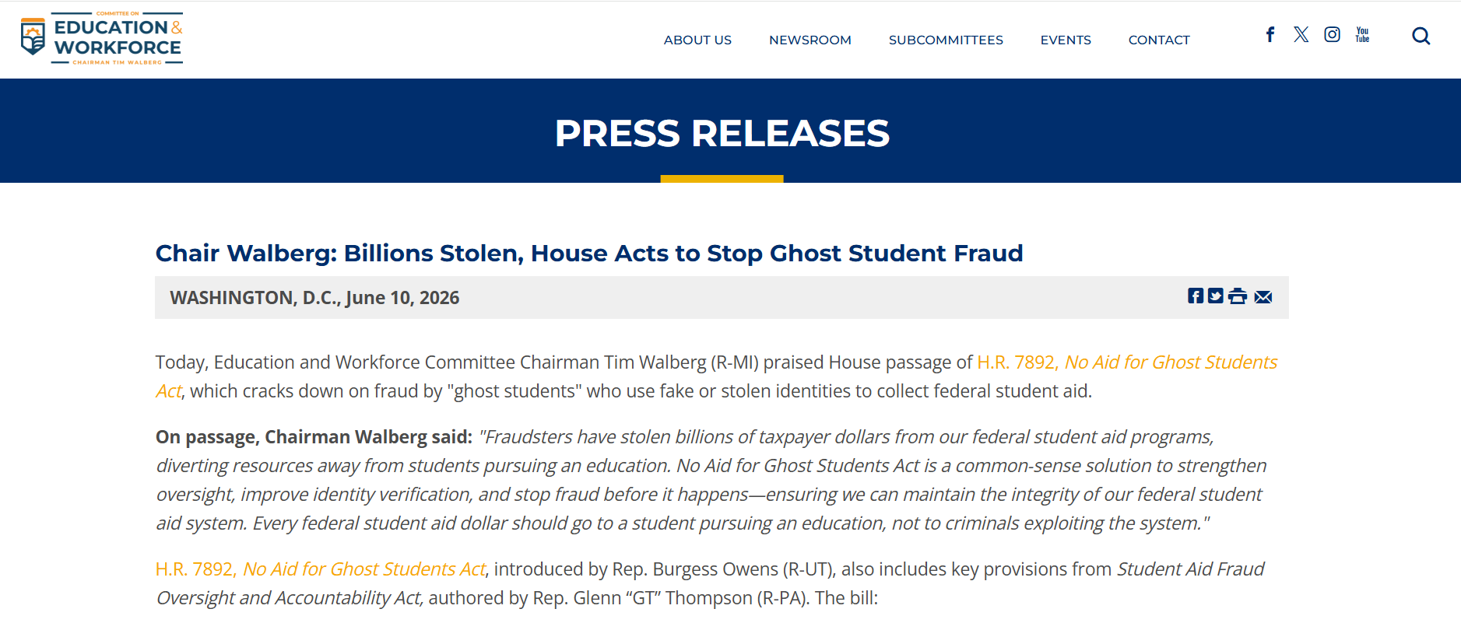
https://edworkforce.house.gov/news/documentsingle.aspx?DocumentID=413368

Slide 51
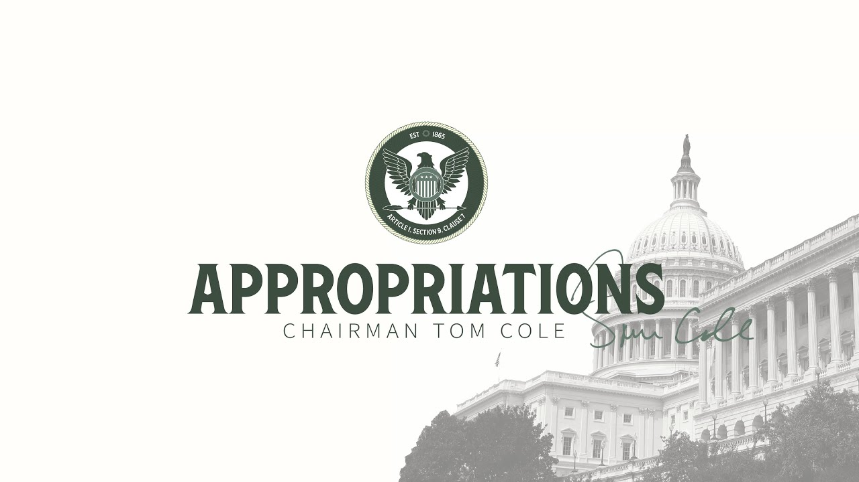
House committee on appropriations

Slide 52
MANAGER’s AMENDMENT
Rep. Lauren Underwood (D-IL) expressed support for the amendment, citing provisions that would block the Department of Education from declassifying nursing as a professional degree, affecting students’ access to student loans. She also supported health research provisions included in the amendment.
Rep. Henry Cuellar (D-TX) expressed support for the amendment, citing an outcome-based program review provision that requires the agencies included in the bill to undergo a review of their internal policies and regulations to determine what is outdated and what may need reform. He also thanked the committee for adding language related to energy workforce development. He urged the committee to support the amendment.
Rep. Adriano Espaillat (D-NY) thanked the Chairman and Ranking member for the manager’s amendment, saying it helps address potential harm to constituents who benefit from PELL grants.

Slide 53
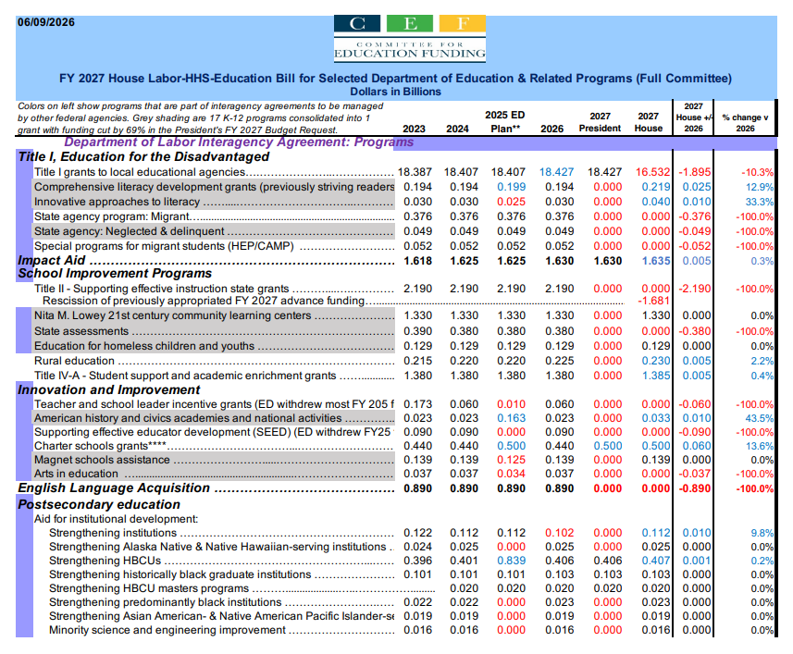

Slide 54
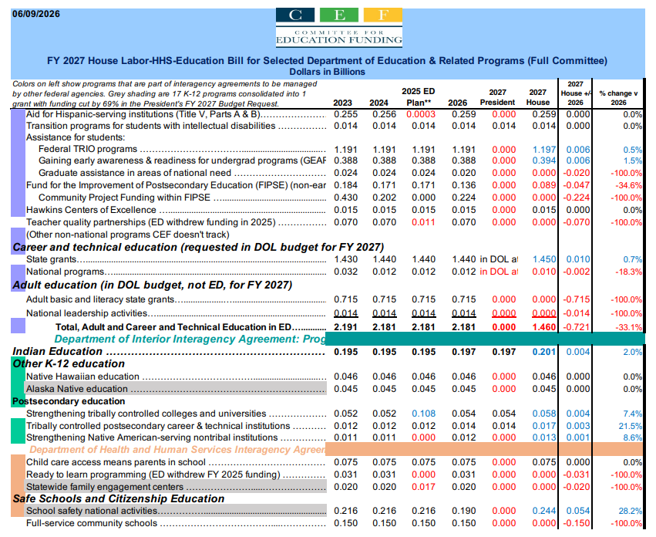

Slide 55
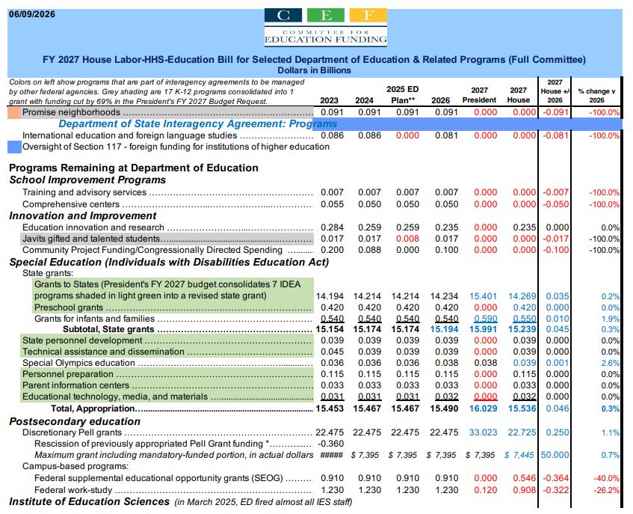

Slide 56
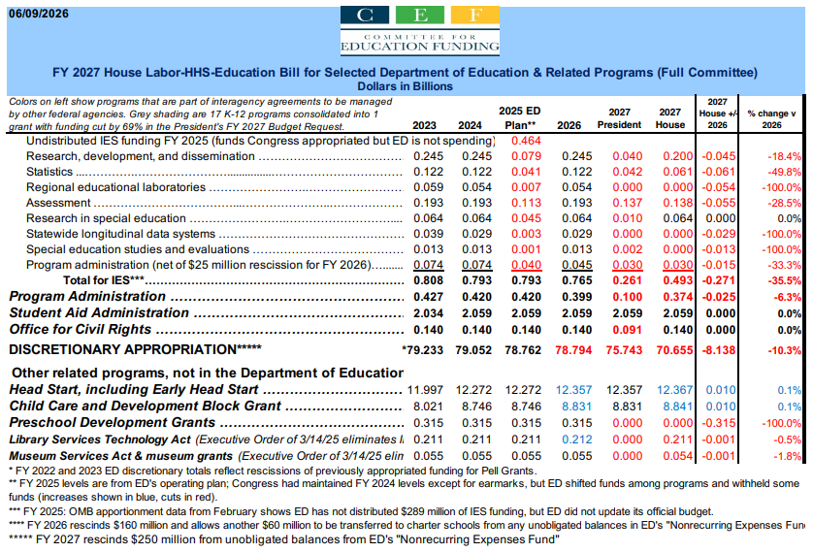

Slide 57
GENERAL PROVISIONS
SEC. 316. None of the funds made available by this Act may be used to—
implement, administer, or enforce section 685.401 of title 34, Code of Federal Regulations (relating to borrower defense to repayment), as amended by the final regulations published by the Department of Education in the Federal Register on November 1, 2022 (87 Fed. Reg. 65904 et seq.) or take any substantially similar action; or
(2) implement, administer, or enforce section 668.28 of title 34, Code of Federal Regulations (relating to the 90/10 rule), as added or amended by the final regulations published by the Department of Education in the Federal Register on October 28,2022 (87 Fed. Reg. 65426 et. seq.) or take any substantially similar action.

Slide 58
GENERAL PROVISIONS
SEC. 319. (a) Section 455(a)(3) of the Higher Education Act of 1965 (20 U.S.C. 1087e(a)(3)) is amended by adding at the end the following:
‘‘(D) TERMINATION OF AUTHORITY TO0 MAKE SUBSIDIZED LOANS TO UNDERGRADUATE STUDENTS.— Subject to paragraph (8) and notwithstanding any provision of this part or part B, for any period of instruction beginning on or after July 1, 2027—
‘‘(i) an undergraduate student shall not be eligible to receive a Federal Direct Stafford loan under this part; and
‘‘(ii) the maximum annual amount of Federal Direct Unsubsidized Stafford loans such a student may borrow in any academic year (as defined in section 481(a)(2)) or its equivalent shall be the maximum annual amount for such student determined under section 428H, plus an amount equal to the amount of Federal Direct Stafford loans the student would
have received in the absence of this subparagraph.’’.
(b) Section 455(a)(8) of the Higher Education Act of 1965 (20 U.S.C. 1087e(a)(8)) is amended by adding at the end the following:
‘‘(D) APPLICATION OF PRIOR UNDERGRADUATE LIMITS.—Paragraph (3)(D) shall not apply during the expected time to credential described in subparagraph (B), with respect to an individual who, as of June 30, 2027, meets the requirements of clauses (i) and (ii) of subparagraph (A).’’.

Slide 59

What could be next?

Slide 60
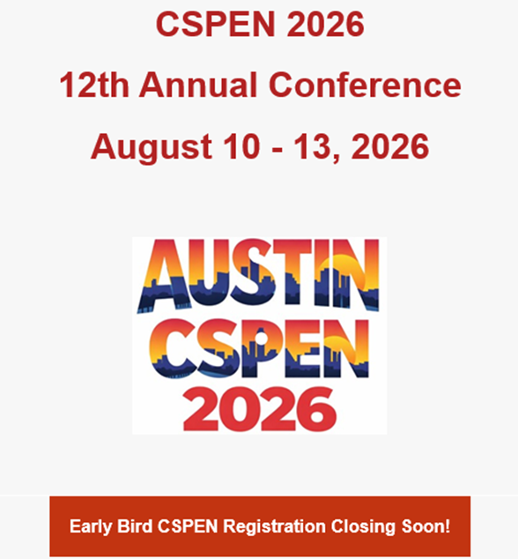
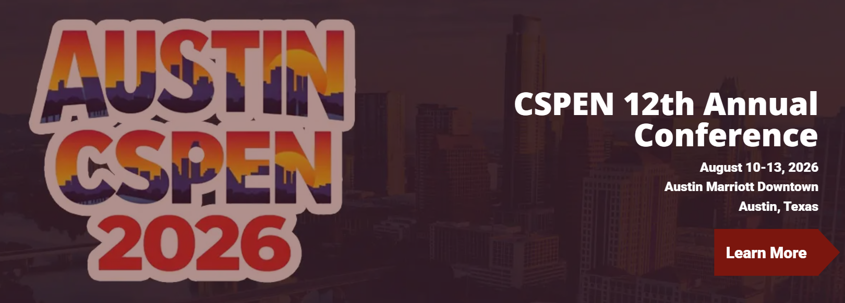

Slide 61


